Slide 1
The Voices of People with Disabilities and Older Adults
Strengthening Advocacy in the HCBS Settings Rule
No. 3 Getting the Services You Need from the Waiver
The Participant-Centered Service Planning and Service Delivery
Nancy Thaler,
Senior Policy Advisor
Jill Jacobs
Commissioner of the Administration on
Disabilities

Slide 2
Webinar Logistics
Participants will be muted during this webinar. You can use the chat feature in Zoom to post questions and communicate with the hosts.
Toward the end of the webinar, our speakers will have an opportunity to respond to questions that have been entered into chat.
The webinar will be live captioned in English.
Live English captions can be accessed by clicking the “CC” button at the bottom of your Zoom screen.
This live webinar includes an evaluation poll at the end of the session.
Notes:
If you need to include any recurring logos on interior (non-title and non-closing) slides, add to the slide master so that assistive technology does not read it on every slide. Always add the first instance to the actual slide (not the slide master) so that assistive technology will read it once.

Slide 3
Welcome
This is second in the Administration for Community Living’s (ACL) Webinar Series on the role of stakeholders in ensuring high quality in Home and Community Based Services (HCBS).
In this session we are going to dive into the Medicaid Waiver Application including how components of the HCBS rule can be imbedded in the state’s waiver application.
Notes:
If you need to include any recurring logos on interior (non-title and non-closing) slides, add to the slide master so that assistive technology does not read it on every slide. Always add the first instance to the actual slide (not the slide master) so that assistive technology will read it once.

Slide 4
Agenda
The Medicaid Waiver application – an Overview
Services - Appendix D Participant-Centered Planning and Service Delivery
State presentation– Getting the Services I Need from the Waiver
Questions and Answers
Closing Comments and Evaluation Poll
Notes:
If you need to include any recurring logos on interior (non-title and non-closing) slides, add to the slide master so that assistive technology does not read it on every slide. Always add the first instance to the actual slide (not the slide master) so that assistive technology will read it once.

Slide 5
Why the Waiver Application is Important
States describe
Who and how many people they will serve
What services they will provide and how much
What protections are in place
Whether people can self-direct and family members can be paid
How they will follow the HCBS Rule
When CMS approves the application, the state must implement it as approved. Only what is in the waiver can be provided.

Slide 6
The Waiver Application
Basic Information:
Identifies level of care
Describes geographic limits
Describes public input
Signature agreeing to meet the assurances.
Appendix A – Waiver Administration and Operation
Appendix B – Access and Eligibility
Appendix C – Services
Appendix D – Participant-Centered Service Planning
Appendix E – Participant Direction
Appendix F – Rights
Appendix G – Safeguards
Appendix H – Quality
Appendix I – Financial Accountability
Appendix J – Budget Neutrality

Slide 7
Why the Waiver Application is Important?
The Person-Centered Plan is the only vehicle to assure that
Needs are assessed and met
Preferences are honored
Opportunities are provided
Choice is offered
Rights are protected
Hopes and dreams for a good life can be achieved

Slide 8
Person-Centered Service Plan HCBS Regulation
Person-centered planning process. Based on the independent assessment required in § 441.720, the State must develop (or approve, if the plan is developed by others) a written service plan jointly with the individual (including, for purposes of this paragraph, the individual and the individual's authorized representative if applicable). The person-centered planning process is driven by the individual. The process:
(1) Includes people chosen by the individual.
(2) Provides necessary information and support to ensure that the individual directs the process to the maximum extent possible and is enabled to make informed choices and decisions.
(3) Is timely and occurs at times and locations of convenience to the individual.
(4) Reflects cultural considerations of the individual and is conducted by providing information in plain language and in a manner that is accessible to individuals with disabilities and persons who are limited English proficient, consistent with § 435.905(b) of this chapter.
(5) Includes strategies for solving conflict or disagreement within the process, including clear conflict of interest guidelines for all planning participants.
(6) Offers choices to the individual regarding the services and supports the individual receives and from whom.
(7) Includes a method for the individual to request updates to the plan, as needed.
(8) Records the alternative home and community-based settings that were considered by the individual.

Slide 9
Person-Centered Service Plan HCBS Regulation
(b) The person-centered service plan. The person-centered service plan must reflect the services and supports that are important for the individual to meet the needs identified through an assessment of functional need, as well as what is important to the individual with regard to preferences for the delivery of such services and supports. Commensurate with the level of need of the individual, and the scope of services and supports available under the State plan HCBS benefit, the written plan must:
(1) Reflect that the setting in which the individual resides is chosen by the individual. The State must ensure that the setting chosen by the individual is integrated in and supports full access of individuals receiving Medicaid HCBS to the greater community, including opportunities to seek employment and work in competitive integrated settings, engage in community life, control personal resources, and receive services in the community to the same degree of access as individuals not receiving Medicaid HCBS.
(2) Reflect the individual's strengths and preferences.
(3) Reflect clinical and support needs as identified through an assessment of functional need.
(4) Include individually identified goals and desired outcomes.
(5) Reflect the services and supports (paid and unpaid) that will assist the individual to achieve identified goals, and the providers of those services and supports, including natural supports. Natural supports are unpaid supports that are provided voluntarily to the individual in lieu of State plan HCBS.
(6) Reflect risk factors and measures in place to minimize them, including individualized backup plans and strategies when needed.
(7) Be understandable to the individual receiving services and supports, and the individuals important in supporting him or her. At a minimum, for the written plan to be understandable, it must be written in plain language and in a manner that is accessible to individuals with disabilities and persons who are limited English proficient, consistent with § 435.905(b) of this chapter.
(8) Identify the individual and/or entity responsible for monitoring the plan.
(9) Be finalized and agreed to, with the informed consent of the individual in writing, and signed by all individuals and providers responsible for its implementation.
(10) Be distributed to the individual and other people involved in the plan.
(11) Include those services, the purchase or control of which the individual elects to self-direct, meeting the requirements of § 441.740.
(12) Prevent the provision of unnecessary or inappropriate services and supports.

Slide 10
Person-Centered Service Plan: HCBS Regulation
(13) Document that any modification of the additional conditions, under § 441.710(a)(1)(vi)(A) through (D) of this chapter, must be supported by a specific assessed need and justified in the person-centered service plan. The following requirements must be documented in the person-centered service plan:
(i) Identify a specific and individualized assessed need.
(ii) Document the positive interventions and supports used prior to any modifications to the person-centered service plan.
(iii) Document less intrusive methods of meeting the need that have been tried but did not work.
(iv) Include a clear description of the condition that is directly proportionate to the specific assessed need.
(v) Include a regular collection and review of data to measure the ongoing effectiveness of the modification.
(vi) Include established time limits for periodic reviews to determine if the modification is still necessary or can be terminated.
(vii) Include informed consent of the individual; and
(viii) Include an assurance that the interventions and supports will cause no harm to the individual.
(c) Reviewing the person-centered service plan. The person-centered service plan must be reviewed and revised upon reassessment of functional need as required in § 441.720, at least every 12 months, when the individual's circumstances or needs change significantly, and at the request of the individual.

Slide 11
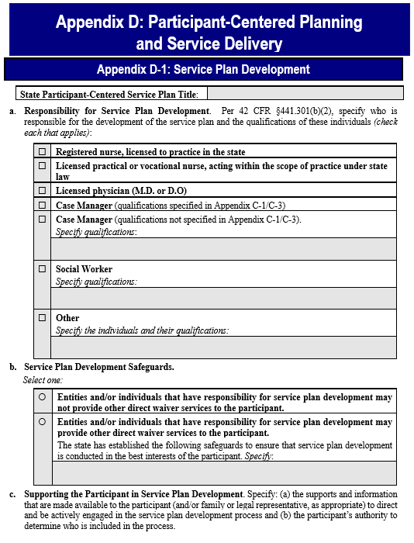
Service Plan Development Appendix D - 1
a) Who Does the Plan
b) Safeguard for Conflict of Interest
c) Supports for the Person to Direct the Plan

Slide 12
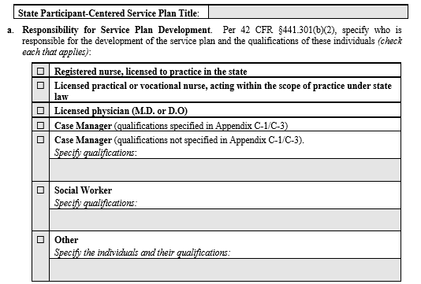
Service Plan Development Appendix D - 1 – a. Who Does the Plan
Registered Nurse
LPN or Voc. Nurse
Physician MD or DO
Case Manager – specify qualifications
Social Worker - specify qualifications
Other - specify qualifications

Slide 13
Service Plan Development Appendix D - 1 – b. Conflict of Interest Safeguards

Slide 14
Service Plan Development Appendix D - 1 – c. Supporting the Participant in Plan Development
Specify the supports and information that are made available to the person

Slide 15
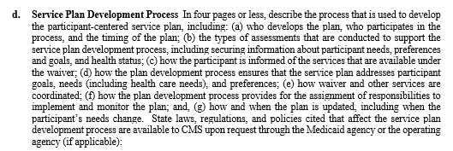
Service Plan Development Appendix D - 1 d. Service Plan Development
4 pages
Who develops the plan
Who participates
Timing of the plan
Types of assessment
How the person is informed of available services
How goals, needs and preferences are addressed
How services are coordinated
How responsibilities to implement and monitor are assigned
When is the plan updated

Slide 16
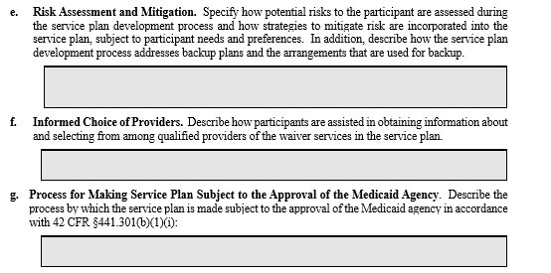
Service Plan Development Appendix D - 1 e, f, g

Slide 17
Service Plan Development Appendix D - 1 h and i

Slide 18
Service Plan Development Appendix D – 2 Service Plan Implementation and Monitoring

Slide 19
Provider Role
Participate in the planning process if designated by the person
Along with the case manager, support the person to participate
Discussing the process ahead of time
Assuring accommodations are in place
Implement that plan
Develop a provider level plan with specifics on implementation
Translate the PCP into everyday guidance for direct care staff
Maintain a record of implementation

Slide 20
Colorado Person-Centered Assessment and Support Plan
Effort covers eligibility determination, needs assessment and service/support plan
When did it start
Stakeholder engagement
Assures that all pieces are person centered and avoids asking people the same questions over and over/telling their story repeatedly
HCBS Rule Requirements included in Colorado’s PCSP
Needs Assessed and services linked to them
Personal Goals and Preferences and services linked to them
Documenting choice
Quality of life things like identifying who is important and how to see them; recording what people like to do
Employment and Community Integration
Notes:
*Started in 2014 with a contractor conducting an environmental scan of National Assessment & Plan tools and a review of the Person-Centeredness of the Department’s practices & systems
*All populations (Elderly, physical disabilities, brain injury, mental health, spinal cord injuries, IDD, all children’s waivers)

Slide 21
Colorado Single Assessment & PCSP Background
Development began in 2016 with the passage of legislation (SB 16-192) requiring a single, statewide assessment for Medicaid LTSS to replace the more than 30 tools that were in use
The Department undertook an extensive stakeholder engagement process (~6 years) to develop a comprehensive, person-centered assessment and support planning process
The process will include (estimated implementation July 2023):
Streamlined eligibility determination
Level of Care (LOC) Screen
Needs Assessment
Person-Centered Support Plan
The new processes are all housed within a brand-new Care and Case Management IT system to streamline and automate the process

Slide 22
Colorado Person-Centered Assessment & Support Plan
The people who do the plan – case managers
Conflict free and why (CMRD)
Ratio in caseloads 65:1 per RFP & Rate Structure
Training, training, training
What do providers do with the Person-Centered Support Plan
They must have it and know it (sign that they agree to follow it, as the “contract” for services with the Member)
They write a service plan that staff can follow on a daily basis
How does the state know this is working on an ongoing basis - oversight

Slide 23
Colorado Single Assessment & PCSP How It works
The new CSA will be used for all populations and all HCBS waivers in CO
The process is designed using modules, so members can work with their case managers on only the required items needed to move forward or delve deep in some or all areas, making the process person-centered by design
Notes:
Assures that all pieces are person centered and avoids asking people the same questions over and over
Across all waivers (list them) for all populations

Slide 24
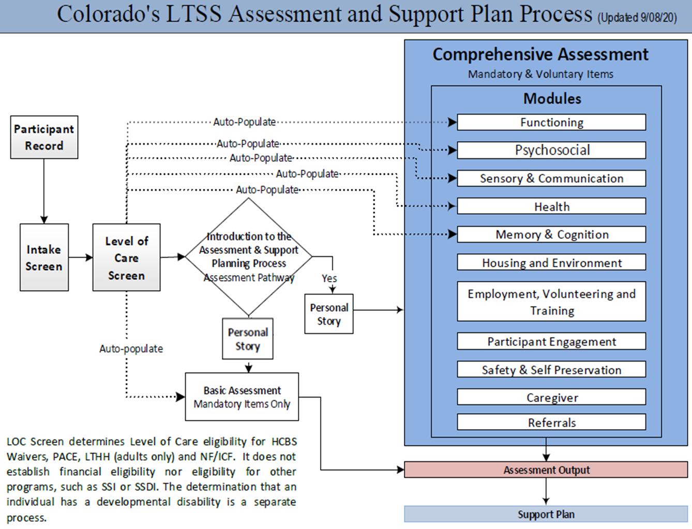
All modules can be found on the website under “Assessment Tools” at: hcpf.colorado.gov/new-assessment-and-person-centered-support-plan
Notes:
Requirements in the plan with screen shots of things important to people such as
Needs, preferences and services linked to them
Goals and services linked to them
Documenting choice
Quality of life things like identifying who is important and how to see them; recording what people like to do
Employment and community integration

Slide 25
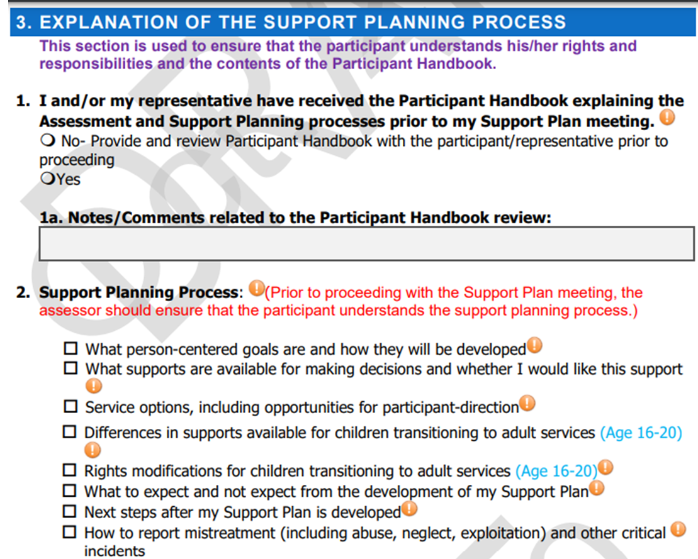
25
https://hcpf.colorado.gov/sites/hcpf/files/Support%20Plan-October%202020.pdf

Slide 26
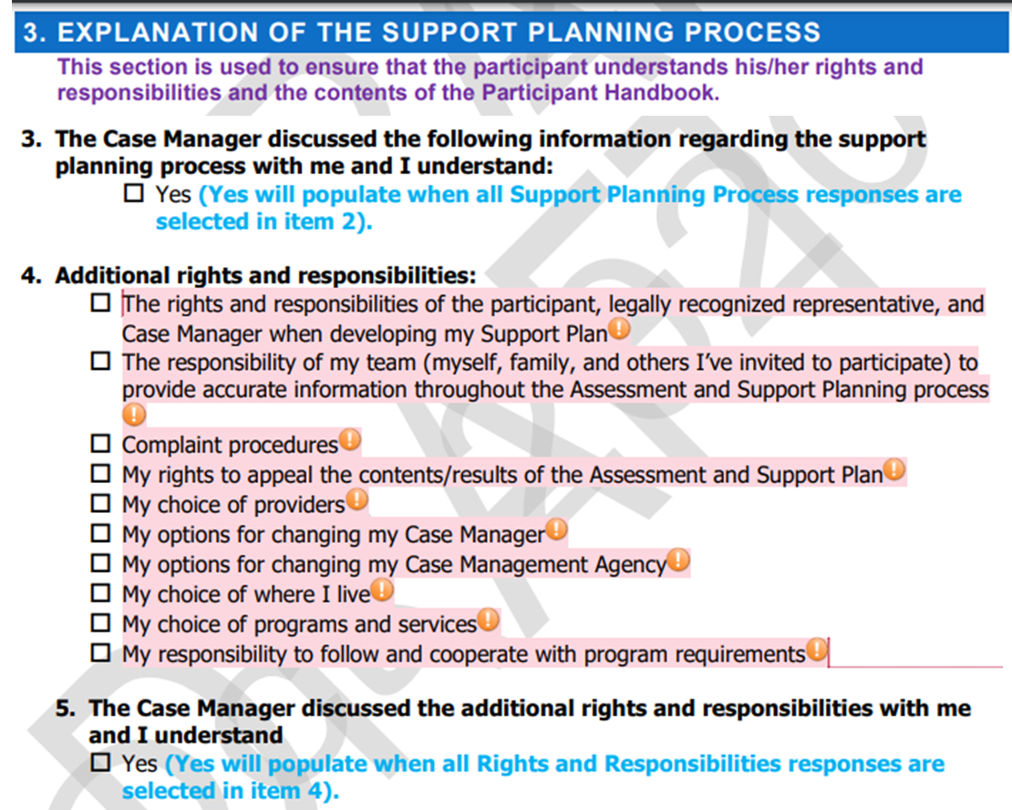
26
https://hcpf.colorado.gov/sites/hcpf/files/Support%20Plan-October%202020.pdf

Slide 27
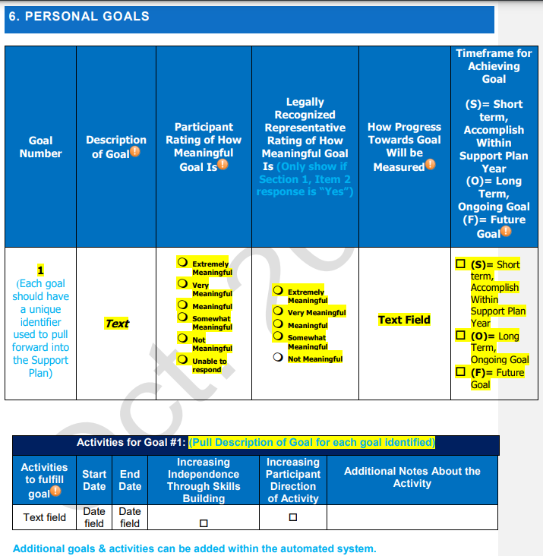
27

Slide 28
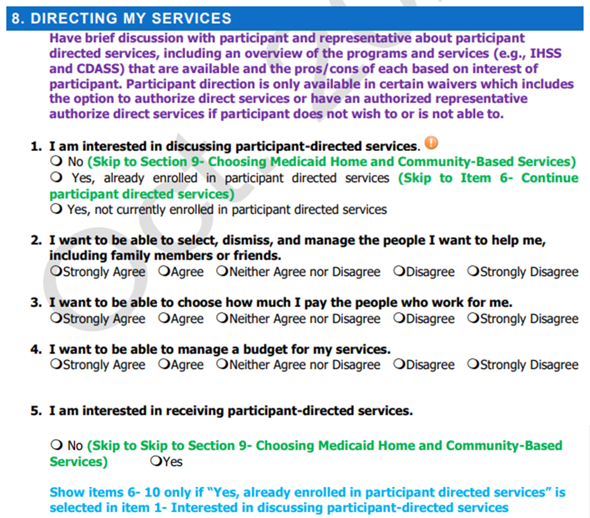
28
https://hcpf.colorado.gov/sites/hcpf/files/Support%20Plan-October%202020.pdf

Slide 29
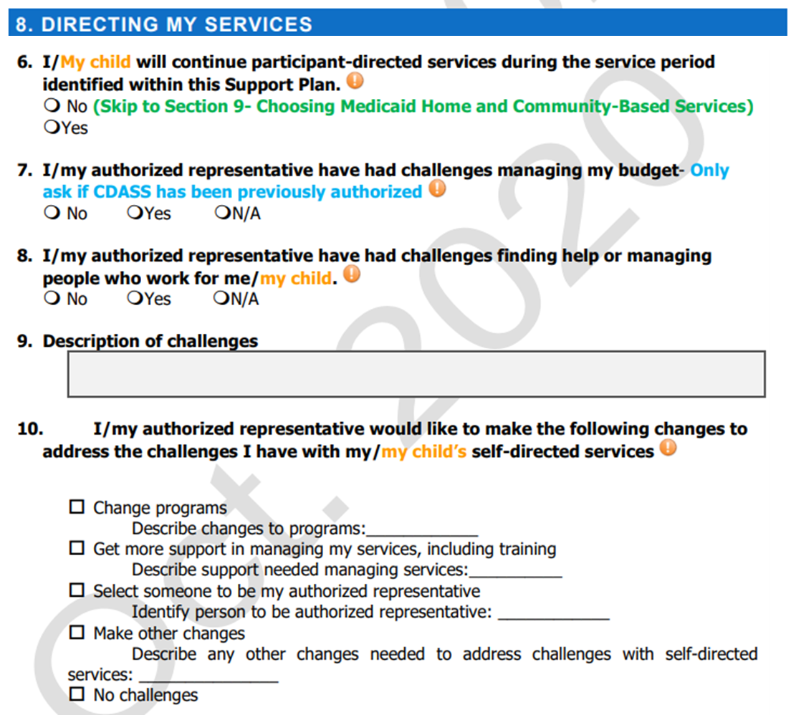
29
https://hcpf.colorado.gov/sites/hcpf/files/Support%20Plan-October%202020.pdf

Slide 30
Colorado Single Assessment & PCSP The People
Members
Member handbook and training to help navigate the process
Decide how much of the assessment to go through (outside the required items)
Case Managers
New, comprehensive training for all case managers, including person-centeredness
Providers
Receive a copy of the person-centered support plan
Providers must sign agreement with the decision made by Members for services they will provide
Can invite anyone to participate in the process
Members decide where the CSA & PCSP are conducted
New IT system to support the process and ongoing case management
Case managers at Case Management Agencies contracted with the Department conduct the process
Required to demonstrate competency before conducting CSA
Will have direct access to their own Member record through a Mobile application
Notes:
The people who do the plan – case managers
Conflict free and why
Ratios
Training, training, training
What do providers do with the person centered plan
They must have it and know it
They write a service plan that staff can follow on a daily basis (do you have guidance or rules for that?)

Slide 31
Colorado Single Assessment & PCSP Oversight and Accountability
Case managers are required to demonstrate competency with the new CSA process (WBTs, VILTs, competency tests in the LMS system)
Spot checks for Inter-Rater Reliability
Department Quality Performance Unit reviews (QIS PMs)
Notes:
How does the state know this is working on an ongoing basis - oversight

Slide 32
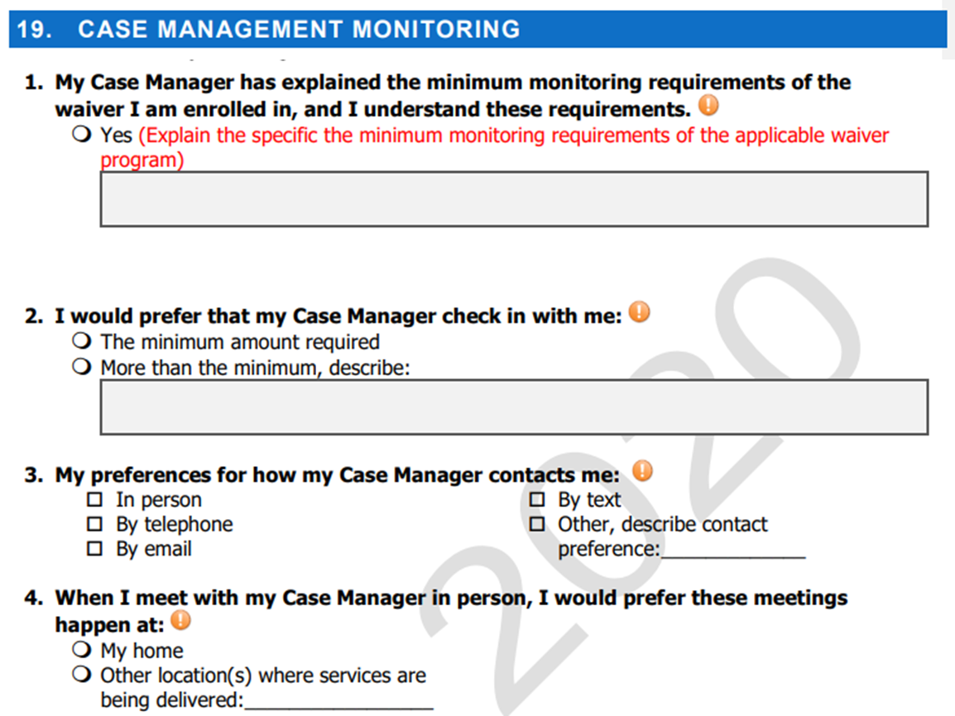
32
https://hcpf.colorado.gov/sites/hcpf/files/Support%20Plan-October%202020.pdf

Slide 33
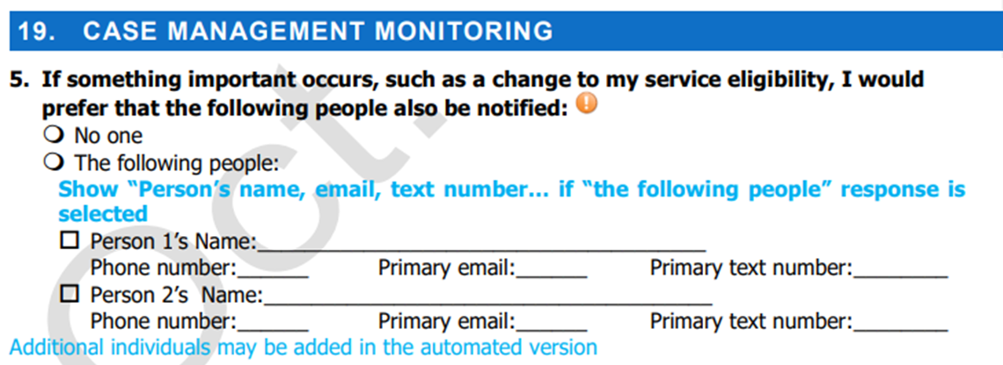
33
https://hcpf.colorado.gov/sites/hcpf/files/Support%20Plan-October%202020.pdf

Slide 34
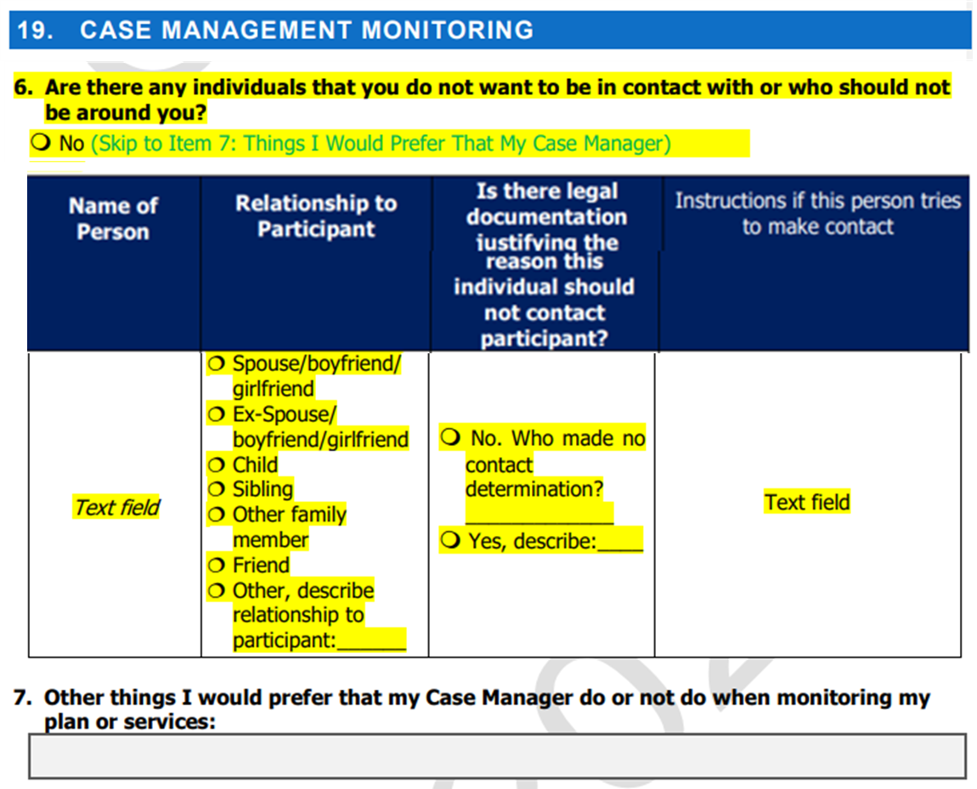
34
https://hcpf.colorado.gov/sites/hcpf/files/Support%20Plan-October%202020.pdf

Slide 35
Why is the Waiver Application Important?
The Person-Centered Plan is the only vehicle to assure that
Needs are assessed and met
Preferences are honored
Opportunities are provided
Choice is offered
Rights are protected
Hopes and dreams for a good life can be achieved

Slide 36
How You Can Influence What Services are in the Waiver
Get copies of the proposed application and distribute it to others
Show up in person and give public comment – ask questions
Submit written comments from your organization
Coordinate templates for others to use in submitting comments
Consult partners about submitting join comments
Hold discussion sessions about the proposed services as compared to what people need
Ask for a meeting with the state agency to learn more about the application

Slide 37
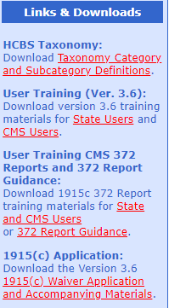
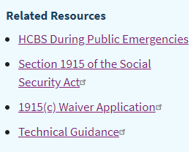
State Waiver Applications
Access proposed and approved waivers for all states at
https://www.medicaid.gov/medicaid/section-1115-demo/demonstration-and-waiver-list/index.html?f%5B0%5D=waiver_state_facet%3A991#content#content
Access the application form, technical guide and other
related materials at CMS Waiver Applications Portal:
https://www.medicaid.gov/medicaid/home-community-based-services/home-community-
based-services-authorities/home-community-based-services-1915c/index.html
Click on 1915(c) Waiver Application in the box on the right
On the left click on 1915(c) Application download version.
Will download as a zip file.

Slide 38
Please put any questions in the chat and give us your honest feedback in the on-screen poll. Thank you.
Notes:
The ACL logo shown here is part of the master, as it is assumed that an initial instance of the logo will appear on the title slide with appropriate alt. text that does not need to be re-read here by assistive technology. If this is the only place where the ACL logo will appear, remove it from the slide master and insert it with alt. text.

