Slide 1

The Voices of People with Disabilities and Older Adults
Participant Direction
No. 4 Getting the Services You Need from the Waiver
Nancy Thaler, Senior Policy Advisor
Administration for Community Living
Kate Murray, President
Applied Self-Direction
Notes:
Title: Participant Direction
No. 4 Getting the Services You Need from the Waiver

Slide 2
Webinar Logistics
Participants will be muted during this webinar. You can use the chat feature in Zoom to post questions and communicate with the hosts.
Toward the end of the webinar, our speakers will have an opportunity to respond to questions that have been entered into chat.
The webinar will be live captioned in English.
  Live English captions can be accessed by clicking the “CC” button at the bottom of your Zoom screen.

Slide 3
Welcome
This is 4th in the Administration for Community Living’s (ACL) Webinar Series on the role of stakeholders in ensuring high quality in Home and Community Based Services (HCBS) services.
In this session we are going to dive into the Medicaid Waiver Application, focusing on the section related to participant direction.

Slide 4
Agenda
The Medicaid Waiver application – an Overview
Participant Direction: Appendix E
Questions and Answers
Closing Comments

Slide 5
Why the Waiver Application is Important
States describe
  Who and how many people they will serve
  What services they will provide and how much
  What protections are in place
  Whether people can self-direct and family members can be paid
  How they will follow the HCBS Rule
When CMS approves the application, the state must implement it as approved. Only what is in the waiver can be provided.
Notes:
The application describes the proposed waiver’s design and must include sufficient information to permit CMS (acting on behalf of the Secretary of Health and Human Services) to determine that the waiver meets applicable statutory and regulatory requirements.
The approved waiver application specifies the operational features of the waiver. A state must implement the waiver as specified in the approved application. If the state wants to change the waiver while it is in effect, it must submit an amendment to CMS for its review and approval. All requests for new waivers, waiver renewals and amendments must be submitted by the state Medicaid agency.
This is not an exhaustive list of what is in the waiver application. For example, there is not mention of the person- centered planning process- development, implementition and monitoring. No mention regarding rate methodology, etc.

Slide 6
The Waiver Application
Basic Information:
  Identifies level of care
  Describes geographic limits
  Describes public input
  Signature agreeing to meet the assurances.
Appendix A – Waiver Administration and Operation
Appendix B – Access and Eligibility
Appendix C – Participant Services
Appendix D – Participant-Centered Service Planning
Appendix E – Participant Direction
Appendix F – Rights
Appendix G – Safeguards
Appendix H – Quality
Appendix I – Financial Accountability
Appendix J – Cost Neutrality

Slide 7

Appendix E Participant Direction

Slide 8
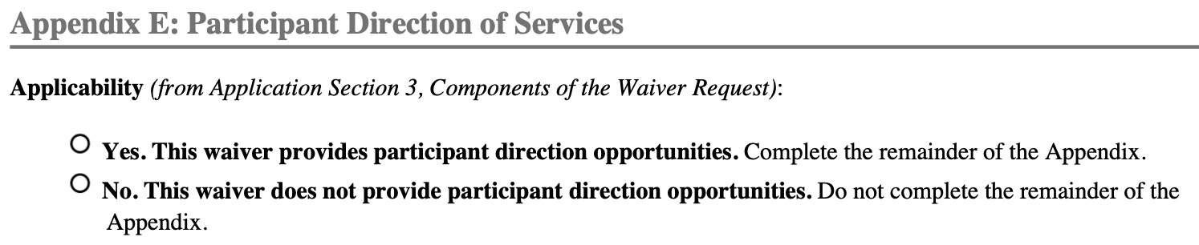
Appendix E: Applicability
Appendix E of the waiver application is all about participant direction
You can find out if a waiver offers participant-directed services by checking Appendix E
Notes:
Appendix E is where you can find out all about the participant direction opportunities that a waiver offers. When we say “participant direction”, we mean a model of service delivery in which participants have decision making authority over how, when, and from whom their services and supports are delivered. Depending on your state, this model may be called “self-direction” or “consumer direction.”
As of 2023, 45 states and the District of Columbia currently offer participant-directed services through 1915(c) waivers. While not all participant-directed services are offered through waivers, the waiver is the most common pathway states use to offer participant direction within their Medicaid programs. The majority of 1915(c) waivers now offer at least some participant-directed services.
An important thing to keep in mind is that every waiver is unique in how it offers participant-directed services. No two waivers are exactly alike. Looking at other states’ Appendix Es can be useful for learning more about how participant direction works in other states and about the possibilities of this model.

Slide 9
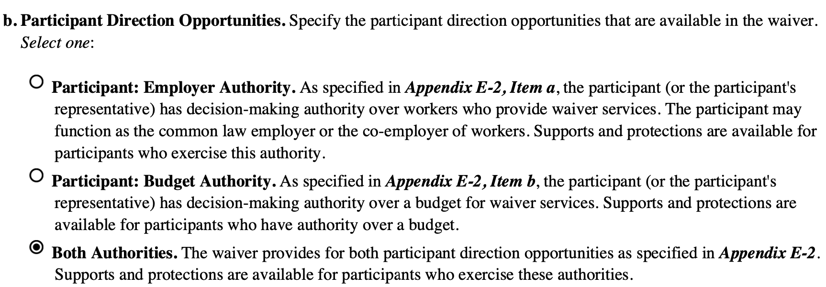
Appendix E-1: Overview
In Appendix E-1, the state will describe how participant-directed services are designed and how they will operate
Waivers can offer employer authority, budget authority, or both
Notes:
We’ll talk more about these concepts and what they mean for waiver participants in the next slide.

Slide 10
Employer and Budget Authority
Employer Authority
Participants recruit, hire, supervise and direct the workers who furnish supports.
Budget Authority
Participants manage a flexible budget.
  Can set rates of pay for staff
  May be able to use budget to purchase goods and non-employee services
Notes:
These definitions are adapted from the 1915(c) Technical Guide published by CMS. We include a link to the Technical Guide at the end of this presentation if you are interested in learning more.
Participant-directed services with employer authority ONLY are often authorized in hours. A participant may be authorized, for example, 20 hours per week of personal care services. Through employer authority, the participant can select staff of their choice, train and direct them on how they want the work to be done, and even terminate staff that do not meet the participant’s standards. Typically, participants cannot set the rate of pay for their staff in this model. Instead, the state usually sets the rate that a worker can be paid.
With budget authority, participants have more flexibility. Instead of receiving an authorization in hours, participants with budget authority manage a flexible budget that is usually allocated in dollars. So instead of receiving a certain amount of hours, a participant might receive, for example, $2,000 per month that they can spend in a flexible way so long as the spending meets all waiver rules. In budget authority, participants can typically select how much they want to pay their worker per hour. Depending on the state, participants may also be able to reserve budget funds to purchase items that the waiver doesn’t otherwise cover but that will help support their health and/or community integration. Participants in budget authority accept the responsibility of making sure they do not spend more than their budget can cover. Budgets are most often allocated in a monthly or annual format.
Over time, it is becoming more common for participant-directed waiver services to include both employer AND budget authority.

Slide 11
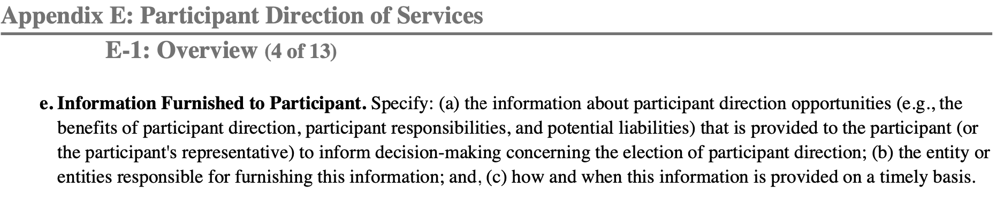
Introducing Participant Direction
States must describe how participants are informed about participant direction, when they are informed, and who informs them
Notes:
How participant direction is offered to people can be an important point for advocacy. Is participant direction being offered consistently to everyone who is eligible? Is the information that participants receive of high quality and written in accessible language? For many people, whether they choose to participate in this option or not often comes down to that very first conversation.

Slide 12
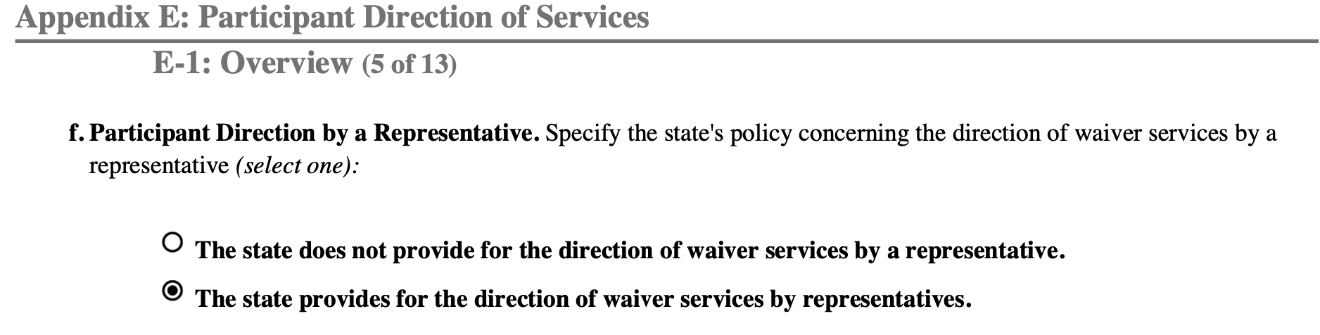
Appendix E-1-f: Use of Representatives
The waiver will show whether a participant can appoint a representative to handle some or all employer duties on their behalf
Nearly all states allow for using representatives
Notes:
Representatives are expected to act in the best interest of the participant, and it is important for states to build in safeguards to help ensure this. If a state allows for use of representatives, they have the option to require that a representative be a legal guardian of the participant. Requiring representatives to be a legal guardian of the participant is most common in waivers that target children. However, the majority of waivers with participant direction allow the participant to designate anyone they know and trust to be their representative. This could be, but does not have to be, a legal guardian. In other cases, it could be a different family member or a trusted friend.

Slide 13
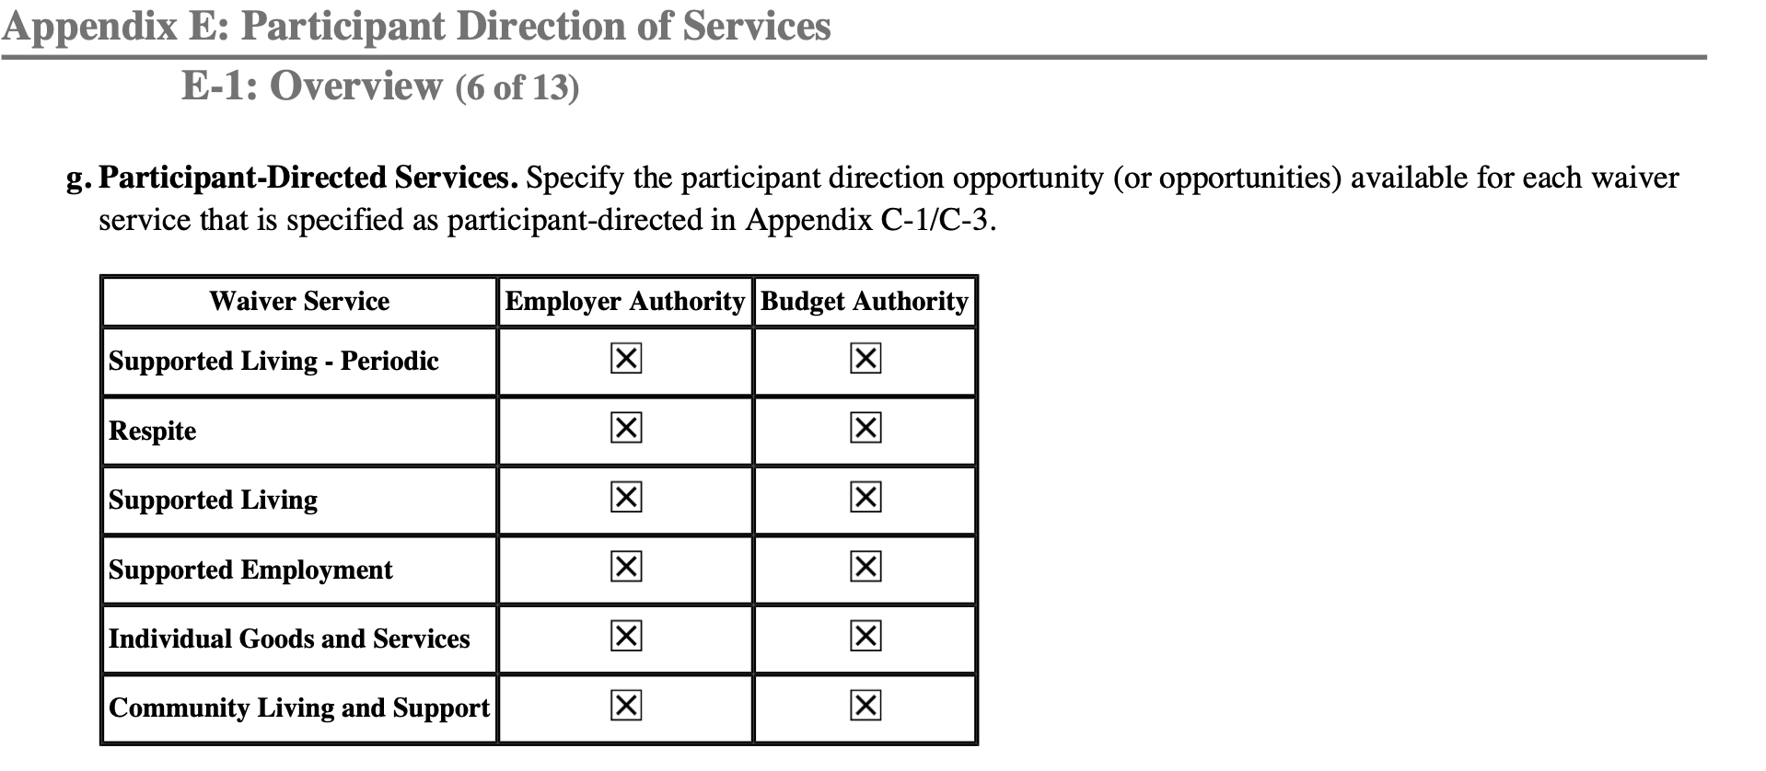
Appendix E-1-g: What Services Can Be Self-Directed?
Appendix E-1-g shows every waiver service that can be self-directed
The table also shows whether each service has employer authority, budget authority, or both
Notes:
Appendix E-1-g is an important component of the waiver because it shows every service available in the waiver that can be self-directed. The included table also shows whether each service has employer authority, budget authority, or both. If the service is not listed here in this table, it cannot be self-directed. And if the service IS listed here, it CAN be self-directed.

Slide 14
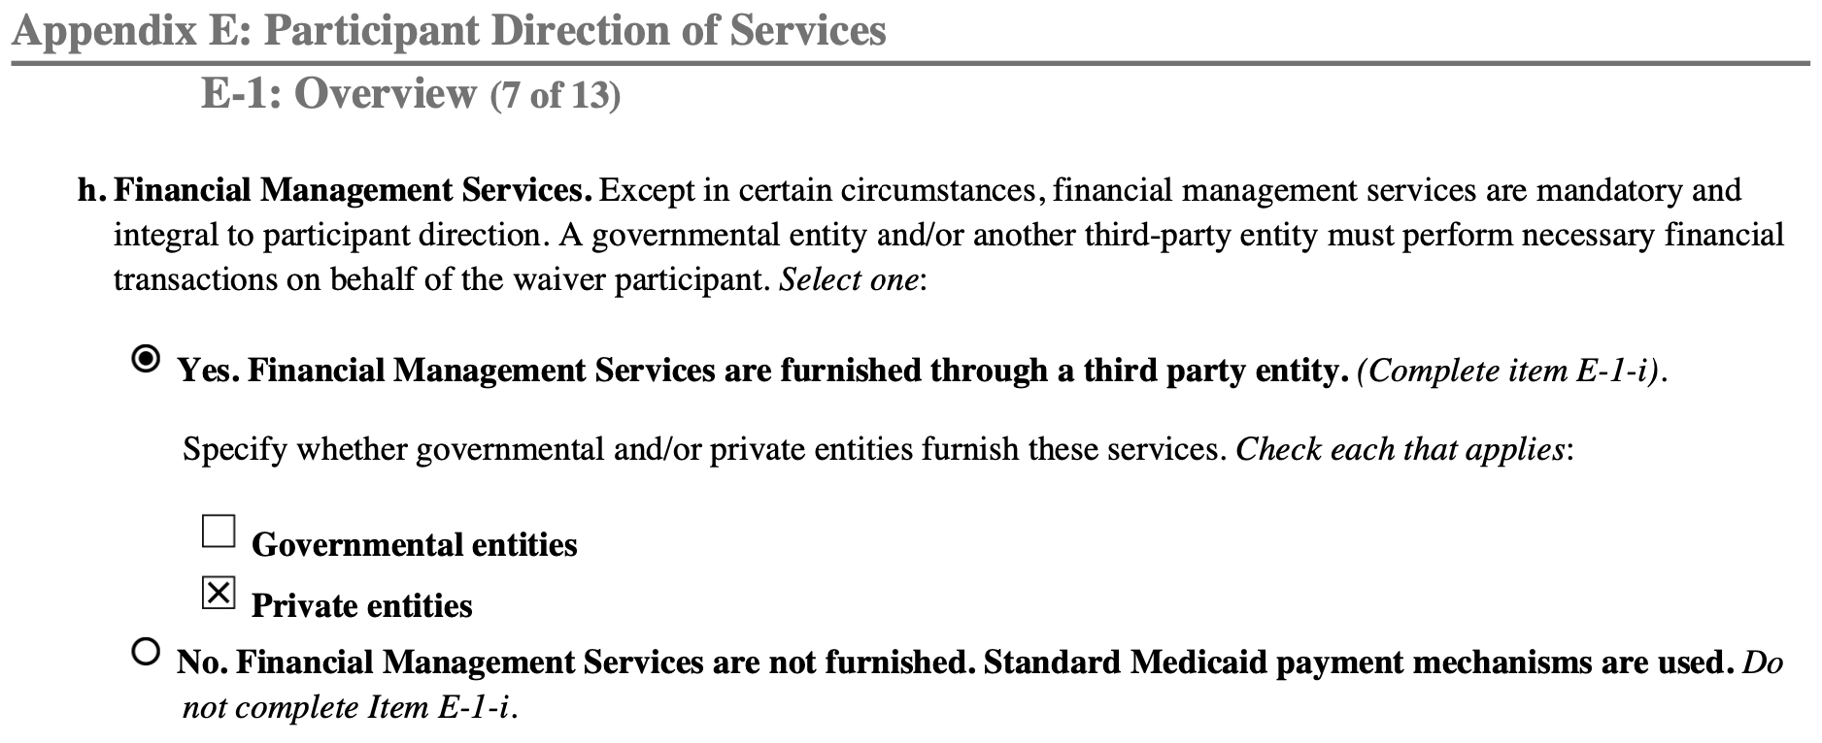
Appendix E-1-h: Financial Management Services (FMS)
Notes:
The Financial Management Services entity, or FMS, is a key support of participants who self-direct. Depending on the state you live in, this may be called a Fiscal Intermediary, Financial Support Service, Fiscal Employer Agent, or Intermediary Service Organization, among others. The FMS entity is responsible for processing payroll and managing administrative and “paperwork” responsibilities on behalf of people who self-direct, such as filing taxes. This is critical because participants who self-direct are legally considered employers of their staff, and there are many compliance requirements that come with being an employer. The FMS entity takes care of most of these so that participants do not become overburdened with paperwork and compliance obligations. The FMS entity makes sure these responsibilities are taken care of correctly and on time.
While not every waiver with participant-directed services uses FMS, the vast majority do. While state and local governments can provide FMS themselves to participants, it is most common for FMS to be provided by private entities that specialize in this service.

Slide 15
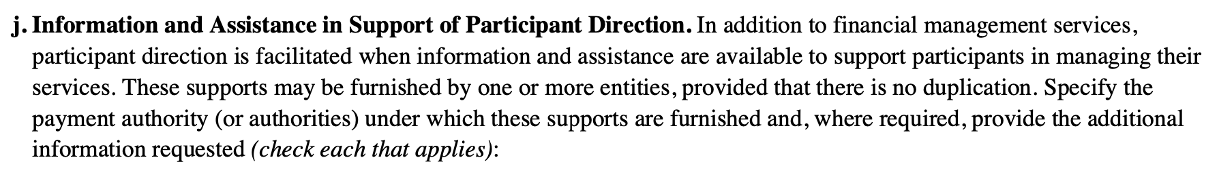
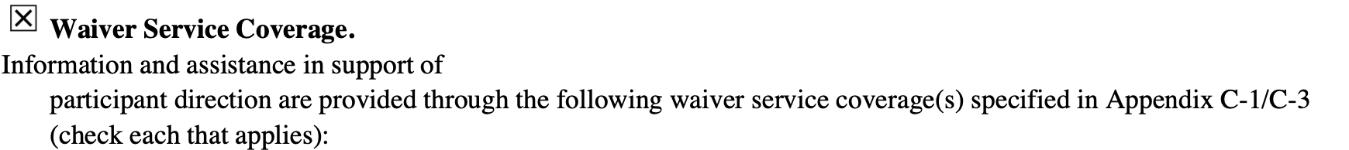
Appendix E-1-j: Information and Assistance in Support of Participant Direction
States are required to provide or arrange for a system of supports and assistance in developing the person-centered service plan and budget plan, managing the individual's services and workers and performing the responsibilities of an employer.
Notes:
Information and Assistance is another major participant support, although this function may go by a different name in your state. CMS describes Information and Assistance in the following way: “States are required to provide or arrange for the provision of a system of supports that are responsive to an individual's needs and desires for assistance in developing the person-centered service plan and budget plan, managing the individual's services and workers and performing the responsibilities of an employer.” Specifically, this could mean “information regarding how a self-directed care program works; individual rights and responsibilities; and available resources; counseling; training; assistance, such as the use of a supports broker/consultant and financial management services (FMS); and access to an independent advocacy system available in the state.”
Information and Assistance is structured very differently in different states. Depending on where you live, you may be more familiar with the term “support broker”, “counselor”, “consultant”, ”independent facilitator”, or some other term. The person performing this role may be independent, or they might work for a provider agency or an FMS entity. In other cases, the case manager may perform this function all on their own. There are several options in the waiver application of how this can be performed, as shown on this slide. But no matter what, states are required to make sure that participants have access to people who can help them learn about self-directing, answer questions, and support them as they scale the learning curve.
In Appendix E-1-j, the state is required to describe their Information and Assistance structure to ensure participant direction is accessible to eligible participants.

Slide 16
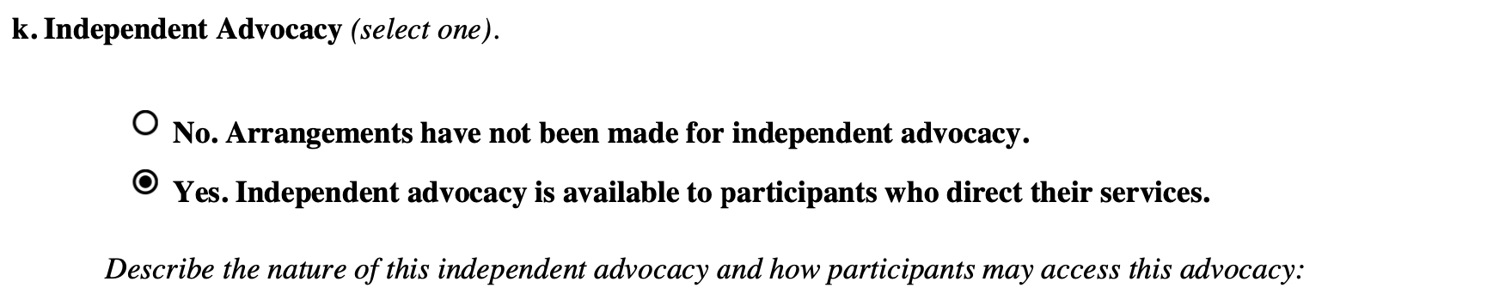
Appendix E-1-k: Independent Advocacy
Independent advocacy is not required in a waiver, but states can choose to offer it. Independent advocacy can be provided in multiple ways. Some common ways include a support broker, a paid advocate working on behalf of an advocacy organization, and/or a peer support specialist.
Notes:
The state must also describe whether participants have access to independent advocacy as they self-direct. Nearly all states have made at least some arrangements for independent advocacy opportunities, although their extent differs.

Slide 17
Appendix E-1-l: Voluntary Termination of Participant Direction
Participant direction is always an option—participants are never required to self-direct
Participants can disenroll at any time
States must have processes in place to ensure service continuity for participants who no longer want or are able to self-direct
Notes:
In Appendix E-1-l, the state must describe its process for how a participant can transition out of participant direction. For example, a participant may wish to use traditional agency services going forward. This section of the waiver requires the state to explain its process for these situations. Next, we’ll talk about involuntary disenrollment.

Slide 18
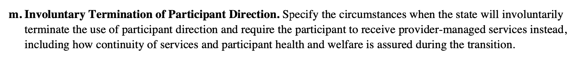
Appendix E-1-m: Involuntary Termination of Participant Direction
Usually takes place due to issues related to health and safety, or not following program rules
States must still ensure service continuity and prevent service disruption if someone is involuntarily disenrolled
Notes:
Involuntary termination of participant direction takes place when the participant is forced to stop self-directing. Most often, this takes place because the participant or representative has repeatedly directed their workers to provide more services than the budget or authorization can cover. In other cases, involuntary termination might be caused by health and safety: for example, if a person has not been able to hire anyone for a long time and is not getting the services they need. The rules in your state will be described in Appendix E-1-m.

Slide 19
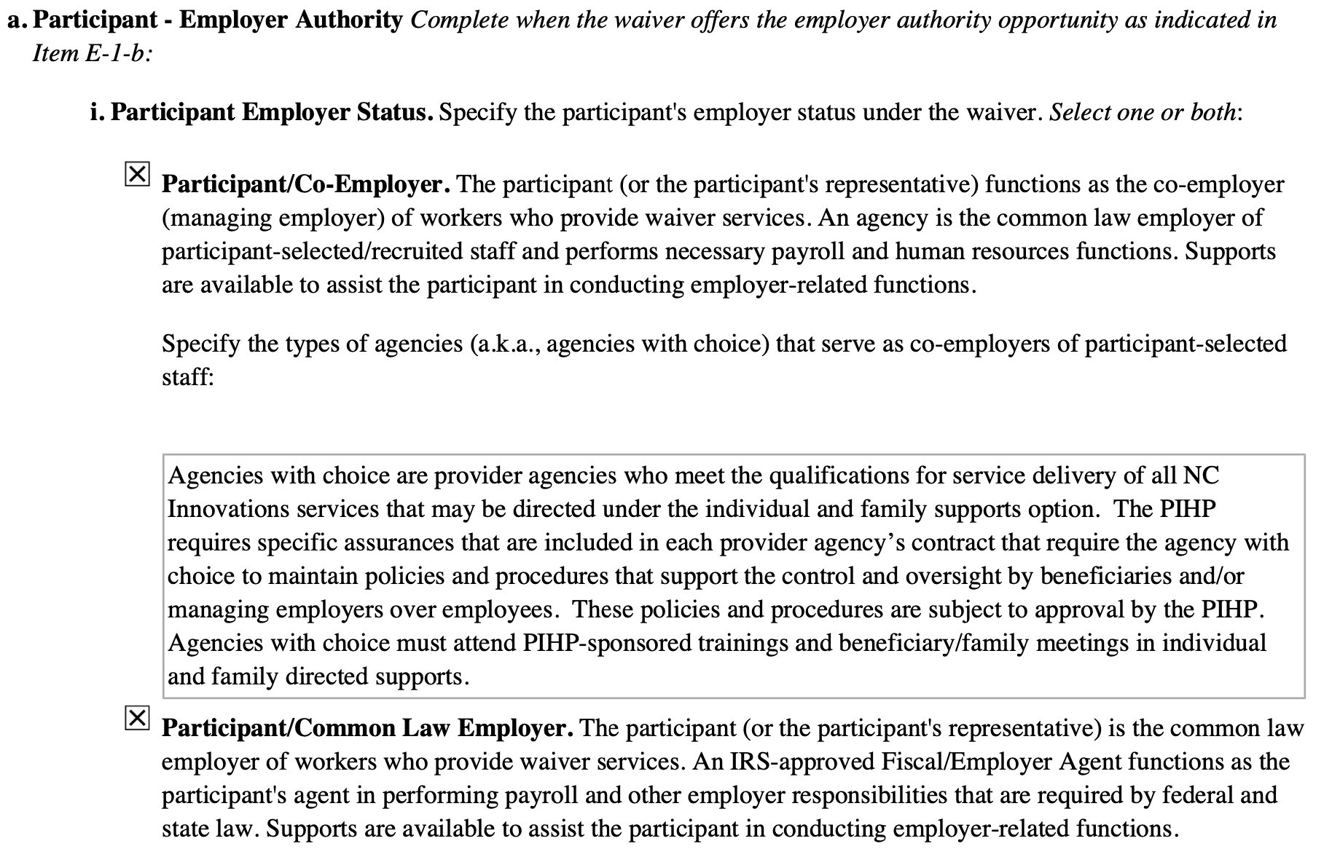
Appendix E-2: Opportunities for Participant Direction
States can structure the employment relationship differently in self-direction
The participant (or representative) can be the sole employer of their workers, or can co-employ workers alongside an agency
States can select one or both options
Notes:
The first part of Appendix E-2 is about Employer Authority in Appendix E-2-a. Under Employer Authority, the employment relationship between the participant and their worker can be structured in two different ways.
Some states allow participants an option to be the sole employer or a co-employer, while others only offer one model. When the participant acts as the sole employer or “common law employer”, they, or their representative, are the sole employer of the workers they hire. The participant will likely use an FMS entity to handle payroll and administrative responsibilities, but there is no agency involved in the employment relationship.
In a co-employer model, the participant shares employer responsibilities with an agency. Typically, the participant selects staff, sets their schedule, manages their day-to-day performance, and informs the agency if a worker is not meeting their needs. The co-employer agency, sometimes known as an “agency with choice”, may be able to offer worker benefits like health insurance, as well as support to participants with worker recruitment.
In this section, the state will specify which arrangement(s) it is using in the waiver and will also describe the specific responsibilities that participants will manage.
Regardless of employment model chosen in the waiver, participants should always be able to exercise authentic choice and control in a participant-directed model.

Slide 20
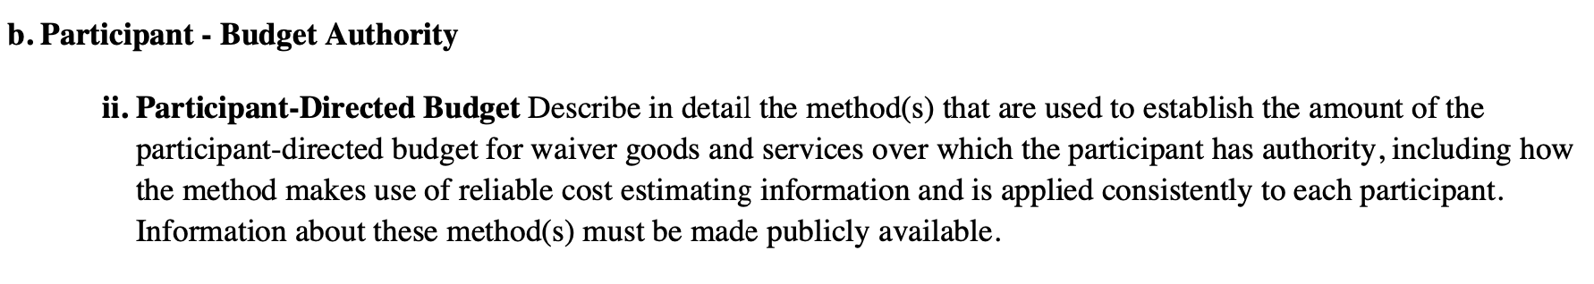
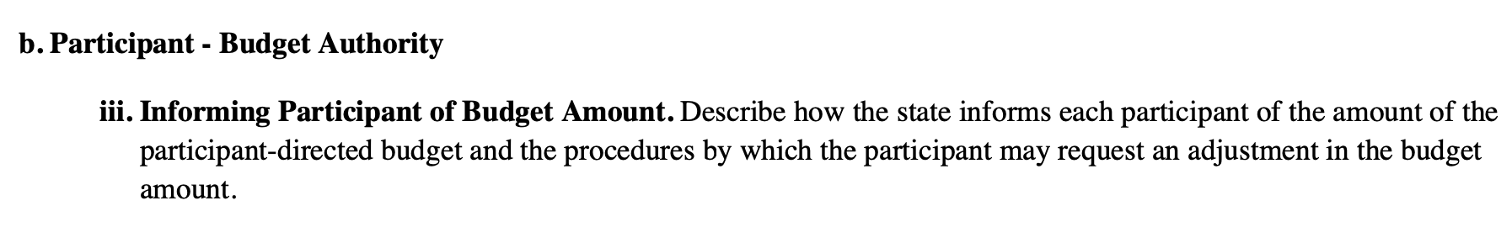
Appendix E-2-b: Budget Authority
When a waiver offers budget authority, the state must describe the methodology used to calculate participants’ budgets
Also must describe process for how participants are notified of their budget amount
Notes:
Under budget authority, the participant can control a flexible budget—usually a dollar amount per month or per year. But how is that budget amount created? In Appendix E-2-b, states must describe the methodology they use to set the amount of the self-directed budget. They must also explain how participants will be informed about the budget amount they receive.
CMS requires this information be publicly available, and this can be an important tool for advocates. It can be helpful to reference Appendix E-2-b in waivers from other states to compare how your state’s methodology is alike or different from others’. Note: if the waiver does not offer budget authority, this section will be left blank.

Slide 21
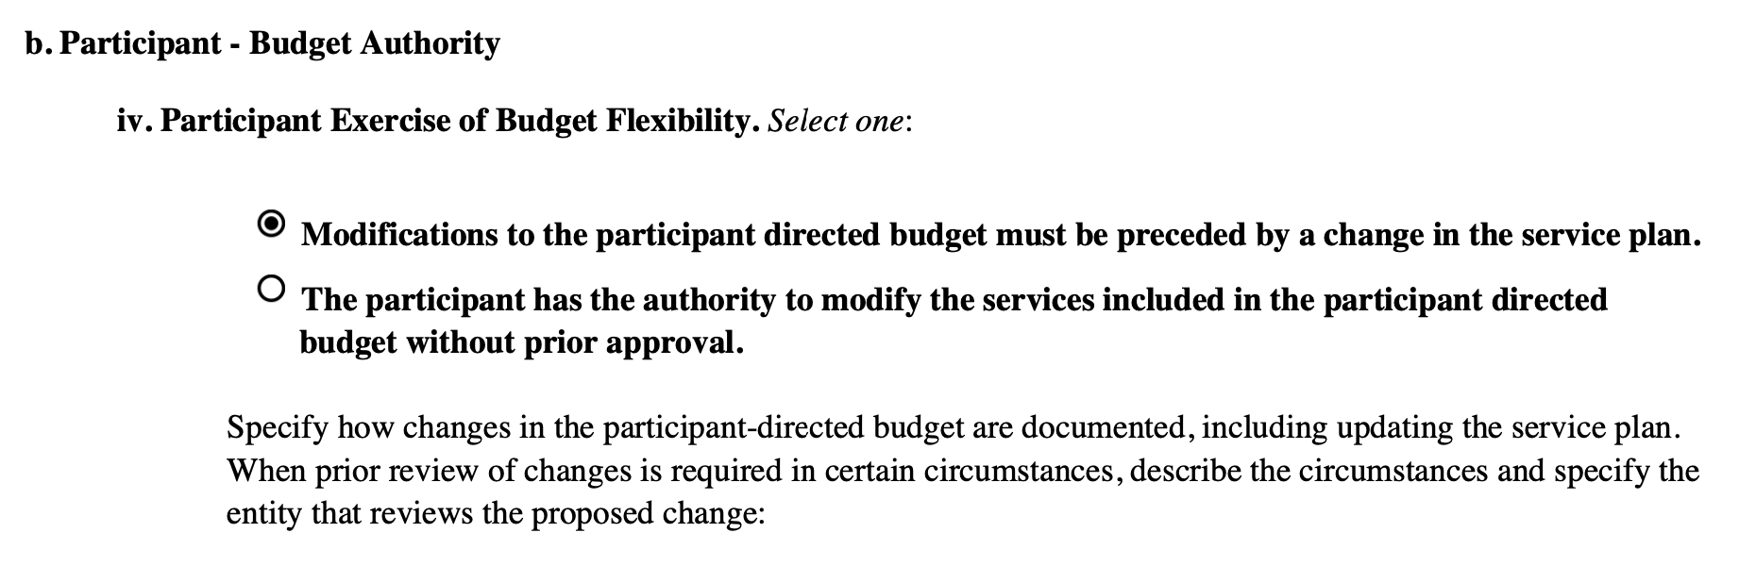
Appendix E-2-b Budget Authority
States have the option to require that a participant’s service plan must be changed before the participant can modify the services they spend their budget on
In waivers with especially flexible budget authority, the participant can change the services they purchase with their budget without changing their service plan first
Notes:
Finally, Appendix E-2-b explains how participants can use budget authority. In most waivers that offer participant direction, the state requires that modifications to the participant directed budget must be preceded by a change in the service plan. However, some states allow participants to modify the services included in the budget without prior approval.

Slide 22

Kate Murray, President kate@appliedselfdirection.com
https://www.appliedselfdirection.com/our-team

Slide 23
Why the Waiver Application is Important?
States describe
  Who they will serve and how many people
  What services they will provide and how much
  What protections are in place
  Whether people can self-direct and family members can be paid
  How they will follow the HCBS Rule
When CMS approves it, the state must implement it as approved. Only what is in the waiver can be provided.
CMS expects there will be public input.

Slide 24
How You Can Influence What Services are in the Waiver
Get copies of the proposed application and distribute it to others
Show up in person and give public comment – ask questions
Submit written comments from your organization
Coordinate templates for others to use in submitting comments
Consult partners about submitting join comments
Hold discussion sessions about the proposed services as compared to what people need
Ask for a meeting with the state agency to learn more about the application

Slide 25
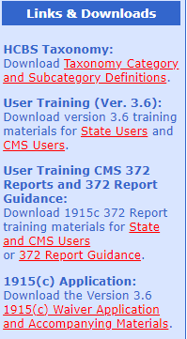
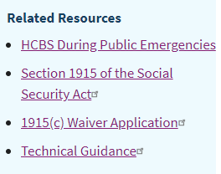
State Waiver Applications
Access proposed and approved waivers for all states at
https://www.medicaid.gov/medicaid/section-1115-demo/demonstration-and-waiver-list/index.html?f%5B0%5D=waiver_state_facet%3A991#content#content
Access the application form, technical guide and other
related materials at CMS Waiver Applications Portal:
https://www.medicaid.gov/medicaid/home-community-based-services/home-community-
based-services-authorities/home-community-based-services-1915c/index.html
Click on 1915(c) Waiver Application in the box on the right
On the left click on 1915(c) Application download version.
Will download as a zip file.

Slide 26
Please put any questions in the chat
Thank you.

