Slide 1
The Voices of People with Disabilities and Older Adults
Participant Rights
No.5 Getting the Services You Need from the Waiver
Nancy Thaler, Senior Policy Advisor
Administration for Community Living
Jill Jacobs, Commissioner, Administration on Disabilities
Administration for Community Living
Elizabeth Edwards, Senior Attorney
National Health Law Program
Elizabeth Priaulx, Legal Specialist
National Disability Rights Network
Notes:
Title: Participant Rights
No. 5 Getting the Services You Need from the Waiver

Slide 2
Welcome
This is 5th in the Administration for Community Living’s (ACL) Webinar Series on the role of stakeholders in ensuring high quality in Home and Community Based Services (HCBS) services.
In this session we are going to dive into the Medicaid Waiver Application, focusing on the section related to participant rights.

Slide 3
Webinar Logistics
Participants will be muted during this webinar. You can use the chat feature in Zoom to post questions and communicate with the hosts.
Toward the end of the webinar, our speakers will have an opportunity to respond to questions that have been entered into chat.
The webinar will be live captioned in English.
Live English captions can be accessed by clicking the “CC” button at the bottom of your Zoom screen.
This live webinar includes an evaluation poll at the end of the session.

Slide 4
Agenda
The Medicaid Waiver application – an Overview
Participant Rights: Appendix F
Questions and Answers
Closing Comments and Evaluation Poll

Slide 5
Why the Waiver Application is Important
States describe
Who and how many people they will serve
What services they will provide and how much
What protections are in place
Whether people can self-direct and family members can be paid
How they will follow the HCBS Rule
When CMS approves the application, the state must implement it as approved. Only what is in the waiver can be provided.
Notes:
The application describes the proposed waiver’s design and must include sufficient information to permit CMS (acting on behalf of the Secretary of Health and Human Services) to determine that the waiver meets applicable statutory and regulatory requirements.
The approved waiver application specifies the operational features of the waiver. A state must implement the waiver as specified in the approved application. If the state wants to change the waiver while it is in effect, it must submit an amendment to CMS for its review and approval. All requests for new waivers, waiver renewals and amendments must be submitted by the state Medicaid agency.
This is not an exhaustive list of what is in the waiver application. For example, there is no mention of the person- centered planning process- development, implementation and monitoring. No mention regarding rate methodology, etc.

Slide 6
1915(c) v. Other Authorities
Many states operate HCBS that are 1915(c) – this Webinar only discusses requirements in 1915(c) waivers.
States may provide similar programs under authorities like Section 1115 Demonstrations but they may have similar, but not identical requirements as 1915(c) waivers. Look to the approved document

Slide 7
The Waiver Application
Basic Information:
Identifies level of care
Describes geographic limits
Describes public input
Signature agreeing to meet the assurances.
Appendix A – Waiver Administration and Operation
Appendix B – Access and Eligibility
Appendix C – Participant Services
Appendix D – Participant-Centered Service Planning
Appendix E – Participant Direction
Appendix F – Participant Rights
Appendix G – Safeguards
Appendix H – Quality
Appendix I – Financial Accountability
Appendix J – Cost Neutrality

Slide 8
Appendix F Participant Rights
Fair Hearing
Dispute Resolution
Grievance/Complaint

Slide 9
Required vs. Optional
Required
Optional
Fair Hearing
42 CFR § 431.210;
42 CFR § 438 subpart F
(managed care)
Dispute Resolution
Grievance/Complaint System

Slide 10
Note: Different Requirements for Managed Care and Fee for Service
Fee for Service:
State fair hearing
Managed Care Plans:
Adverse Action
Grievance
Requirement to go through informal appeal

Slide 11
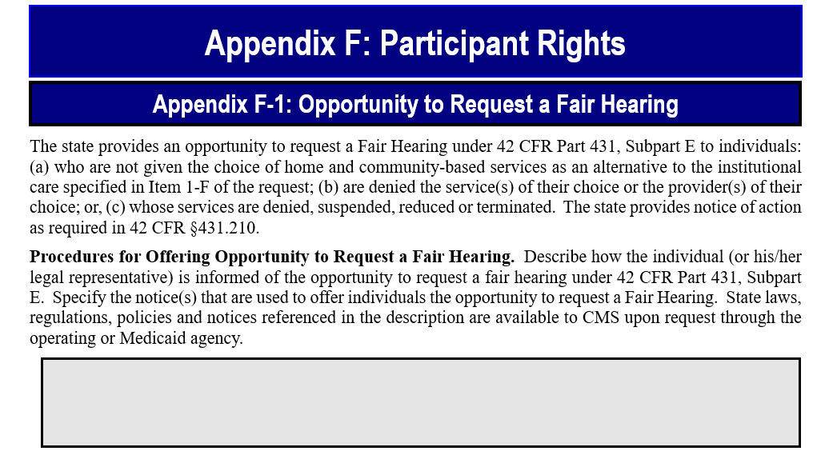
11

Slide 12
Fair Hearing: Triggers
Participants can request a fair hearing when:
Services denied, suspended, reduced or terminated
Includes termination from waiver and involuntary termination of self-directed services
Services not provided with reasonable promptness
Denial of eligibility
Waiver App. F-1:
Not providing choice of HCBS as alternative to institutional care
Denying an individual the services or provider of their choice;
Services denied, suspended, reduced or terminated
Other hearing requirements: timelines, case file, accessibility, language, expedited review
42 C.F.R 431 subpart E
Notes:
Decision on services includes when participant budget functions as a limit on the amount of waiver goods and services
Decision to not allow self-direction is not subject to fair hearing process b/c CMS says services are unaffected

Slide 13
Review Criteria Fair Hearing
Must specify how individuals are informed about the Hearing process during entrance to the waiver.
If service denied, reduced, suspended individuals must again be notified of right to hearing. The description must specify:
how notice is made
the entity or entities responsible for issuing the notice; and,
the assistance (if any) that is provided to individuals in pursuing a fair Hearing
Notes:
--emphasize continued benefits; time restrictions; fear of recoupment

Slide 14
Criteria for Fair Hearing, continued
“Aid Paid Pending”: Must specify how the participant is informed that services will continue during the period while the participant’s appeal is under consideration
unless the state is not required to continue the services in accordance with 42 CFR §431.230
Must specify where notices of adverse actions and the opportunity to request a Fair Hearing are kept.

Slide 15
What is Missing?
Interplay with person centered planning
What is offered to a person
Budgeting issues
Protections against discouragement
Education to individuals
Assistance to individuals
Notes:
Assistance to individuals: do notices have contact information for legal services and the P&A? K.W. case

Slide 16
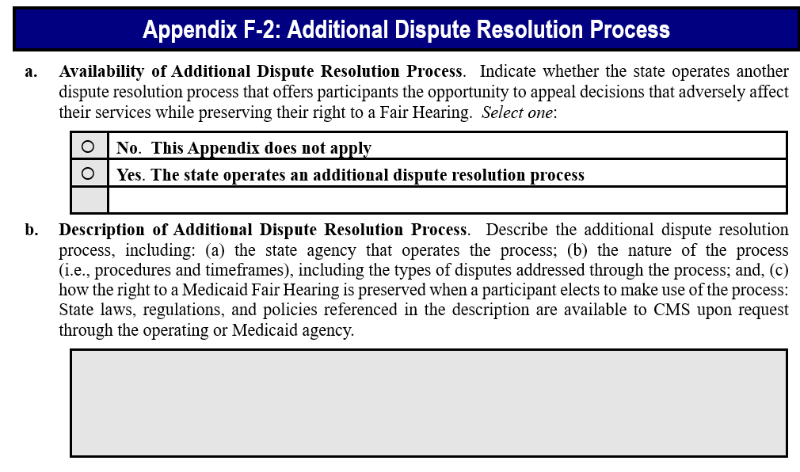
16

Slide 17
Review Criteria When There is Dispute Resolution
Identify the state agency that operates the dispute mechanism
Describe the types of disputes that can be addressed, including the process and timelines.
When a participant elects to make use of the dispute mechanism, the participant must be informed that the dispute resolution mechanism is not a pre-requisite or substitute for a Fair Hearing
Note: except in managed care.
Notes:
Remember, this is optional

Slide 18
Managed Care
Required informal appeal
Grievance system
Similar names for potentially difference processes can create confusion!

Slide 19
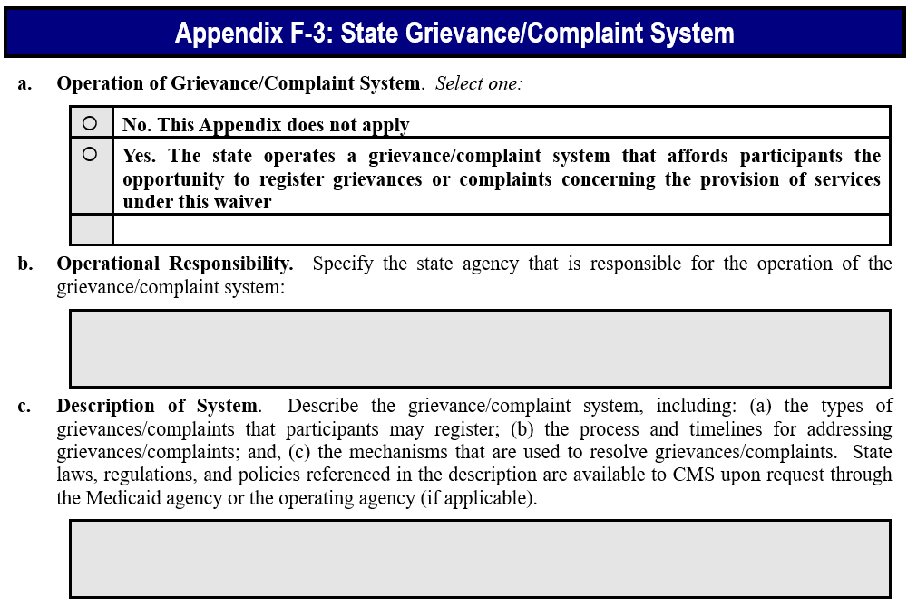
19
Notes:
more common for participant-directed waiver services to include both employer AND budget authority.

Slide 20
Review Criteria When There is Grievance/Complaint System
The state must describe the types of complaints that can be addressed, the process and timelines.
When a participant elects to file a grievance or make a complaint, the participant is informed that doing so is not a pre-requisite or substitute for a Fair Hearing.
Note: except in managed care
Notes:
Remember this is optional

Slide 21
NC Example
Managed care for behavioral health services, including I/DD waiver
Settlement of litigation, L.S. v. Wos led to changes in due process implementation
Issues with use of notices and opportunity for fair hearing related to assignments of budgets
Notice of noncompliance led to communication bulletin

Slide 22
More on NC Example
Revision of materials regarding the use of the SIS score
Clear that families are encourage to request the waiver services they need, not strictly within assigned budgets
No discouragement allowed, with sample language provided in the bulletin

Slide 23
NC Sample Language in Bulletin
Denial or partial denial could not be based on rationales such as:
“The assigned budget would typically meet the needs of someone with similar support needs.”
“It was determined that [name] is not an outlier to his assigned category.”
“Documentation shows needs consistent with the assigned budget category.”

Slide 24
NC Sample Language, Cont.
Denial or partial denial could be based on rationales such as:
“The information/assessments provided do not justify an increase in service hours.”
“the information provided does not indicate that the individual would benefit from the combination of services hours requested.”

Slide 25
NC Innovations Waiver App. F-1
Describes the program as being under managed care
Participants receive info explaining appeal rights, including how to access a fair hearing, continuing benefits, and contact numbers for state agency and free legal assistance
Requirement to go through informal appeal/grievance procedure
Copies of notices maintained at originating agency
Notes:
F-3 explains LME/MCO grievances/complaints and identifies categories as including:
Complaint Reporting Categories include: (1) Abuse, neglect and exploitation (2) Access to services (3) Administrative issues (4) Authorization/payment/billing (5) Basic needs (6) Client rights (7) Confidentiality/HIPAA (8) PIHP services (9) Medication (10) Provider choice (11) Quality of care (12) Service coordination between providers (13) Other to include any complaint that does not fit the previous areas.

Slide 26
How You Can Influence What Services are in the Waiver
Get copies of the proposed application and distribute it to others
Show up in person and give public comment – ask questions
Submit written comments from your organization
Coordinate templates for others to use in submitting comments
Consult partners about submitting joint comments
Hold discussions about proposed services compared to what people need
Meet with the state agency to learn more about the application

Slide 27
Effective Storytelling/Comments
Provide examples of problems and the role of waiver policies, such as limits, restrictions, or discouragement without hearing rights
Explain why complaint systems feel ineffective
Explain if the process lacks an opportunity to request what is needed
Make comments relevant to subject under consideration. Try to be solution focused
Manage your expectations of changes

Slide 28
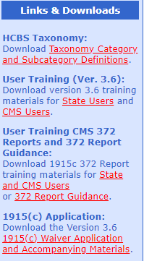
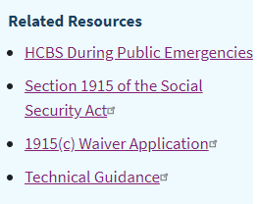
State Waiver Applications
Access proposed and approved waivers for all states at
https://www.medicaid.gov/medicaid/section-1115-demo/demonstration-and-waiver-list/index.html?f%5B0%5D=waiver_state_facet%3A991#content#content
Access the application form, technical guide and other
related materials at CMS Waiver Applications Portal:
https://www.medicaid.gov/medicaid/home-community-based-services/home-community-
based-services-authorities/home-community-based-services-1915c/index.html
Click on 1915(c) Waiver Application in the box on the right
On the left click on 1915(c) Application download version.
Will download as a zip file.

Slide 29
Please put any questions in the chat and give us your honest feedback in the on-screen poll. Thank you.

