Slide 1

AI and the Direct Care Workforce: Perspectives on Adoption, Ethics, and What Comes Next
July 22, 2026

Slide 2
Welcome & Overview
Nicole Howell
Director, DCW Strategies Center

Slide 3
Housekeeping
ASL translation is being provided on this webinar.
Captions are available through the Teams captions feature.
Please reach out to directcareworkforce@ncoa.org should you have any technical issues during the webinar.
This webinar will be recorded and a copy of the slides will be available after the webinar.
Notes:
directcareworkforce@ncoa.org

Slide 4

Direct Care Workforce Strategies Center – Overview
Created by the Administration for Community Living in 2022, the Direct Care Workforce Strategies Center (DCW) provides technical assistance to states, service providers, and stakeholders to improve the recruitment, retention, training, and professional development of direct care workers providing home and community-based services (HCBS).
QR code link to the Direct Care Workforce Strategies Center homepage
Resource Hub
A one-stop digital stop of informational resources highlighting state innovations and proven practices ready for broader adoption
Technical Assistance
Tiered opportunities for state cross-systems teams to receive technical support aimed at strengthening their HCBS Direct Care Workforce systems-change efforts
Advisory Committee
A national group of advisers to ensure the experiences of direct care workers, care recipients and family caregivers inform the Center’s priorities and products
Self-led Training Opportunities
Expert-led webinars, mini-labs, and workshops for states and stakeholders highlighting actionable tools and replicable models to strengthen the HCBS direct care workforce
Notes:
https://acl.gov/DCWcenter

Slide 5











Strategies Center Partners
Notes:
DCW Partner slide

Slide 6
Agenda
New Era of Care: Why This Conversation Matters – Robert Espinoza, Found & CEO, The CareWorks Project
Federal Perspectives: Responsible Innovation in Aging and Disability – Kelly Cronin, Deputy Administrator for Innovation and Partnership, Administration for Community Living
AI, Accessibility, and the Future of Work – Sean Ruddy, Workforce Analyst, US Department of Labor
From Policy to Practice: Responsible Adoption – Gabrielle Sedor, Chief Operations Officer and Foundation Director, ANCOR
Moderated by Nicole Howell, Director, DCW Strategies Center
Notes:
Agenda slide, fill as needed

Slide 7
Why?
Opportunities
Reduce administrative burden and improve workforce efficiency
Strengthen training, coaching, and career development
Improve recruitment, retention, and worker support
Enhance care coordination and access to information
Expand capacity while supporting high-quality, person-centered care
Challenges
Protect privacy, security, and public trust
Address bias and ensure responsible AI use
Maintain the human connection at the center of care
Prepare workers and employers through training and change management
Ensure AI complements, rather than replaces, the caregiving workforce
Notes:
Why AI? Why now? Why does it matter for the caregiving sector
National technical assistance center working with states, employers, and partners to strengthen the direct care workforce
Real-world perspective informed by technical assistance across multiple states
Focused on practical, ethical, and workforce-centered AI adoption
Committed to translating emerging technologies into actionable strategies and tools

Slide 8
Poll Question #1
How familiar are you with AI applications in caregiving?
      Not at all familiar
      Slightly familiar
      Moderately familiar
      Very familiar
      Extremely familiar

Slide 9


A New Era of Care: Why This Conversation Matters
Robert Espinoza
Founder & CEO
The CareWorks Project

Slide 10


Ten Insights from a National Study of AI & the Home Care Workforce
What We've Learned
Robert Espinoza, Founder & CEO, The CareWorks Project
July 22, 2026

Slide 11


An advisory and innovation studio to help leaders reimagine long-term care in today’s economy.
We bring together long-term care expertise, narrative strategy, program design, and leadership development to help public and private sector leaders solve complex challenges and seize new opportunities.
careworksproject.co

Slide 12
Why This Research Matters
Over the past year, we set out to better understand what AI could—and should—mean for home care workers, their employers, and the people they support.
Along the way, we reviewed the emerging evidence, interviewed national experts, surveyed stakeholders, conducted focus groups with direct care workers, examined AI tools and real-world use cases, and synthesized the findings into three groundbreaking reports.

Slide 13
AI Is No Longer Coming. It's Already Here.
01
Home care has entered the age of artificial intelligence.

Slide 14

The Biggest Opportunities Aren't Where Most People Think.
02
AI's greatest value may be reducing paperwork—not replacing the “human touch” of caregiving.

Slide 15
Care Is Human.
AI Should Be, Too.
03
The greatest promise of AI is giving home care workers more time to deliver supports and services.

Slide 16
Trust Is the Real Infrastructure.
04
Without trust, even the best technology will fail.

Slide 17
Home Care Workers and Clients Must Shape AI Tools.
05
Their expertise matters, and people embrace technology they helped create.

Slide 18
Better Decisions Depend
on Better Data.
06
AI is only as effective as the information behind it.

Slide 19
Small Wins Build Big Change.
07
Start with practical problems and not ambitious promises that might not be met.

Slide 20
Innovation Requires Guardrails.
08
Responsible AI is good leadership and smart for business.

Slide 21
AI Is a Home Care Workforce Strategy.
09
The best AI improves the experience of work.

Slide 22
The Future Isn't Only About AI.
10
It's about the future of care across the board.

Slide 23

Thank you for everything you do to strengthen long-term care systems so people can live with dignity, workers can thrive, and communities can rely on care that works.
Robert Espinoza, Founder & CEO , The CareWorks Project
robert@careworksproject.co | careworksproject.co
© 2026 The CareWorks Project. All rights reserved.

Slide 24
Poll Question #2
Where do you see the greatest opportunity for AI in direct care?
      Reducing administrative tasks and documentation
      Staff scheduling and workforce management
      Training and professional development for direct care workers
      Supporting care planning and service coordination
      Improving communication with clients, families, and care teams
      Enhancing health and safety monitoring
      Language translation and accessibility support
      I'm not sure/Need to learn more

Slide 25
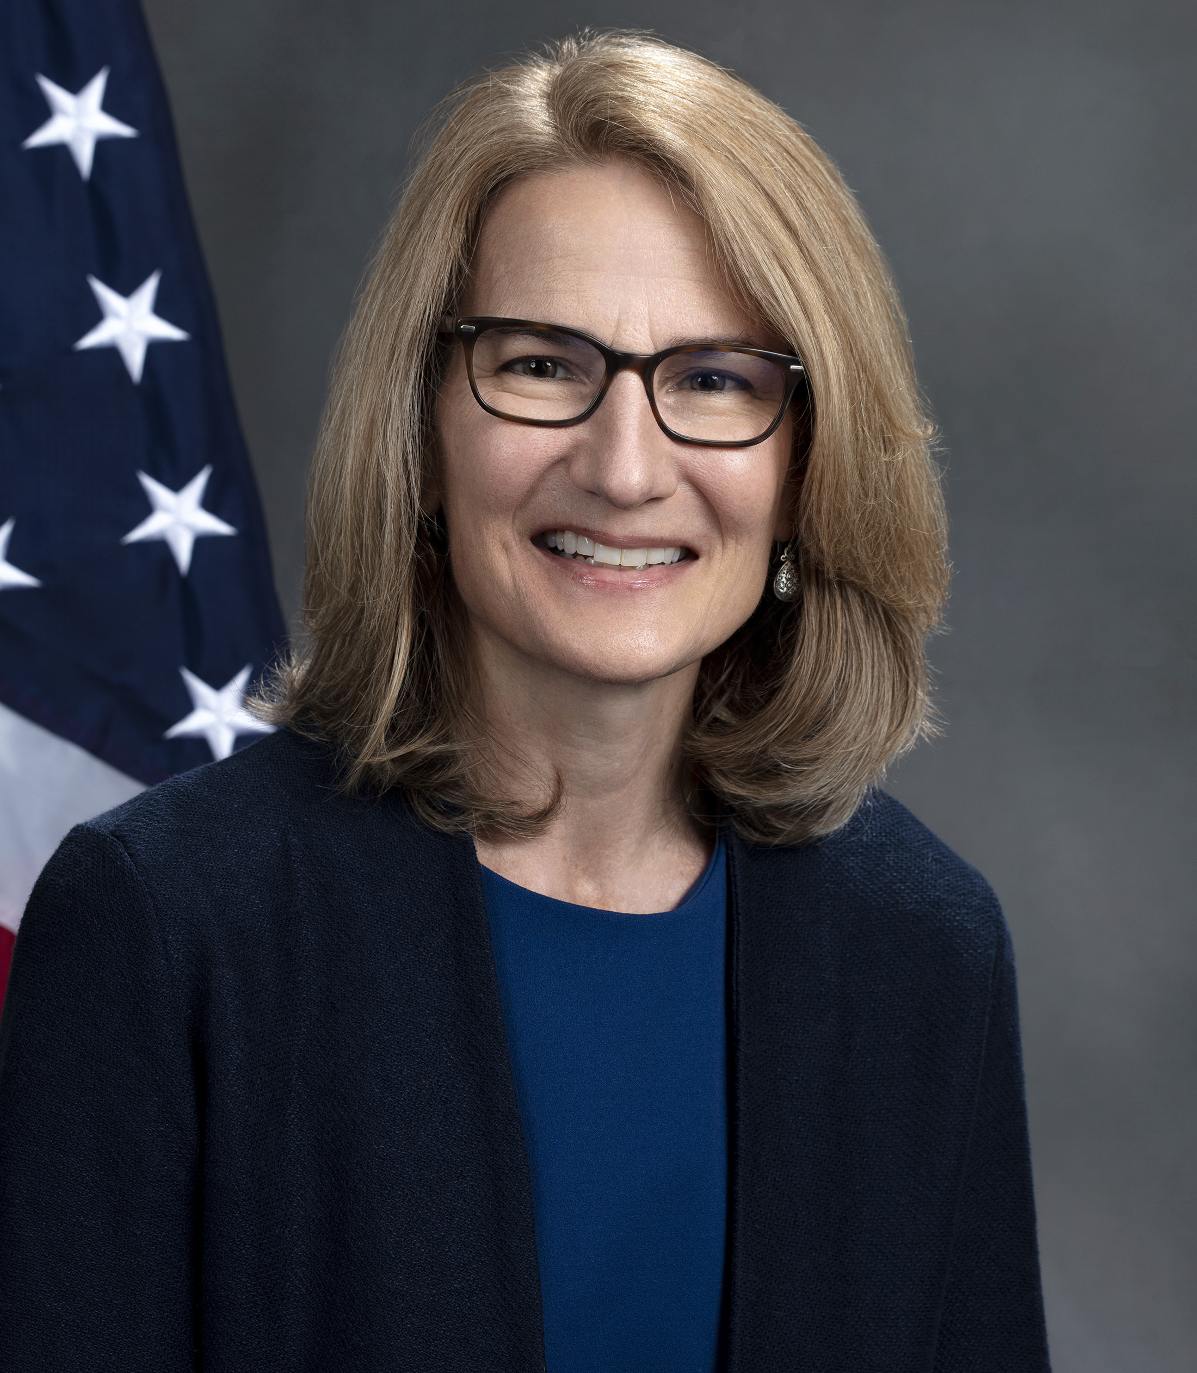
Federal Perspectives: Responsible Innovation Aging and Disability
Kelly Cronin
Deputy Administrator for Innovation and Partnership
Administration for Community Living (ACL)
Notes:
Transition slide

Slide 26

OUR VISION
Administration for Community Living
For all people, regardless of age and disability, to live with dignity, make their own choices, and participate fully in society.
OUR MISSION
Maximize the independence, well-being, and health of older adults, people with disabilities across the lifespan, and their families and caregivers.
STRATEGIC PRIORITIES
Caregiving
Connecting people to services
Whole-person health
Employment
Protecting rights & preventing abuse
Economic security
https://acl.gov/about-acl
Notes:
The Administration for Community Living, a division of HHS, was created around the principle that all people, regardless of age or disability, should be able to live independently and participate fully in their communities. ACL funds states to provide community-based services through a network of state and local partners. Learn more at www.acl.gov

Slide 27
THE CARE GAP
America’s growing care gap demands action
Demand for home care is surging, but the caregiver workforce is not keeping pace.
63M
20%
800K
family caregivers face significant physical, emotional, and financial strain
of caregivers receive training — the vast majority have none
additional direct care workers needed by 2032 to meet demand
The growing care gap threatens health, safety, independence, and dignity.
Notes:
Family caregivers are the backbone of our long-term services and supports system, providing over $470 billion of unpaid care a year. There is a shortage of more than 600k paid direct care workers. By 2032 the US will need an additional 800,000 direct care workers. We want to raise up how to implement AI responsibly in the home — not to replace human connection.

Slide 28
Caregiver AI Adoption & Key Takeaways
AI Adoption Trends
• Broad Outreach: 59% of surveyed caregivers have experienced utilizing AI tools within their workflows.
• Consistent Use: A robust 33% utilize AI platforms on a regular basis, establishing it as a core resource.
• Latent Interest: 17% have not tried AI yet but express open curiosity, indicating clear market expansion potential.
Top Application Frameworks
• Understanding a diagnosis: 121 respondents (44%)
• Preparing doctor questions: 86 respondents (32%)
• Organizing medical info: 73 respondents (27%)
• Emotional support frameworks: 66 respondents (24%)
• Writing insurance appeals: 59 respondents (22%)
• Admin / coordination assistance: 58 respondents (21%)
• Core Focus: Clinical clarity (diagnosis comprehension & physician communication) drives primary engagement over administrative workflows.
Survey Response | Count | Percentage
Yes, regularly | 91 | 33%
Yes, once or twice | 70 | 26%
No, but interested | 45 | 17%
No, not interested | 66 | 24%
Source: Caregiver Tech Insights Survey 2026 | https://www.caregiveraction.org/wp-content/uploads/2026/05/CIC-Survey-2026.pdf

Slide 29
STRATEGIC VISION
Ideal AI solutions…
Are affordable, practical, safe, and scalable
1
Strengthen caregiving in the home and community
Strategic vision for AI in caregiving
2
Help meet growing demand for care without compromising quality
THE GOAL
3
Leverage AI to improve care quality, reduce caregiver burden, and strengthen the caregiving infrastructure for the future.
Supplement, not replace, human connection
4
Informed by voices and experiences of caregivers
5
Notes:
The goal is to leverage AI to improve care quality, reduce caregiver burden, and strengthen the caregiving infrastructure for the future. Ideal solutions supplement, not replace, human connection, and are informed by the voices and experiences of caregivers.

Slide 30

Caregiver AI Prize Challenge
The Goal: Drive innovation in affordable, user-centered AI tools that improve care quality, reduce caregiver burden, and extend the direct care workforce — supplementing, not replacing, human connection.
TWO TRACKS
AI Tools for Caregivers
AI Tools for Extending the Caregiver Workforce
1
Support family and professional caregivers directly in the home.
2
Expand the capacity and reach of the direct care workforce.
THREE PHASES — TRACKS ADVANCE BY WINNING THE PRIOR PHASE
1
2
3
→
→
PHASE 1
PHASE 2
PHASE 3
Design
win to advance
Implementation & Testing
win to advance
Promise of Sustainability

Slide 31
DESIGN PRINCIPLES
Caregiver Challenge AI principles
Protect privacy, dignity, and choice
Support human-in-the-loop accountability
1
2
Support caregivers’ well-being and reduce burden
Supplement, not replace, human connection
3
4
Promote safety, reliability, and transparency
5
Support person-centered care
6
7
Ensure affordability and access
Notes:
Seven design principles guide the Caregiver Challenge: protect privacy, dignity, and choice; support human-in-the-loop accountability; support caregivers' well-being; supplement not replace human connection; allow personalized and flexible care; promote safety, reliability, and transparency; and ensure affordability and access. Full descriptions at acl.gov/caregiver-ai-challenge.

Slide 32
Use Cases for AI Tools in Caregiving
Track 1: Supporting caregivers
Track 2: Extending the workforce
Virtual assistants
Enhanced communication tools
Memory and cognitive support
Care coordination and navigation
Decision support tools
Conversation companions
Remote monitoring and risk prediction
Robotics and assistive devices
Caregiver training and education
Emotional support tools for caregivers
Matching and scheduling
Documentation and reporting
Training and upskilling
Real-time coaching and support
Predicting care needs and risks
Remote monitoring and risk prediction
Data aggregation
Workforce management activities
Administrative task reduction

Slide 33

THE GOAL
Demonstrate how teams of advanced community care networks and health care partners can integrate the delivery of comprehensive, person-centered services to improve the affordability of high-quality care and independence at home.
Up to 1 million
Medicare and Medicaid dually and near-dually eligible beneficiaries with multiple chronic conditions and at least one functional limitation — reached through community-clinical integration.
Meritorious prizes reward innovative approaches to…
Implementation of AI to enable community-clinical integration and care coordination
01
Reaching the near-dually eligible beneficiaries with complex needs
02
Notes:
The Health at Home Challenge aims for community-clinical integration for up to one million dually and near-dually eligible beneficiaries with complex needs. It rewards teams that integrate comprehensive, person-centered services to improve affordability and independence at home. Meritorious prizes recognize innovative use of AI and approaches to reach near-dually eligible beneficiaries.

Slide 34
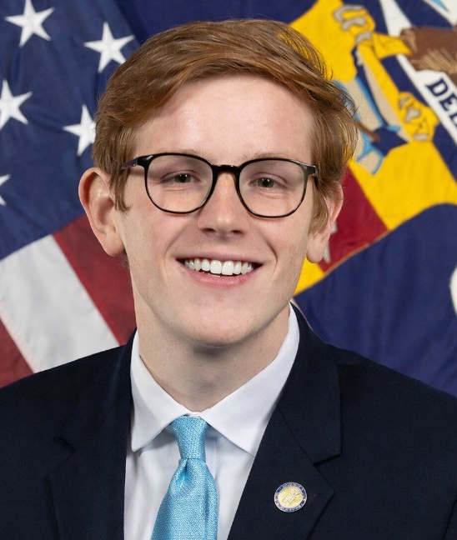
AI, Accessibility, and the Future of Work
Sean Ruddy
Workforce Analyst
US Department of Labor
Notes:
Transition slide

Slide 35
Building an
AI-Ready Workforce:
AI Literacy Efforts
Department of Labor
July 15, 2026

Slide 36
Background
The Department is leading a bold set of efforts to prepare American workers to succeed in an AI-driven economy, as outlined in America’s Talent Strategy and the AI Action Plan.
Our work is categorized under three pillars:
  Opportunities of AI
    AI literacy skills and AI-related training pathways
  Challenges of AI
    Innovations in workforce retraining
  Agility in an AI-Driven Economy
    Improving data and tracking AI impacts

Slide 37
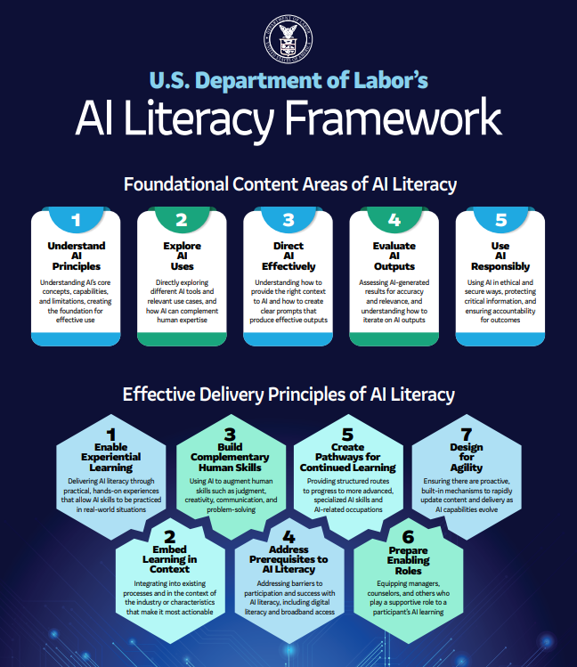
DOL AI Literacy Framework
Published in February 2026, the DOL AI Literacy Framework provides:
  A working definition for AI literacy,
  a detailed set of foundational content areas of AI literacy, and
  effective delivery principles for AI education and skill development training.
DOL defines AI literacy as a foundational set of competencies that enable individuals to use and evaluate AI technologies responsibly, with a primary focus on generative AI, which is increasingly central to the modern workplace.

Slide 38
Audience Considerations
Workers
Education/Training Providers
Understand what AI literacy means for their career and how to build these skills proactively
Integrate AI literacy into programs, equipping learners with the skills to succeed in AI-enabled workplaces
Employers
State/Local Agencies
Build AI literacy across their workforce, preparing employees to work effectively and responsibly with AI tools
Advance AI literacy across the public workforce and education systems, preparing students and job seekers for evolving labor market needs, while addressing employer demand for AI-ready workers

Slide 39
Foundational Content Areas
Understand AI Principles
  What AI is and how it works
Explore AI Uses
  Practical applications in context
Direct AI Effectively
  Framing prompts and iterating strategically
Evaluate AI Outputs
  Assess accuracy and completeness
Use AI Responsibly
  Ethical and effective application

Slide 40
Delivery Principles
Enable Experiential Learning
Embed Learning in Context
Build Complementary Human Skills
Address Prerequisites to AI Literacy
Create Pathways for Continued Learning
Prepare Enabling Roles
Design for Agility

Slide 41
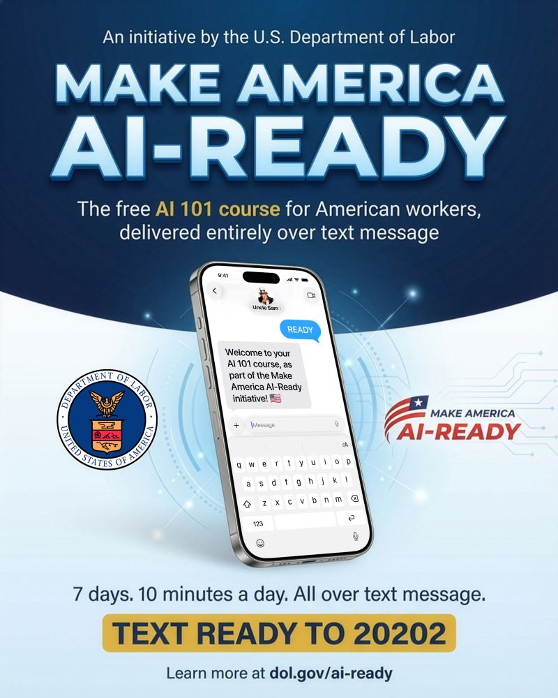
DOL’s Make America AI-Ready Initiative
Make America AI-Ready:
  A free, 1-week AI literacy course that will help American workers learn the basics of AI
  Delivers bite-sized learning content and daily challenges to users entirely over text message
  Directly aligns with the five foundational areas outlined in the AI Literacy Framework
  Provides information's over 7 days, 10 minutes a day. All over text message.
Get started by texting “READY” to 20202

Slide 42
Questions?

Slide 43
Audience discussion
What workforce skills will become even more important as AI becomes more common?
Put responses in Q + A section

Slide 44

From Policy to Practice: Responsible Adoption
Gabrielle Sedor
Chief Operations Officer and Foundation Director
ANCOR
Notes:
Transition slide

Slide 45

AI and the Direct Care Workforce: What Lies Ahead?
Gabrielle Sedor, CAE
July 2026

Slide 46

Our Purpose
Advancing the future of supports and services for people with intellectual and developmental disabilities
Notes:
When we talk about ANCOR, this is our purpose – this is why we exist.

Slide 47
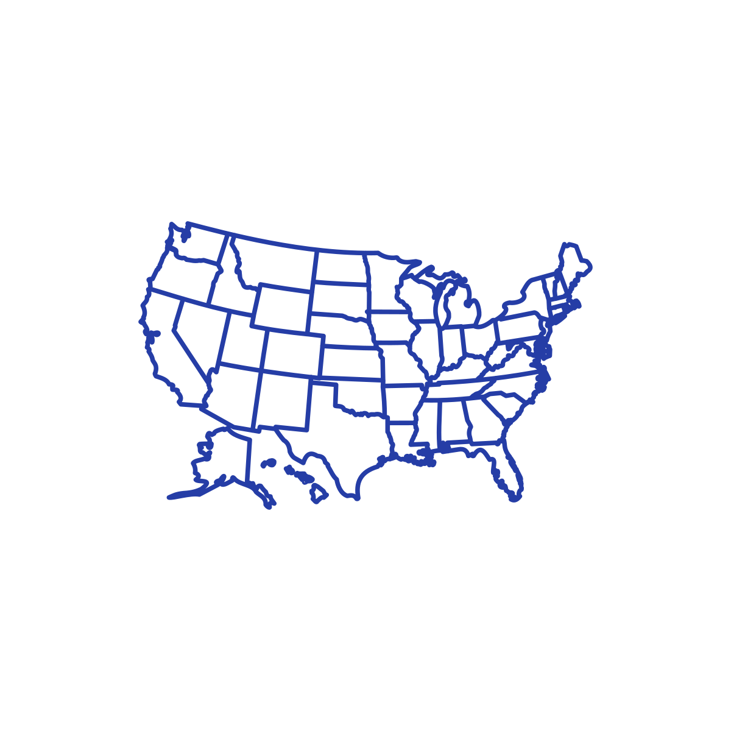


ANCOR by the Numbers
2,500+
private providers of I/DD services
59
state provider associations
15,000
actively engaged professionals
Notes:
By the numbers….
59 state provider associations, 19 of which are 100%

Slide 48
Where it Starts
Notes:
But enough about ANCOR, let’s take a step back and really try to get a sense of what we as HCBS providers of service (and families and people needing service) are dealing with…..

Slide 49
The total number of people getting LTSS through state I/DD agencies grew by 80% from 794,925 in 2000 to 1,434,307 in 2020. (credit: RISP)
Credit: Residential Information Systems Project (RISP). University of Minnesota’s Institute on Community Integration.
Notes:
We are supporting a LOT of people.

Slide 50
According to RISP...
There were 8.38 million people with an intellectual or developmental disability in the United States in 2020.
Of those, only 20% of children and 44% of adults were known to their state developmental disabilities agency.
Source: Residential Information Systems Project (RISP).
University of Minnesota’s Institute on Community Integration.
Notes:
But that is really just a small percentage of the families who actually need home and community-based supports.
There is no shortage of demand

Slide 51
According to the U.S. Census Bureau...
The projected population growth of adults 85 years and older will increase by 170% between 2022 and 2060.
(That’s compared to an increase of 54% during the same time period for those 65 years and older and a 4% increase for those aged 18-64.)
Source: U.S. Census Bureau. 2023 National Population Projections Datasets. https://census.gov/data/datasets/2023/demo/popproj/2023-popproj.html
Notes:
That’s looking back.
Let’s look forward.
According to the US Census,
By 2060 we will have more folks 85 years old and older than any other age group.
More people to care for + fewer people to do it = impact on services that rely on direct support

Slide 52
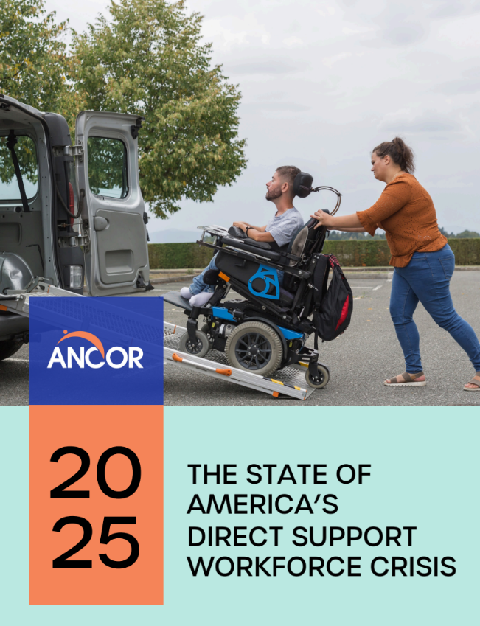
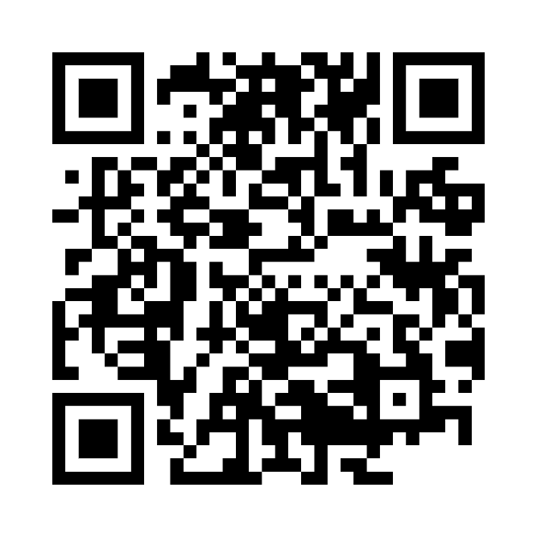
The State of America’s Direct Support Workforce Crisis 2025
Scan the QR code to browse the latest findings
Notes:
Those premonitions are confirmed in our most recent release of the State of America’s Direct Support Workforce Crisis 2025.
You can scan this QR code or grab this from our website. This is seen as a solid source of information – from previous Administrations and this one. It was cited during ACL’s recent National Caregiver Recognition Event and we’ve seen it referenced numerous other times.

Slide 53


Key Findings
Providers experiencing moderate or severe staffing challenges in past year
Providers discontinuing programs or services due to staffing challenges
88%
29%
Providers intending to delay the launch of new programs due to staffing challenges
Providers turning away new referrals due to staffing challenges
62%
59%
Notes:
Of note: we did see positive shifts in the data immediately after American Rescue Plan (ARPA) funds were released in states.
I’ll be watching to see what plays out in the coming years, especially since we could be facing a reduction of almost $1T from Medicaid over the next ten years if nothing is done to roll back cuts in HR1….
Data – where we can show both positive and negative impact - along with our stories and the stories of staff and people we support are going to be important in making that case….

Slide 54
The Role of Technology and AI
Notes:
So its only reasonable that providers and families are turning towards technology, including AI to assist in supporting people with IDD.

Slide 55
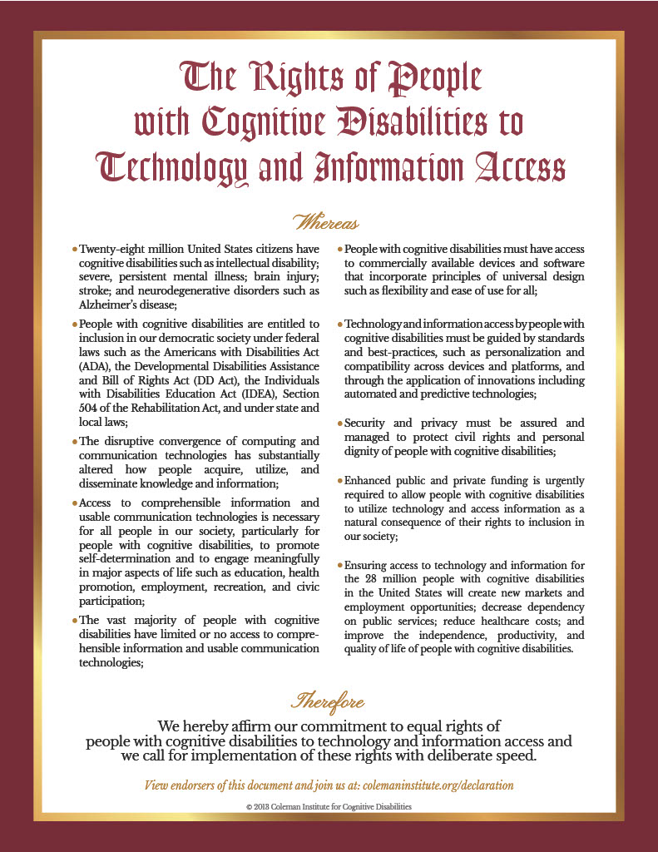
Some History…
Coleman Institute Conference and ANCOR Technology Summit happened annually in Colorado. (2010-2016)
Declaration written in 2013 by David Braddock and others at the Coleman Institute in consultation with people with lived experiences.
ANCOR among numerous local, state and national endorsers.
Notes:
ANCOR has long supported access to technology for people with IDD and their caregivers.
Beginning with the Declaration of the Rights of People with Cognitive Disabilities to Technology and Information Access in 2013.
All statements are still true! Essentially, every way that we benefit from technology, people with disabilities should benefit too. Every caution and safeguard we put into place for technology, people with disabilities should have those same protections too.
AI fits perfectly.

Slide 56
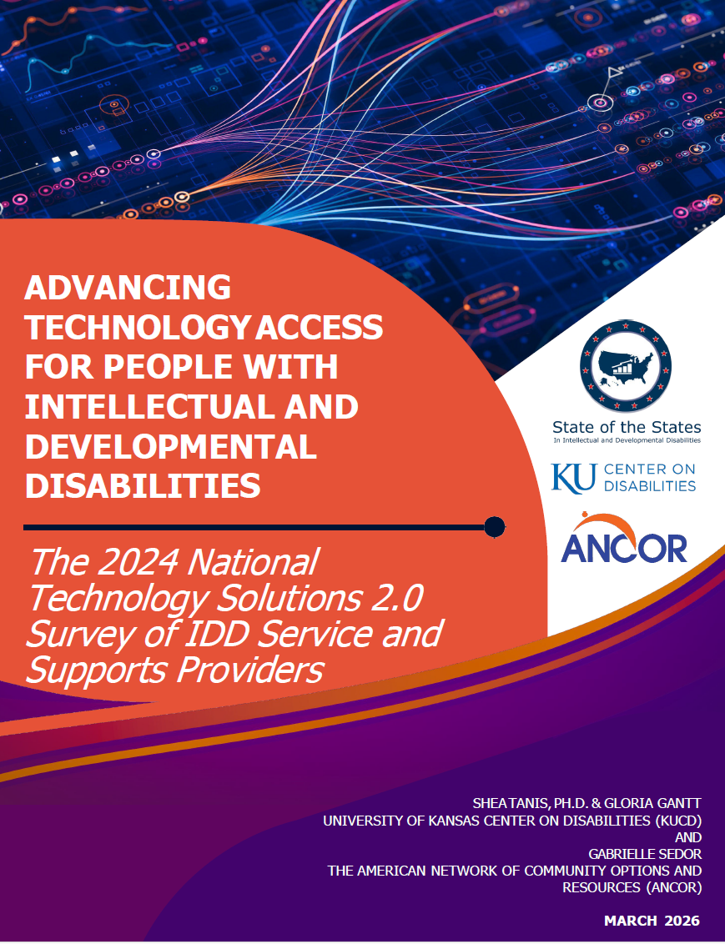
How Are Providers Using (and paying for ) Technology
#ANCORConnect26
Notes:
Fast forward to the most recent survey we did with Dr. Shea Tanis and the State of the States to assess how providers are (and aren’t) using technology solutions.
Staffing/Technology Innovations
Active supports
What does it look like to not have 24-hr staff support?
Med reminders
Stove shut offs
Motion/door sensors
Success coaches for DSPs
Fires and emergency situations – state mandates on response
Supported living w technology
Worry around cameras from residents – privacy
Providers are using technology with AI to track trends (i.e. toilet flushing to ID UTIs)

Slide 57

Technologies Investments by Providers
Computers or tablets (78%)
Broadband or internet activation fees (77%)
Smartphones (49%)
Smart home technology (39%)
Accessible appliances (32%)
Notes:
3, 4, and 5 all have AI built into them.

Slide 58

Demonstration of Cost Efficiencies
In 2024, 85% of providers indicated they could demonstrate cost savings or greater efficiencies as a result of investing in technology solutions
In 2020, 53% of providers indicated they could demonstrate cost savings or greater efficiencies as a result of investing in technology solutions
Notes:
And affirms that with the use of technology comes demonstrable savings.

Slide 59





How Are Providers Using AI Tools Today?
Communications
Policy & Compliance
Strategy & Leadership
Workforce & HR
Data and Reporting
Help with Letters & Emails
Presentations
Meeting Minutes
Staff Updates
Newsletters
Talking Points
Summarize and Interpret Regulatory Requirements
Draft or Update Internal Policies
Create Checklists for Audits and Readiness
Brainstorm Strategic Plan Goals and Initiatives
Draft Agendas, Memos
Explore Funding Scenarios and Program Changes
Job Descriptions
Recruitment & Hiring
Onboarding Materials and Training Content
Onboarding Materials and Training Content
Culture & Engagement Ideas
Summarize Spreadsheets and Surveys
Help with Dashboards and KPIs
Forecast Planning
Notes:
And here’s how providers are utilizing Artificial Intelligence.
Credit to the NY Alliance and Data Potato

Slide 60
AI Supporting the HCBS Workforce
High turnover and vacancy rates threaten HCBS availability nationwide.
The workforce needs: Fulfillment, supportive environment, professional development, recognition, adequate compensation^{1,2}
How AI can help:
Reduce burnout: Automate admin tasks so staff can focus on meaningful work
Improve training: On-demand microlearning and real-time coaching
Support career growth: Skill development and advancement pathways
Enhance supervision: Better and more real-time feedback and recognition tools
Promote work-life balance: Smarter scheduling, less after-hours paperwork
AI won't fix everything, but it can improve the work experience that drives retention.
ANCOR. (2022). The State of America's Direct Support Workforce Crisis 2022. Retrieved from https://www.ancor.org/resources/the-state-of-americas-direct-support-workforce-crisis-2022/
U.S. Department of Health and Human Services. (2023). HHS Report on the Direct Support Professional Workforce. Retrieved from https://www.relias.com/wp-content/uploads/2023/05/23-HHS-IDD-4165-Report-DSP.pdf
Notes:
And it makes sense.
There are ways that AI can address some of our workforce needs.
One of our providers shared that he was visiting with one of his DSPs – a DSP that won our DSP of the Year award! - “I don’t like what I’m doing anymore” – can we be more intentional about what we ask our DSPs to do?

Slide 61
AI Supporting Quality Improvement
AI to assess incident data to determine if there are gaps in training, policies or protocols
AI in smart homes to track health needs (i.e. toilet flushing to identify possible UTIs)
Rewriting policies for consistency across departments and services
AI for customer service calls in person-directed services
Notes:
“A very bad day….”
Person-directed services - Using AI for customer service calls in person- directed service, pulls notes/records. Records call. Was customer satisfied? Can use for training to improve customer service.
Huge opportunities, esp for QI, data analytics and program integrity measures and to assist DSPs, esp those whose first language isn't English.

Slide 62

AI - Outside of the Box!
Notes:
Opportunities to recruit staff from other industries displaced by AI?

Slide 63
Barriers that Prevent Advancement to Technology Solutions for Individuals with I/DD
Financial resources (64% in 2024)
Reimbursement of services (63% in 2024)
Knowledge of available and emerging technologies (57% in 2024)
Training on available and emerging technologies (50% in 2024)
Notes:
Our Technology Report shares the barriers….
In rural and remote areas – internet access

Slide 64






Risks and Concerns for Providers
Loss of Human
Judgment
Accuracy
(Hallucinations)
Bias &
Discrimination
Job
Displacement
& Staff Distrust
Privacy & Data
Exploitation
Over-
Dependence
Notes:
But its not without worry and an eye on these issues. (credit to NY Alliance)
there are worries about how regulators/funders are using AI to regulate
would like a deeper understanding of HOW AI is being used.
with interoperability - respecting privacy - data use/sharing agreements. managing consent?

Slide 65

“We are learning our way..”
1.
2.
ANCOR Technology Community of Practice
ANCOR Tech Advisory Council
3.
4.
Tech Summit 2027 and ANCOR Connect
NEW! ANCOR Collab with NY Alliance’s AI Community of Practice
Notes:
Top of AI Wishlist?
Translations – more languages and going in both directions (reading, writing, speaking) in EHRs and other infrastructure tools.
Transparency – who am I talking to? Where is AI present?

Slide 66

Join our growing national community of providers at ancor.org/join.

Slide 67

SAVE THE DATE
2026 ANCOR Policy Summit & Hill Day
September 15-16, 2026

Slide 68

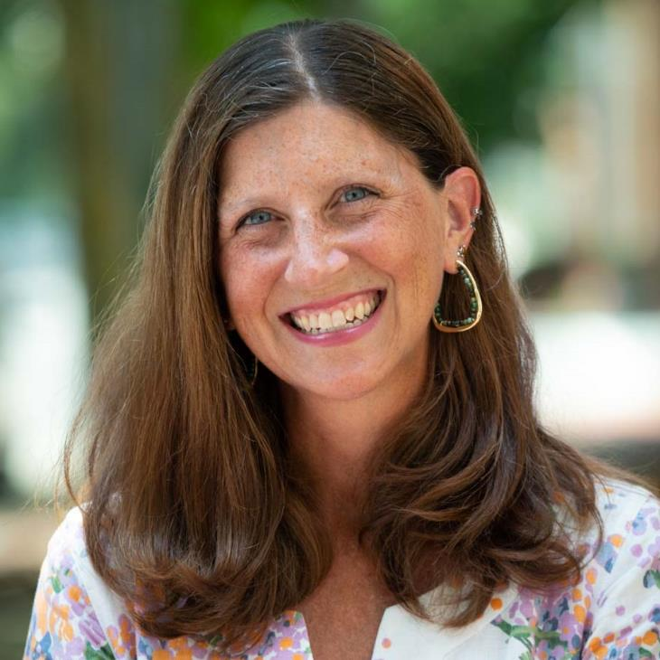
Gabrielle Sedor
Chief Operations Officer & Foundation Director
gsedor@ancor.org

Slide 69
Interactive Discussion
Q&A with Audience & Presenters
Notes:
Transition slide

Slide 70
Presenter Contact Information:
Robert Espinoza
robert@careworksproject.co
Gabrielle Sedor
gsedor@ancor.org
Kelly Cronin
Kelly.Cronin@acl.hhs.gov
Sean Ruddy
Ruddy.Sean.M@dol.gov

Slide 71

Final Reminders
Check out resources on our website and sign up for Center updates (scan QR code below)
Notes:
https://acl.gov/DCWcenter
https://forms.office.com/r/Yv30gLgsth
https://act.ncoa.org/a/dcw-newsletter

