Slide 1

Career Progression Lab Talk Jeannine LaPrad, PHI November 7, 2025

Slide 2


PHI Quality Care Through Quality JObs

Slide 3












Strategies Center Partners
Notes:
DCW Partner slide

Slide 4

Career Progression
PLC FOCUS
Opportunities to support long-term career development and workforce stability among DCWs.
STATE OPPORTUNITIES
Developing strategies to build career ladders and lattices
Expanding access to ongoing education and skills development
Promoting the use of stackable credentials, badges, and competency-based training models
Defining and standardizing DCW roles and titles
Creating specialized tracks that reflect areas of expertise (such as behavioral health, dementia care, or complex medical support)
Supporting portability of credentials across employers and settings

Slide 5


THE 5 PILLARS OF DIRECT CARE JOB QUALITY
QUALITY TRAINING
FAIR COMPENSATION
QUALITY SUPERVISION & SUPPORT
RESPECT & RECOGNITION
REAL OPPORTUNITY
© 2025 PHI

Slide 6
Defining Career Pathways, Ladders, and Lattices

Slide 7

Career Pathway
A schematic or mapped series of manageable education and training steps toward industry-aligned skills, credentials, and career advancement.
Each step is designed to prepare people for employment while providing a clear pathway to the next level of education and training within an industry.
Pathways may also include necessary credentials and supportive services.
Urban Institute: Local Workforce System Guide, 2022.

Slide 8

Career Ladder
A metaphorical path representing a traditional, linear career progression, moving from entry-level positions to higher levels of responsibility, skill, and authority within a specific career field or department.

Slide 9

Career Lattices
A more modern and agile approach that depicts a flexible framework for career growth, allowing for movement not just up, but also sideways, diagonally, or even a temporary downward step to different roles and departments.

Slide 10
Career Pathways, Ladders, and Lattices in LTSS

Slide 11
Review of State Examples of Career Pathways
Visuals/Career Progression Maps
6 of 14 states include visual depictions of career pathways for DCWs
Some could be found on state government sites, others on partner agency sites
Many states have developed information about career pathways for direct care workers and direct support professionals.
The information that is available varies regarding clarity, completeness, and accessibility.
Our review revealed 3 key points that the most successful pathways had in common.
Training Requirements/Opportunities
9 of 14 states have outlined training and/or related credentials, some much more detailed than others.
All of these examples provided information of the time commitment necessary to complete the training
Advancement Within Direct Care
10 of 14 states outlined career progression within direct care
In many of those cases direct care worker was the "advanced "career. They often started at title like "Homemaker or Personal care Aide.
Other states set up their pathways to go straight from direct care worker to CNA or LPN

Slide 12
Career Pathway Development Across the Continuum of Direct Care Roles
Training & Credentialing Infrastructure
Personal Care Aides
Home Health Aides
Nursing Assistants in Nursing Homes
Direct Support Professionals
Independent and Family Caregivers
Information about Education and Career Pathways
Incentives and Other Resources to Support Career Progression

Slide 13


Career Lattices and Ladders in Direct Care (a few examples)
Lattices
Developing foundational and contextualized competencies within established scope of practice in direct care (e.g., MI)
Universal core competencies and entry level training that support employment into a range of direct care occupations (e.g., WI)
Portable, transferable credentials allow workers to move between care settings easily (e.g., WI)
Ladders
Advancement-focused within direct care (e.g. WI and NY CISA)
New Jersey’s DSP career advancement law
Apprenticeship models, Center for Caregiver Advancement’s CNA Registered Apprenticeship Program (CNA RAP)

Slide 14

Michigan: Direct Care Workforce Training, Credentialing, and Career Advancement
Personal Direct Care Specialist
mobility assistance to leadership, plus three in-person skills labs where students demonstrate hands-on competency
Direct care workers seeking advanced skills in personal care and clinical support
Hybrid 36 hours
Home and Direct Care Specialist
Develop expertise in person-centered approaches to housekeeping, meal planning, and nutrition
Virtual12 hours
Direct care workers wishing to expand their skills in instrumental activities of daily living (IADLs)
Direct Care Associate
aging, disabilities, mental health, and cultural competency
Virtual12 hours
Direct care wanting training in specialized areas of care and support services
Direct Care Fundamentals
person-centered care, professional boundaries, infection control, and other crucial skills
Virtual12 hours
Individuals interested in starting a career in direct care work
Join The Workforce - IMPART Alliance

Slide 15
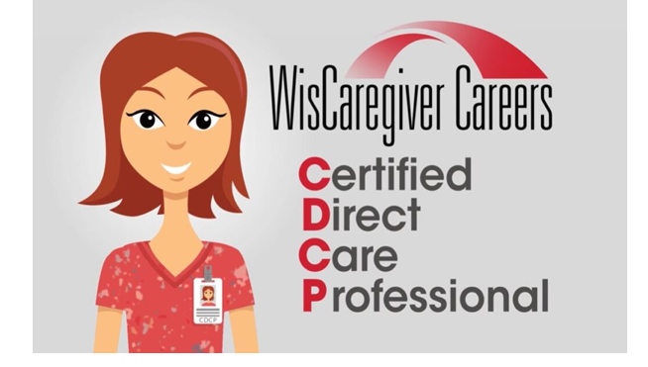
Wisconsin: WisCaregiver Careers and Certified Direct Care Professional
Upskilling and Career Advancement Opportunities.
Wisconsin Division of Quality Assurance(DQA) -Approved CNA training.· Crosswalks to Assisted Living, Personal Care.
August 2024, the CDCP program is recognized to meet the caregiver training requirements for 1-2 bed adult family homes (AFHs).
Pilot CDCP-to-CNA program launched with Healthcare Workforce Training Institute (HWTI).
wiscaregiver careers certified direct care professional
CDCP Credential and Training
Universal Worker - Free, online, self-paced, training is approximately 30 hrs
Skill development in 14 competency areas based on national standards
Proctored competency with 3-year certification as a certified direct care professional (CDCP)
Certification to work in a wide variety of settings
CDCP website: wiscaregivercdcp.com

Slide 16




New York: Direct Care Workforce Upskilling and Advancement Pathway
1
Entry Level Booster provides enhanced training and practice opportunities to better prepare new HHAs to begin work with a more medically complex and diverse population of clients.
An 8 hours course “Entry Level Immersive Experience” simulates day 1 as a new HHA; providing workers with an idea of what to expect and giving them an opportunity to apply what they have learned in real life situations.
Condition Specific Specialty Training such as dementia care and behavioral health provide workers with specialized skills and techniques to support people with these conditions in a person-centered, trauma informed way.
Each topic is an 8-hour course. 30 days after the completion of training, there is a 4-hour learning lab to practice new skills, peer to peer interaction, and scenario work.
2
Advanced Role: Care Integration Senior Aide
Condition Specific Specialty Training
Entry Level Booster
Advanced Role: Care Integration Senior Aide is a new position focused on improving care outcomes, supporting home care aides in the home by being a fully integrated and equitable member of the interdisciplinary care team, leveraging enhanced observe record and report to escalate changes in condition related a clients to physical mental and social well being. Requires 32 hours of training.
3
PHI Releases ‘Care Integration Senior Aide’ Guide for Home Care Employers - PHI

Slide 17
Developing Career Pathways in Direct Care

Slide 18
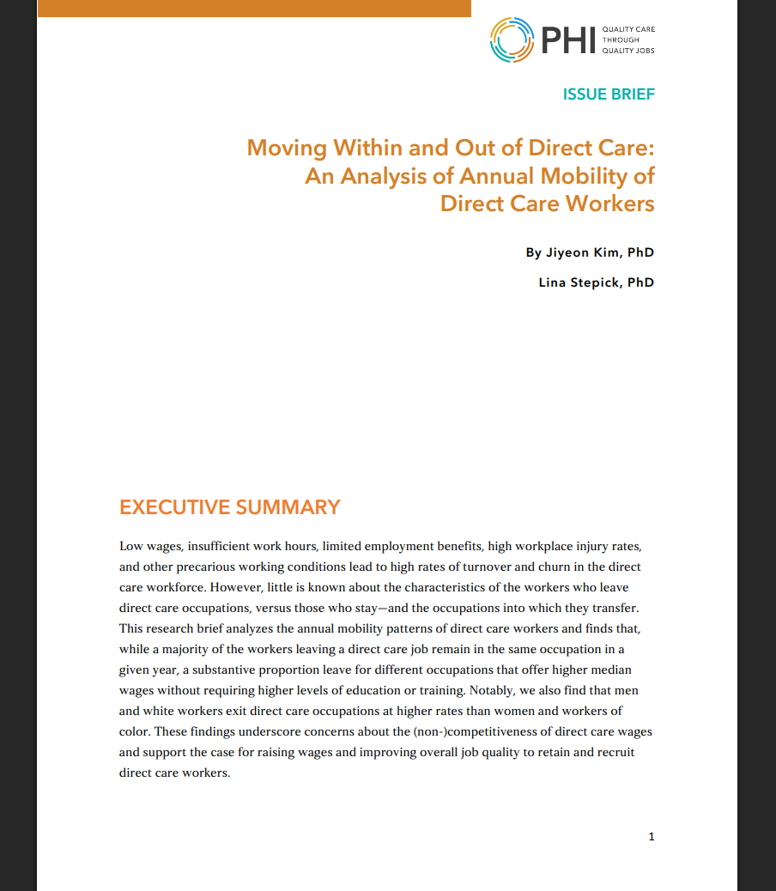
Moving Within and Out of Direct Care: Analyzing the Mobility of Direct Care Workers
Most direct care workers remain in the field year-to-year (81%).
Demographics play a significant role in direct care worker mobility.
When direct care workers change careers, they predominantly stay in healthcare (65%).
About 93% of workers who leave direct care transition to jobs with higher median wages, even though these new roles generally don't require higher education or training levels.
Men and white workers exit direct care at higher rates than women and workers of color.
Specifically, white men (11%) are most likely to leave for different occupations, while women of color (6%) are least likely to leave.
With medical assistant being the most common transition occupation (17%).
This suggests workers are seeking similar roles with better compensation or working conditions rather than leaving the care sector entirely.
Those who leave typically go to
higher-paying occupations.

Slide 19





Universal Direct Care Workforce
Development Framework
Universal Core Competencies
Core competencies and entry level training that cut across all direct care occupations and care settings
Specialized training—contextualized to specific settings and populations—can be stacked on top
Training is portable and recognized across employers and settings, with no need for re-training
Wage progression is associated with stackable training and credentials
Advanced roles that strengthen care coordination and delivery, establish career ladders, and promote cost efficiencies for the long-term care system
Consistent Training Standards
High-Quality Programs & Credentials
Wage & Career Progression
Advanced Roles & Peer Mentoring

Slide 20

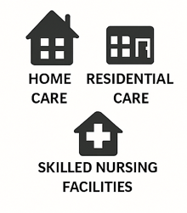
Direct Care Career Progression Model
IMPROVED JOB QUALITY & CARE
CARE SETTINGS:
CREDENTIALS:
REFLECT COMPETENCY, STACKABILITY AND PORTABILITY
home care, residential care, skilled nursing facilities
ADVANCED
COMPETENCIES
Example: Care Integration
SPECIALIZED COMPETENCIES
Example: Dementia Care
ENTRY, SPECIALIZED AND ADVANCED TRAINING
ENTRY, SPECIALIZED, & ADVANCED CREDENTIALS
DIRECT CARE ROLES:
Personal Care Aides
Home Health Aides
Nursing Assistants
Direct Support Professionals
Residential Care Aides
CONTEXTUALIZED COMPETENCIES
(BY CARE SETTING & POPULATION BEING SERVED)
Example: Care for Older Adults
ENTRY LEVEL
FOUNDATIONAL COMPETENCIES
Example: Direct Care Work
Notes:
ADVANCED
COMPETENCIES
Example: Care Integration

Slide 21
Guiding Principles for Career Pathway Development in Direct Care
Enhance Competency and Career Development Infrastructure
Improve and Streamline Training Access and Affordability
Identify Clear Career Pathways and Support Advancement
Offering Employment, Training, and Retention Support
Develop Wage Progression Opportunities
Invest in Research and Data Collection

Slide 22



Levers and Lessons for Moving Forward
How you define the "direct care workforce" guides who should be at the table and how you will align around shared goals
Interagency cooperation is vital, and requires buy-in, shared vocabulary, understanding, and goals
Make sure key stakeholders are regularly involved in the process (workers, employers, people receiving care, training providers)
Partnering with education and training institutions can bring in additional resources, expertise, and opportunities
Training accessibility is crucial (e.g., price, availability geographically and timewise, language access)
Look for ways to coordinate across states, especially neighbors who are part of your labor market
Notes:
Header and 3 row textboxes with icons (icon can be changed, color must remain the same)

Slide 23

End of presentation

