Slide 1

Innovation in the Direct Care Workforce: Unlocking Success through Peer-Learning Collaboratives (PLCs)
January 29, 2025
The program will begin at 2:00pm ET

Slide 2
Housekeeping
All participants have cameras turned off and are muted.
ASL translation is being provided on this webinar.
CART is available through the Zoom captions feature.
Please reach out to directcareworkforce@ncoa.org should you have any technical issues during the webinar.
The webinar will be recorded and a copy of the slides will be available after the webinar.
Notes:
mailto:directcareworkforce@ncoa.org

Slide 3
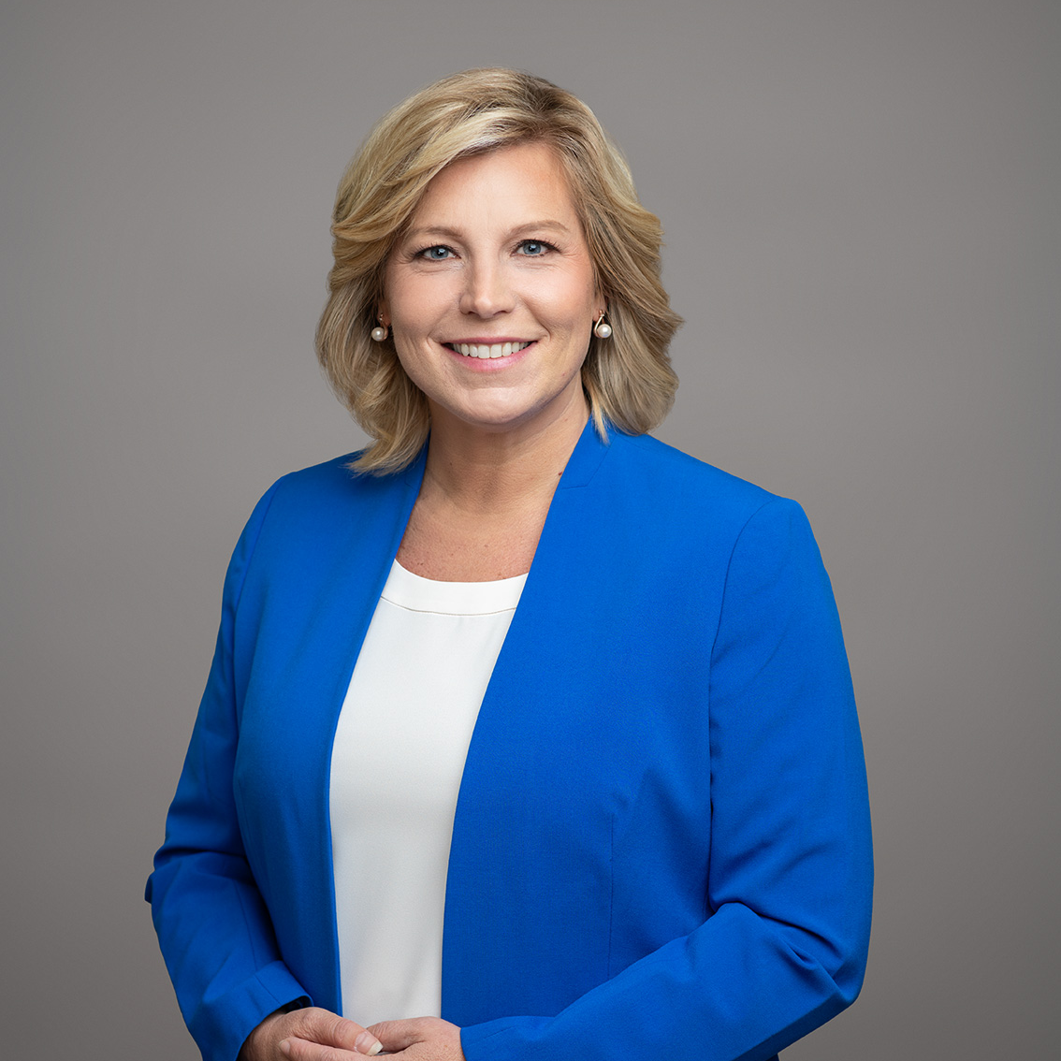
Welcome & Overview
Ramsey Alwin, Moderator
Chief Executive Officer
National Council on Aging

Slide 4
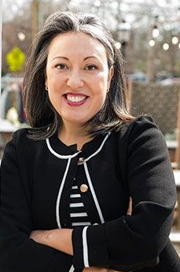

DCW Strategies Center Overview
Jessica Johnston Senior Director, Center for Economic Wellbeing National Council on Aging

Slide 5
Building national capacity to support community living
Provide tools and training to assist state systems and service providers
Facilitate peer-to-peer sharing of lessons learned and promising systems-change practices
Created by the Administration for Community Living in 2022, the Direct Care Workforce Strategies Center (Strategies Center) provides technical assistance to states and service providers and facilitates collaboration with stakeholders to improve the recruitment, retention, training, and professional development of members of the direct care workforce.
Maintain a clearinghouse of resources and promising practices

Slide 6
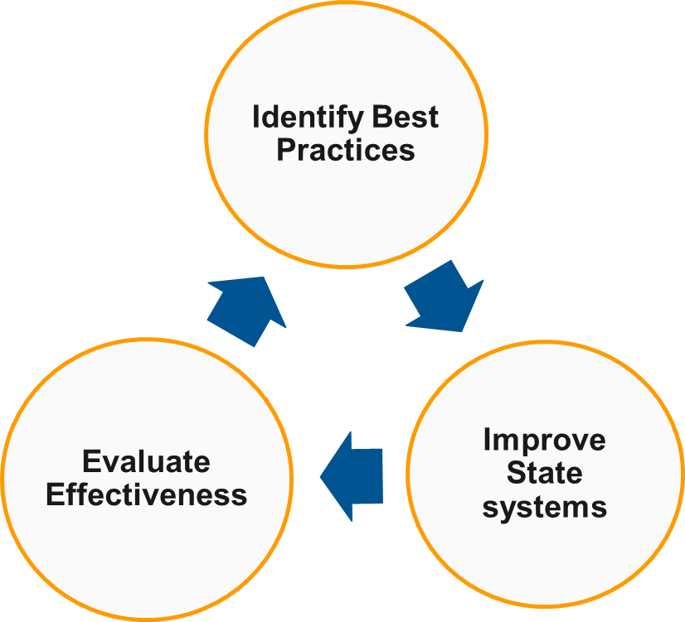
DCW Strategies Center Objectives
Identify evidence-based, promising, and innovative practices.
Catalogue practices and models.
Leverage best and promising practices to provide technical assistance (TA).
Assess the effectiveness of TA models.
Use data and evaluation to drive continuous improvement.

Slide 7










Representative List of Strategies Center Partners

Slide 8




Strategies Center Activities Overview
Resource Hub
Emphasis on resource curation for the DCW website with the development of materials being driven mainly by TA demand.
Advisory Committee
Emphasis on opportunities to elevate the voices of direct care workers and service recipients/providing supports for member participation.
Technical Assistance (TA)
TA opportunities include both state Intensive TA, State Peer-Learning Collaboratives, and self-guided TA.
Center Data Project
Provide enhanced data collection efforts related to DCW, including policy briefs and expanded surveys.
Notes:
https://acl.gov/DCWcenter

Slide 9



Strategies Center Technical Assistance
Self-Guided Technical Assistance
DCW State Peer-Learning Collaboratives
DCW Intensive Technical Assistance Opportunity
Center Resource Hub
Strategies Center Webinar Series
Partner Conference Sessions
Policy briefs or other Strategies Center-produced materials
Full group virtual sessions with the support of facilitators and subject matter experts to coach and support progress
Selection of 6 topics
Time-limited, action-oriented, topically focused
Application required
5-6 states receive up to 240 hours of virtual and in-person technical assistance from a small group of subject matter experts selected based on participating states’ systems-change priorities and SME knowledge areas
Application required

Slide 10
Strategies Center Webinar Series
Federal Action to Address the Direct Care Workforce Crisis (March 2024) TA webinar recording with speakers and ASL | Event TA webinar recording with speakers and slides | TA webinar slides
Addressing the Shortage: The Current State of the Direct Care Workforce (April 2024) TA webinar recording with slides and ASL | TA webinar slides
Call-to-Action for Building the Home and Community-Based Services Workforce Data Infrastructure (May 2024) TA webinar recording with slides and ASL | TA webinar slides
Workforce Investment Systems 101: Engaging with State Workforce Systems – Learning the Language to Build Partnerships (June 2024) TA webinar recording with slides and ASL
Using Marketing Campaigns to Expand & Advance the Direct Care Workforce: The WisCaregiver Careers Experience (July 2024) TA webinar recording with slides and ASL
Notes:
https://youtu.be/HpACamcEZtY
https://youtu.be/IYzwSdnaI2w
https://acl.gov/sites/default/files/Direct Care Workforce/DCW_Strategies_Center_March_7_Webinar_508.pdf
https://www.youtube.com/watch?v=m3xj9pygK78
https://acl.gov/sites/default/files/Direct Care Workforce/BPCx_NCOA_Presentation_4-25.pdf
https://youtu.be/WtzbL2EqGeI
https://acl.gov/sites/default/files/Direct Care Workforce/DCW_Strategies_Center_May_21_Webinar_Slides_508.pdf
https://www.youtube.com/watch?v=fyHB6Nb31qM
https://www.youtube.com/watch?v=YZQw8lY38Bw

Slide 11
States Receiving Strategies Center Technical Assistance
In 2024, 20 states received technical assistance through the Strategies Center:
Alaska
California
Colorado
Connecticut
Delaware
Illinois
Indiana
Kansas
Kentucky
Louisiana
Maine
Michigan
Nevada
New Hampshire
New Jersey
New Mexico
Oregon
Utah
Vermont
Washington

Slide 12
Strategies Center Year Two Accomplishments
Launched national technical assistance programs, providing technical assistance to 20 total states (14 PLC, 6 ITA).
Fourteen PLC states engage monthly in cohort meetings, attend regularly-scheduled cross-cohort webinars, and meet regularly with SMEs to advance towards identified milestones.
Six intensive technical assistance states completed their readiness assessment phase activities, meet regularly with TA coaches, and convene together monthly to discuss themes.
Hosted four national webinars open to the public on a wide variety of topics related to the direct care workforce, with several others planned for the remainder of the year.
Facilitated the first meetings of the Strategies Center’s Advisory Committee of nearly 30 individuals representing unique perspectives across the field.
Formally announced the Strategies Center’s Resource Hub on the website, with resources on topics ranging from self-direction to recruitment and retention.

Slide 13
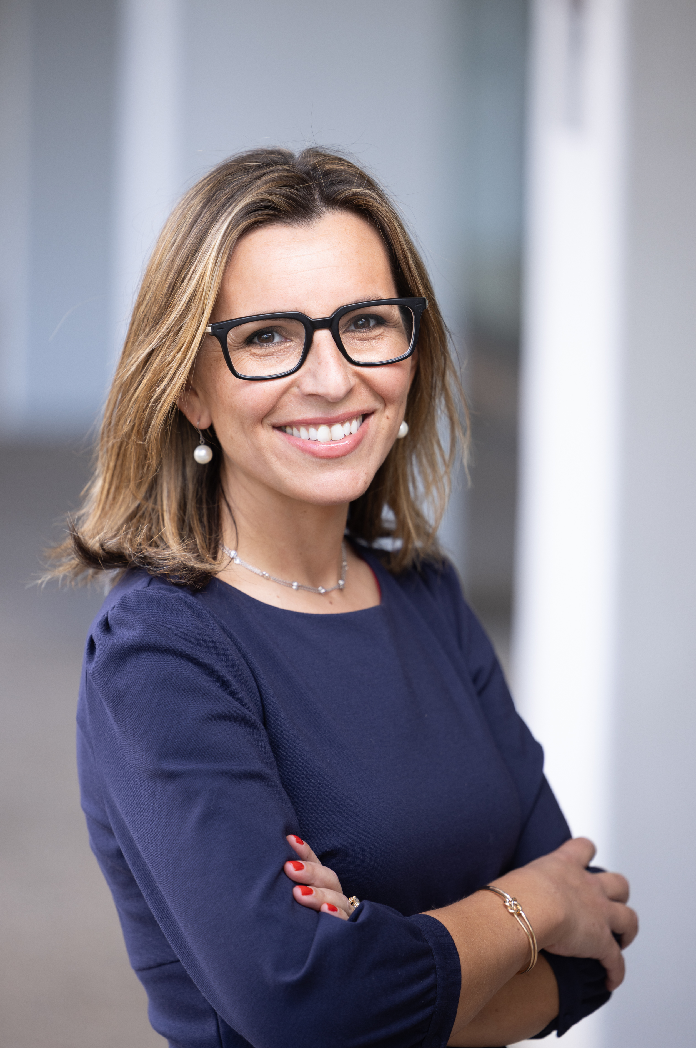
Overview of the Strategies Center’s Peer-Learning Collaboratives
Jordanna Davis Founder & President, Rockingstone Group

Slide 14
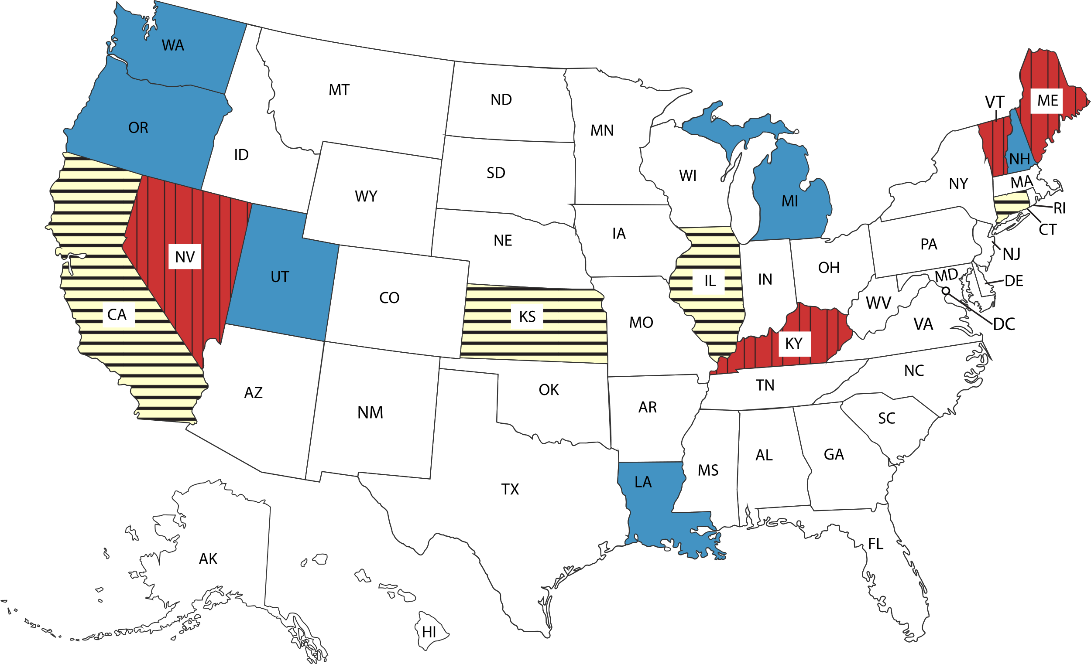
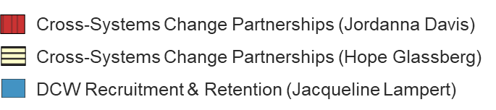
2024 Peer-Learning Collaboratives
Peer-Learning Collaboratives (PLCs) are time-limited, results-oriented, topically-focused working groups of states leveraging learning from peers and subject matter experts to make progress on systems change milestones.

Slide 15
2024 Peer-Learning Collaborative Meetings
PLCs meet monthly in three unique cohort groupings. Each state has participated in seven Center-led PLC cohort meetings (as of 1/29/25).
Each meeting includes:
State round-robin updates
State-in-focus
Expert presentation (Center partners and invited experts)
Examples: Workforce Data: Best Practices in Collection, Use, and Dissemination; Universal Core Competencies and Career Pathways in Direct Care; Recruiting, Training, and Supporting DCWs with Lived Experience
Peer learning discussion

Slide 16
2024 PLC Subject Matter Experts (SMEs)
States receive 90-120 hours of individualized support from subject matter experts
More than 750 total hours as of 1/15/25
SMEs include:
AnereS Strategies: Serena Lowe, Lead SME, Tobey S. Partch-Davies
GoodLife Innovations: Beth McCoach, Megan McKinney-Todd
Pigorsch Media Design: Hans Pigorsch, Susan Pigorsch
PHI: Emily Dieppa-Colo, Kezia Scales
University of Minnesota Institute on Community Integration: Julie Bershadsky, Amy Hewitt, Barbara Kleist, Jerry Smith
Lisa A. Mills, Shannon Webb

Slide 17
2024 PLC Sample State Milestones
Crosswalk of existing DCW workforce initiatives
Framework to leverage funding streams toward a common goal
Education campaign to educate the public/job seekers about DCW opportunities
Develop a structure for career lattice/ladders
Recruitment plans targeting specific populations
Best practices for non-wage benefits

Slide 18




PLC Timeline
April – May 2024:
PLC staff team held individual orientation and milestone planning calls with states
June 2024:
States were matched with Subject Matter Experts
June 2024 – March 2025:
PLC cohorts meet monthly; states meet regularly with SMEs
February – March 2025:
Concluding conversations

Slide 19
PLC Contacts
Jordanna Davis
jdavis@rockingstonegroup.com
Hope Glassberg
hglassberg@rockingstonegroup.com
Jacqueline Lampert
jlampert@rockingstonegroup.com
rockingstonegroup.com
Notes:
mailto:jdavis@rockingstonegroup.com
mailto:hglassberg@rockingstonegroup.com
mailto:jlampert@rockingstonegroup.com
rockingstonegroup.com

Slide 20
Experience of State Leaders in the Peer-Learning Collaboratives
Moderated Panel Discussion

Slide 21
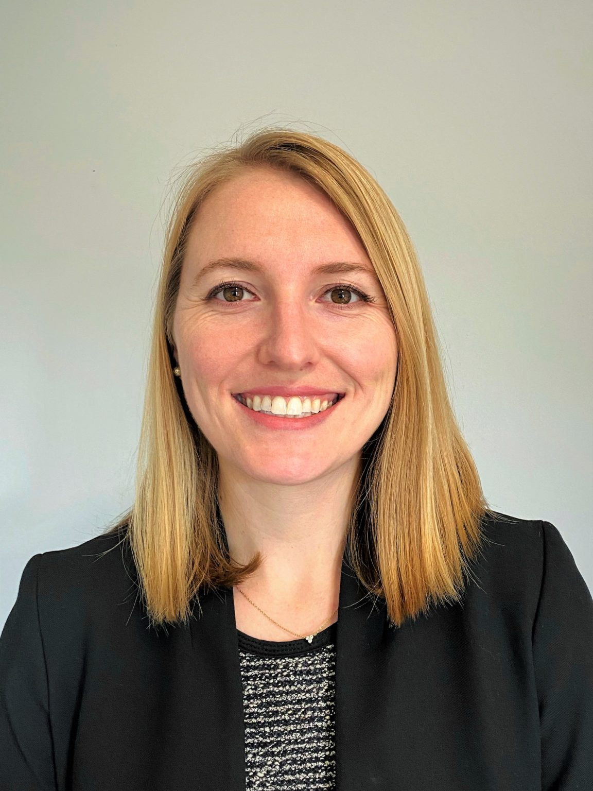
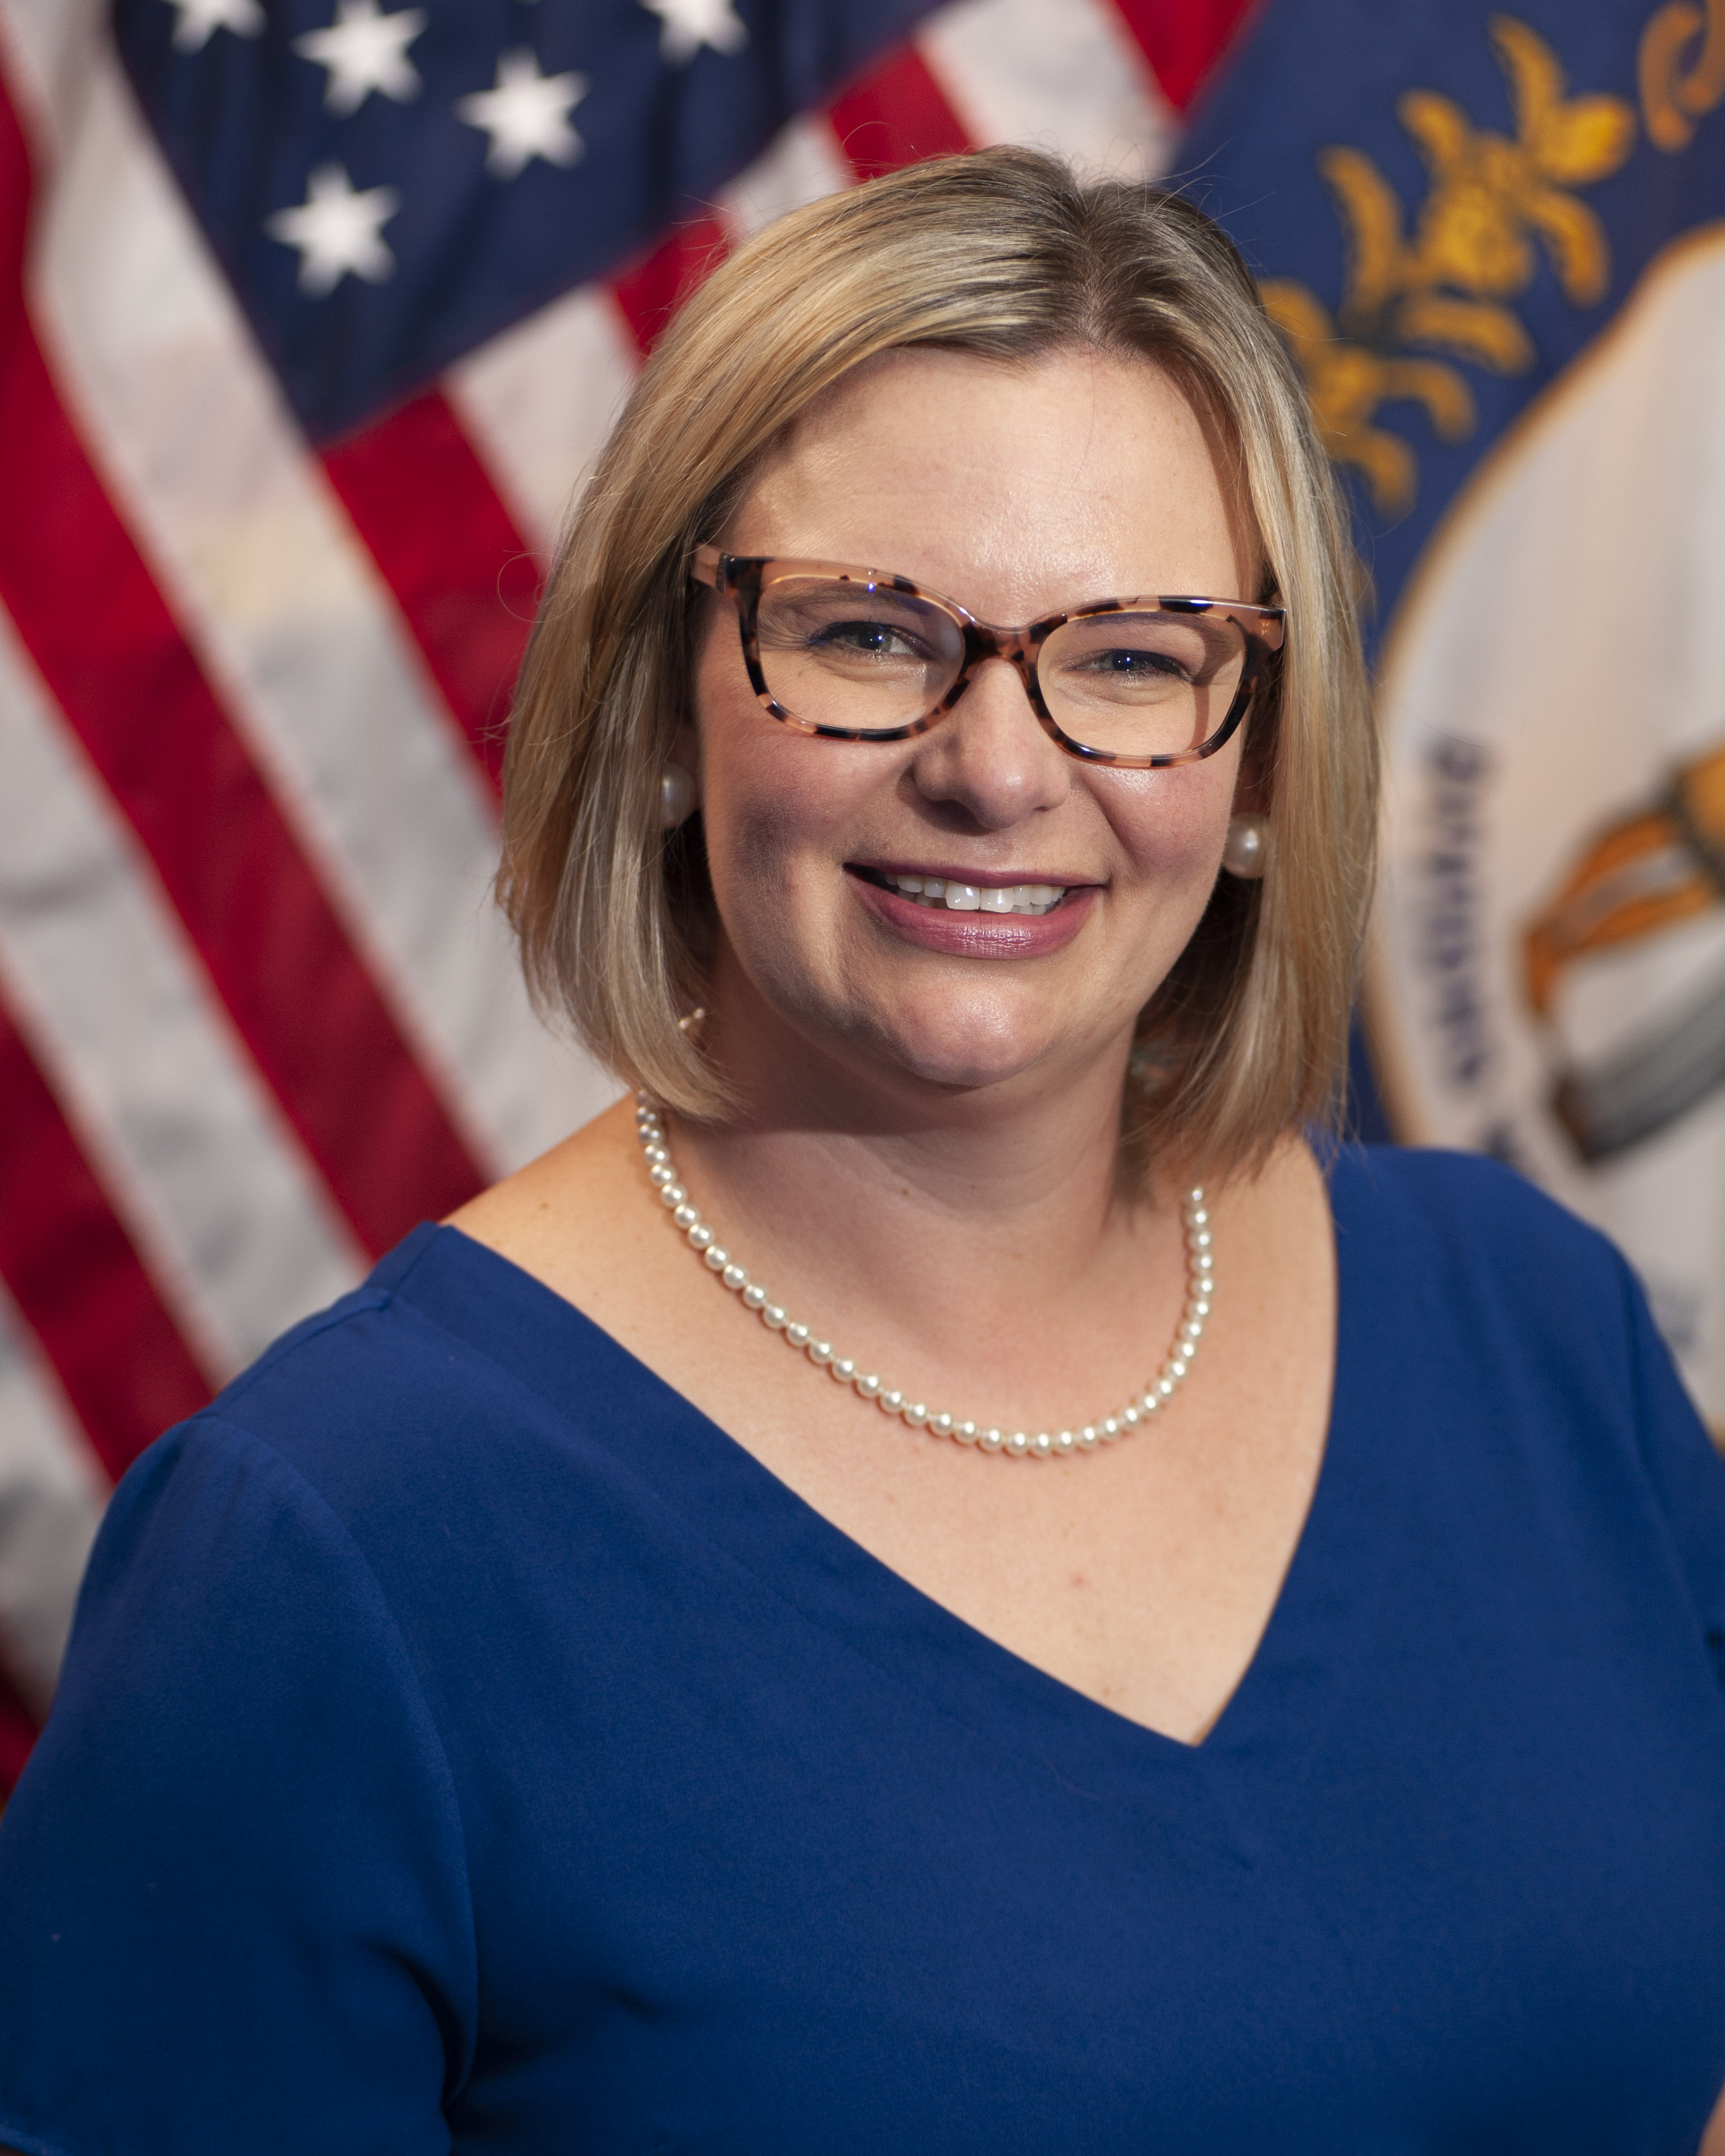
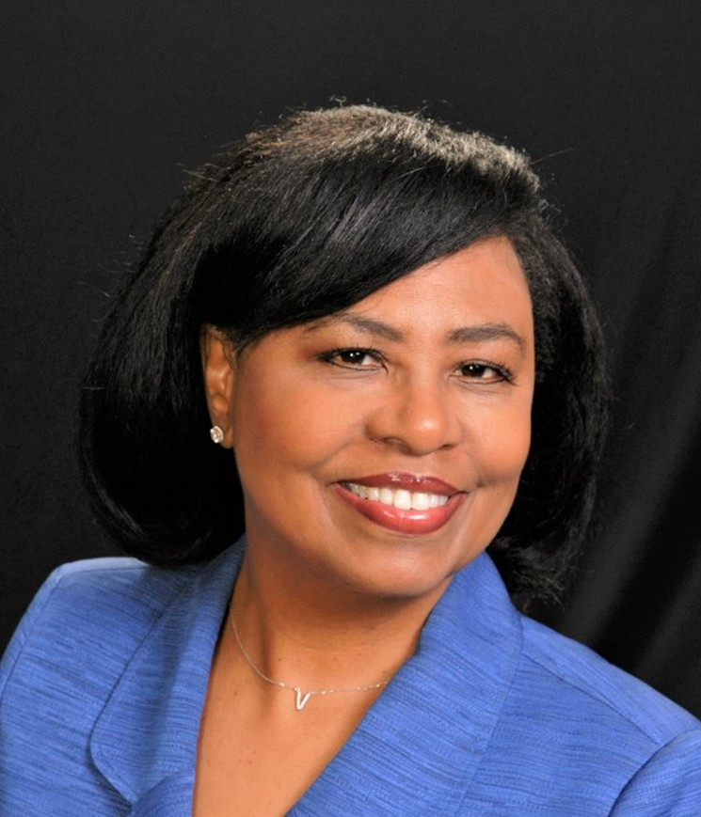
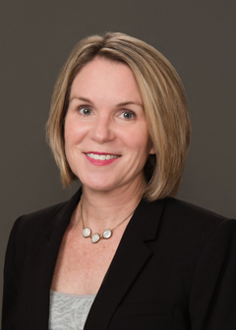
Panelists
Anna Heard, Senior Policy Analyst
Center for Best Practices, National Governors Association
Victoria Elridge, Commissioner
Department for Aging and Independent Living,
Kentucky Cabinet for Health and Family Services
Valerie Jemerson, Talent Development Liaison Sector Strategies, Industry Engagement Division,
Workforce Development, Michigan Department of Labor and Economic Opportunity
Sarah Steenhausen, Deputy Director
Division of Policy, Research and Equity,
California Department of Aging

Slide 22
Final Reminders
Thank You
Visit the website for resources and to sign up for Strategies Center updates at: https://acl.gov/DCWcenter
Please complete the evaluation: https://s.alchemer.com/s3/PLC-Webinar-1-29-Feedback-Form
Stay on the lookout for the roll-out of new technical assistance and training opportunities for State government leaders and HCBS providers this spring!
Notes:
https://acl.gov/DCWcenter
https://s.alchemer.com/s3/PLC-Webinar-1-29-Feedback-Form

Slide 23
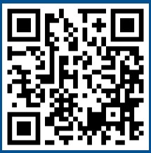
Contact Building national capacity to support community living
directcareworkforce@ncoa.org
https://acl.gov/DCWcenter
Notes:
https://acl.gov/DCWcenter
mailto:directcareworkforce@ncoa.org

Slide 24

Thank You

