Slide 1
Food Insecurity Webinar Series
Webinar 4
Referrals and Interventions for Older Adults with Food Insecurity
Kathryn Tucker, MS, RD, LD, ACL Contractor
Jennifer Raymond, JD, MBA, Chief Strategy Officer, AgeSpan
October 20, 2022
Please select the CC Live Transcription button in the toolbar at the bottom of the screen to enable closed captioning.

Slide 2
Objectives
Identify who can refer participants that are food insecure.
Understand how to develop “warm handoffs” to improve referral engagement.
Identify intervention options available to those who are food insecure.
Provide potential referral options for networks to use when food insecurity is identified.
Identify potential training resources available to providers.

Slide 3

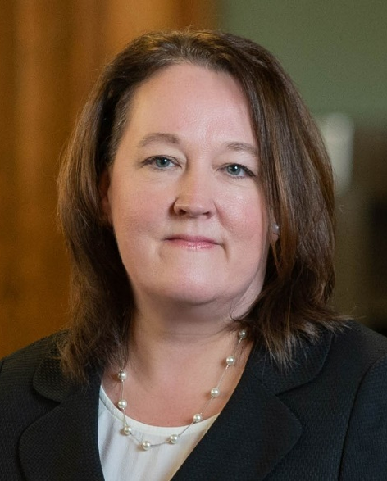
Speakers
Kathryn Tucker
Consultant
ACL
Jennifer Raymond
Chief Strategy Officer
AgeSpan

Slide 4
What is Food Insecurity?
Food insecurity is defined as “the limited or uncertain availability of nutritionally adequate and safe foods or limited or uncertain ability to acquire acceptable foods in socially acceptable ways.”

Slide 5
Level of Food Security
Low food security
Poor nutrition quality and limited variety. Little or no indication of reduced food intake.
Very low food security
Reports of skipping meals or not eating. Has reduced food availability.

Slide 6

Who Can Identify Food Insecurity?
Aging and Disability Resource Center staff
Case managers
Telephone reassurance callers
Transportation providers
Meal deliverers
Volunteers
Activity leaders
In-home services providers
Evidence-based program leaders

Slide 7

What is a Warm Handoff?
A warm handoff is a handoff that is conducted in person, whenever possible, between two agencies, in front of the participant and family if present.

Slide 8

Importance of a Warm Handoff
Engages the participant and family as part of the team.
Ensures participants receive accurate information.
Prevents those in need from falling through the cracks.
Builds relationships and communication between partners.
Provides a safety check for participants, ensuring everyone is on the same page about their needs.

Slide 9
Using Warm Handoffs in Your Organization
Personally introduce participants to others in your organization
Utilize in-person meetings, telephone conferences, or a virtual setting.
Organizations you have referred to can utilize a warm handoff to refer to your agency.
Use with health care providers, food pantries, SNAP, dietitians, and other community-based organizations.

Slide 10
Scenario 1
Ms. Jones has been coming into the senior center to receive congregate meals. She tells senior center staff she will be unable to come back for a few weeks due her car breaking down. She is worried she will not have enough food in the house to eat regularly.
Staff give her a number for the Area Agency on Aging to sign up for transportation and the number for the food pantry. They are very kind and tell her to call those numbers.

Slide 11
Scenario 1 Question
Did they handle the situation correctly?
YES
NO

Slide 12
Scenario 1 Results
Staff could have called the AAA to discuss Ms. Jones’s situation while she was there with them. Then, they could have worked on signing her up for transportation to the center to continue participating in congregate meals. Alternatively, they could have switched her over to home-delivered meals or other nutrition services, like receiving a food box.
Did they handle the situation correctly?
NO

Slide 13
Scenario 1 Results: What Else Could They Have Done?
Senior center staff could have also called the food pantry to introduce them to Ms. Jones and explain her situation. Then, they could have handed the phone to Ms. Jones so she could speak directly with food pantry staff to discuss next steps. They may also have been able to talk with her about her SNAP benefits.

Slide 14
Scenario 2
Mr. Smith comes into the congregate meal site to get a meal.
Staff explains that he can’t be put on a waitlist for a meal because he needed to sign up the day before.
Mr. Smith nods and leaves.

Slide 15
Scenario 2 Question
Did they handle the situation correctly?
YES
NO

Slide 16
Scenario 2 Results
Staff could have helped Mr. Smith sign up for the next day's meal. Then, they could have introduced him to other participants and shown him around the facility. Additionally, they could have introduced Mr. Smith to other staff members to make sure he is connected to other services. They could have then provided a warm handoff to a local food pantry if needed and followed up with Mr. Smith the next day.
Did they handle the situation correctly?
NO

Slide 17

Referrals and Interventions
Demonstrate value of community-based organizations and community services to internal and external stakeholders

Slide 18
Interventions and Referrals within the OAA
Senior Nutrition Program
In-home services
Telephone reassurance
Transportation
Case management
Health screenings
Health promotion and evidence-based programs
Caregiver programs

Slide 19
External Referral Opportunities
SNAP, SNAP-Ed programs, or other benefit programs
The Commodity Supplemental Food Program and Senior Farmers’ Market Nutrition Program
Food pantries and grocery delivery programs
Food “Farmacy” programs and community gardens
Case management and Medicaid Waiver programs
Health care providers and care transition programs
Senior community service employment programs

Slide 20

Types of Referral
Health care provider or case manager
Internal registry
Self-referrals

Slide 21
Referral Workflow
Clarify roles in outreach enrollment process
Identify who is responsible for:
  Scheduling workshops
  Contacting key staff
  Enrolling participants
  Collecting and entering data
  Following up with participants
Develop HIPAA compliance procedures

Slide 22
Technology-Based Referral Systems
Charity Tracker
Holon Solutions (Partners 4 Community Health)
Activate Care
Vinculo (At Your Service)
WeWa.life LLC (WeWaLife)
Harvard Pilgrim Healthcare (CareRS)

Slide 23


Tracking Data
Outreach efforts
Common needs
Attendance
Completion rates
Satisfaction surveys
Outcomes

Slide 24
Agency & Community Action
Promote “No Wrong Door” approach.
Increase integration of technology in program.
Meet needs of a diverse population.
Ensure I&A services and ADRCs provide information to participants.
Increase social service professionals’ understanding of role.
Provide nutrition education and shopping assistance.
Participate in community campaigns.

Slide 25
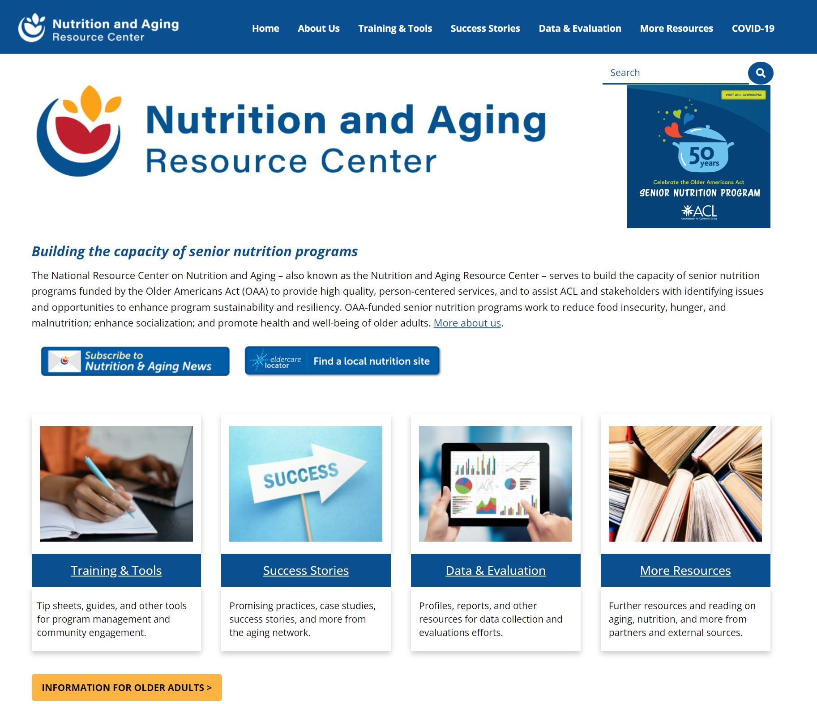
Nutrition and Aging Resource Center
Resources include:
Food insecurity information
Consumer information
Tip sheet for providers
Guides
Webinars
Innovation programs

Slide 26
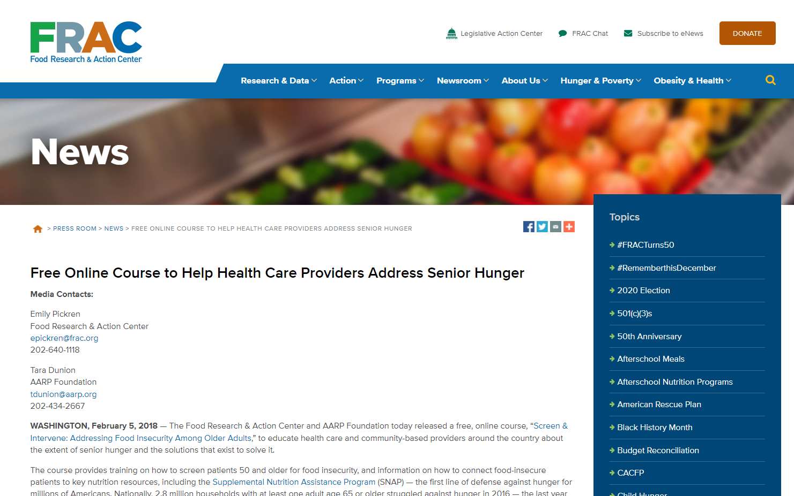
Training Resources-FRAC
Food Research & Action Center Free Online Course to Help Health Care Providers Address Senior Hunger

Slide 27
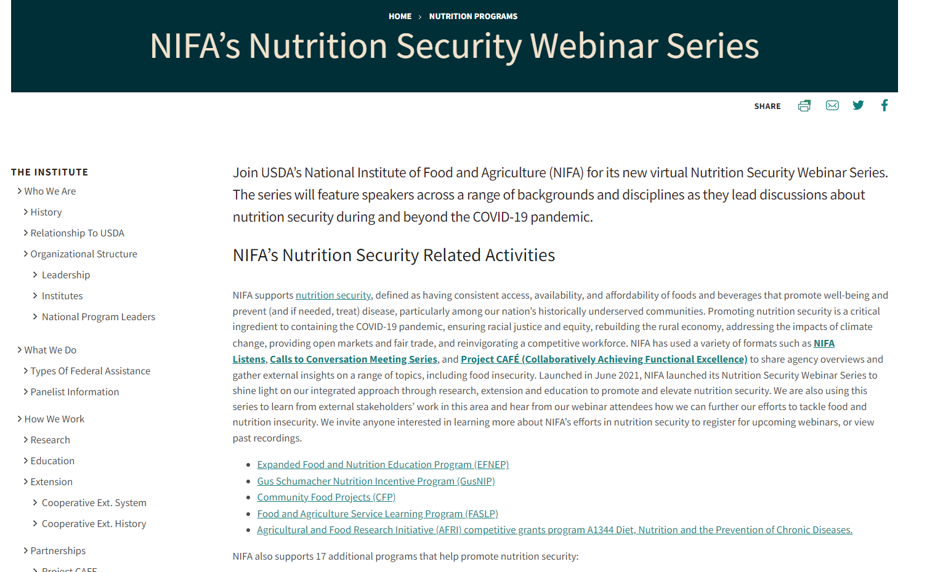
Training Resources-NIFA
National Institute of Food and Agriculture Nutrition Security Webinar Series

Slide 28
Takeaways
Identify those who are food insecure.
Develop internal and external referral options.
Identify interventions available.
Educate staff on using “warm handoff” techniques.
Follow participants throughout services.
Collect data and measure outcomes.

Slide 29
Food Insecurity Webinar Series
& Educational Topics
July 2022: Combating Food Insecurity with Collaboration
September 2022: Identifying and Screening for Food Insecurity
October 2022:
Referrals and Interventions for Older Adults with Food Insecurity
August 2022:
State Units Food Insecurity Promising Practices
NRCNA website at https://acl.gov/senior-nutrition/events-presentations

Slide 30
For Dietitians
To receive CPEU credit, go to the CDR website.
Log the program:
  Step 2: Activity Log under Activity Type 170 - Lecture/Seminar or Activity Type 171 - Teleseminar/Webinar
Claim 1 CPEU for every 1 contact hour spent during the activity.
Save all documentation of the webinar and attendance for records.

Slide 31
Questions?
Kathryn Tucker, MS RD LD, Kathryn.tucker@acl.hhs.gov
Jennifer Raymond, JD, MBA, AgeSpan, jraymond@AgeSpan.org

Slide 32
Education Resources
NRCNA Resources:
Assistance with Food vs. Meals Infographic
Grocery Delivery Options by County Template
Partnerships with Foodbanks and Other USDA Programs
Using Groceries and Other Nutrition Services to Meet Senior Needs
Other Resources:
Eldercare Locator
Implementation Quick Start Guide: Warm Handoff (AHRQ)
National Aging and Disability Transportation Center
Social Work Case Management Software Options (Capterra)
Warm Handoffs: A Guide for Staff (AHRQ)

