Slide 1
Coordination During Emergencies and Disasters for the Aging Network February 25, 2026
Kari Benson, Deputy Assistant Secretary for Aging, Administration on Aging (AoA)
Adam Mosey, Special Assistant, AoA
Nicole Becerra, Aging Services Program Specialist, AoA
Mojisola Obiako, MRC Region 10 Liaison, Administration for Strategic Preparedness & Response (ASPR)
Audrey Mazurek, ICF Director, ASPR TRACIE, ASPR

Slide 2
Welcome
Kari Benson, Deputy Assistant Secretary for Aging

Slide 3
Housekeeping
This webinar is being recorded
All attendees are in listen only mode.
Place all questions in the Question & Answer (Q&A) box
Communication Access Realtime Translation (CART) and American Sign Language (ASL) services are provided
To enable CART captions, navigate to More actions > Turn on live captions

Slide 4
Agenda
Welcome & Opening
Overview of Administration for Strategic Preparedness & Response (ASPR):
Technical Resources, Assistance Center, and Information Exchange (TRACIE)
Office of Medical Reserve Corps (MRC)
Older Americans Act (OAA) Provisions: Planning, Flexibilities, and Reporting
Competitive Funding Opportunities
Summary and Resources
Please note: When a hyperlink is provided on a slide, the notes section will include the full website link.

Slide 5
Why This Matters Now
Recognizing the urgent and time sensitive needs of older adults and caregivers during times of emergency
Increased frequency and severity of disasters
Lessons learned from prior public health emergencies
First comprehensive update to OAA regulations in 36 years, including:
Provisions related to flexibilities under a Major Disaster Declaration (MDD)

Slide 6
Administration for Strategic Preparedness & Response

Slide 7

Aging Network Disaster and Emergency Webinar: The Medical Reserve Corps (MRC) and ASPR TRACIE Mojisola “Moji” Obiako Audrey Mazurek

Slide 8
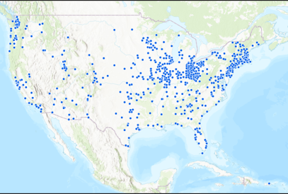
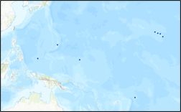
About the Medical Reserve Corps (MRC)
A nationwide network of volunteers, organized into local, community-based units
700+ MRC units
~270,000 volunteers
MRC units engage in their communities to improve risk-informed hazards emergency response capabilities, build community preparedness and resilience, and strengthen public health
ASPR’s Office of MRC supports these local units by providing grants, training, technical assistance, national-level partnerships, etc.
Unit locations as of March 2025

Slide 9
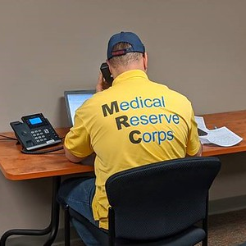
MRC Concept
Nationwide network
Community-based
Support existing programs and resources
Improve the health and safety of communities and the nation
Identify, credential, train, and prepare volunteers
Build community resilience

Slide 10
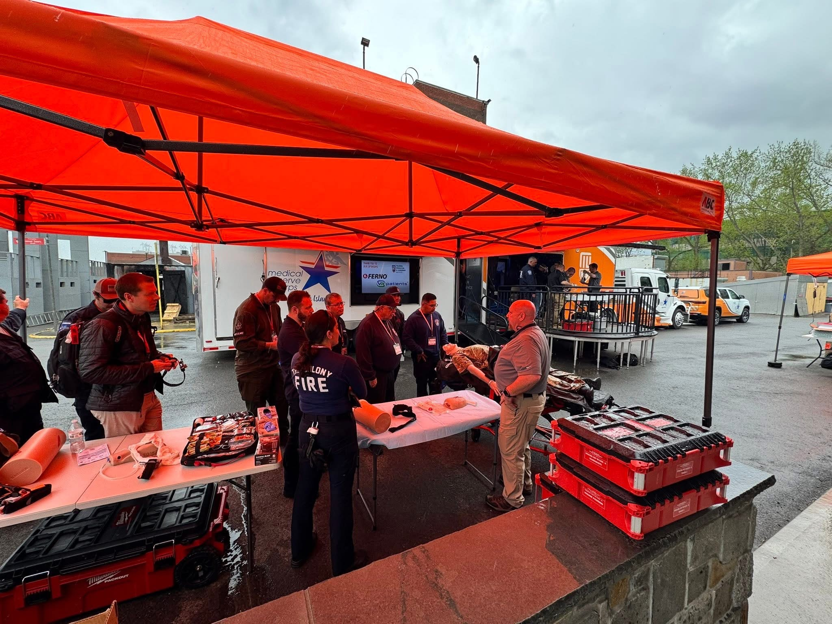

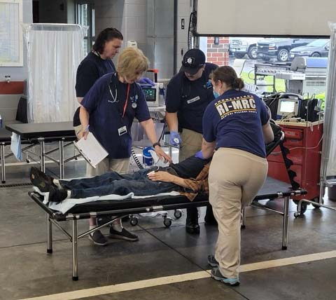
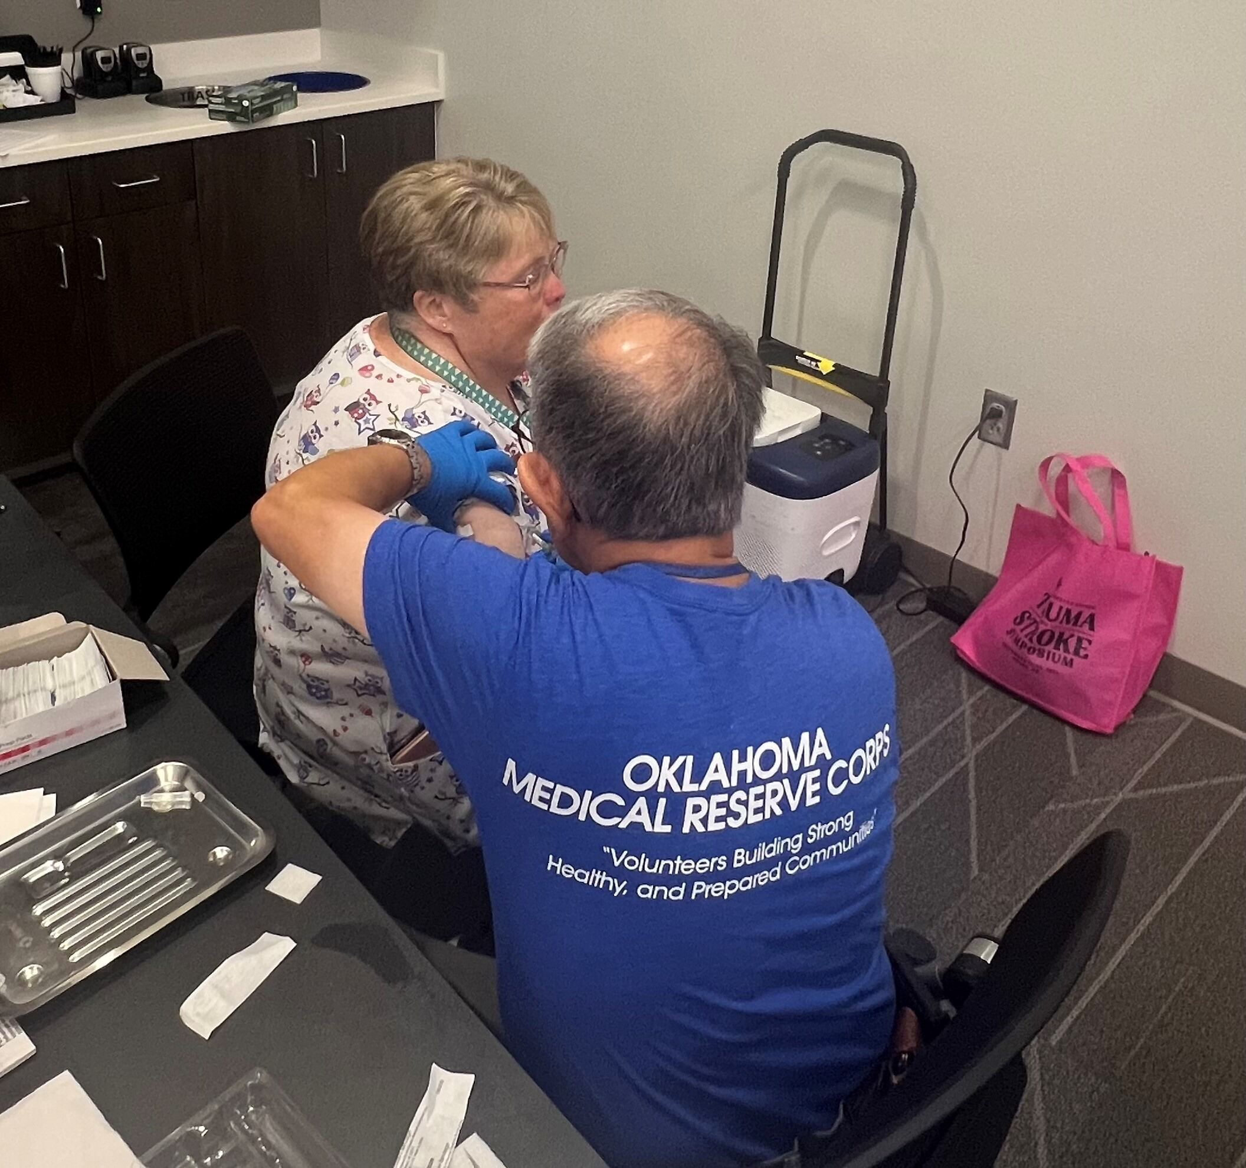
The Role of the Office of Medical Reserve Corps
Provides national coordination
Conducts technical assessment of unit capabilities
Develops tools & resources
Hosts webinars & office hours
Maintains reporting infrastructure
Leads training & preparedness initiatives
Amplifies unit impact
Supports integration with partners
Manages grant & cooperative agreement funding

Slide 11
At-a-Glance: MRC History
Timeline | Event(s)
2002 | MRC starts as a demonstration project by HHS after the events of September 11, 2001
2002-2006 | Hurricane Katrina
2006 | Congress passes the Pandemic and All-Hazards Preparedness Act (PAHPA), which formally establishes the MRC
2006-2013 | H1N1 Hurricane Sandy
2013 | Congress moves authority and responsibility for the MRC program from the Office of the Surgeon General to the Office of the Assistant Secretary for Preparedness and Response (now ASPR)
2013-2025 | Ebola Zika Hurricanes Harvey, Irma, Maria California Wildfires
2025 | The MRC network comprises approximately 300,000 volunteers in more than 700 community-based units

Slide 12
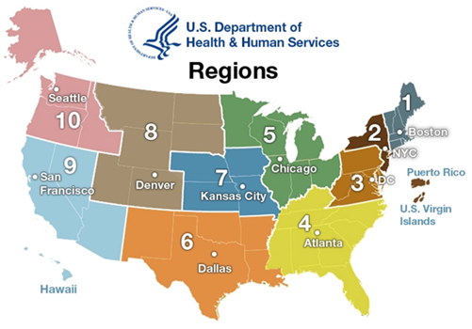
Number of MRC Units by Region
Data as of March 2025

Slide 13
Types of Medical/Public Health MRC Volunteers
Additionally, MRC includes 120,000+ support volunteers nationwide (non-medical/non-public health)
Data as of March 2025

Slide 14




Emergency & Recovery Support Functions
MRC supports the following Emergency Support Functions:
Emergency Support Function (ESF) 6: Mass Care, Housing and Human Services
Emergency shelter operations and medical care; mass dispensing efforts (e.g., medication, water, other supplies); support services to disaster call centers, family assistance centers, and reception/evacuation centers
Emergency Support Function (ESF) 8: Public Health and Medical Services
Medical facility surge support; mass dispensing efforts (e.g., point of distribution for medical countermeasures); disease testing and surveillance; community vaccination clinics; veterinary care; patient movement support
Health, Education and Human Services (HEHS) Recovery Support Function (RSF)
Disaster behavioral health support

Slide 15



MRC Activities in CY2024
$11.5M
300,000
19,000
Economic Value of Time Donated
Hours
Activities
Approximately 10,000 volunteers in 350 units across 45 states & territories specifically engaged their local student population, including through partnership with Health Occupations Students of America (HOSA) – Future Health Professionals
MRC Volunteers in 40 states responded to 383 community-level emergencies*:
Common Causes: Extreme Weather, Cold, Heat; Wildfires & Building Fires
Common Services: Sheltering, Behavioral Health, and Medical; Emergency Operations Center & Call Center Support
200 MRC Units in 43 states engaged in activities that aimed to prevent opioid abuse, enhance community education and training around the risk of opioids, and reduce the number of opioid-related deaths.
MRC activities are dedicated to prevention, mitigation, preparedness, and recovery.
*not a national public health emergency (PHE)
Data as of March 2025

Slide 16




MRC in Action: 2025 Emergency Responses
Several MRC units (nationwide): In response to severe winter weather, MRC units in Indiana, Kentucky, Missouri, New Hampshire, New Jersey, New Mexico, New York, Ohio, Tennessee, Vermont, and Virginia supported warming centers and overnight shelters, as well as provided other supportive services to affected community members.
Several MRC units (nationwide): In response to extreme heat experienced across the U.S., MRC units in New Jersey, New York, Vermont, Maryland, Massachusetts, Missouri, Oregon, Virginia, Texas, and Washington supported heat relief efforts by handing out cooling kits, setting up cooling centers, and treating heat-related illnesses at various outdoor events.
St. Louis City MRC, Cape Girardeau County MRC, Cooper County MRC, Mid Rivers MRC (MO): Following a series of deadly tornadoes in Missouri, several MRC units supported response efforts by clearing debris, operating a point-of-distribution (POD) for tetanus vaccinations, providing administrative support, and staffing a Multi-Agency Resource Center (MARC).
Southwest Virginia MRC (VA): In response to Feb. 2025 flooding, MRC volunteers provided medical support to temporary shelter residents.

Slide 17


MRC & Red Cross Partnership History
Apr. 2009
Joint Memo signed between the American Red Cross (ARC) and the Medical Reserve Corps
May 2017
Letter of Agreement with an MRC/ARC Partnership Implementation Plan
Fall 2024
National Memorandum of Agreement (MOA), including template for ARC Region – Local MRC Unit agreement, and streamlined processes to support local and large-scale disaster relief operations
Notes:
Record locator#UID-2025-11-21-477

Slide 18
Contact Information
Would you be interested in supporting your local MRC unit with your specialized expertise, or do you know someone who might?
Contact Us!
MRC Email: MRCcontact@hhs.gov | Website: https://aspr.hhs.gov/MRC

Slide 19


New Partnership: OMRC and ASPR TRACIE
After 10 years of collaboration, the Office of Medical Reserve Corps (OMRC) and ASPR’s TRACIE are formalizing their partnership to integrate stakeholders and ensure MRC units and volunteers can quickly access planning, operational, and educational resources. Over the next year, MRC stakeholders can expect:
Resource development for MRC units and volunteers to include tip sheets, operational products, and other materials housed on a new MRC Resource Page
Communities of Practice within the secure, moderated information exchange (IE) that will foster information sharing, best practices, and collaborative learning within and between MRC units
Notes:
Record locator#UID-2025-11-21-477

Slide 20
ASPR’s Technical Resources, Assistance Center, and Information Exchange
Developed as a healthcare emergency preparedness information gateway to address the need for:
Enhanced and rapid technical assistance (TA)
A comprehensive, one-stop, national knowledge center for healthcare system preparedness
Multiple ways to efficiently share and receive information between various entities, including peer-to-peer
A way to leverage and better integrate support (force multiplier)
Ways to prepare deployed and field staff via resources developed with our cadre of subject matter experts
Notes:
Record Locator# UID-2026-01-06-525

Slide 21
ASPR TRACIE’s Three Domains
Self-service collection of audience-tailored materials
Subject-specific, subject matter expert (SME)-reviewed “Topic Collections”
Unpublished and SME peer-reviewed materials highlighting real-life tools and experiences
Personalized support and responses to requests for information and technical assistance
Accessible by toll-free number (1844-5-TRACIE), email (askasprtracie@hhs.gov), or web form (ASPRtracie.hhs.gov)
Area for password-protected discussion among vetted users in near real-time
Ability to support chats and the peer-to-peer exchange of user-developed templates, plans, and other materials
Notes:
Record Locator# UID-2026-01-06-525

Slide 22
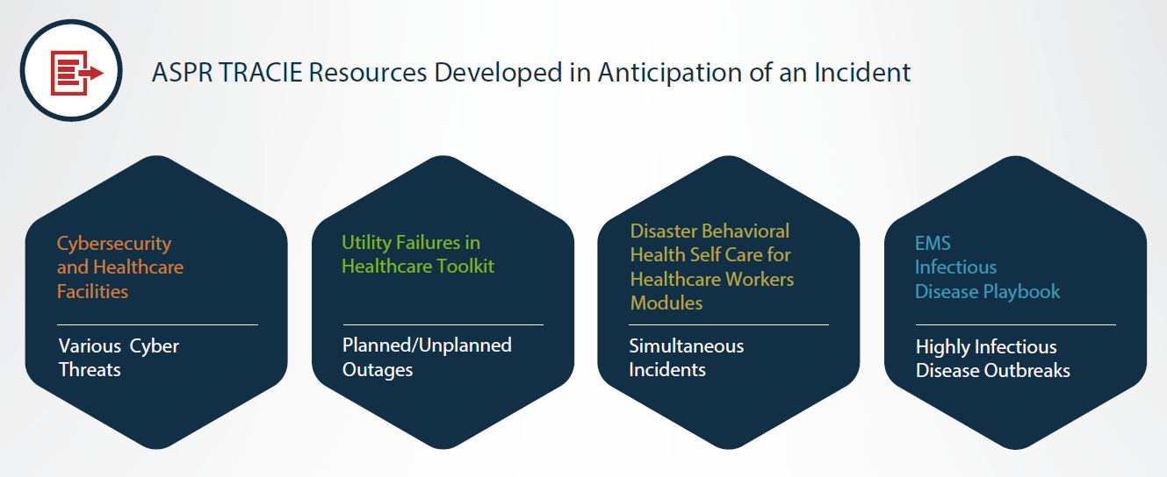
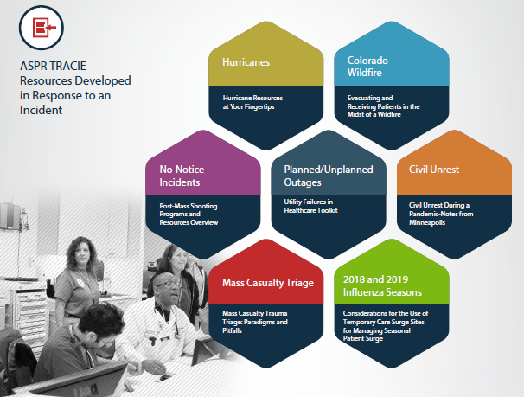
ASPR TRACIE Supports All Hazards and Phases of Emergency Management
> 550 ASPR TRACIE-developed resources
In anticipation of and in response to incidents
Searchable resource library
Topic collections
Resource pages
The Exchange newsletter
Virtual based learning opportunities
Plans, tools, and templates
Notes:
Record Locator# UID-2026-01-06-525

Slide 23
Comprehensively Reviewed Topic Collections (1)
Active Shooter and Explosives
Blood and Blood Products
Burns
Communications
Communication Systems
Information Sharing
Risk Communications/Emergency Public Information and Warning
Social Media in Emergency Response
Crisis Standards of Care
Cybersecurity
Decontamination
Hospital Patient Decontamination
Pre-Hospital Patient Decontamination
Disasters and At-Risk Populations
Electronic Health Records and Downtime Procedures
Emergency Management
Emergency Operations Plans/ Emergency Management Program
Exercise Program
Hazard Vulnerability/Risk Assessment
Healthcare-Related Disaster Legal/ Regulatory/ Federal Policy
Incident Management
Training and Workforce Development
Ethics
Family Reunification and Support
Fatality Management
Healthcare Coalitions
Coalition Administrative Issues
Coalition Models and Functions
Coalition Response Operations (including Mutual Aid)
Healthcare Facility Evacuation/Sheltering
Hospital Surge Capacity and Immediate Bed Availability
Notes:
Record locator#UID-2025-11-21-477
Links:
https://asprtracie.hhs.gov/technical-resources/30/active-shooter-and-explosives/0
https://asprtracie.hhs.gov/technical-resources/96/blood-and-blood-products/0
https://asprtracie.hhs.gov/technical-resources/28/burns/0
https://asprtracie.hhs.gov/technical-resources/78/communication-systems/77
https://asprtracie.hhs.gov/technical-resources/80/information-sharing/77
https://asprtracie.hhs.gov/technical-resources/79/risk-communications-emncy-public-information-and-warning/77
https://asprtracie.hhs.gov/technical-resources/73/social-media-in-emncy-response/77
https://asprtracie.hhs.gov/technical-resources/63/crisis-standards-of-care/0
https://asprtracie.hhs.gov/technical-resources/86/cybersecurity/0
https://asprtracie.hhs.gov/technical-resources/38/hospital-patient-decontamination/37
https://asprtracie.hhs.gov/technical-resources/39/pre-hospital-patient-decontamination/37
https://asprtracie.hhs.gov/technical-resources/156/disasters-and-at-risk-populations/0
https://asprtracie.hhs.gov/technical-resources/66/electronic-health-records-and-downtime-procedures/0
https://asprtracie.hhs.gov/technical-resources/84/emncy-operations-plans-emncy-management-program/1
https://asprtracie.hhs.gov/technical-resources/7/exercise-program/1
https://asprtracie.hhs.gov/technical-resources/3/hazard-vulnerability-risk-assessment/1
https://asprtracie.hhs.gov/technical-resources/83/healthcare-related-disaster-legal-regulatory-federal-policy/1
https://asprtracie.hhs.gov/technical-resources/14/incident-management/1
https://asprtracie.hhs.gov/technical-resources/11/training-and-workforce-development/1
https://asprtracie.hhs.gov/technical-resources/61/ethics/0
https://asprtracie.hhs.gov/technical-resources/64/family-reunification-and-support/0
https://asprtracie.hhs.gov/technical-resources/65/fatality-management/0
https://asprtracie.hhs.gov/technical-resources/22/coalition-administrative-issues/21
https://asprtracie.hhs.gov/technical-resources/24/coalition-models-and-functions/21
https://asprtracie.hhs.gov/technical-resources/25/coalition-response-operations-including-mutual-aid/21
https://asprtracie.hhs.gov/technical-resources/57/healthcare-facility-evacuation-sheltering/0
https://asprtracie.hhs.gov/technical-resources/58/hospital-surge-capacity-and-immediate-bed-availability/0

Slide 24
Comprehensively Reviewed Topic Collections (2)
Location-Specific Collections
Alternate Care Sites (including shelter medical care)
Ambulatory Care and Federally Qualified Health Centers (FQHC)
Dialysis Centers
Homecare and Hospice
Long-term Care Facilities
Pharmacy
Rural Disaster Health
Virtual Medical Care
Mass Distribution and Dispensing of Medical Countermeasures
Mass Gatherings/Special Events
Mental/Behavioral Health (non-responders)
Patient Movement, MOCCs, and Tracking
Pediatric/Children
Populations with Access and Functional Needs
Pre-Hospital (e.g., EMS)
Pre-Hospital Mass Casualty Triage and Trauma Care
Recovery and COOP
Continuity of Operations (COOP)/ Business Continuity Planning
Recovery Planning
Responder Safety and Health
Specific Hazards
Bioterrorism and High Consequence Biological Threats
Chemical Hazards
Coronaviruses
Ebola/VHF
Influenza Epidemic/ Pandemic
Natural Disasters
Radiological and Nuclear
Zika
Utility Failures
Veterinary Issues
Volunteer Management
Workplace Violence
Notes:
Record locator#UID-2025-11-21-477
Links:
https://asprtracie.hhs.gov/technical-resources/48/alternate-care-sites-including-shelter-medical-care/47
https://asprtracie.hhs.gov/technical-resources/49/ambulatory-care-and-federally-qualified-health-centers-fqhc/47
https://asprtracie.hhs.gov/technical-resources/50/dialysis-centers/47
https://asprtracie.hhs.gov/technical-resources/51/homecare-and-hospice/47
https://asprtracie.hhs.gov/technical-resources/52/long-term-care-facilities/47
https://asprtracie.hhs.gov/technical-resources/53/pharmacy/47
https://asprtracie.hhs.gov/technical-resources/92/rural-disaster-health/47
https://asprtracie.hhs.gov/technical-resources/55/virtual-medical-care/47
https://asprtracie.hhs.gov/technical-resources/67/mass-distribution-and-dispensing-administration-of-medical-countermeasures/0
https://asprtracie.hhs.gov/technical-resources/85/mass-gatherings-special-events/0
https://asprtracie.hhs.gov/technical-resources/68/mental-behavioral-health-non-responders/0
https://asprtracie.hhs.gov/technical-resources/70/patient-movement-moccs-and-tracking/0
https://asprtracie.hhs.gov/technical-resources/31/pediatric-children/0
https://asprtracie.hhs.gov/technical-resources/62/populations-with-access-and-functional-needs/0
https://asprtracie.hhs.gov/technical-resources/54/pre-hospital-ems/0
https://asprtracie.hhs.gov/technical-resources/33/pre-hospital-mass-casualty-triage-and-trauma-care/0
https://asprtracie.hhs.gov/technical-resources/17/continuity-of-operations-coop-business-continuity-planning/110
https://asprtracie.hhs.gov/technical-resources/18/recovery-planning/110
https://asprtracie.hhs.gov/technical-resources/72/responder-safety-and-health/0
https://asprtracie.hhs.gov/technical-resources/41/bioterrorism-and-high-consequence-biological-threats/27
https://asprtracie.hhs.gov/technical-resources/29/chemical-hazards/27
https://asprtracie.hhs.gov/technical-resources/44/coronaviruses-sars-mers-and-covid-19/27
https://asprtracie.hhs.gov/technical-resources/45/ebola-vhf/27
https://asprtracie.hhs.gov/technical-resources/42/influenza-epidemic-pandemic/27
https://asprtracie.hhs.gov/technical-resources/36/natural-disasters/27
https://asprtracie.hhs.gov/technical-resources/32/radiological-and-nuclear/27
https://asprtracie.hhs.gov/technical-resources/87/zika/27
https://asprtracie.hhs.gov/technical-resources/35/utility-failures/0
https://asprtracie.hhs.gov/technical-resources/81/veterinary-issues/0
https://asprtracie.hhs.gov/technical-resources/74/volunteer-management/0
https://asprtracie.hhs.gov/technical-resources/75/workplace-violence/0

Slide 25
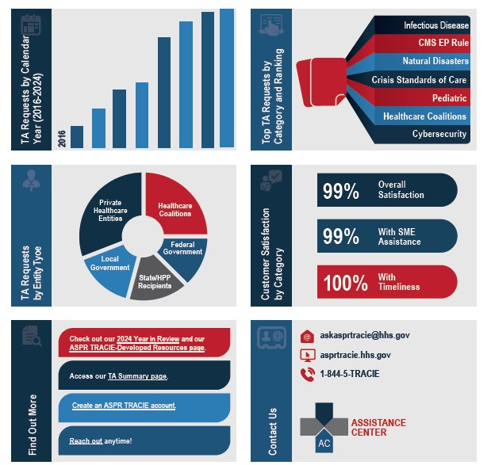
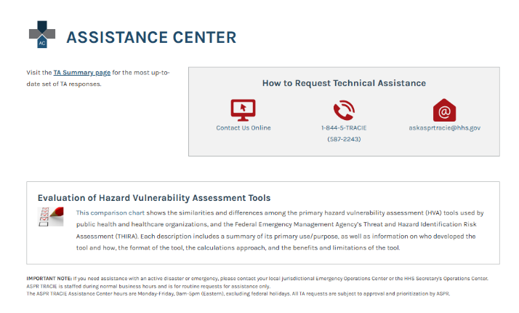
Assistance Center
Notes:
Record Locator# UID-2026-01-06-525

Slide 26
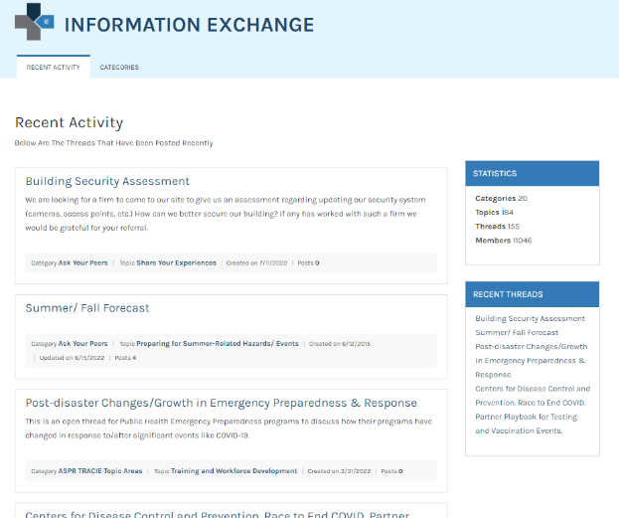
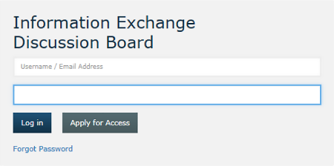
Information Exchange
Notes:
Record Locator# UID-2026-01-06-525

Slide 27
Select ASPR TRACIE Resources
Topic Collections
Populations with Access and Functional Needs: Older Adults
Dialysis Centers
Homecare and Hospice
Long-term Care Facilities
Centers for Medicare & Medicaid Services (CMS) Emergency Preparedness Rule: Programs for All-Inclusive Care for the Elderly (PACE) Requirements
Outbreak Considerations for Long-Term Care Communities
Post-Disaster Lessons Learned: Dialysis Patient Management
Medical Surge and the Role of Home Health and Hospice Agencies
Notes:
Links:
https://asprtracie.hhs.gov/technical-resources/62/populations-with-access-and-functional-needs/0#population-specific-resources-older-adults
https://asprtracie.hhs.gov/technical-resources/50/dialysis-centers/47
https://asprtracie.hhs.gov/technical-resources/51/homecare-and-hospice/47
https://asprtracie.hhs.gov/technical-resources/52/long-term-care-facilities/47
https://files.asprtracie.hhs.gov/documents/aspr-tracie-cms-ep-rule-pace-requirements.pdf
https://files.asprtracie.hhs.gov/documents/outbreak-considerations-for-long-term-care-communities.pdf
https://files.asprtracie.hhs.gov/documents/aspr-tracie-ta-post-disaster-dialysis-best-practices.pdf
https://files.asprtracie.hhs.gov/documents/aspr-tracie-medical-surge-and-the-role-of-home-health-and-hospice-summary-final.pdf

Slide 28

Contact ASPR TRACIE
Notes:
Record Locator# UID-2025-05-08-178
Link:

Slide 29
OAA Provisions: Planning, Flexibilities, & Reporting

Slide 30
Planning & Coordination

Slide 31
Planning and Coordination (1)
State Units on Aging (SUAs), Area Agencies on Aging (AAAs), and Title VI grantees must establish emergency plans.
Plans must be based on an all-hazards approach that are informed by completed risk assessments.
Plans must be maintained and integrated into agency operations.
See §1321.97 and §1322.33 for additional details and specific regulatory provisions.
Notes:
Links
https://www.ecfr.gov/current/title-45/subtitle-B/chapter-XIII/subchapter-C/part-1321/subpart-E/section-1321.97
https://www.ecfr.gov/current/title-45/subtitle-B/chapter-XIII/subchapter-C/part-1322/subpart-D/section-1322.33

Slide 32
Planning and Coordination (2)
Plans must include:
Continuity of Operations Plan (COOP), updated on an annual basis
Coordination with emergency management agencies
Communication with aging network partners, including processes for developing and updating long-range plans
Other relevant information, as determined by the SUA, AAA, or Title VI grantee.
See §1321.97 and §1322.33 for additional details and specific regulatory provisions.
Notes:
Links
https://www.ecfr.gov/current/title-45/subtitle-B/chapter-XIII/subchapter-C/part-1321/subpart-E/section-1321.97
https://www.ecfr.gov/current/title-45/subtitle-B/chapter-XIII/subchapter-C/part-1322/subpart-D/section-1322.33

Slide 33
Additional Planning Considerations
Furthermore, SUA emergency plans must:
Demonstrate involvement of the head of the state agency
Describe coordination with AAAs, service providers, Tribes, and local emergency management
SUAs, AAAs, and Ombudsman must also be familiar with policy and procedure requirements related to emergency planning and COOP for the Long-Term Care (LTC) ombudsman program.
See §1321.97 and §1324.11(e)(9) for additional details and specific regulatory provisions.
Notes:
Links
https://www.ecfr.gov/current/title-45/subtitle-B/chapter-XIII/subchapter-C/part-1321/subpart-E/section-1321.97
https://www.ecfr.gov/current/title-45/subtitle-B/chapter-XIII/subchapter-C/part-1324/subpart-A/section-1324.11#p-1324.11(e)(9)

Slide 34
Coordination Amongst Aging Network Entities
SUAs, AAAs, and Title VI programs should coordinate in emergency and disaster preparedness planning, response, and recovery.
SUAs and AAAs that have Title VI programs in operation within their jurisdictions must have policies and procedures, developed in communication with the relevant Title VI program director(s), in place for how they will communicate and coordinate with Title VI programs regarding emergency and disaster preparedness planning, response, and recovery.
Similarly, Title VI grantees must have policies and procedures in place for how they will communicate and coordinate with SUAs and AAAs.
See §1321.103 and §1322.37 for additional details and specific regulatory provisions.
Notes:
Links
https://www.ecfr.gov/current/title-45/subtitle-B/chapter-XIII/subchapter-C/part-1321/subpart-E/section-1321.103
https://www.ecfr.gov/current/title-45/subtitle-B/chapter-XIII/subchapter-C/part-1322/subpart-D/section-1322.37

Slide 35
Takeaways for Emergency Planning and Coordination
Key takeaways include:
Plans must exist before a disaster
Coordination is required, not optional
Planning supports flexibility during an MDD
See §1321.97, §1322.33, §1324.11(e)(9) for additional details and specific regulatory provisions.
Notes:
Links
https://www.ecfr.gov/current/title-45/subtitle-B/chapter-XIII/subchapter-C/part-1321/subpart-E/section-1321.97
https://www.ecfr.gov/current/title-45/subtitle-B/chapter-XIII/subchapter-C/part-1322/subpart-D/section-1322.33
https://www.ecfr.gov/current/title-45/subtitle-B/chapter-XIII/subchapter-C/part-1324/subpart-A/section-1324.11#p-1324.11(e)(9)

Slide 36
Flexibilities

Slide 37
The Stafford Act and MDD Definition
Robert T. Stafford Disaster Relief and Emergency Assistance Act, Public Law (PL) 100-707, signed into law in 1988.
What does it do?
Creates the official authority for federal disaster response activities
Ensures a comprehensive and coordinated federal response to disasters and emergencies
Provides necessary support to disaster survivors and helps to prevent future disasters
Major Disaster Declaration* means a Presidentially declared disaster under the Robert T. Stafford Relief and Emergency Assistance Act.
This declaration activates OAA disaster flexibilities.
*See §1321.3 for the specific regulatory definition.
Notes:
Links
https://www.ecfr.gov/current/title-45/subtitle-B/chapter-XIII/subchapter-C/part-1321/subpart-A/section-1321.3
https://www.fema.gov/disaster/request-for-presidential-disaster-declaration
https://www.fema.gov/disaster/stafford-act

Slide 38
Three Flexibilities Summarized
MDD Financial Flexibilities
Flexibility | Summary | Who Can Utilize | Requirements
Setting Aside Funds | Allows SUAs to set aside 5% of Title III grant for disaster response | SUAs | Requires MDD and prior approval in the intrastate funding formula (IFF)/from the Assistant Secretary for Aging (ASA)
State Plan Administration | Allows SUAs to deploy State Plan Administration funds for disaster response | SUAs | Requires MDD
Disaster Relief Services | Allows SUAs and Title VI grantees to use OAA funds for disaster relief services | SUAs; Title VI grantees | Requires MDD

Slide 39
Flexibility #1: Setting Aside Funds to Address Disasters
SUAs may set aside up to 5% of their total Title III allocation to address disasters.
To do so, SUAs must receive prior approval from ACL either via:
The SUA’s approved IFF, or
Prior approval by the ASA.
Applies only during a Presidentially declared MDD and when:
Title III services are impacted, and
Flexibility is needed as determined by the SUA
SUAs must have policies and procedures to award funds through the IFF or funds distribution plan if the funds are not awarded within 30 days of the end of the Federal fiscal year in which the funds were received.
See §1321.99 , which is authorized under section 310 of the OAA, for additional details and specific regulatory provisions.
Notes:
Link
https://www.ecfr.gov/current/title-45/subtitle-B/chapter-XIII/subchapter-C/part-1321/subpart-E/section-1321.99

Slide 40
Funds set aside by SUAs to address disasters may be awarded during an MDD in the following ways:
1.To a AAA serving a planning and service are (PSA) covered under the MDD without having to go through the IFF; | 2. For single PSA states, to a service provider without the requirement of allocation through a funds distribution plan; or | 3. To be used for direct service provision, direct expenditures, and/or procurement of items on a statewide level*
*SUAs using this approach must:
Judge such an approach is necessary to ensure adequate supply of such services
Consults with AAAs, and ombudsman if applicable, before exercising this approach
Use set aside funding for services provided through AAAs to the extent reasonably practicable
Ensures proper reporting of clients, units, and services
See §1321.99 , and §1321.101 for additional details and specific regulatory provisions.
Notes:
Links
https://www.ecfr.gov/current/title-45/subtitle-B/chapter-XIII/subchapter-C/part-1321/subpart-E/section-1321.99
https://www.ecfr.gov/current/title-45/subtitle-B/chapter-XIII/subchapter-C/part-1321/subpart-E/section-1321.101

Slide 41
Flexibility #2: State Plan Administration
If a state requests and receives an MDD:
The SUA may award portions of State plan administration, up to a maximum of 5% of the Title III grant award:
For use in a PSA covered under an MDD without allocation through the IFF or funds distribution plan
Funds are to be used for direct service provision
See §1321.101, and §1321.9 for additional details and specific regulatory provisions.
Notes:
Links:
https://www.ecfr.gov/current/title-45/subtitle-B/chapter-XIII/subchapter-C/part-1321/subpart-E/section-1321.101
https://www.ecfr.gov/current/title-45/subtitle-B/chapter-XIII/subchapter-C/part-1321/subpart-B/section-1321.9

Slide 42
Flexibility #3: Using OAA Funds for Disaster Relief Services
If a state and/or tribe requests and receives an MDD:
The SUA or Title VI grantee(s) may use any portion of open grant awards under Title III, Title VI, or Title VII for disaster relief services
This may include any allowable services under the Act for areas where the specific MDD is authorized, and
Where older adults and family caregivers are affected, and provided to eligible older adults, elders, or family caregivers
An SUA or Title VI grantee may only make obligations exercising this flexibility during the MDD incident period or 90 days thereafter or with prior approval from the ASA.
See §1321.101 and §1322.35 for additional details and specific regulatory provisions.
Notes:
Links:
https://www.ecfr.gov/current/title-45/subtitle-B/chapter-XIII/subchapter-C/part-1321/subpart-E/section-1321.101
https://www.ecfr.gov/current/title-45/subtitle-B/chapter-XIII/subchapter-C/part-1322/subpart-D/section-1322.35

Slide 43
Title III and Title VI – Shared Requirements (1)
Emergency planning is required
Coordination is mandatory
Flexibilities are tied to an MDD
Accountability and reporting remain in effect

Slide 44
Title III and Title VI – Shared Requirements (2)
Topic | OAA Statutory References | OAA Regulations Part 1321 | OAA Regulations Part 1322
MDD definition | 310 | § 1321.3 | § 1322.3
COOP | 307(a)(28), 306(a)(17) | § 1321.97(a)(1)(i) | § 1322.33(a)
Long-range emergency and disaster preparedness plans | 307(a)(28), 306(a)(17) | § 1321.97(a)(1)(iii) | § 1322.33(c)
Coordination | 306(a)(11)(B), 307(a)(21)(A), 307(a)(28), 306(a)(17), 614(a)(11), 624(a)(3) | § 1321.97(a)(1)(ii); § 1321.103 | § 1322.33(b), § 1322.37
Flexibilities | 310(c), 308(b)(2) | § 1321.101(b) | § 1322.35(b)
Modifications during MDD/PHE |  | § 1321.105 | § 1322.39

Slide 45
Reporting & Documentation

Slide 46
When Exercising Flexibilities Under an MDD
An SUA must submit a state plan amendment if the SUA exercises any of the flexibilities outlined previously. The state plan amendment must at a minimum include:
the specific entities receiving funds;
the amount, source, and intended use for funds; and
other such justification of the use of funds.
The SUA must notify the ASA within 30 days of exercising MDD flexibilities.

Slide 47
Considerations for Disaster Relief Provisions
Disaster relief services may include any allowable services under the Act to eligible older individuals, elders, or family caregivers during the period covered by the MDD
Expenditures of funds under disaster relief flexibilities must be reported separately from the grant where funding was expended, and grantees must track the source of all expenditures
Policies and procedures:
SUAs must have policies and procedures outlining communication with AAAs and/or local service providers regarding SUA expectations for eligibility, use, and reporting of services/funds provided under these flexibilities (include the Ombudsman, if applicable)
Title VI grantees must have policies and procedures outlining eligibility, use and reporting
SUAs must submit a state plan amendment if the SUA exercises any of the flexibilities discussed
See §1321.101 , §1321.31(b), and §1322.35 for additional details and specific regulatory provisions.
Notes:
Links
https://www.ecfr.gov/current/title-45/subtitle-B/chapter-XIII/subchapter-C/part-1321/subpart-E/section-1321.101
https://www.ecfr.gov/current/title-45/part-1321/section-1321.31#p-1321.31(b)
https://www.ecfr.gov/current/title-45/subtitle-B/chapter-XIII/subchapter-C/part-1322/subpart-D/section-1322.35

Slide 48
Using MDD Flexibilities Responsibly
If flexibilities are used:
SUAs must submit an (informational) state plan amendment to ACL within 30 days of the action
Disaster expenditures must be reported separately
The source of all funds must be clearly accounted for
Eligibility, use, and reporting policies must be followed

Slide 49
Competitive Funding Opportunities

Slide 50
Disaster Assistance State Grant (DASG)
Provides limited disaster reimbursement and assistance funds to SUAs and Title VI grantees
Only available when the President declares a MDD under the Stafford Act, and may only be used in the designated areas
Examples for use of funds: outreach, supplies, food/meals, advocacy, case management, transportation
1 year project period; average awards: up to $200,000
Watch Grants.gov for additional information
Notes:
Link: https://www.grants.gov/

Slide 51
Community Care Corps
The Community Care Corps program (C3) is a cooperative agreement between ACL and The Oasis Institute, in partnership with USAging, Caregiver Action Network, and Altarum.
C3 awards grants to local organizations to deploy volunteers to assist with nonmedical tasks such as transportation, errands, companionship, minor home modifications, technology support and emergency preparedness.
A current C3 grantee, Seniors in Service Tampa Bay, launched the Senior Disaster Support Program in response to consecutive Hurricanes Helene and Milton, which swept through Florida in 2024.
Notes:
Link: https://www.grants.gov/

Slide 52
Non-MDD Flexibilities SUAs May Consider
Transfers between allowable OAA Title III grants (e.g., B→ to C1/C2 or C1/C2→ B)
Request a waiver of public comment periods during emergencies
Using C1 funds to support carry-out or similar meals if approved in the state plan
SUAs can reach out to ACL for additional technical assistance at AoA.OAA@acl.hhs.gov
See §1321.9, §1321.29, §1321.27 and §1321.87 for additional details and specific regulatory provisions.
Notes:
Links
https://www.ecfr.gov/current/title-45/subtitle-B/chapter-XIII/subchapter-C/part-1321/subpart-B/section-1321.9
https://www.ecfr.gov/current/title-45/subtitle-B/chapter-XIII/subchapter-C/part-1321/subpart-B/section-1321.29
https://www.ecfr.gov/current/title-45/subtitle-B/chapter-XIII/subchapter-C/part-1321/subpart-B/section-1321.27
https://www.ecfr.gov/current/title-45/subtitle-B/chapter-XIII/subchapter-C/part-1321/subpart-D/section-1321.87

Slide 53
Summary and Resources

Slide 54
OAA Resources
The Older Americans Act
OAA Regulations: Part 1321, Part 1322, Part 1324
For guidance and trainings to support OAA implementation, please visit: https://acl.gov/programs/older-americans-act-implementation
State Plan Guidance
Corrective Action Plan (CAP) template & instructions
Slides and recordings of prior trainings
Fact sheets
Additional resources
Notes:
Links:
https://acl.gov/sites/default/files/about-acl/2020-04/Older%20Americans%20Act%20Of%201965%20as%20amended%20by%20Public%20Law%20116-131%20on%203-25-2020.pdf
https://www.ecfr.gov/current/title-45/subtitle-B/chapter-XIII/subchapter-C/part-1321?toc=1
https://www.ecfr.gov/current/title-45/subtitle-B/chapter-XIII/subchapter-C/part-1322?toc=1
https://www.ecfr.gov/current/title-45/subtitle-B/chapter-XIII/subchapter-C/part-1324?toc=1
https://acl.gov/programs/older-americans-act-implementation
https://acl.gov/sites/default/files/AoA_Form_Grants_State_Plan_Guidance_508_final.pdf
https://acl.gov/sites/default/files/AoA_Form_Grants_CAP_Template_508_final.pdf
https://acl.gov/sites/default/files/AoA_CAP_Instructions_508_final.pdf

Slide 55
Additional Resources (1)
Federal Emergency Management Agency (FEMA) Disasters and Other Declarations: listing of disaster declarations including MDDs declared by President
U.S. Department of Health & Human Services Declarations of Public Health Emergencies
ACL.gov: Emergency Preparedness and Emergency Response
ACL Nutrition Resource Center & Aging Resource Center Planning & Preparedness
Notes:
Links:
https://www.fema.gov/disaster/declarations
https://aspr.hhs.gov/legal/PHE/pages/default.aspx
https://acl.gov/emergencypreparedness
https://acl.gov/programs/emergency-response-information
https://acl.gov/senior-nutrition/planning-and-preparedness

Slide 56
Additional Resources (2)
The National Long Term Care Ombudsman Resource Center Disaster Resources
Capacity-Building Toolkit for including Aging & Disability Networks in Emergency Planning
Emergency Preparedness Handbook for Oregon Area Agencies on Aging 2024
Notes:
Links:
https://ltcombudsman.org/misc/search-results?cx=011469937775421039183%3Az6kfcjrmlcq&cof=FORID%3A10&ie=UTF-8&sa=Submit&q=disaster
https://www.naccho.org/uploads/downloadable-resources/NACCHO_Aging-and-Functional-Needs-Planning-FINAL.pdf
http://www.o4ad.org/uploads/5/9/2/2/59228911/updated_preparedness_handbook_for_aaas_5-24-24.pdf

Slide 57
Additional Resources (3)
FEMA Tribal Affairs Hub
Indian Health Service (IHS) Emergency Management
HHS emPOWER Program Platform: provides de-identified data from Medicare claims data regarding people who are electric-dependent. This is a helpful tool to use in planning for and addressing power needs in planning and responding to emergencies
Ready.gov: FEMA National public service campaign designed to educate and empower people to prepare for emergencies and disasters.
Older Adults
Caregivers
Social media toolkits
Ready Business
Notes:
Links:
https://www.fema.gov/about/organization/tribal-affairs
https://www.ihs.gov/california/index.cfm/offices/oehe/dehs/emergency-management/?mobileFormat=0
https://empowerprogram.hhs.gov/
https://www.ready.gov/
https://www.ready.gov/older-adults
https://www.ready.gov/caregivers
https://www.ready.gov/toolkits
https://www.ready.gov/business

Slide 58
OAA Program and Fiscal Questions
Program: AOA.OAA@ACL.HHS.GOV
Fiscal: AOA.Grants@ACL.HHS.GOV

Slide 59
Reminders: Key Financial Reporting (1)
Title/Document | Due Date | Frequency | Reporting Method
Certification of Maintenance of Effort for Title III Form & Instructions | August 1, or next business day | Annual | Submit form to AoA.grants@acl.hhs.gov with a CC to AoA.OAA@acl.hhs.gov
Certification of Minimum Expenditures for Long-Term Care Ombudsman Program Form & Instructions | August 1, or next business day | Annual | Submit form to AoA.grants@acl.hhs.gov with a CC to AoA.OAA@acl.hhs.gov
Transfers Form & Instructions | August 1 or before, in the final year of the original two-year project period | As needed; Annual | Submit form to AoA.grants@acl.hhs.gov with a CC to AoA.OAA@acl.hhs.gov
Notes:
Links:
https://acl.gov/sites/default/files/AoA_Form_Grants_Certification_of_Maintenance_Effort_508_final.pdf
https://acl.gov/sites/default/files/AoA_Form_Grants_MOE_LTCO_INSTRUCTIONS_508_final.pdf
https://acl.gov/sites/default/files/AoA_Form_Grants_LTCO_Minimum_Certification_of_Expenditures_508_final.pdf
https://acl.gov/sites/default/files/AoA_Form_Grants_Transfer_Certification_final.pdf
https://acl.gov/sites/default/files/AoA_Transfer_Instructions_508_final.pdf

Slide 60
Reminders: Key Financial Reporting (2)
Title/Document | Due Date | Frequency | Reporting Method
Reallotment Form & Instructions | Second Friday in September | Annual | Submit form to AoA.grants@acl.hhs.gov with a CC to AoA.OAA@acl.hhs.gov
Title III Supplemental Form to Standard Form (SF)-425 & Instructions | For Annual Reports, no later than 90 days after the reporting period end date. For Final Reports: no later than 120 days after the project period end date, January 28 | Annual | Submit form attachment to the Federal Financial Report submissions in the Payment Management System (PMS)
Notes:
Links:
https://acl.gov/sites/default/files/AoA_Form_Grants_Reallotment_Form_508_final.pdf
https://acl.gov/sites/default/files/AoA_Form_Grants_Reallotment_Instructions_508_final.pdf
https://acl.gov/sites/default/files/AoA_Form_Grant_T3_Supplemental_Form_508_final.pdf
https://acl.gov/sites/default/files/AoA_Form_Grants_T3_Supplemental_Instructions_508_final.pdf

Slide 61
Reminders: Key Programmatic Reporting
Title/Document | Due Date | Frequency | Reporting Method
Title III, VII (Chapters 3 & 4) | January 31, or before | Annual | Submit online in Older Americans Act Performance System (OAAPS): State Program Report (SPR) Nutrition Services Incentive Program (NSIP)
Ombudsman data | January 31, or before | Annual | Submit online in National Ombudsman Reporting System (NORS), within OAAPS.
NSIP data certified | February 28, or before | Annual | Certify online in OAAPS.
Notes:
Link:
https://oaaps.acl.gov/welcome

Slide 62
Thank you!

