Slide 1

Title Slide Option A
2023 Administration on Aging (AoA) Fiscal Training
Older American Act (OAA) Title III, VII, and NSIP Formula Grants
AoA COVID Supplemental Formula Grants
AoA Fiscal Training
Webinar
Alice Kelsey
Brandon Copeland
Sherry Cochran
May Ling Mckee
July 10, 2023

Slide 2
Agenda
Introduction
Scope and Upcoming Due Dates
Unwinding Guidance
Long-Term Care Ombudsman (LTCO) Fiscal Management
Supplantation
Title III Maintenance of Effort (MOE)
Title III Match Requirements
Transfers
Reallotments
Drawdown Rates and Advanced Payments
Large Purchase Requests
Financial Reporting: SF 425
Financial Resources

Slide 3
Introduction
Deputy Director for the Administration on Aging
  Alice Kelsey: Alice.Kelsey@acl.hhs.gov
  202-795-7342
  Programmatic, Maintenance of Efforts (MOE), and matching questions
ACL Regional Administrators: Regions 1-10
  Programmatic, Maintenance of Efforts (MOE), and matching questions
Fiscal Operations Specialist: Regions 5-9
  Brandon Copeland: Brandon.Copeland@acl.hhs.gov
  202-795-7430
  Financial Questions
Fiscal Operations Specialist: Regions 1- 4, 10
  Sherry Cochran: Sherry.Cochran@acl.hhs.gov
  202-795-7388
  Financial Questions
Supervisory Grant Management Specialist:
  May Ling McKee: MayLing.McKee@acl.hhs.gov
  202-795-7326
  Financial Questions

Slide 4
Introductions (ACL Regional Administrators)
Region | RA | Email | Telephone#
I | Jennifer Throwe | Jennifer.Throwe@acl.hhs.gov | (617) 565-1158
II | Rhonda Schwartz | Rhonda.Schwartz@acl.hhs.gov | (212) 264-4601
III | Costas Miskis (Interim) | Constantinos.Miskis@acl.hhs.gov | (404) 562-7591
IV | Costas Miskis | Constantinos.Miskis@acl.hhs.gov | (404) 562-7591
V | Lacey Boven | Lacey.Boven@acl.hhs.gov | (816) 702-4180

Slide 5
Introductions (ACL Regional Administrators, cont.)
Region | RA | Email | Telephone#
VI | Derek Lee | Derek.Lee@acl.hhs.gov | (214) 767-1865
VII | Cynthia Brammeier | Cynthia.Brammeier@acl.hhs.gov | (816) 321-7341
VIII | Percy Devine | Percy.Devine@acl.hhs.gov | (303) 844-7815
IX | Fay Gordon | Fay.Gordon@acl.hhs.gov | (415) 437-8790
X | Louise Ryan | Louise.Ryan@acl.hhs.gov | (206) 615-2299

Slide 6
Scope of Training
ACL Mandatory Grant Fiscal Reporting
  Title III: Part B(OASS), C-1(OACM), C-2(OAHD), C NSIP(OANS), D(OAPH), and E(OAFC)
  Title VII (Long Term Care Ombudsman (OAOM), Elder Abuse(OAEA)
  Coronavirus Response and Relief Supplemental Act (CRRSA):
    Supp# 5: Nutrition (HDC5)
    Supp# 5: SSA Title XX (APC5, LOC5)
  American Rescue Plan (ARP):
    Supp# 6: OAA Title III (SSC6,CMC6,HDC6,PHC6,FCC6)
    Supp# 6: OAA Title VII (OMC6)
    Supp# 6: SSA Title XX (APC6, LOC6)
  CDC Vaccine Access (VAC5)
  Public Health Workforce (STPH)

Slide 7
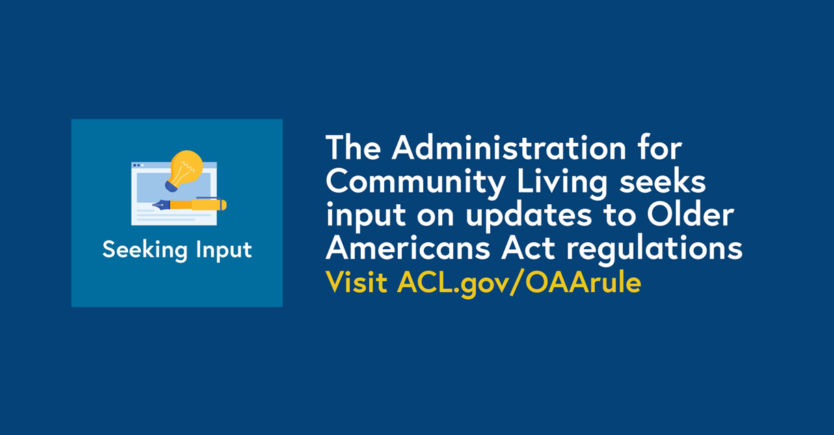
Older Americans Act
Notice of Proposed Rule Making

Slide 8
Upcoming Due Dates
Upcoming Items | Due Date
SF425 Reports | Semi-Annual Reports: April 30, 2023 October 30, 2023 Final Reports: January 31, 2024
Title III Maintenance of Effort | August 1, 2023
LTCO Certification of Minimum Expenditures | August 1, 2023
Transfers: FFY2023 Title III and ARP Title III | August 15, 2023
No-Cost Extension Request | August 1, 2023
Reallotments | September 8, 2023

Slide 9
Unwinding Guidance
Major Disaster Declaration (MDD) for COVID-19 – Ended May 11, 2023
  ACL strongly encourages unwinding of all MDD flexibilities by September 30, 2023
  If States obligated funding with flexibilities (i.e. “bucketing”) during the MDD incident period, those flexibilities may be available until the obligation is liquidated or the obligation period ends, see unwinding guidance for more information and for technical assistance
    States must adhere to the project period end dates, and no-cost extensions will not extend the obligation period for MDD flexibilities
Public Health Emergency (PHE) for COVID-19 – Ended May 11, 2023
  DRI/DGA waiver
  100% Transfer between C1/C2

Slide 10
Long Term Care Ombudsman (LTCO) –
Fiscal Management
45 § 1324.13(f) Fiscal management
The Ombudsman shall determine the use of the fiscal resources appropriated or otherwise available for the operation of the Office. Where local Ombudsman entities are designated, the Ombudsman shall approve the allocations of Federal and State funds provided to such entities, subject to applicable Federal and State laws and policies. The Ombudsman shall determine that program budgets and expenditures of the Office and local Ombudsman entities are consistent with laws, policies and procedures governing the Ombudsman program.

Slide 11
LTCO Minimum Certification of Expenditures
Each year’s FFY expenditures must meet or exceed the FFY2019 (base year) expenditures, the minimum expenditures must be met in the following areas:
  State Title III Expenditures
  AAA Title III Expenditures
  Title VII LTCO Expenditures
  Title VII Elder Abuse Expenditures
Other expenditures are included, however they are not subject to the minimum expenditure requirements:
  Other Federal Funding
  Other State Funding
  Local Funding

Slide 12
LTCO NORS Reporting
State Ombudsman programs are required to report funds expended in the National Ombudsman Reporting System (NORS)
When submitting annual minimum funding certification, State Units on Aging (SUAs) should relay final fiscal data to State Ombudsman for inclusion in final NORS report
All final expenditures must be included in NORS report
NORS reports are due no later than Jan 31
  If final numbers change after Jan 31, states should communicate changes to the Ombudsman Office so they can update them in NORS.

Slide 13
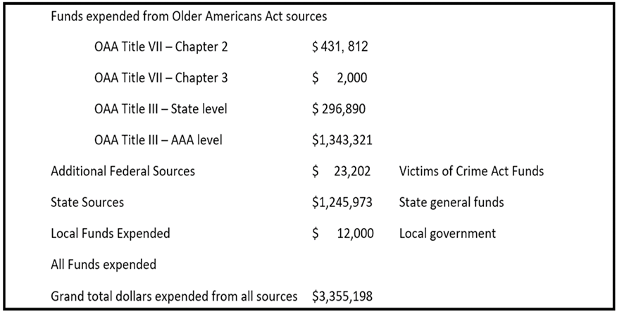
LTCO NORS Reporting Continued

Slide 14
Supplant Language
Funding appropriated for activities may not be used to supplant (replace) expenditures from other Federal, State, and local funds
Funding is subject to supplement and not supplant requirements
  OAA Citations: 306(a)(9)(B), 307(a)(9)(B), 321(d), 374(d)(4), 705(a)(4), and 752(e)(2)
  Elder Justice Act Citation: Sec. 2042.(b)(3)(C)
Contact your ACL Regional Administrator with any questions

Slide 15
Title III Maintenance of Effort (MoE)
Title III Maintenance of Effort is a statutory requirement that the State must meet a minimum amount of expenditures per fiscal year
  The minimum is the average of the three prior year certification amounts
    i.e. FFY 2022 certification amount must meet or exceed the average of certified amounts for 2019, 2020, and 2021
    OAA Section 309(c)
COVID Supplemental funds may be used to meet MOE requirements
  Excess State match reported on the SF-425 for Title III and any Title III COVID supplemental funding does not become part of the Maintenance of Effort unless the State certifies it as such.
  May not include any program income used as match under ARP
  Contact your fiscal contact for more information
Submit to AOA.Grants@acl.hhs.gov and cc your Regional Administrator

Slide 16
Title III Match Requirements
Grant Awards | B* | C1 | C2 | D | E | State Plan Admin | Area Plan Admin
FY 2021, 2022, 2023 Regular T3 (OASS, OACM, OAHD, OAPH and OAFC) | 15%** | 15%** | 15%** | N/A | 25% | 25% | 25%
Supplemental 5 - HDC5 | N/A | N/A | N/A | N/A | N/A | 25% | 25%
ARP (SSC6, CMC6, HDC6, PHC6, and FCC6) | 15%** | 15%** | 15%** | N/A | 25% | 25% | 25%
*No match required for the portion of funds used to support the LTCO program
**1/3 of 15% of match for services must come from State sources

Slide 17
Minimum Match Requirements
Title III and ARP Title III
  25% State Plan and Area Plan Administration
  15% Service Match for Part B, C-1, C-2
    1/3 must come from State sources
    No match required for portion of funds used to support LTCO from Part B
  25% Service Match for Part E
  No service match for Part D
Title III: Nutrition Supplement 5 (HDC5)
  25% State Plan and Area Plan Administration
  No service match required
No Match Required:
  Title VII: OAOM, OMC6, OAEA
  NSIP
  Vaccine Access (VAC5)
  Expanding Public Health Workforce (STPH)
  ARP: Adult Protective Service (APC6) & Ombudsman (LOC6)

Slide 18
Title III: State and Area Plan Administration
State Plan Administration May Elect to be Subject to the greater of:
  5% of the cumulative total of the Title III grant
OR
  $750,000 for States or $100,000 for Guam, American Samoa, Virgin Islands, Northern Mariana Islands cumulative total of the Title III grant
Area Plan Administration
  Up to 10% of the Total Title III allocation
    May not be allocated to Part D
Required Match is 25%

Slide 19
Title III: Single Planning Service Area (PSA)
State Plan Administration
May Elect to be subject to the greater of:
  State Plan Administration limit of 5% of the Total Title III Award;
  OR
  Area Plan Administration limit of 10% of the total Title III Award
Required Match is 25%

Slide 20
Title III: Territory Plan Administration
Guam, the United States Virgin Islands, American Samoa, and the Commonwealth of the Northern Mariana Islands may elect the greater of:
  State Plan Administration limit of 5% of the Total Title III Award;
  OR
  $100,000
Puerto Rico may elect the greater of:
  State Plan Administration of 5% of the Total III Award;
  OR
  $ 750,000
Required Match is 25%

Slide 21
Title III Parts B, C1, and C2 Services Match
Title III and ARP Title III Parts B – Supportive Services, C1 – Congregate Meal and C2 – Home Delivered Meal: 15% Match
  Federal Expenditures May Not Exceed 85% of Total Expenditures
    OAA Section 304(d)(1)(D)
  1/3 of the Required 15% Match Must Come From State Sources
    OAA Section 309(b)(2)
  No Match is Required for the Portion of Title IIIB that is for Support of Long-Term Care Ombudsman Program
  Match May Be Pooled between Parts B, C1, and C2

Slide 22
Title III Part D Service Match
Title III and ARP Title III Part D – Disease Prevention and Health Promotion
  No Match Required for Service Expenditures
Funding may only be used for programs and activities which have been demonstrated through rigorous evaluation to be evidence-based and effective
  https://www.acl.gov/programs/health-wellness/disease-prevention

Slide 23
Title III Part E Service Match
Title III and ARP Title III Part E – Family Caregiver Support
  25% Match
    OAA Section 373
Match May Come from State or Non-State Sources

Slide 24
In-Kind Contributions
Non-Federal share (Match) may include cash, expenditures by the grantee, and third-party in-kind contributions.
Funds and Expenditures used to Match OAA funds must not conflict with Older Americans Act requirements and Regulations.
To be used as Match, in-kind contributions must be from a third-party, verifiable and the records must show how the value of the in-kind contribution was determined.
  That valuation must be reasonable, subject to audit, and meet the requirements at 2 CFR 200 Part 306
  https://www.ecfr.gov/current/title-2/subtitle-A/chapter-II/part-200/subpart-D/section-200.306

Slide 25
Examples of In-Kind Contributions
Volunteer services (a reasonable hourly rate applied to a volunteer’s time multiplied by the number of hours he/she/they works). For example, advisory/grievance council members, kitchen help, servers, receptionist, HDM drivers;
Donated time of employees from other organizations (salaries or positions must not be supported by Federal funds);
Unpaid interns or fellows;
Donated supplies and loaned equipment;
Donated food from food banks, etc.;
Donated utilities;
Donated or discounted space;
Transportation services to and from nutrition sites, medical appointments, shopping trips, etc. provided from non-Federal sources.

Slide 26
Voluntary Contributions
Voluntary Contributions May Be Used as Match
  Exception only for ARP - see notice of award terms and conditions
Voluntary Contributions Meet the Definition of Program Income
  45 CFR 75.307

Slide 27
ARP Program Income
ARP Title III Grant Only: Program income generated as a result of the ARP Title III grant may be used to meet match requirements
  Program income may only be used to meet the match requirement of the federal award in which the income is generated
If a State elects to allow program income as match, SUAs must have clear policies and procedures in place to account for and document program income used as match for the ARP grants
  Program income may not be use used to meet the 1/3 of 15% match requirement for Parts B, C1, and/or C2
  Program income must be expended on the service for which the income was collected
States are required to report in Box 12 of the SF-425 the dollar amount of the program income by grant award number allocated to meet match requirements

Slide 28
Regular Transfers
Due August 15, 2023
  FFY2023 Title III
  ARP Title III
Current Transfer Limits:
  30% maximum between Parts B/C
    Waiver required to exceed 30% by an additional 10%
    Maximum transfer limit is 40% with approved waiver
  40% maximum between Parts C1/C2
    Waiver required to exceed 40% by an additional 10%
    Maximum transfer limit is 50% with approved waiver

Slide 29
Reallotments
Annual Statement
  Current year Title III and Title VII funding will be fully used
  Amount of funding that will not be used
  Request for available Title III and Title VII funding, if any, the SUA could use
Due on September 8, 2023. Submit to AOA.Grants@acl.hhs.gov with a CC: to your Regional Administrator and Fiscal Specialist
Reallotment Program Instruction: PI-14-06

Slide 30
No-Cost Extensions (NCE)
Extension of time to a project period to complete the work of the grant under that extension period, without additional federal funds
  Not available for grants where no-cost extensions have been approved in the past, i.e. Supplemental 5 Nutrition (HDC5), Vaccine Access (VAC5), etc.
Due August 1, 2023 to AoA.OAA@acl.hhs.gov with a cc to your Regional Administrator
If approved, a new NoA will be issued with a 12 - month extended project period

Slide 31
Drawdown Rates
Funds should be made available to be drawn down upon approval and receipt of goods & services based on contract terms and conditions between grantees and subgrantees.
Drawdown rates will be reviewed alongside FFR review with inquiries made about rates that are considered too fast or too slow.
Late drawdown will affect final report submission which will in turn impact ACL’s close-out effort.

Slide 32
Advanced Payments
2 CFR §200.305(b)(1) requires SUAs to minimize the time that elapses between the transfer of grant funds to a AAA and the expenditure of those funds by the AAA. This means that advance payments “must be limited to the minimum amounts needed and be timed to be in accordance with the actual, “immediate cash requirements” of the AAA.
ACL has interpreted “immediate cash requirements” to mean thirty days or less of advance funding.
In addition, federal regulation 2 CFR §200.305(b)(8) generally requires that OAA advance payments be deposited into interest bearing accounts and any interest earned in excess of $500 be remitted to ACL.
This policy shall apply to all funding (state and federal) distributed through under area plans.

Slide 33
Large Purchase Requests: Equipment
Per 45 CFR 75.439(a)(2) equipment purchases made by a direct grantee exceeding $5,000 per unit must receive written approval from ACL prior to purchase.
Equipment means tangible personal property (including information technology systems) having a useful life of more than one year and a per-unit acquisition cost which equals or exceeds the lesser of the capitalization level established by the non-Federal entity for financial statement purposes, or $5,000.
Grantee will use and dispose the property in accordance with 45 CFR 75.320 paragraph (e) and 2 CFR 200.313 paragraph (e).
Equipment can only be used for grants program purposes
A sub-grantee (i.e., AAA) of a direct grantee (i.e., SUA) must receive prior approval from the direct grantee for equipment purchases exceeding $5,000. ACL does not provide prior approval to subgrantees of a direct grantee.
If a grantee seeks to enter into a contract for the purchase of services that involves the use of equipment, the grantee should follow their own procurement process per 45 CFR 92.36. Such a purchase does not fall under the Large Purchase request policy.

Slide 34
Financial Reporting: SF 425
SF425 reports required to be submitted in the Payment Management System (PMS) semi-annually
  for Period Ending March 31, 2023: Due April 30, 2023
  for Period Ending September 30, 2023: Due October 30, 2023
FFY 2021 (if NCE), 2022, 2023 Regular T3, T7, and NSIP
CRRSA Supp#5 (HDC5)
CRRSA Supp#5 (LOC5 and APC5)
Vaccine Access (VAC5)
ARP (SSC6, CMC6, HDC6, PHC6, FCC6, OMC6, LOC6 and APC6)
STPH
Technical questions, issues on reporting, grantee master profile updates, payment specific questions: PMS Liaison - https://pms.psc.gov/find-pms-liaison-accountant.html
Notes:
Note: VAC5 & ARP grants are not required this reporting period

Slide 35
Project Period
Project period is the time during which the non-Federal entity may incur new obligations to carry out the work authorized under the Federal award (45 CFR 75.2)
Obligations are orders placed for property and services, contracts and subawards made, and similar transactions during a given period that require payment by the non-Federal entity during the same or a future period (45 CFR 75.2)
Grant activities may only occur during the project period

Slide 36
Project Periods
 | Project Period End Date w/out No-Cost Extension | Project Period End Date with No-Cost Extension
FY2021 (T3, T7 & NSIP) | 9/30/2022 | 9/30/2023
FY2022 (T3, T7 & NSIP) | 9/30/2023 | 9/30/2024
FY2023 (T3, T7 & NSIP) | 9/30/2024 | *
Supplement 5 (HDC5) | 9/30/2022 | 9/30/2023
Vaccine Access (VAC5) | 9/30/2022 | 9/30/2023
Public Health Workforce (STPH) | 9/30/2024 | *
ARP Title III (T3) and Ombudsman (OMC6) | 9/30/2024 | *
ARP Ombudsman (LOC6) | 9/30/2025 | *
ARP APS (APC6) | 9/30/2024 | *
*not available to request

Slide 37
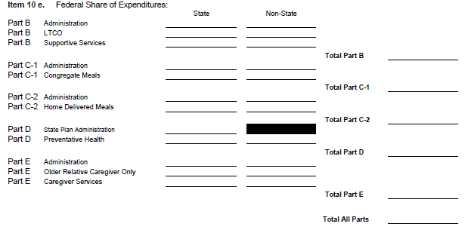
Federal Share of Expenditures
 | Cumulative
e. Federal share of expenditures Expenditures are the Sum of Cash Disbursements for Direct Charges for Property and Services; the Amounts Owed by the Recipient for (1) Goods and Other Property Received; (2) Services Performed by Employees, Contractors, Sub-recipients, and Other Payees; and (3) Programs for Which No Current Services or Performance are Required Do not Include Program Income on this line

Slide 38
Unliquidated Obligations & Total Federal Share
 | Cumulative
f. Federal share of unliquidated obligations For Accrual Expenditure Basis: Obligations incurred but for which an Expenditure has not yet been recorded. Obligations means orders placed for property and services, contracts and subawards made, and similar transactions during a given period that require payment by the non-Federal entity during the same or a future period. Obligations include direct and indirect expenses but not yet paid or charged to an award, including amounts due to subrecipients and contractors. Final Report – Line Must be Zero
g. Total Federal share (sum of lines e and f) Sum of Lines 10e and 10f (Federal Share of Expenditures & Unliquidated Obligations)

Slide 39
Unobligated Balance
 | Cumulative
h. Unobligated balance of Federal funds (line d minus g) Unobligated Balance: Line 10d less Line 10g Grant award funds not obligated Required to be obligated during the 24-month project period; i.e. FFY2021 awards must be obligated no later than 09/30/2022 without a no-cost extension or 9/30/2023 with a no-cost extension; funds not obligated during the project period will be de-obligated and not available for expenditure

Slide 40
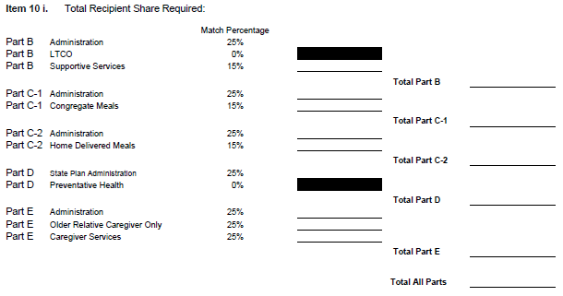
Recipient Share Required
10i. Total Recipient Share Required Total Recipient Share required No Recipient Share required for Title III D Services, Title VII, NSIP, or Part B (LTCO) However, there is a Minimum Expenditure Requirement for the Ombudsman Program

Slide 41
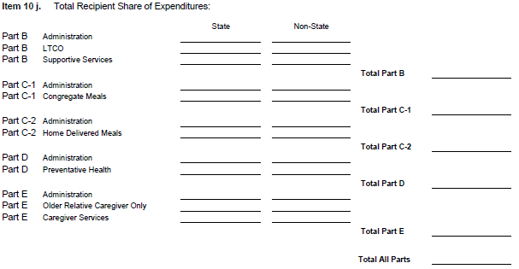
Recipient Share of Expenditures
j. Recipient share of expenditures Actual Cash Disbursements or Outlays, Less any Rebates, Refunds or Other Credits, Including Payments to Sub-recipients and Contractors. Amount May Include the Value of Allowable Third Party In-Kind Contributions On Final Report this Line Should be Equal to or Greater than the Required Match Amount of Line 10i. Unless match is being pooled. If match is being pooled, make a note in box 12

Slide 42
Remaining Recipient Share
k. Remaining recipient share to be provided (line i minus j) Amount of Line 10i Less Line 10j. If Line 10j is Greater than the required Match amount in Line 10i, amount entered should be Zero

Slide 43
Program Income
Program Income:
l. Total Federal program income earned Amount of Program Income Earned to Date Voluntary Contributions and Cost Sharing Fees
m. Program income expended in accordance with the deduction alternative Not Allowed Under the Older Americans Act
n. Program income expended in accordance with the addition alternative Only Allowable Use of Program Income Under OAA Must be Used to Expand the Service for which the grant was awarded
o. Unexpended program income (line l minus line n) To the extent available, the non-Federal entity must disburse funds available from program income and interest earned on such funds before requesting additional cash payments (45 CFR 75.305)

Slide 44
Indirect Expenses – Line 11
11. Indirect Expense | a. Type | b. Rate | c. Period From | Period To | d. Base | e. Amount Charged | f. Federal Share
 |  |  |  | g. Totals:
Cumulative Amounts from the Date of the Inception of the Award through the End Date of the Reporting Period
Amounts included in Indirect Expenses should be included in 10e. and 10j., Federal and Grantee Expenditures, on 425 and on Supplemental Forms

Slide 45
Remarks – Line 12
12. Remarks: Attach any explanations deemed necessary or information required by Federal sponsoring agency in compliance with governing legislation:
Note if Funds Have or Have Not Been Drawn Down if there is an Unobligated Balance on the Final Report
Note if Funds are Being Returned due to Unobligated Balance
Note Explanation if Cash on Hand Exceeds More than Three Business Days of Cash
Submission of Revised Reports, Etc.
If Match is Pooled Between Services (Match may not be pooled for administration)
ARP Only – Amount of Program Income used as match

Slide 46
Technical Assistance Spreadsheet(s)
Spreadsheet to assist completion of required financial reports
Title III (Parts B, C-1, C-2, D, E) & Title III Supplemental Form, NSIP, Title VII Ombudsman, Title VII Elder Abuse
Report Checklist
If match is being pooled, please make a note in the comment box and in Box 12 of the SF425
Match can only be pooled between B, C1 and C2

Slide 47
Data to Enter on Technical Assistance Tool
SF 425: Title III, Title VII, and NSIP
  Header Information: Lines 1-9
  10a: Cash Receipts
  10b: Cash Disbursements
  10d: Total Federal Funds Authorized
  10h: Unobligated Balance
  10l: Total Federal Share of Program Income Earned
  10n: Program Income Expended in Accordance with the Addition Alternative
AoA Supplemental Form: Title III Only
  Header Information: State, FY, Date Submitted, Reporting Period Ended, Final Reports
  10d: Total State Plan Administration and Total Area Plan Administration
  10e: Federal Share of Expenditures; State and Non-State
  10j: Total Recipient Share of Expenditures; State and Non-State
  Comments: If match is pooled between services

Slide 48
Financial Resources
Unwinding Guidance for State Units on Aging
Older Americans Act: https://www.acl.gov/about-acl/authorizing-statutes/older-americans-act
Code of Federal Regulations: http://www.ecfr.gov
Federal Funding Accountability and Transparency Act (FFATA or Transparency Act): www.usaspending.gov
Uniform Administrative Requirements, Cost Principles, and Audit Requirements for HHS Awards: 45 CFR 75
ACL Program Instructions
AGID (Aging Integrated Database)

Slide 49
Add closing slide title
Questions:
Regional Administrators (Regions I to X)
Alice.Kelsey@acl.hhs.gov
Brandon.Copeland@acl.hhs.gov
Sherry Cochran: Sherry.Cochran@acl.hhs.gov
MayLing.McKee@acl.hhs.gov
@

