Slide 1

Creative Fundraising for Senior Nutrition Programs
Hosted by ACL’s Office of Nutrition and Health Promotion Programs
April 13, 2023

Slide 2
Agenda
Opening Comments
Speakers
  “Beyond Fundraising” Cristi Twenter, Executive Director, Edmond Mobile Meals
  Joel Sekorski, Director, Sullivan Senior Center
Question & Answer
Wrap Up
Notes:
If you need to include any recurring logos on interior (non-title and non-closing) slides, add to the slide master so that assistive technology does not read it on every slide. Always add the first instance to the actual slide (not the slide master) so that assistive technology will read it once.

Slide 3
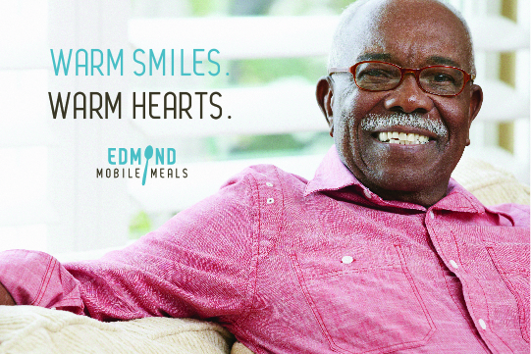

Beyond Fundraising
Cristi Twenter
Notes:
Thank you.
Bio/Background – career built around relationship management.

Slide 4
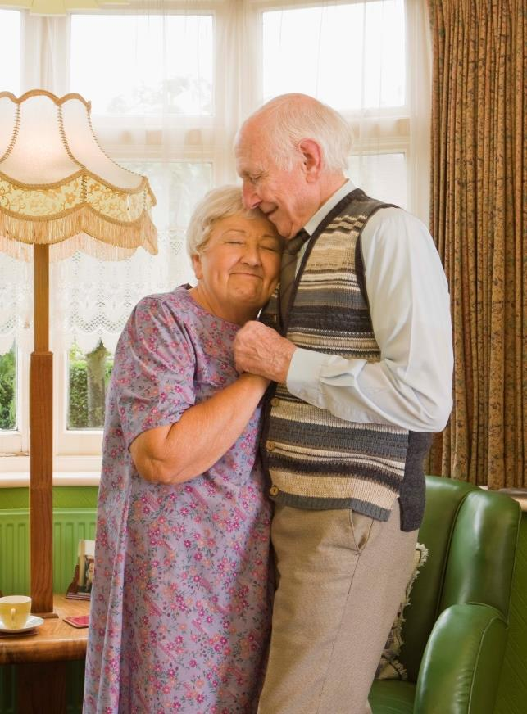

OUR MISSION
To provide a nourishing meal to Edmond's homebound elderly, disabled, and convalescing adults, without regard to income or age, and to provide wellness checks and social visits.

Slide 5
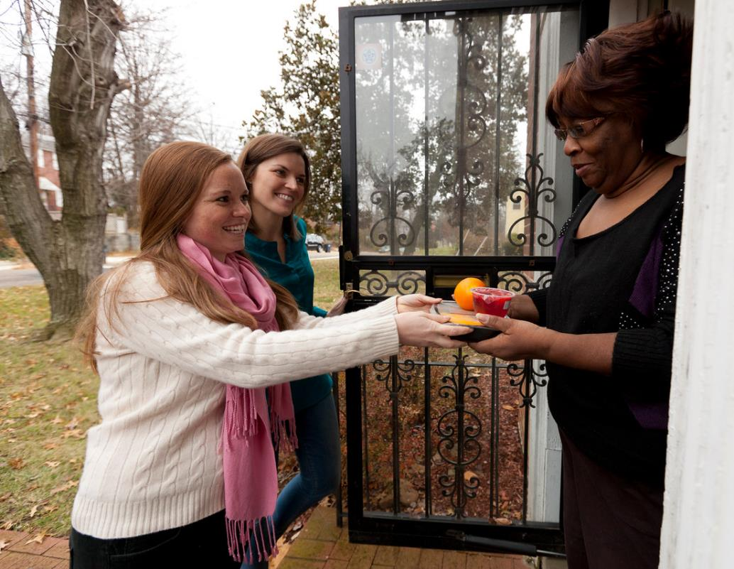
WHO DO WE SERVE?
Homebound and isolated individuals with no in-home caretakers.
Individuals with chronic health issues.
Individuals who cannot shop or cook for themselves.
Individuals recovering or rehabilitating from an accident, illness or surgery.
Seniors living within our boundaries – physical, permanent Edmond address.
We serve between 260-280 meals per day, Monday-Friday (optional weekends).
Serve over 500 different clients, over 64,000 meals each year.
Service Area: 100 Sq. Miles; 17 routes
40% of clients are unable to pay for meals.
40 Volunteers needed per day.

Slide 6


Resource Development
Requires a shift in perspective.
Board buy-in & active participation at their comfort level.
Move away from multiple events to long-term partnerships.
Focus on WHY, not WHAT with storytelling.
Emphasis on Donor Stewardship.
Ideas Today:
Diversify resource development strategies
Creating a resource development roadmap
Building community relationships
Notes:
Small staff – Development is just one of many hats ED wears.
As fundraisers, we spend too much time, energy, money on being an event planners. If you need multiple events to raise funds means you are planning events year-round. It is incredibly taxing, but is the long-term return on that effort worth it?
Our budget has more than doubled since I became director. One of my top priorities was to shift our strategies away from annual fundraising to long-term sustainability.
How do you make this shift?
Board buy-in, education.
Focus on developing and maintaining relationships based on WHY you do what you do & the value it brings to your community. Find partners who match your values, vision & goals.

Slide 7


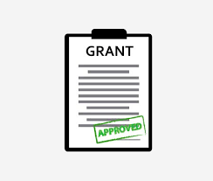


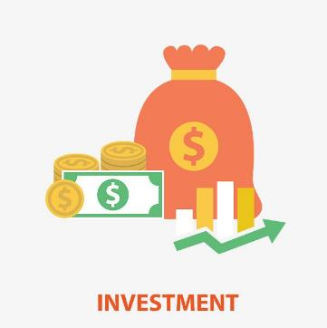


Strategies to Diversify
Notes:
Can’t put all your eggs in one basket and expect to meeting growing needs or be sustainable for the long run. Federal funding, state funding, even municipal funding is never guaranteed, but so many programs have become almost entirely reliant upon it.
Grants – There are more grants out there that are not Government funded.
All about the storytelling.
What corporations in your area have foundations?
Matching opportunities.
Grantstation & other resources to submit regional or local grants
Many grants ask for similar information. To save time, create a narrative template with basic information & your story. Customize for each app.
Private Donations – Make it EASY for anyone to donate. A top reason why Gen Z, Millennials & Gen X make donations is because it was EASY & they could do it immediately.
Cash App, Venmo, Applepay, QR codes, online giving.
Is your BOARD giving?
Events – Events have changed since COVID. Hybrid events are here to stay.
2022 Giving Experience Study info.
Incorporate virtual options (virtual 5k + in person; online auction + live)
Some type of competition at the event boosts engagement
Make the experience smooth & easy from start to finish.
Campaigns – AF, Monthly, Capital, etc.
Build your own donor database. ROI, year-to-year is better than a generic mailing list.
Multi-channel communication
Leverage special calendar dates – anniversaries, founders days, Giving Tuesday matches.
WHY statements about IMPACT of the gift. $25 = 1 week of meals.
Community Connections – look for local partners whose values match with your mission.
The relationship can start in many ways. A volunteer, board member, or client.
Engage!
Client Contributions – do you ask your clients for a contribution toward the cost of the service? Consider a pay what you can option, or if other funding requires a sliding scale based on income, or other parameters.
In-Kind Donations – These can be very helpful in offsetting disposable expenses.
Utilities, Rent
Drives tied in with a campaign
Items and services for events
Investment & Interest: This must be the result of strategic discussions around your cash. After you have the amount of cash in the bank (6 months, 12 months, etc) for expenses – how is your extra cash working for you? ENDOWMENT FUNDS don’t start out LARGE! Look for competitive money market, cds, other investments and matching funds specific to starting Endowments!

Slide 8
Diversify & Prioritize Sustainability 1 of 2
Notes:
Edmond Mobile Meals actual budges in 2014, 2017, 2019 & 2023.
Client contributions decreased by half. If we serve seniors, they are facing major financial insecurity.
Private Donations – variable with the economy, which is why you see a planned decrease in that area. We may see more than planned.
Events – The purple (2023) is where I have wanted to be with events since I became director. In 2019 we were up to 3 events per year. I almost resigned. We do still hold one event.
Campaigns – Far more effective for building long-term, loyal donor base by connecting them with the WHY. ROI from year-to-year Stewardship is key here.
Community Connections – This is the next step in long term sustainability. In less than 10 years we shifted from most of this revenue being from events, to a partnership. Donor stewardship. Engagement with mission. Versus a short-lived experience.
Grants – Grant writing is an art form. Find yourself a good storyteller. There are so many opportunities. The better you get at telling your WHY stories, the more grants will come your way.
In-Kind donations – Helps with expenses!
Investment/Interest – Biggest focus of growth for EMM. 5 year plan to reach $1mm in Endowment fund. Was less than $100k when I became director, now at $875,000. Will result in permanent annual income of $50,000…that we never have to ask for or work for! This is the true investment in your programs legacy!
Data Points:
Client Contributions: 2014: 22, 2017: 21, 2019:16, 2023: 14.
Private Donations: 2014: 14, 2017: 13, 2019: 11, 2023: 10.
Events: 2014: 24, 2017: 14, 2019: 18, 2023: 6.
Fundraising Campaigns: 2014: 2, 2017: 10, 2019: 9, 2023: 14.
Community Connections: 2014: 0, 2017: 1, 2019: 1, 2023: 10.
Grants: 2014: 32, 2017: 32, 2019: 30, 2023: 39.
In-Kind: 2014 :5, 2017: 8, 2019: 14, 2023: 4.
Investment/Interest: 2014: 1, 2017: 1, 2019: 2, 2023: 5.

Slide 9
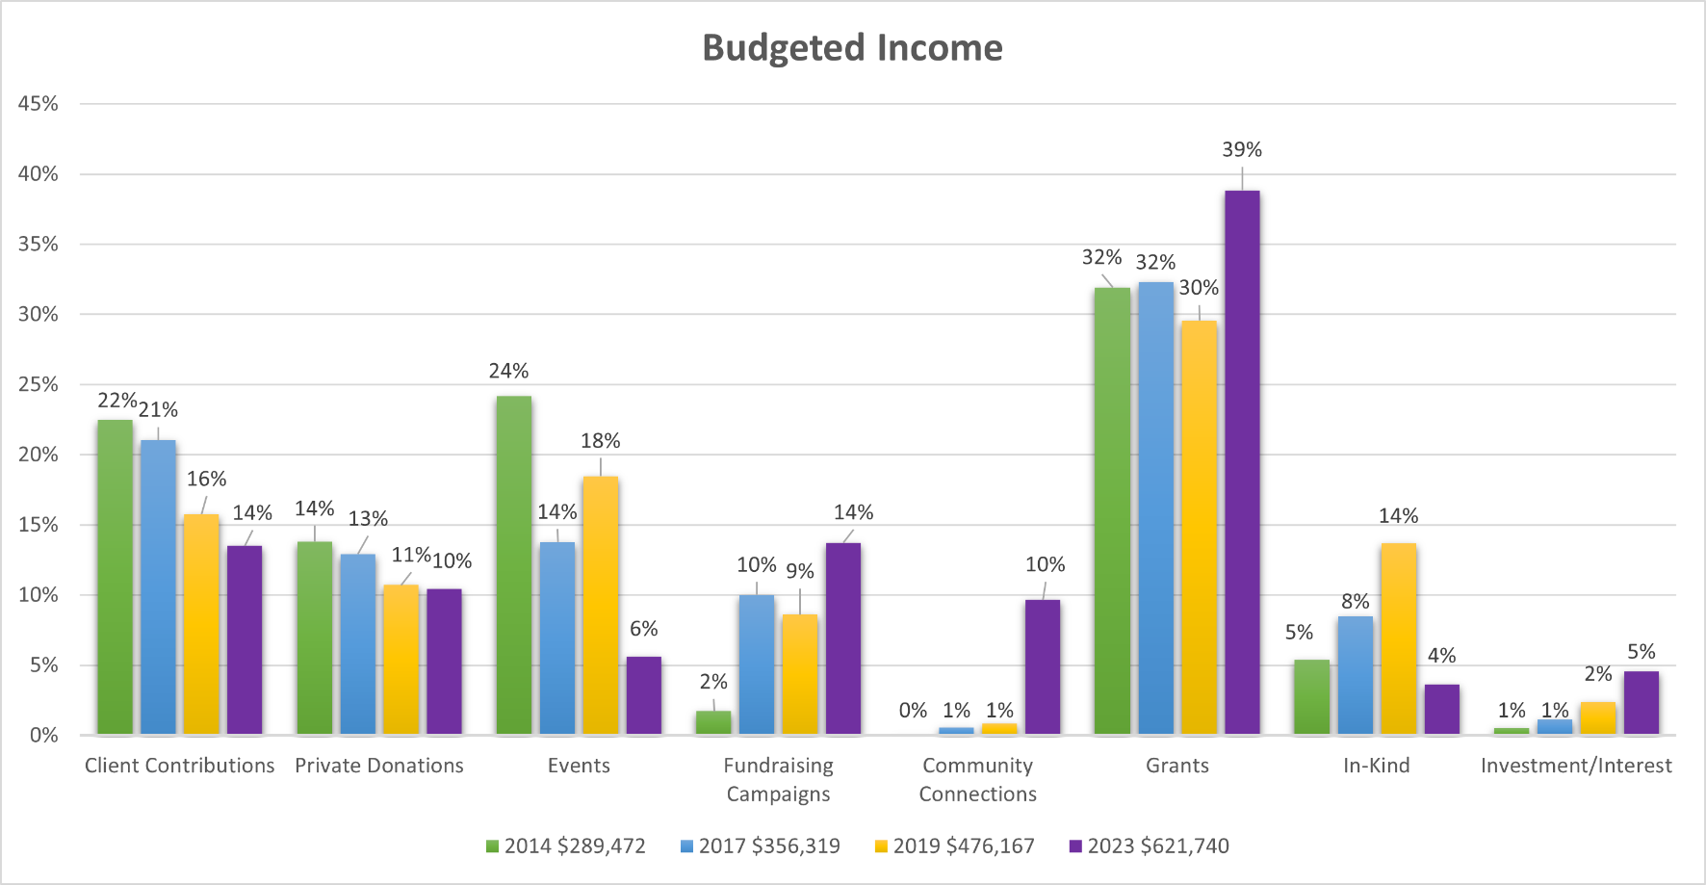
Diversify & Prioritize Sustainability 2 of 2
Notes:
Edmond Mobile Meals actual budges in 2014, 2017, 2019 & 2023.
Client contributions decreased by half. If we serve seniors, they are facing major financial insecurity.
Private Donations – variable with the economy, which is why you see a planned decrease in that area. We may see more than planned.
Events – The purple (2023) is where I have wanted to be with events since I became director. In 2019 we were up to 3 events per year. I almost resigned. We do still hold one event.
Campaigns – Far more effective for building long-term, loyal donor base by connecting them with the WHY. ROI from year-to-year Stewardship is key here.
Community Connections – This is the next step in long term sustainability. In less than 10 years we shifted from most of this revenue being from events, to a partnership. Donor stewardship. Engagement with mission. Versus a short-lived experience.
Grants – Grant writing is an art form. Find yourself a good storyteller. There are so many opportunities. The better you get at telling your WHY stories, the more grants will come your way.
In-Kind donations – Helps with expenses!
Investment/Interest – Biggest focus of growth for EMM. 5 year plan to reach $1mm in Endowment fund. Was less than $100k when I became director, now at $875,000. Will result in permanent annual income of $50,000…that we never have to ask for or work for! This is the true investment in your programs legacy!
Data Points:
Client Contributions: 2014: 22%, 2017: 21%, 2019: 16%, 2023: 14%.
Private Donations: 2014: 14%, 2017: 13%, 2019: 11%, 2023: 10%.
Events: 2014: 24%, 2017: 14%, 2019: 18%, 2023: 6%.
Fundraising Campaigns: 2014: 2%, 2017: 10%, 2019: 9%, 2023: 14%.
Community Connections: 2014: 0%, 2017: 1%, 2019: 1%, 2023: 10%.
Grants: 2014: 32%, 2017: 32%, 2019: 30%, 2023: 39%.
In-Kind: 2014 :5%, 2017: 8%, 2019: 14%, 2023: 4%.
Investment/Interest: 2014: 1%, 2017: 1%, 2019: 2%, 2023: 5%.

Slide 10

Create a Resource Development Roadmap
Be strategic when recruiting new Board members
Develop a cash/investment policy
What are your goals for each category
Who are your champions?
Create specific messaging & strategies for each category.

Slide 11
Resource Development Roadmap
Goal: Secure grant funding to support general program operations.
Grants ($135,800) | Description | Objective | Action Steps | Goal Amount | Expenses Budget
Grantor Name | Grant | Secure stable sources of consistent annual funding | Forms returned | $75,000 | $0
Grantor Name | Grant | Secure stable sources of consistent annual funding | interview | $10,100 | $0
Grantor Name | Grant | Secure stable sources of consistent annual funding | Application | $11,000 | $0
Grantor Name | Grant | Secure stable sources of consistent annual funding | Application | $5,000 | $0
Grantor Name | Grant | Secure stable sources of consistent annual funding | Application | $10,000 | $0
Grantor Name | Grant | Secure stable sources of consistent annual funding | Application | $1,500 | $0
Grantor Name | Grant | Secure stable sources of consistent annual funding | reporting | $16,000 | $0
Grantor Name | Grant | Secure stable sources of consistent annual funding | App | $4,000 | $0
Grantor Name | Grant | Secure stable sources of consistent annual funding | Application | $4,000 | $0

Slide 12
Resource Development Roadmap(continued)
Goal: To create advocacy and support, and to connect the community with the mission of Edmond Mobile Meals.
Campaigns ($67,500) | Description | Objective | Action Steps | Leader | When | Goal Amount | Expenses Budget
Annual Fund Campaign | Annual Giving | Increase donations over 2019 | Increase mailing list, targeted communications | TBD | TBD | TBD | TBD
Giving Tuesday | Day of Giving - Ties with Annual Fund | Secure matching source for 2020 | Research businesses/donors to match up to $5000 | TBD | TBD | TBD | TBD
Just Feed One Campaign | Monthly Giving | Increase number of monthly donors by 5 individuals | Targeted communications / Impact of monthly giving, mailing | TBD | TBD | TBD | TBD
Friendly Visitor Program | friendly visitor support | Provide contact/visits to isolated clients | Submit Grant to MOWA (ED), recruit FV teams/volunteers, liability forms signed, develop feedback materials/promotion | TBD | TBD | TBD | $1,000
One Millionth Meal | Celebrate the One Millionth Meal delivered since program was founded | Leverage Milestone into program recognition, fundraising & increasing endowment fund | Develop Calendar for all ideas, create separate task list, create & distribute assets, secure nomination for the ONE AWARDS | TBD | TBD | TBD | TBD

Slide 13







Stewardship
Long-term relationships, so treat them with utmost care.
Who? How?
Create a donor stewardship policy.
Engage year-round!
Categorize donors.

Slide 14
Donor Stewardship Policy
Donor Level | Defined As | Action(s) | Timeline | Responsible Party
Any Donor | Any donation of any value | Thank you letter | Within 1 week of donation, bi-annual donor newsletter | Executive Director
Any Donor | Cash donations of $250+ | Tax receipt letter | To be mailed by January 15th for preceding year donations | Executive Director
New Donor | First time donation | Thank you letter | Within 1 week of donation | Executive Director
New Donor | >$25 | EMM pin, sticker or other small welcome token | Within 1 week of donation (with thank you letter) | Executive Director
Loyal Donor | Monthly | Monthly thank you letter | Within 1 week of donation | Executive Director
Loyal Donor | Yearly | Thank you letter Lifetime donation impact letter | Within 1 week of donation End of each year | Executive Director Board Members
Major Donor | Donation of $5,000+ (individual, company or foundation) | Thank you letter Hand written thank you Phone call | Within 1 week of donation Within 1 week of donation Within 1 month of donation | Executive Director Board of Directors Board member
Major Donor | Individual or company only | Invitation to Top Donors Dinner Social media post (local heroes) Individual impact report | 1st quarter each year preceding year donations Within quarter of donation (all large donors within same time period) Beginning of fiscal year for previous year gifts | Executive Director Executive Director Executive Director
Major Donor | $10.000+ (lifetime) | Wall of Fame | Within a year of $10,000 | Executive Director
Legacy donor | Gift of $25,000+ (individual, company or foundation; includes planned giving) | Thank you letter Hand written thank you Phone call | Within 1 week of donation Within 1 week of donation Within 1 month of donation | Executive Director Board of Directors Executive Director + Board
 | Individual or company only | Invitation to Top Donors Dinner Press release Social media post (local heroes) Featured article/blog post on website (partner heroes) Impact letter | 1st quarter each year preceding year donations Within quarter of donation (pending donor approval) Within quarter of donation-all large donors within same time period) Within quarter of donation Within 1 year of donation | Executive Director Executive Director Executive Director Executive Director
 | Gift of $50,000+ | Video for website & social media | Within 6 months of donation | Executive Director
In-Kind Donation | Any non-cash donation | Acknowledged as describe above at the appropriate monetary level | As described above | Executive Director

Slide 15







Building Community Relationships
Match up interests.
Board & volunteers as ambassadors.
Attend Chamber of Commerce networking events.
Present your WHY to Civic Groups.
Invite local businesses to volunteer, attend an event, have a private tour.
Host lunch & learns.

Slide 16
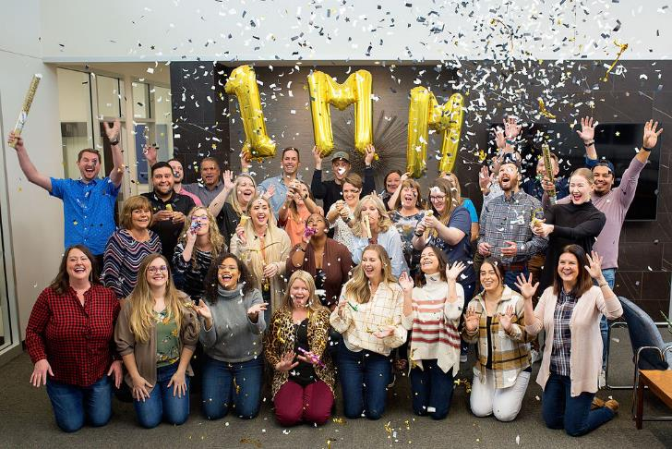
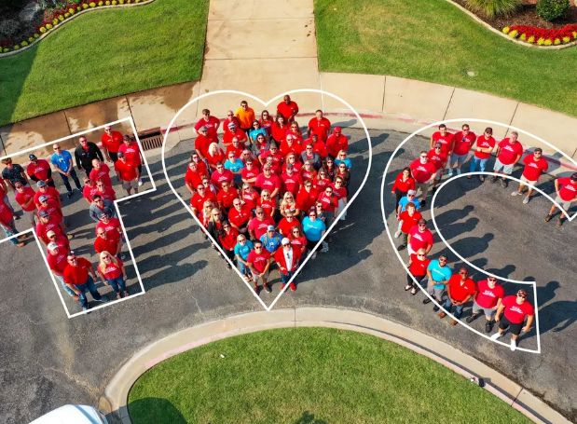
Examples of
Community Partnerships

Slide 17
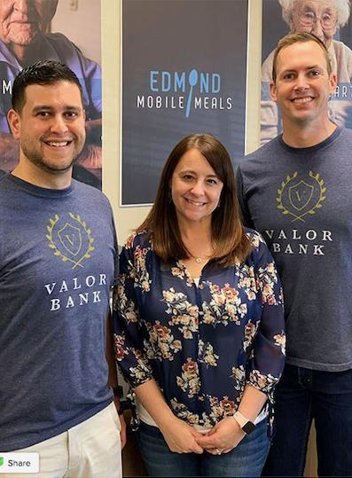
Valor Bank – Giving Vision
Concept:
Local Bank established in 2014 with a vision of philanthropic values. Gives 10% of profits to local nonprofits annually.
Partner Contributions:
Promotes volunteerism & giving back to the community.
Employees volunteer.
Annual financial gift.
EMM Contributions:
Provide volunteer opportunities
Follow donor stewardship guidelines to recognize gift
Partnership Story: (Est. 2018)
Former Board Member became employed at bank with introduction to CEO who was looking to support valuable local nonprofits.
Became our banking partner for checking, money market and savings.
Now our 4th largest lifetime donor, and top donor each year since 2018.

Slide 18
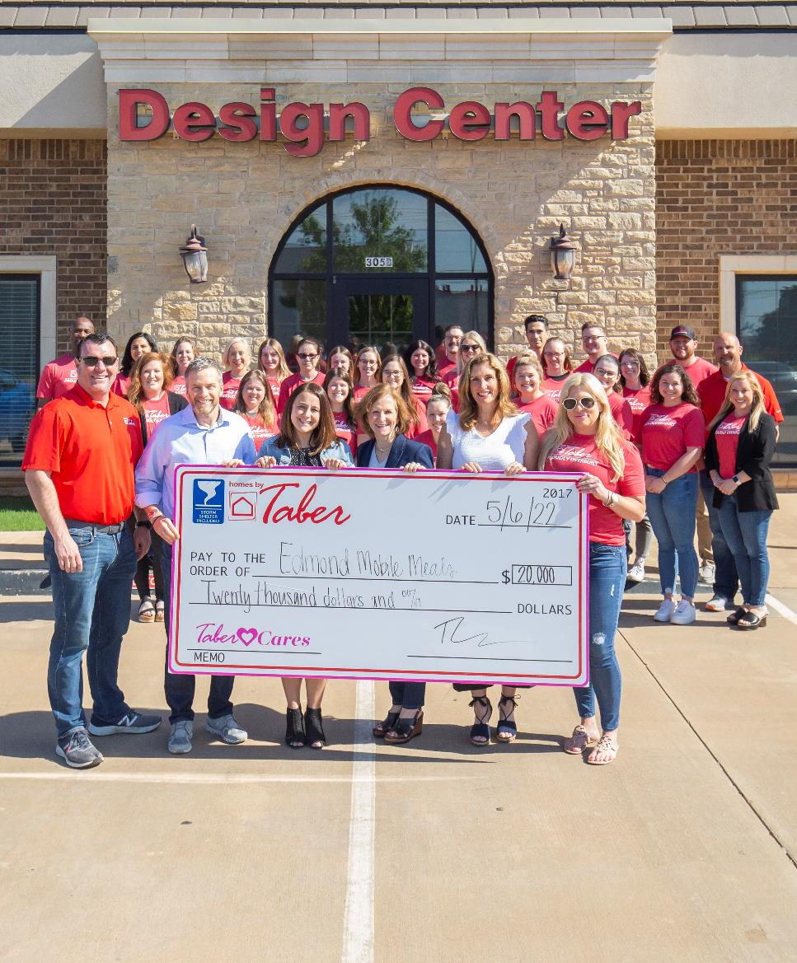
Taber Cares
Concept:
Local Homebuilder. Selects one local nonprofit to support.
Applications by nonprofits are submitted annually.
Partner Contributions:
Promotes volunteerism & giving back to the community.
Employees volunteer.
Financial gift of $250 for each new home sold during selected month.
EMM Contributions:
Provide volunteer opportunities
Follow donor stewardship guidelines to recognize gift
Partnership Story: (Est. 2019)
Application.
Engagement with philanthropy team. Invitation to tour and volunteer.
Top donor each year. Quarterly team volunteers. Weekly owner volunteer.

Slide 19
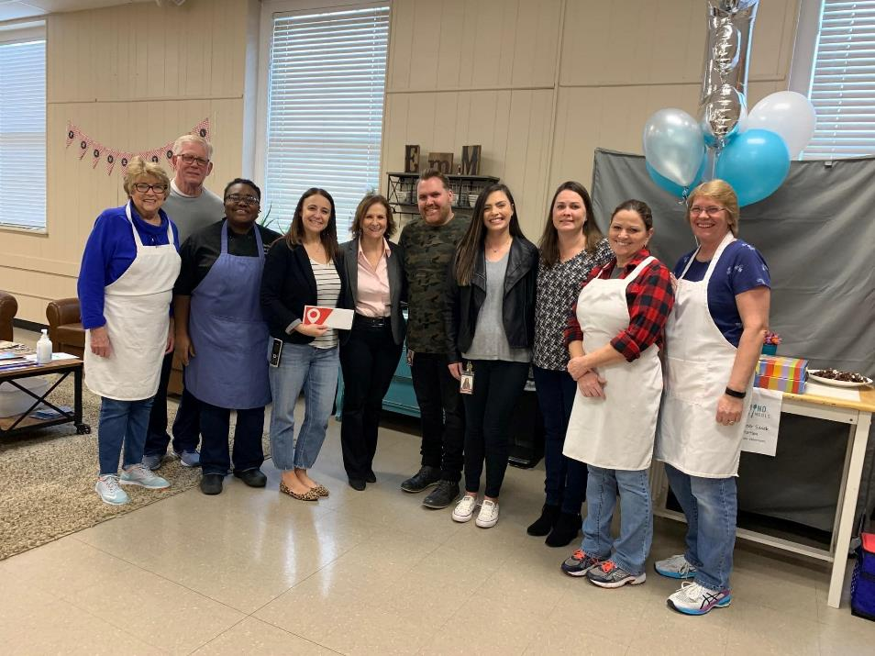
Life.Church Mission Partner
Concept:
Church outreach program.
Seeks local nonprofits to affect positive change in community.
Partner Contributions:
Promotes volunteerism & giving back to the community.
Employees and members volunteer.
Annual financial gift.
EMM Contributions:
Provide volunteer opportunities.
Provides outcome data. (# Meals and Clients served each year)
Participate in Mission Partner events on Life.Church campus.
Partnership Story: (Est. 2015)
One of first Community Partnerships.
Board member advocated to Missions Pastor to engage with us.
3rd largest lifetime donor and top donor each year since 2015.

Slide 20
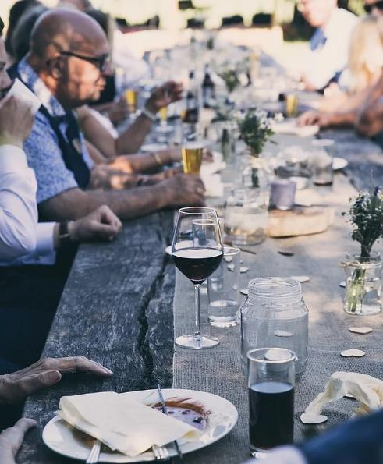
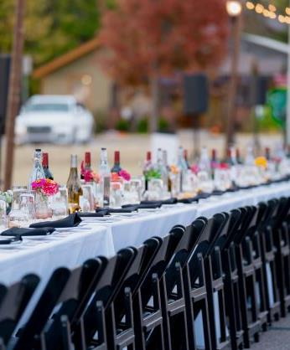
Middle of the Road Dinner
Concept:
Idea developed over conversation in local bookstore.
Ticketed event to bring people together over dinner and shared love of community.
Meet new people and engage in meaningful conversation.
Partner Contributions:
Coordinates all elements.
3 course dinner donated by local restaurant group.
Sells tickets. Capped at 200 seats, $100 each.
100% of major sponsor funds going to EMM.
EMM Contributions:
Promote event and assist with ticket sales.
Attend event.
Partnership Story: (Est. 2022)
Local store owner & community organizer dreamed of hosting event for years but had not found the right nonprofit partner. Because the concept was sharing food and connecting with neighbors, Edmond Mobile Meals was their ideal partner.

Slide 21
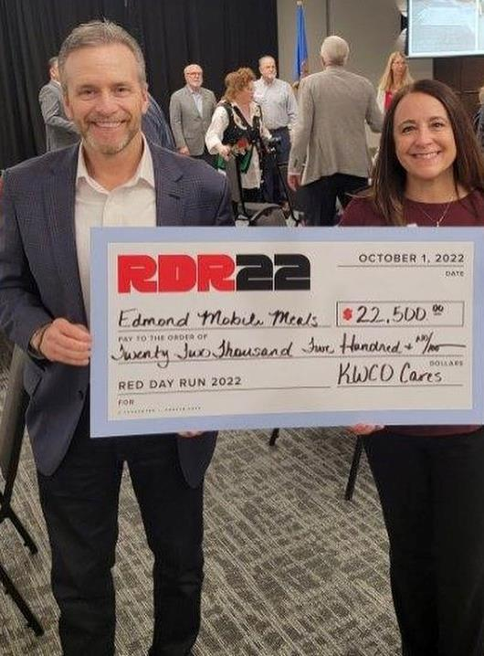
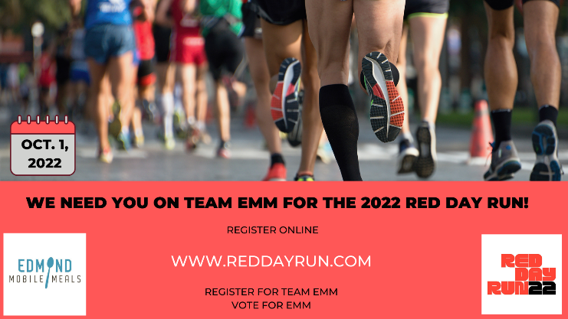
Red Day Run
Concept:
5k Run Keller-Williams Central Oklahoma.
Day of Giving to honor founder, Mo Anderson.
Renew, Energize, Donate.
Partner Contributions:
Manages all aspects of race logistics.
Secures event sponsors.
EMM Contributions:
Register at LEAST 100 race participants.
Promote event, registrations & votes.
Attend pre-race, post-race events.
Partnership Story: (Est. 2018)
Application open to local nonprofits.
Tithe nonprofits → Named nonprofits. Tithe nonprofit with most registrations moves up to named nonprofit.
Named nonprofits, share funds raised based on total number of votes.
Top 20 lifetime donor since 2018.

Slide 22
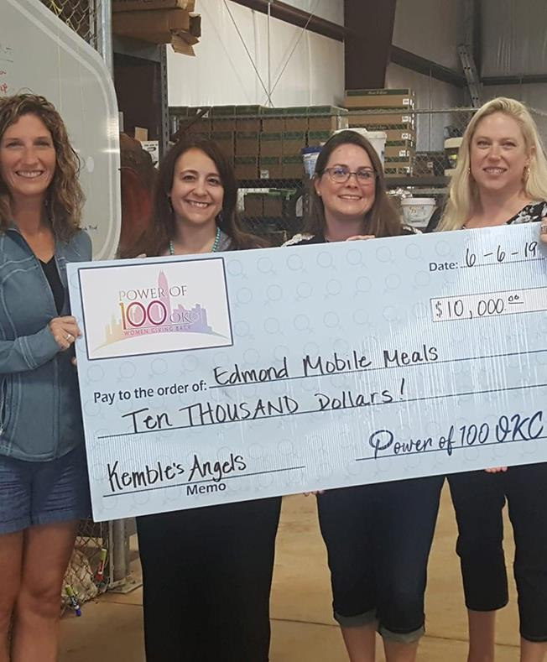

Power of 100
Concept:
Civic group. 100 women give $100 quarterly.
Any member can nominate a local nonprofit to be considered.
At quarterly event, 3 nominated nonprofits are randomly selected to give a 5-minute presentation. Members vote for their favorite presentation. Nonprofit is awarded $10,000.
Partner Contributions:
Recruit members.
Hosts quarterly events.
EMM Contributions:
Provide talking points to members for presentation if selected.
Partnership Story: (Est. 2018)
Nominated several times in 2018, but not selected to present.
1Q’2019 – Selected to present and won the vote to receive the award.

Slide 23




QUESTIONS?
Cristi Twenter
(405) 341-3111
cristi@edmondmobilemeals.org
facebook.com/EdmondMobileMeals
Instagram.com/EdmondMobileMeals
Twitter.com/edm_mobilemeals

Slide 24


Pop-Up Kitchen
Sullivan Senior Center &
Litchfield Hills/Northwest
Elderly Nutrition Program Present:
FUNDRAISING & INNOVATION
Presented by Joel Sekorski
Director Services for the Elderly
City of Torrington, CT

Slide 25
Objective
Today’s presentation is focused on areas to identify strengths and weaknesses within your organization. Let’s take a look at ways to bolster future fundraising, discuss pathways to find your best opportunities and then we will take a look at how we here at the Sullivan Senior Center put these ideas to work for us.

Slide 26
OBJECTIVES FOR FUNDRAISING:
Identify your staff’s and facility’s strengths and weaknesses.
Understand your target audience.
Create a budget that can perpetuate itself and allow for growth.
Create a benefit for participation.
Stick to what works.
Always acknowledge your partners publically.
A look at our PROBLEM & our PLAN
Here’s what we did…

Slide 27
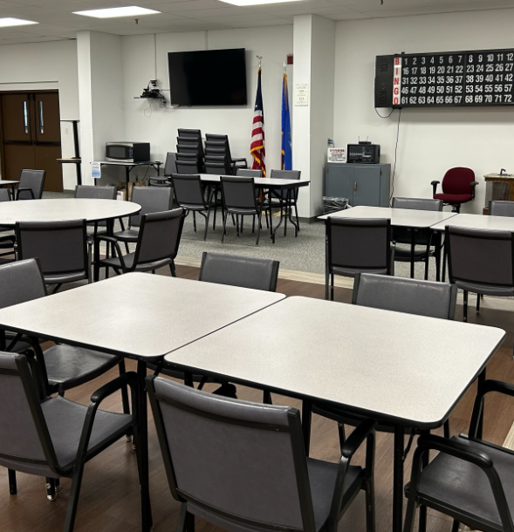
THE PROBLEM:
Much like everyone else, in the days after lockdowns ended, we were looking for innovative ways to bring both new and returning members back down to our Senior Center.

Slide 28
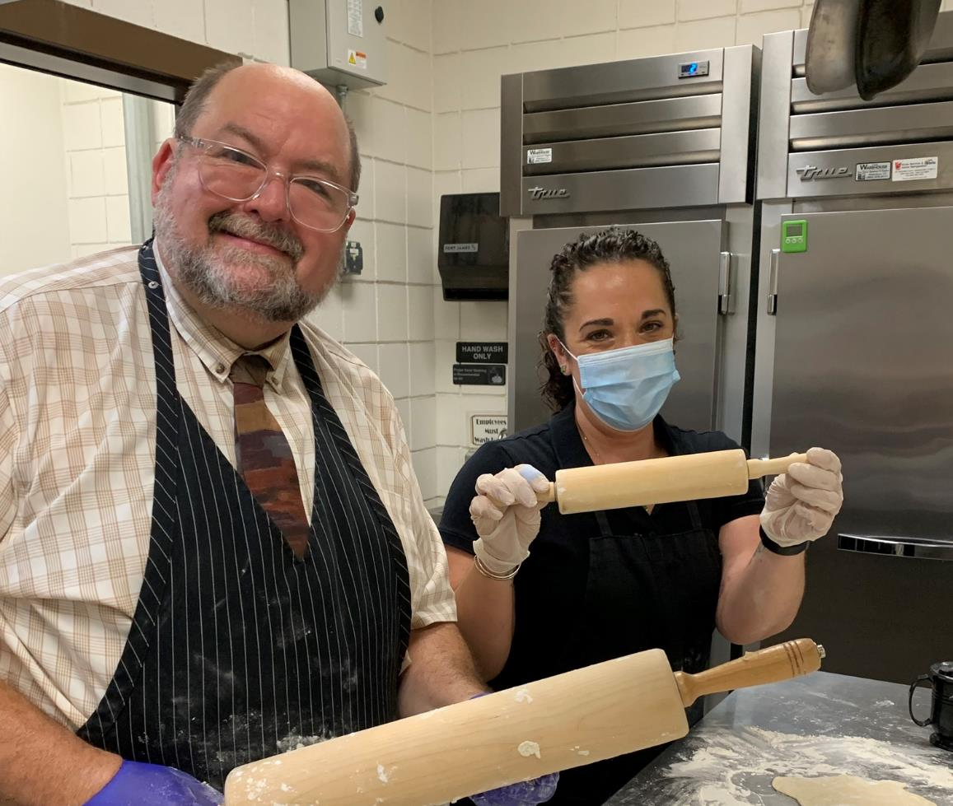
THE PLAN:
Director Joel Sekorski, himself a former chef, knows a thing or two about generating excitement through food. He believed that we could create an electric word-of-mouth "buzz" by offering special "pop-up" events--and thus the Pop Up Kitchen was born.

Slide 29
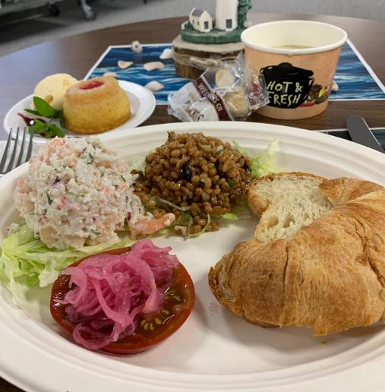
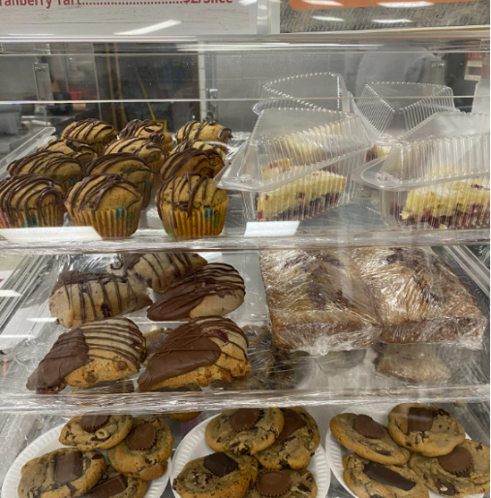
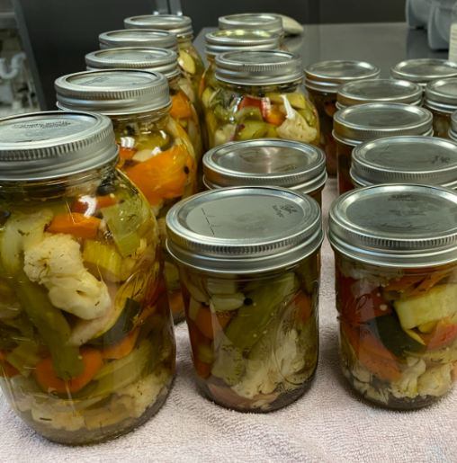
Farm to Pantry Canning
Luring them in with delicious food:
a multi level concept
Pop Up Cafe
Pop Up Bakery

Slide 30
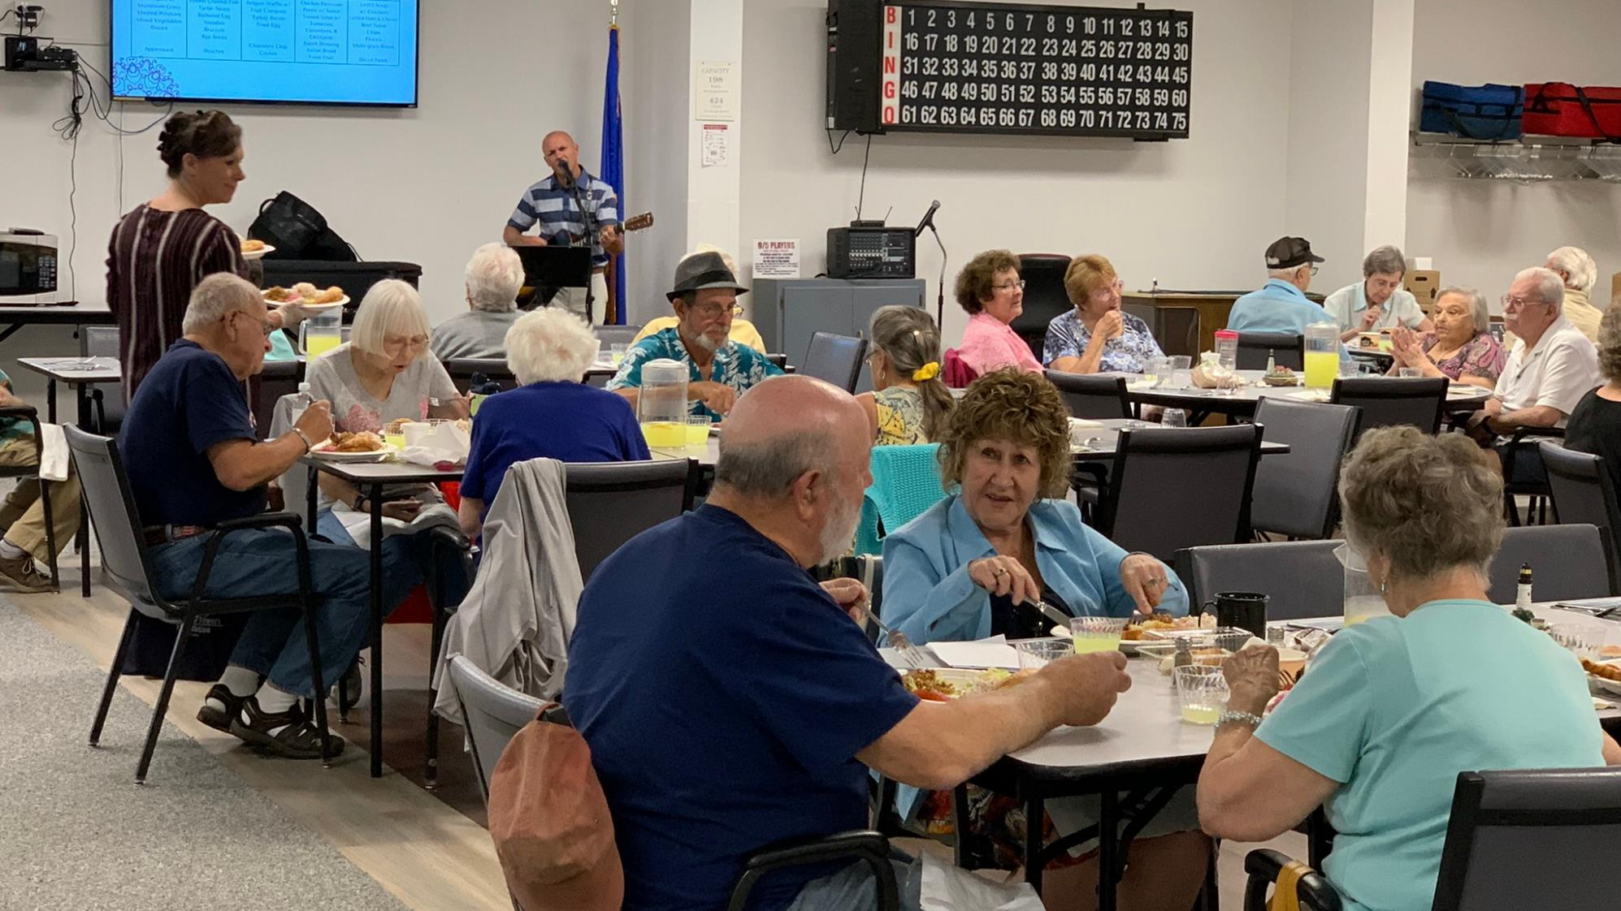


Pop-Up Cafe
An Upscale Experience at an affordable price

Slide 31
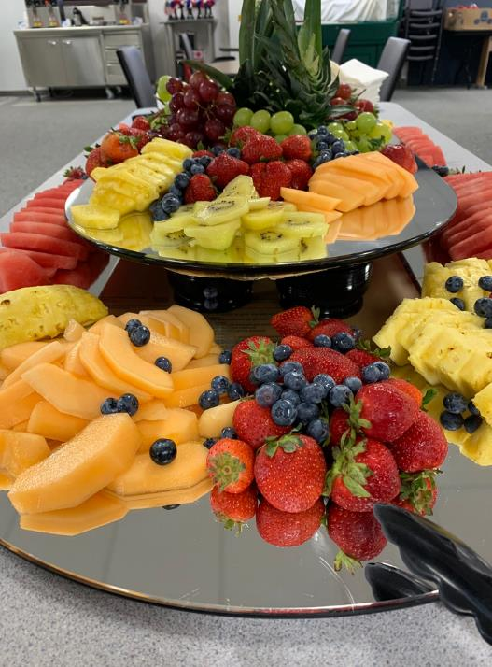
Pop Up Cafe
  Prepared our food fresh in house as opposed to receiving from our daily congregate lunch caterer.
  Focused on seasonal menus and ingredients.
  Offered unique experiences such as musicians and fruit and vegetable trays.

Slide 32
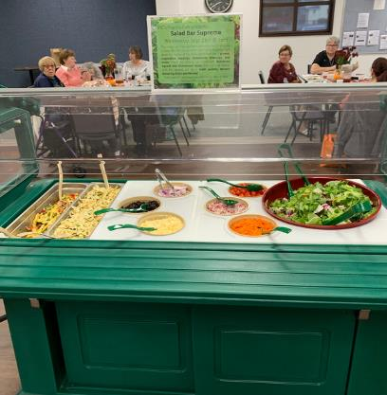
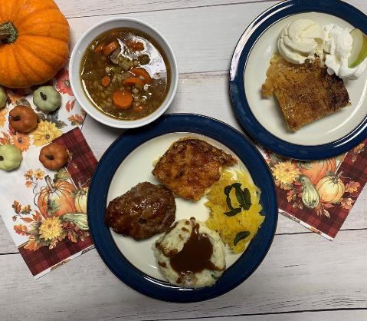
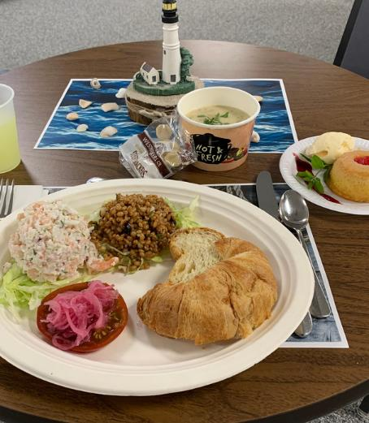
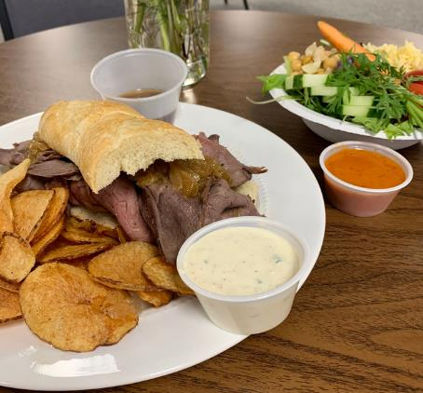
We've been able to hold 4 Pop-Up Cafe events...
Salad Bar
Personal
Pan Meatloaf & Mac ‘n Cheese
Seafood Spectacular
French Dip
House Chips & Salad

Slide 33
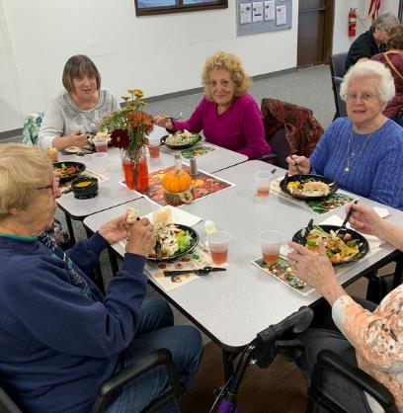
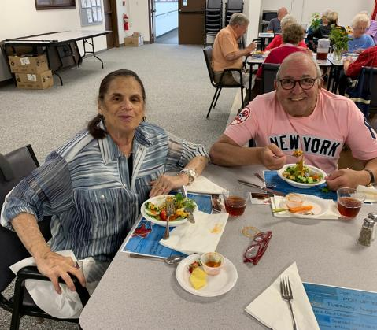
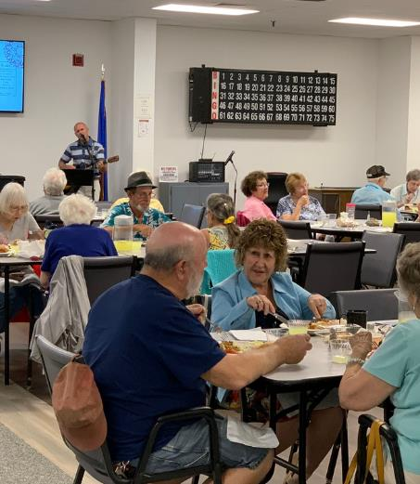
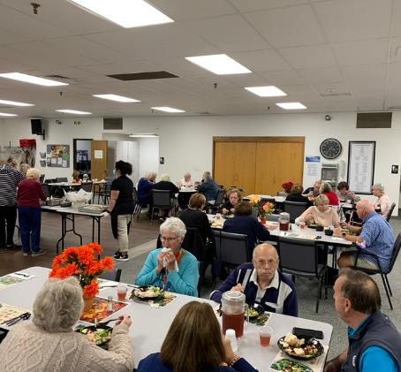
We've been able to hold 4 Pop-Up Cafe events...
Serving more than 200 meals!

Slide 34
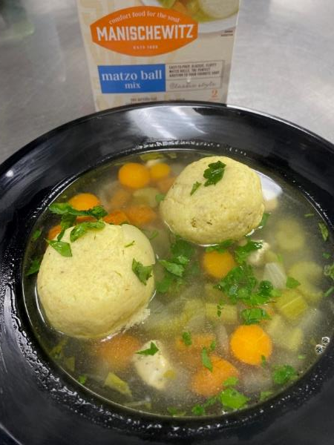
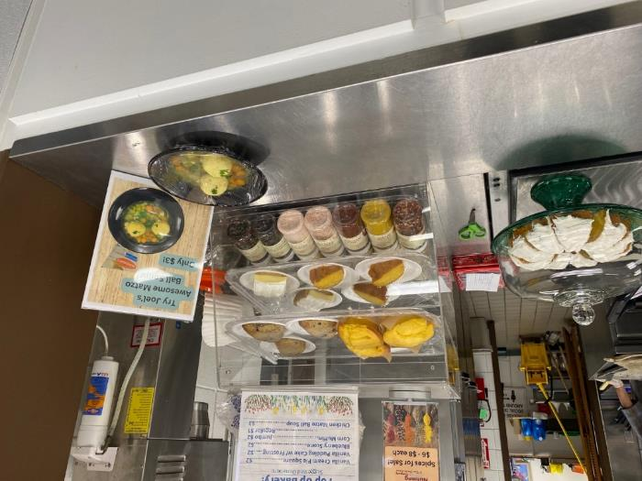
We've been able to hold 4 Pop-Up Cafe events...
Serving more than 200 meals! (continued)
6 Bowl & a Roll Events
Yielding a constant revenue stream

Slide 35
Quote
The novelty and timing of these events drew new members in, building trust, causing some of them to become regular congregate lunch diners.
The format of the Pop Up Cafes merged quality, upscale food with the social benefits of congregate dining, and has been very popular, causing us to sell out these events!

Slide 36
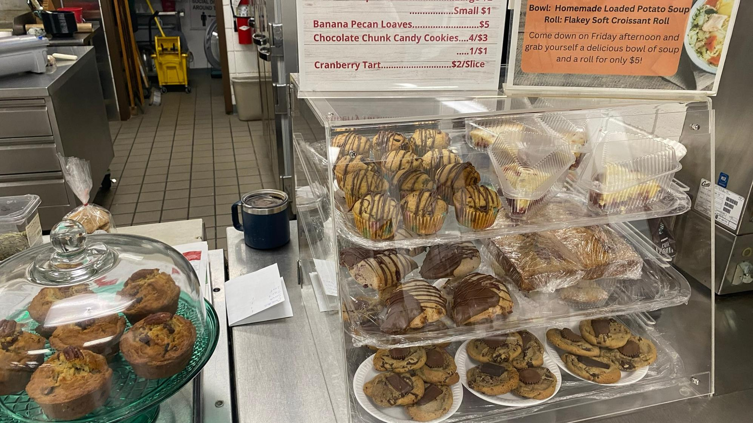


Pop Up
Bakery
Treats to share over coffee with friends
With music in the background

Slide 37
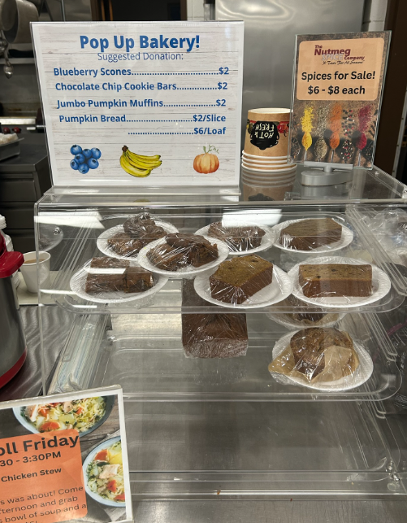
Pop Up Bakery
Every Thursday and Friday, we offer an assortment of bakery-quality goods at below "fundraiser" prices--high enough to be self- sustaining and cover ingredients, but affordable for any budget.
Complementary coffee and tea are also available to all members, so members can meet up and hang out for coffee at a fraction of the cost of Starbucks or Dunkin.

Slide 38
Bakery yields $600 profit over the last 6 weeks!
  We've sold hundreds of muffins, cookies, cake slices, and more.
  We've been able to use fresh, seasonal ingredients purchased from area farms through CSA shares.
  The Pop-Up Bakery has become self-sustaining--the income from the items gets recycled back into purchasing more ingredients for more baked goods!

Slide 39
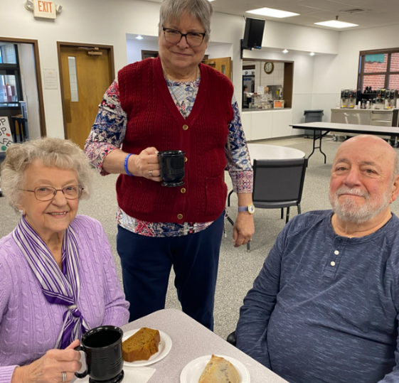
Our members love it.
But most importantly?
It serves our members who already come in for activities, but it also generates excitement, and has drawn new members in to hang out with their friends, have a coffee, and enjoy the ambiance. Instead of leaving to go out they stay at a discount.

Slide 40

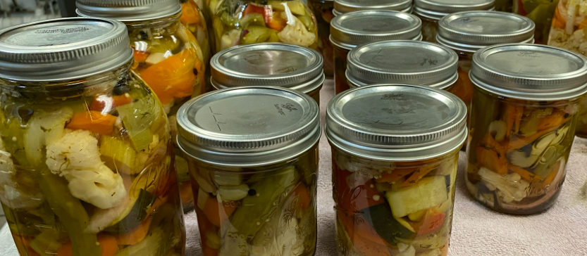

Enjoying local produce
all year long
Farm-to-Pantry
Canning

Slide 41
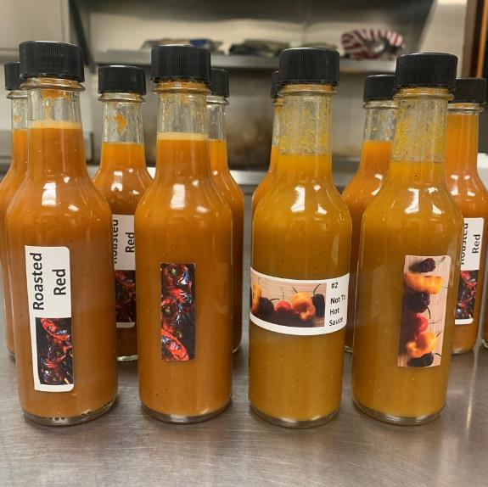
Farm-to-Pantry Canning
We've been fortunate to have access to CSA shares, which provides us with a selection of local produce during the growing season. What we don't use in preparing our Congregate lunches or Pop Up Cafe Meals, we preserve!
When a new batch of relish, jam, or pickles is ready, the buzz gets out: come on down!
To sell out before they hit the shelf is the norm.
Labels are made in house

Slide 42
Farm-to-Pantry Canning (continued)
  We were able to purchase an initial supply of canning jars, rings, and lids, as well as ingredients such as vinegar, mustard seeds, and sugar.
  Farm to Pantry has become self-sustaining, with the income earned being reinvested into supplies.
  By December, we had sold out of all of our preserved items!

Slide 43
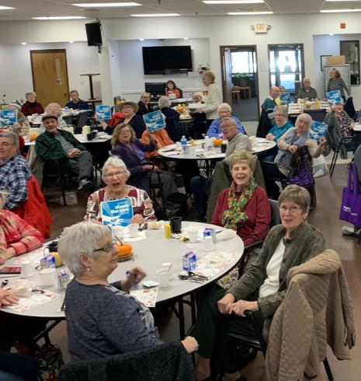
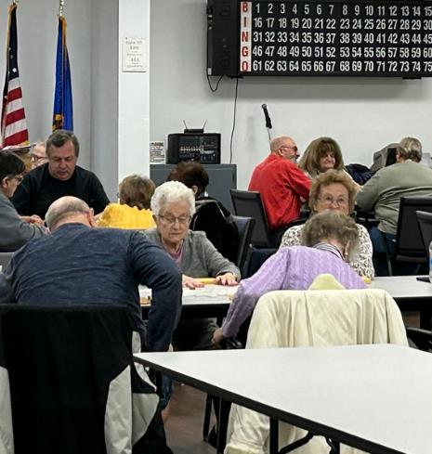

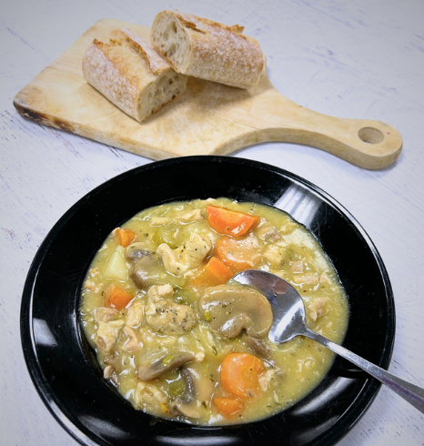
We Look Toward the Future
We have so many great plans to generate excitement for 2023 and beyond, and this grant provided an amazing foundation for us to build on. Our center is filling back up again, with both new and familiar faces, putting us in a great place as we look toward the future.
Don’t be afraid to bundle raffles and multiple ideas. Our experience has shown “GO BIG ~ WIN BIG!

Slide 44
Q & A
Joel Sekorski
Director Elderly Services
City of Torrington, CT
Joel_Sekorski@TorringtonCT.org

Slide 45
Takeaways
Remind the audience what has been covered
Review any calls to action
Mention any follow-on materials/events
Keep these notes brief
Notes:
If you need to include any recurring logos on interior (non-title and non-closing) slides, add to the slide master so that assistive technology does not read it on every slide. Always add the first instance to the actual slide (not the slide master) so that assistive technology will read it once.

Slide 46
Questions & Answers
Please use the chat box.

