Slide 1
Senior Nutrition Program Tool Kit
Notes:
This presentation will be an overview of what the Dietary Guidelines for Americans (DGA) are, tips for menu creators on how to adhere to the DGAs and how state policy can ensure the DGAs are met within Senior Nutrition Programs.

Slide 2
Intro
From May 2021 to August 2021, the Administration for Community Living and Tufts University dietetic intern Mackenzie Brown reviewed State Unit on Aging (SUA) menu policies for Senior Nutrition Programs (SNP).
State Units on Aging and Area Agencies on Aging can use the tool kit to help aid in improving SNP programs to adhere to the 2020-2025 Dietary Guidelines for Americans.
Notes:
The review process encompassed geographic differences among states by collecting policies from the North, South, East, and West. Interviews with multiple SUAs were conducted along with members of the DGA committee. Tips and suggestions were created based on SUA and dietitian feedback collected from current state menu policies, interviews, and nutrition-based research.

Slide 3
Older Americans Act & the Dietary Guidelines
Objectives
Understand the purpose of the Older Americans Act.
Summarize why the DGAs are important for SNP programs.
Outline 2020-2025 Dietary Guideline revisions.
Understand the 2020-2025 Dietary Guidelines for Americans.
Summarize the nutrients of concern for older adults.
Notes:
The first portion of this PowerPoint will go over the Older Americans Act and the 2020-2025 Dietary Guidelines for Americans. The objectives are listed on this slide.

Slide 4
Older Americans Act
Nutrition services are authorized under Title III-C of the Older Americans Act (OAA)
Designed to promote the general health and well-being of older individuals, the services are intended to:
Reduce hunger, food insecurity and malnutrition in older
adults
Promote socialization of older individuals
Enhance the health and well-being of older people
Notes:
The Older Americans Act covers services for older adults, including Senior Nutrition Programs. The OAA is designed to promote the general health and well-being of older individuals with the intention of reducing hunger, promoting socialization, and enhancing health and well-being.

Slide 5
OAA & the Dietary Guidelines
OAA requires that all meals served using OAA funds…
Adhere to the current Dietary Guidelines for Americans.
Provide a minimum of one-third of the Dietary Reference Intakes.
Meet state and local food safety and sanitation requirements.
Be appealing to older adults.
Meals must provide:
Minimum of 33 1/3 % of the DRI if the project provides one meal per day.
Minimum of 66 2/3 % of the allowances if the project provides two meals per day.
100% of allowances if the project provides three meals per day.
Notes:
Senior Nutrition Programs that are funded by the OAA are required to serve meals that meet the current DGAs, provide a minimum of 1/3 of the DRIs, meet safety and sanitation requirements, along with serving appealing meals to participants. If a program serves more than one meal a day, the DRI requirements increase as seen on this slide.

Slide 6
The Responsibility of State Units on Aging
Each State Unit on Aging has the responsibility and authority (Older Americans Act Section 305) to implement the nutritional standards (OAA Section 339) to best meet the needs of the older adults who they serve
For example, states may choose to use its funds to provide meals that focus on
Nutrient standards
Prevalent statewide chronic diseases
Predominant health issues affecting older adults
Notes:
State Units on Aging are responsible for developing and administering state plans that carry out the OAA nutritional standards. Some examples of what SUA may choose to focus on are nutrient standards, chronic diseases, and local major health issues. This is elaborated on, later in this PowerPoint.

Slide 7
Dietary Guidelines for Americans (DGAs)
Created by the U.S. Departments of Agriculture and Health and Human Services to provide nutritional guidelines for the general population.
The DGAs are used by federal food, nutrition, and health policies and programs to help the population consume a healthy and nutritionally adequate diet.
Guidelines are revised every five years to ensure the newest evidence-based nutrition research is promoted.
Notes:
The DGAs are created by the U.S. Departments of Agriculture and Health and Human Services to provide nutritional guidelines for Americans. The DGAs are especially important for Senior Nutrition Programs because that is what meals and menus are based upon. Right now, SUAs are following the current 2020-2025 DGAs, but the guidelines are updated every 5 years.

Slide 8
2020-2025 Dietary Guideline Revisions
2020-2025 guidelines are the first to address all stages of life, including infants and toddlers, children and adolescents, adults, women who are pregnant or lactating, and older adults.
Include special nutrient considerations for older adults.
Encourage cultural and personal preference flexibility.
Notes:
The 2020-2025 DGAs were the first to address all life stages, provide special nutrient considerations for older adults, and encourage cultural and personal preference flexibility. An example of the DGAs encouraging cultural and personal preference flexibility is including lactose-free dairy and fortified soy milk alternatives under dairy consumption.

Slide 9
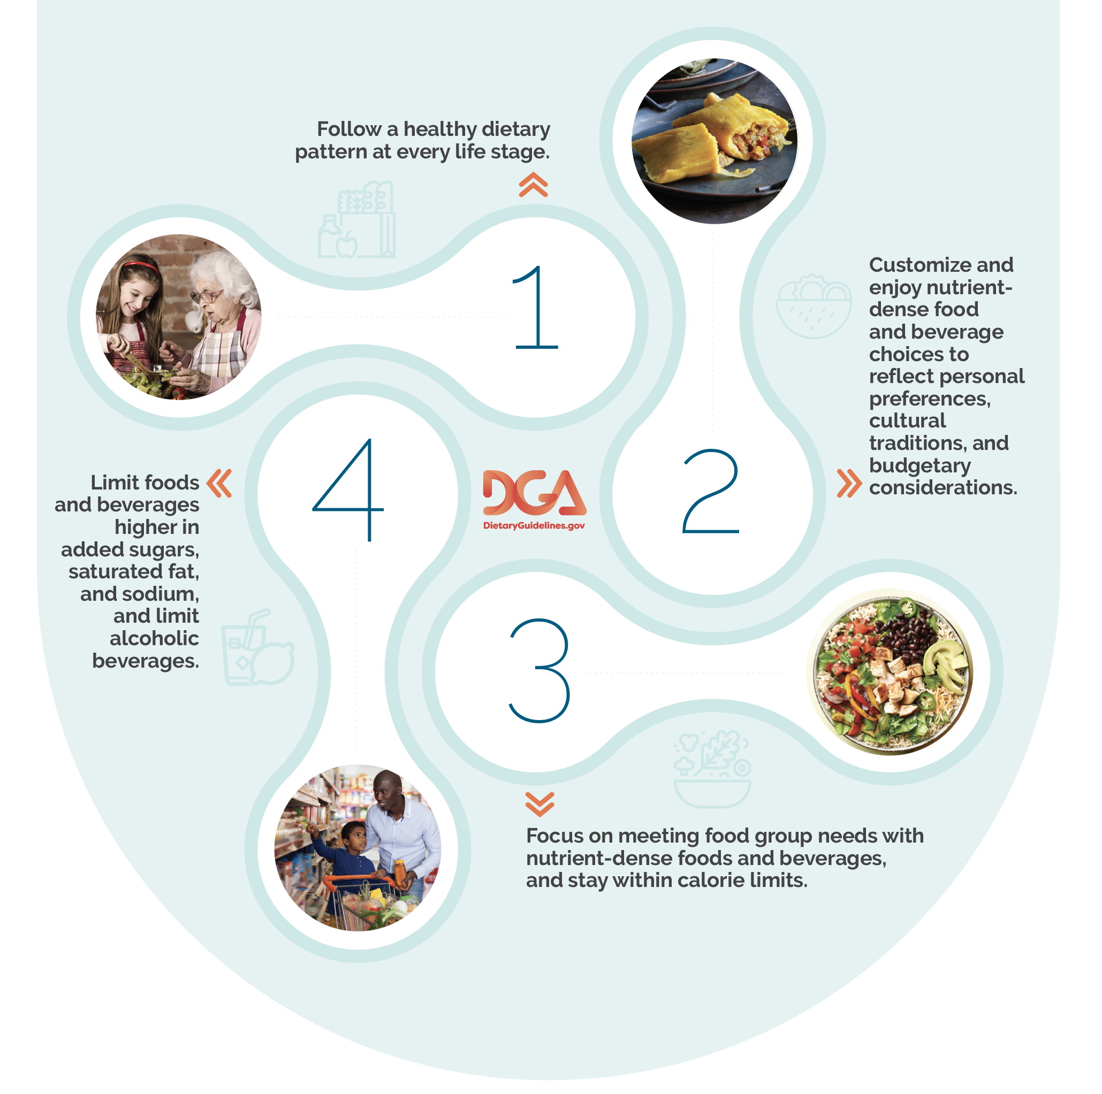
Four DGA Guidelines
https://www.dietaryguidelines.gov/resources/downloadable-graphics
Notes:
This graphic was taken from the Dietary Guidelines for Americans (https://www.dietaryguidelines.gov/resources/downloadable-graphics), which summarizes the four main guidelines seen on this slide.
Follow a healthy dietary pattern at every life stage.
Customize and enjoy nutrient-dense food and beverage choices to reflect personal preferences, cultural traditions, and budgetary considerations.
Focus on meeting food group needs with nutrient-dense foods, beverages, and stay within calorie limits.
Limit foods and beverages higher in added sugars, saturated fat, and sodium, and limit alcohol.

Slide 10
Key Dietary Principles
Meet nutritional needs primarily from foods and beverages.
Choose a variety of options from each food group.
Pay attention to portion size.
Notes:
When considering the key dietary principles, nutrient-dense foods should be the priority within SNP menus, rather than fortified foods and dietary supplements. To help add variety to meals, choosing different foods within each food group encourages flexibility for cultural and personal preferences. Lastly, SNP programs use standardized recipes to ensure portion sizes of meals appropriately reflect their nutritional analysis. Portion size also helps participants maintain a healthy weight and stay within an adequate calorie range. More information can be found in chapter 1 of the DGAs.

Slide 11
Learning Check-In
Choose which sentence is correct
State menu policies should…
Only be based off participant preference.
Be in alignment with the DGAs to offer nutritionally adequate
meals.
3. Not be individualized between each state.
Notes:
The correct answer here is that state menu policies should be in alignment with the DGAs to offer nutritionally adequate meals. Number 1 is incorrect because under the OAA, SNP programs must adhere to nutritional standards. Number three is incorrect because each state has individualized policies that are made to cater their SNPs.

Slide 12
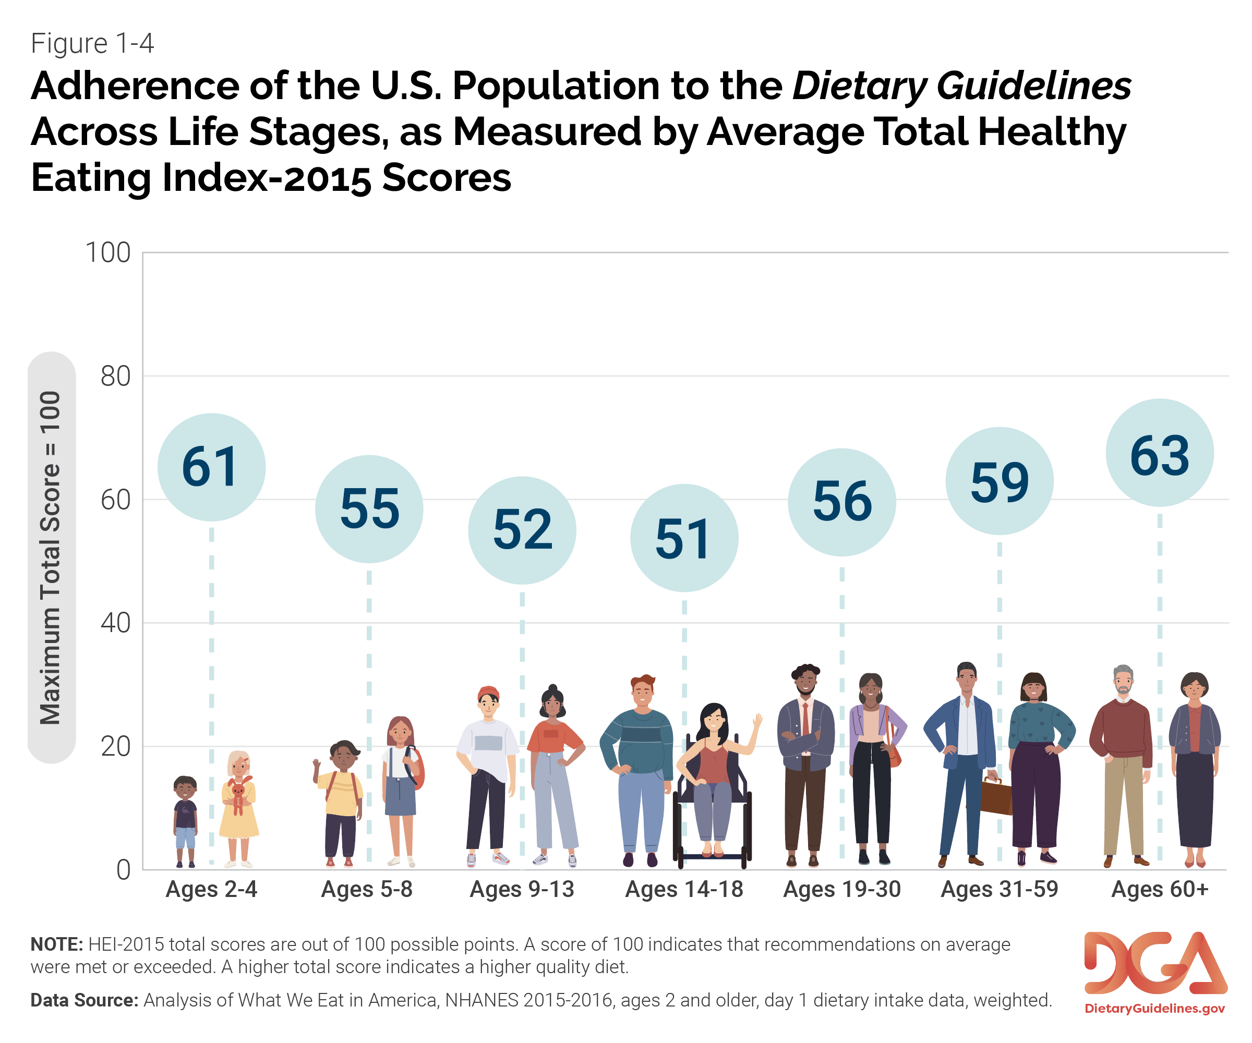
Adherence of the U.S. Population to the DGAs
Notes:
The Healthy Eating Index (HEI) is a measure of diet quality that can be used to assess compliance with the Dietary Guidelines. The higher the HEI, the higher the diet quality within that age range. As you can see, Older adults (60+) have the highest HEI of any portion of the lifespan.

Slide 13
General Population: Nutrient Concerns
Underconsumption of
Calcium
Potassium
Dietary fiber
Vitamin D
Notes:
There are several nutrients not consumed in adequate quantities by the general population. Due to their needed health benefits, these nutrients are considered a public health concern.
Low intakes of calcium could be attributed to participants not wanting to drink milk, which is usually the major source of calcium in a provided meal.
Potassium is mainly found in fruits and vegetables, which is just one of the reasons why Americans are advised to increase their fruit and vegetable intake.
Dietary fiber is often low in diets due to personal preferences for refined grains over whole grain and having a low fruit and vegetable intake.
Vitamin D is harder to reach recommended intakes through diet and therefore incorporating vitamin D-fortified foods and encouraging sunlight exposure is essential.

Slide 14
General Population: Nutrient Concerns (cont.)
Overconsumption of
Sodium
Added sugars
Saturated fats
Notes:
There are also nutrients the general public over-consumes.
When consumed in excess, sodium, added sugars, and saturated fats can contribute to health concerns such as high blood pressure, diabetes, and heart disease.
94% of male and 72% of female older adults exceed the daily recommended sodium intake. Large amounts of sodium are found in processed and fast foods.
Added sugars are often overconsumed due to consuming non-nutrient dense foods, such as sugar sweetened beverages and desserts.
80% of male and 77% of female older adults exceed the daily recommended saturated fat intake, which can lead to weight gain and cardiovascular diseases.

Slide 15
Older Adult Special Considerations
Underconsumption of
Protein
Vitamin B-12
Increased risk of
Dehydration
Alcohol consumption
Notes:
Many older adults do not reach their daily protein goal because of decreased appetite, difficulty chewing and swallowing, decrease caloric intake, and high cost of high protein foods.
As people age, the body decreases its ability to absorb vitamin B-12. This and consuming less protein usually leads to a vitamin B-12 deficiency.
Older adults have a decreased sense of thirst and additional complications relating to bladder control. This often results in dehydration.
When older adults consume alcohol, they are at an increased risk of alcohol related accidents.

Slide 16
Dietary Related Health Concerns
Health Concern | Nutritional Influences
Overweight & Obesity | Excessive caloric intake Excessive intake of empty calories Low physical activity level
Cardiovascular Disease & Risk Factors | Excessive sodium intake Excessive fat intake Low intake of dietary fiber
Diabetes | Excessive intake of foods high in added sugars Excessive intake of sodium and saturated fat
Cancer | Low dietary fiber intake Excessive intake of highly processed foods
Bone Health & Muscle Strength | Low protein intake Low physical activity
Notes:
The DGAs look at how diet impacts health. This slide shows a few health concerns that are influenced by what people eat. As you can see, high calorie intakes, large amounts of sodium, foods high in added sugar and fat, low dietary fiber, and low physical activity levels can cause serious health problems, such as cardiovascular disease and diabetes. For example, consuming high amounts of processed foods can increase sodium intake, which can lead to high blood pressure and water retention.

Slide 17
Nutrients in SNP Menus
Objectives
Understand why each nutrient is essential for older adult health.
Recognize menu modifications that improve nutrient content of meals.
Outline what food sources are high in each nutrient.
Comprehend how to decrease sodium, sugar, and saturated fat in menus.
Notes:
The next portion of this PowerPoint summarizes key nutrients mentioned in the DGAs and nutrition-related tips.

Slide 18
The Importance of Protein
Protein is especially important in the diets of older adult because of their susceptibility to loss of lean muscle mass as they age.
Adequate dietary protein is the main preventative factor for muscle loss and maintaining independence.
High protein foods include:
Meats, poultry, and eggs
Seafood
Nuts, seeds, and soy products
Dairy
Notes:
Older adults 60-70 years of age have a higher intake of protein than those 71 years and older. Within those who are 71 years and older, about 50% of women and 30% of men do not consume enough protein. Based on the DGA, older adults do not consume the recommended amounts of seafood, dairy, fortified soy alternatives, and legumes. As we age, many older adults do not process protein as efficiently, and adding more protein to meals daily help increase the body’s usage. Research shows the aging population requires 1.2 g/kg of protein a day. However, 25-30 g of protein/meal is a good rule of thumb.

Slide 19
SNP Protein Menu Tips
Choose lean or low-fat meat, poultry, and seafood options.
Set consumption limit for ground red meat.
Include a wide variety of protein sources, such as tofu, dairy, beans, nuts, and tempeh.
Add legumes to dishes such as salad, soups, and chilis.
Baking, broiling, grilling, and roasting are the preferred methods of cooking.
Serve seafood at least once a week.
Understand state policy on overlapping nutrient categories, such as legumes counting toward protein OR starchy vegetables.
Protein Tip Sheet
Notes:
Choose lean or low-fat meat, poultry, and seafood options
Skinless chicken
Turkey
Salmon
Shrimp
Click on the protein tip sheet to learn more about food sources, why protein is important, and additional protein resources

Slide 20
Dietary Fiber
Dietary fiber is essential to older adult health because it works to
Prevent becoming overweight and obesity
Improve blood sugar levels
Decreases blood pressure and cholesterol levels
Encourages healthy bowel movements
Daily Recommended Intake
Females (age 51+): 22 g fiber/day
Males (age 51+): 28 g fiber/day
Dietary fiber can be found in fresh fruits, vegetables, and whole grains
Notes:
Dietary fiber has multiple health benefits. It helps to prevent obesity, improves blood sugar levels, decreases blood pressure, and encourages a healthy bowel and digestion. The recommended daily intake is 22 grams for females, and 28 grams for males, 51 and older. High sources of fiber are found in fresh fruits, vegetables, and whole grains.

Slide 21
Increasing Dietary Fiber in SNP Menus
Select whole-grain breads and cereals.
Increase vegetables and fruits.
Choose whole fruits and vegetables rather than fruit or vegetable juices.
Include whole-grain flour, fortified cereals, or oatmeal into baked goods.
Offer a high-fiber cereal for breakfast.
Serve high-fiber foods, which are classified as having 5 or more grams of fiber.
Add legumes to recipes, such as salads, soups, and pastas.
Dietary Fiber Tip Sheet
Notes:
Bran flakes, whole-wheat biscuits, oat bran, and granola-based cereals are examples of cereals that are high in fiber. Use the dietary fiber tip sheet to learn more about how it affects health, high food sources, and additional resources.

Slide 22
Vitamins and Minerals
Vitamin B-12
DRI: 2.4 mcg/day
Sources: Meat, seafood, dairy/dairy alternatives, and fortified ready-to-eat cereals
Vitamin D
DRI: 600 IU/day
Sources: Sun exposure, salmon, portabella mushrooms, dairy, and fortified ready-to-eat cereals
Notes:
People need vitamins and minerals for the body to function and develop normally. The newest 2020-2025 DGAs state there is an underconsumption of calcium, potassium, and vitamin D in the general population, along with low intakes of vitamin B-12 in older adults. Eating inadequate amounts of these nutrients can lead to osteoporosis, fatigue, weakness, anemia, and more. It is important for individuals to receive enough vitamins and minerals to live a healthy life. The next couple of slides share menu tips, food sources, and nutrient requirements for common under-consumed nutrients that SNP programs can incorporate into their meals and menus.

Slide 23
Vitamins and Minerals (cont.)
Calcium
DRI: 1,000-1,200 mg/day
Sources: Dairy products, some vegetables and beans, and fortified products like orange juice
Potassium
DRI: Female: 2,600 mg/day
Male: 3,400 mg/day
Sources: Fruit, vegetables, and dairy products

Slide 24
Menu Tips for Vitamins and Minerals
Increase vegetables, fruit, beans, whole grains, and dairy.
Use in-season produce to offer the highest nutrient content.
Cook fruits and vegetables lightly or eat raw.
Nutrient analysis software may misinterpret vitamin and mineral content of a meal.
Unprocessed foods should be the main source of vitamins and minerals.
Vitamin D & B12 Tip Sheet
Calcium and Potassium Tip Sheet
Notes:
Increasing vegetable, fruit, beans, whole grains, and dairy within meals will help participants reach the recommended intakes of all vitamins and minerals
Use in-season produce to offer the highest nutrient content, such as serving fresh apples in the months of September and October
Cook fruits and vegetables lightly or eat raw to preserve nutrients
Nutrient analysis software may misinterpret the vitamin and mineral content of a meal. If using nutrient analysis, it’s important to use standardized recipes and compare the database to your inventory’s food labels
Unprocessed foods should be the main source of vitamins and minerals, but fortified foods and dietary supplements should be included if necessary
View the vitamin and minerals tip sheet for detailed food source charts, information about each nutrient, and individualized menu tips.

Slide 25
Beverages
Older adults are more susceptible to dehydration due to
Decreased sense of thirst
Complications related to bladder control
SNP programs should always have water available for participants
Serve low sugar beverages such as:
Tea
Infused fruit water
Sparkling water
100% vegetable or fruit juice
Low-fat milk/milk alternatives
Notes:
Beverage choice is important for older adults due to their increased risk of dehydration. SNP programs should ensure there is always water available for participants, along with other low-sugar beverage options.

Slide 26
Milk Alternatives
Older Americans Act (OAA) does not require milk to complete a meal.
OAA does require meals to meet daily reference intake for calcium.
Milk alternatives are foods that share similar nutrients to milk, such as calcium.
Offering milk alternatives is recommended due to the large prevalence of participants who cannot tolerate milk-based products (lactose).
Dairy Requirements for SNPs Tip Sheet
Notes:
Even though the OAA does not require milk with meals, it does require the meal meets the calcium DRI. Some examples of milk alternatives include yogurt, soy milk, cheese, collard greens, kale, fortified tofu, fortified orange juice, etc.
Click on the dairy tip sheet to learn about frequently asked questions, SNP milk alternative requirements, and a detailed milk alternatives food chart.

Slide 27
Decreasing Sodium in SNP Menus
Choose no added salt or reduced sodium products.
Be cautious of foods that have hidden sodium.
Choose plant-based proteins.
On-site nutrition expert should provide participants with nutrition education.
Use herbs and spices, rather than salt:
Rosemary, garlic, basil, chili/cayenne, cumin, oregano, paprika, thyme, and turmeric.
Notes:
Sodium is needed, in small amounts, for the body to work properly. Diets high in sodium can lead to high blood pressure and water retention, which increases risk of cardiovascular diseases and renal complications. Limiting sodium will help individuals improve their health and decrease risk of cardiovascular diseases.
Tips
Choose no added salt or reduced sodium products
Be cautious of foods that have hidden sodium, such as cottage cheese, processed cheese, and processed meats
Choose plant-based proteins that are lower in sodium and saturated fats compared to processed meats, poultry, and seafood
On-site nutrition expert should provide participants with nutrition education regarding the health risks of high sodium intake and the use of additional table salt.
Instruct participants when consuming a high-sodium meal to decrease the sodium in the other meals consumed.
Use herbs and spices, rather than salt
Rosemary, garlic, basil, chili/cayenne, cumin, oregano, paprika, thyme, and turmeric

Slide 28
Decreasing Saturated Fat in SNP Menus
Use olive oil, peanut oil, soybean oil, or canola oil in cooking.
Avoid saturated and trans fats, such as coconut oil, palm oil, and butter.
Select leaner meats like skinless chicken and low-fat milk, such as skim milk.
Offer desserts such as fruit crisp and angel food cake.
Notes:
Fat is an essential part of the diet, but some fats are better choices than others. A diet high in saturated fats can increase the risk of heart disease, weight gain, and high cholesterol. When choosing the type of fat used in cooking, unsaturated fat is preferrable to saturated fats. According to the DGAs, limit fat intake to no more than 22 grams per day, which means each meal should have less than 7-8 grams.
Olive oil, peanut oil, and soybean oil are high in unsaturated fats and are good to use in cooking. Fats such as coconut oil, palm oil, and butter should be avoided. You can choose to select leaner and low-fat meats like skinless chicken. Lastly, desserts do not have to be served unless it is a state policy.

Slide 29
Decreasing Added Sugars in SNP Menus
Do not include desserts as part of the meal pattern, or limit their frequency.
Choose low-sugar or no sugar added foods and beverages.
Limit sweet bakery products to once a week.
Serve unprocessed foods, such as raw vegetables.
Avoid fruit juices that are not made from 100% real fruit.
Limiting Sodium, Saturated Fat, Empty Calories, and Refined Grains Tip Sheet
Notes:
According to the DGAs, limit added sugars to no more than 50 grams per day, which means no more than 17 grams per meal. Decreasing added sugars in meals will help reduce extra calories, low nutrient dense foods, and improve blood sugar levels. On this slide there is a link to a tip sheet on limiting sugar, sodium, and fats in SNP menus.

Slide 30
Menu Template & Examples
Objectives
Use general meal pattern for menu creation.
Prepare meals and menus that reflect the Dietary Guidelines and Dietary Reference Intakes.
Provide quality meals that meet cultural and participant preferences.
Notes:
The next couple of slides will go over a basic dietary pattern for SNP meals, along with menu examples.

Slide 31
Dietary Pattern
A dietary pattern…
Summarizes what individuals eat and drink and the combination of foods and beverages consumed over time.
Helps predict overall health status and disease risk.
Consists of nutrient-dense forms of foods and beverages across all food groups, in recommended amounts, and within calorie limits.
Visit MyPlate.gov to learn more about a healthy dietary pattern.
Notes:
A dietary pattern is the totality of what individuals habitually eat and drink – the combination of foods and beverages consumed over time – and science shows that these foods and beverages act together to affect health. As a result, the dietary pattern may better predict overall health status and disease risk than individual foods or nutrients.

Slide 32
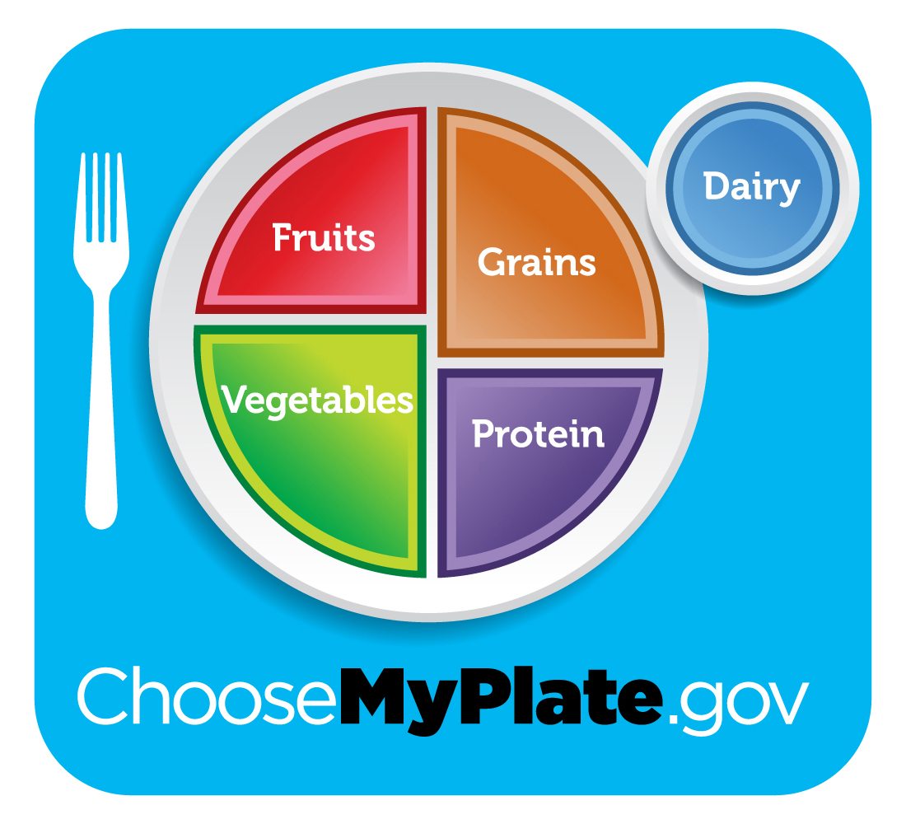
MyPlate.gov
Notes:
This is the My Plate example of a healthy, well-rounded dietary pattern. More can be learned about this at MyPlate.gov

Slide 33
Protein
3 ounces per meal
Portion size equivalents:
1 egg
½ cup (4 oz) legumes (beans and lentils)
1 oz cooked meat, fish, poultry
1 oz cheese
2 tablespoons peanut butter
1/3 cup nuts
¼ cup cottage cheese
1 oz tofu
Notes:
This slide shows how much protein should be served in one meal. Listed below the serving sizes are examples of portion size equivalents. Portion size equivalents help standardize recipes and ensure all nutrient requirements are being met. These portion sizes and nutrient categories help create a healthy dietary pattern for menus and meals.

Slide 34
Fats
Fats/Oils
Use sparingly
Portion size equivalents:
1 tablespoon oil (vegetable, canola, corn, olive, soybean)
1 tablespoon margarine or butter
1 tablespoon mayonnaise

Slide 35
Grains
Minimum of ½ cup or 1 oz (1 – 2 Servings)
Portion Size Equivalents:
½ cup or 1 oz
Minimum 1
1 slice (1 oz) bread
4 oz starchy vegetable
½ cup cooked pasta, rice, noodles
1 oz ready‐to‐eat cereal
2” cube cornbread
1 slice French toast
½ English muffin
4‐6 crackers (1 oz)
1 tortilla, biscuit, waffle, pancake, muffin
½ bagel, 3‐4” diameter
1 small sandwich bun
½ cup cooked cereal
½ large hotdog/hamburger bun, 1 oz
½ cup bread dressing/stuffing
Notes:
For example, if I wanted to create a meal with 1 ounce equivalent of grains, I could choose either 1 slice of French toast or 4 ounces of starchy vegetables to fulfill that requirement.

Slide 36
Fruits/ Vegetables
½ cup, Minimum 2 servings
Portion size equivalents:
1 medium fresh fruit (e.g. apple, pear, banana, etc.)
½ cup cooked, frozen, or canned, drained fruit
½ cup 100% fruit juice
1/3 cup cranberry juice
¼ cup dried fruit
15 grapes
½ cup cooked, drained fresh, frozen, canned, or raw vegetable (e.g., green beans, peas, etc.)
1 cup raw leafy greens and shall consist of at least 3 different vegetable greens
½ cup tomato juice
½ cup 100% vegetable juice

Slide 37
Milk/Milk Alternatives
Minimum 1 cup serving
Portion size equivalents:
8 oz milk
8 oz milk alternative, such as lactose-free, soy, almond, or oat milk
1 ½ oz of cheese
½ cup calcium processed tofu
Calcium fortified, ready-to-eat cereal
Powdered calcium‐fortified beverage mix; must have serving of water to accompany
4 ‐6 oz of calcium fortified juice
1 cup yogurt
¼ cup nonfat powdered dry milk per 1 cup water

Slide 38
Meal Example
Orange Juice
5-spice Chicken
Rice Pilaf
Seasoned Zucchini
Whole-Wheat Dinner Roll
Pineapple
St. Mary’s County, Maryland Congregate Meal Program
Notes:
This menu example was taken from St. Mary’s County in Maryland: https://www.stmarysmd.com/aging/meals.asp. This is a great example of how a meal can be tailored to more appropriately adhere to the DGAs. For example, instead of choosing milk, that may not be preferred by participants, they opted for a calcium fortified orange juice. They use herbs and spices rather than salt for the 5-spice chicken and seasoned zucchini. The whole wheat dinner roll is a great example of how fiber can be added into a meal, rather than choosing a refined grain. Lastly, St. Mary’s chooses to serve fresh pineapple, rather than a dessert that is high in saturated fats and sugar. Use the link provided to see their current monthly menu.

Slide 39
Things to Consider…
Plate appeal
Compromise between participant preferences and the “most nutritious” choice
No benefit to meals if the participant does not eat it
Nutrient analysis software may not accurately reflect meal served
Variety in meals served, little repetition throughout the month
Notes:
When creating menu policies, it is important to consider plate appeal, participant preferences, recipe standardization for accurate nutrient analysis, and serving a variety of meals.
Plates should contain a variety of color, texture, and flavor
Compromise between participant preferences and the “most nutritious” choice. An example of this would be white rice preference vs. brown rice preference
It is important to remember that there is no benefit to meals if the participant does not eat it
Nutrient analysis software may not contain exact foods used in meals. This is important to double check because it could lead to an incorrect nutritional analysis.
It is preferred to have a variety in meals served with little repetition throughout the month

Slide 40
State Units on Aging: Menu Policy
Objectives
Recognize why menu policy is important for nutrition programs.
Understand other state examples of menu policies.
Be aware of what policies are included in menu standardization.
Understand how State Units on Aging can improve state menu policies and standards.
Notes:
The last segment of this PowerPoint goes over State Units on Aging and their menu policies.

Slide 41
State Policies Include
Nutrient analysis
Menu approval process
Menu documentation
Meal site and menu specifications
Dietary Guidelines/DRI per meal nutrient requirement
Meal pattern requirements
Cultural recommendations
Participant inclusion process
Participant nutrition education
Staff nutrition trainings
The comprehensive DGA Implications for SNPs Guide
Notes:
We’ve developed a comprehensive policy document that includes an overview of the 2020-2025 DGA revisions, state menu policy examples, State Units on Aging contact information, and DRIs for older adults.
On this slide are examples of where states can customize their menu policies. Use the State Policy Document to view detailed information about each policy category, state examples, SUA contacts, and main DGA takeaways.

Slide 42
Policy Example
Below is an example of how state policies can differ
Wyoming
Minimum meal requirement of:
9 grams of fiber
300 mcg of vitamin A
30 mg of vitamin C
Massachusetts
A good source of Vitamin C every day.
A good source of Vitamin A at least 3 times per week.
A high fiber bread at least 3 times per week.
Understanding different state policies can help each state and local program reach their highest level of success
Notes:
This is just one example of how menu policies may differ between states.

Slide 43
Considerations for State Units on Aging
Review and revise state policies.
Collaborate with other SUAs.
Check out state collaborations at the Nutrition and Aging Resource Center https://acl.gov/senior-nutrition
Use additional government resources.
Notes:
SUAs should consider reviewing and revising state menu policies at least every 5 years, when the new DGAs are published. SUAs can also collaborate with other states (https://acl.gov/senior-nutrition) to share policy ideas, strengths of their programs, and what has worked for their facility. Lastly, states can use additional government resources that are listed at the end of this presentation.

Slide 44
Overview
State Units on Aging are responsible for developing and administering state plans that carry out the OAA in Senior Nutrition Programs.
Older adults have special nutrients of concern that should be taken into consideration during menu planning and menu policies.
A well-rounded meal will provide participants with the nutrients they need to live a healthy, independent life.
Reviewing and revising menu policies can help Senior Nutrition Programs adhere to the DGAs and DRIs.

Slide 45
Conclusion
“Everyone has a role to play to support access to healthy foods and beverages where people live, learn, work, play, and gather.”
“Having access to healthy, safe, and affordable food is crucial for an individual to achieve a healthy dietary pattern.”
-Dietary Guidelines for Americans
Notes:
To wrap up this presentation, here are two quotes from the DGAs that emphasize why Senior Nutrition Programs are vital to communities.

Slide 46
State Contributions
Thank you to the following states for your contributions to this tool kit:
California
Delaware
Georgia
Iowa
Maryland
Massachusetts
Wyoming
Contact information for these states can be found at the end of the DGA Implications for SNPs Guide.

Slide 47
Resources & References
Full list of references in shared drive.
Notes:
Word document with references page in shared drive****

