Slide 1

Food Insecurity Education Series
WEBINAR
Combating Food Insecurity with Collaboration
Kathryn Tucker, MS, RD, LD, ACL Contractor
Tim Getty, Heritage Area Agency on Aging
July 21, 2022

Slide 2
Objectives
Understand how food insecurity affects older adults.
Identify components of the Older Americans Act, Senior Nutrition Program, and other federal programs.
Recognize collaboration’s role in combatting food insecurity.
Identify key stakeholders who are potential collaborators.
Find ways to increase funding sources to help reach food-insecure seniors.

Slide 3


Speakers
Kathryn Tucker
ACL Consultant
Tim Getty
Heritage AAA

Slide 4
What is food insecurity?
USDA defines food security as “access by all people at all times to enough food for an active life.”
Food insecurity occurs when nutritionally adequate and safe foods may not be available.

Slide 5
Level of Food Security
Low food security
Poor nutrition quality and limited variety. Little or no indication of reduced food intake.
Very low food security
Reports of skipping meals or not eating. Has reduced food availability.

Slide 6

Food Insecurity Data
General Population Data | 2019 | 2020
U.S. Population experiencing food insecurity (low and very low food security) | 10.5% | 10.5%
U.S. households experiencing very low food security | 4.1% | 3.9%
Food-insecure U.S. households in the south | 19.1% | 21.7%
Looking at older adults:
22.1% of older adults with low income who lived alone were food insecure
12% of those were considered to have low food security, and
10.1% were considered to have very low food security.

Slide 7
Food Insecurity Affects Health
2019 Healthy Aging poll:
  14% of older adults were food insecure
  17% of adults 60-64 years experience food insecurity
  10% of adults 65-80 years experience food insecurity
Of those reporting food insecurity:
  45% have fair or poor physical health
  24% have fair or poor mental health
  43% have a fair or poor diet

Slide 8

Social Determinants of Health (SDOH)
Conditions in the environment where people are born, live, learn, work, play, worship, and age.
Affect a wide range of health risks and outcomes, as well as quality of life.

Slide 9





5 SDOH Domains
Economic stability
Education
Health and health care
Neighborhood and build environment
Social and community context

Slide 10

We can’t do it in a day!
Addressing food insecurity one step at a time, over time.

Slide 11
Where do we start?
Federal assistance programs
  OAA Senior Nutrition Program
  Supplemental Nutrition Assistance Program (SNAP)
  Seniors Farmers Market Nutrition Program
  Commodity Supplemental Food Program
Identify ways to improve utilization by your participants

Slide 12
OAA Nutrition Program Intent
Reduce hunger, food insecurity, and malnutrition
1
Promote socialization
2
Promote health and well-being
3
Nutrition Services authorized under Title III-C:

Slide 13
OAA Target Populations
Those with low income
Members of minority groups
People living in rural communities
Individuals with limited English proficiency
Those at risk for institutional care
Reflection: Think about how many people we serve in each of these populations. Some more than others?

Slide 14
More on OAA Nutrition
Designed to promote general health and well-being
Meals 5 or more days a week
  Congregate meals
  Home-delivered meals
Includes nutrition screening, education, and counseling
Other services, such as supplemental food and food boxes

Slide 15
Examples: OAA Addressing SDOH
Economic Stability
Meal programs and nutrition services
Referrals – SNAP, food pantries, etc.
Community service employment program
Education
Language translation
Nutrition education
Health and Health Care
Oral health
Case management
Chronic disease self-management
Nutrition counseling
Neighborhood and Build Environment
Meal programs
Transportation
Heating assistance and home repairs
In-home services
Senior housing
Internet availability
Social and Community Context
Telephone reassurance
Senior centers
Caregiver programs
Virtual connections

Slide 16
SNAP
Households must meet certain eligibility requirements
Benefits spent locally or online
OAA staff refer and encourage to apply
Can apply by phone or online
  States vary with enrollment
  Check with your state SNAP agency

Slide 17
Commodity Supplemental Food Program
Income requirements for eligibility
Distributes USDA food to people 60+ years
Provides nutrients older adults lack
Focuses on heart health
OAA staff refer and encourage to apply

Slide 18
Senior Farmers Market Nutrition Program
Income requirements to be eligible
Access to locally grown produce, honey, and herbs
Increase the consumption of agricultural commodities
Increase purchasing power with SNAP
OAA staff refer and encourage to apply

Slide 19

Why collaborate?
Eliminates duplicate efforts
Improves communication and builds networks
Energizes groups
Helps launch initiatives and realize new possibilities
Buy-in from policymakers and funders
Permanent social change

Slide 20
Collaboration Key Steps
Avoid being territorial
Find your CHAMPION
Communicate goals and objectives
Keep a record
Visit partners and enlist specialist(s)
Collect data and share with partners

Slide 21
Potential Key Stakeholders
Hunger organizations, coalitions, and task forces
Food pantries and feeding kitchens
Schools and U.S. cooperative extension agencies
Hospitals and faith-based organizations
Grocery stores, farmer’s markets, and community gardens
Tribal food programs and local governments

Slide 22
Hunger Organizations, Task Forces, Coalitions
Learn about local, regional, or statewide efforts
Take a seat at the table
Actively participate
Be familiar with other organizations
Identify referral opportunities
Provide available community resources to staff

Slide 23
Collaborating with Local Governments
Partner with research departments
Have partnership ideas ready
Educate staff on programs
Reach out to elected officials as a constituent
Develop a relationship before asking for funding
Look for ways government can partner without funds

Slide 24
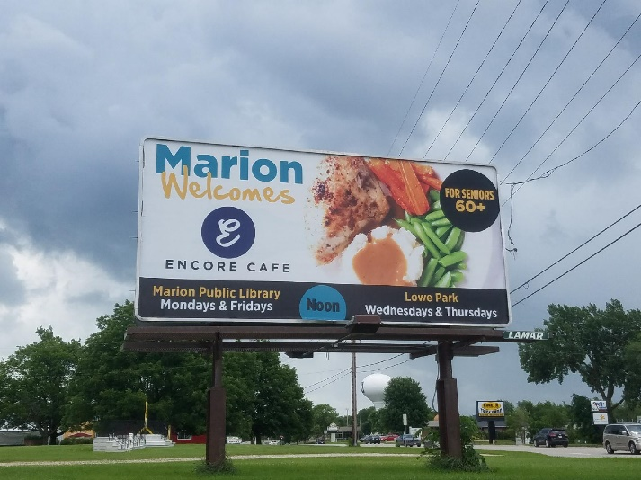
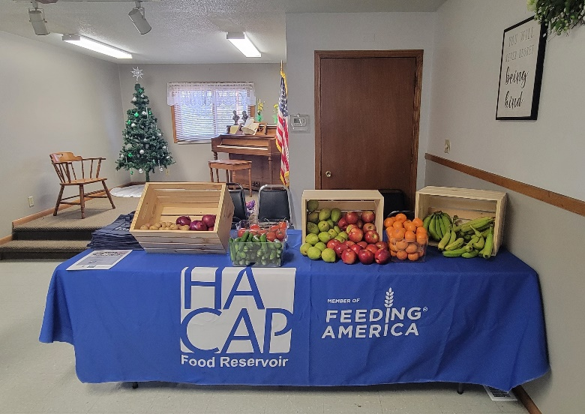
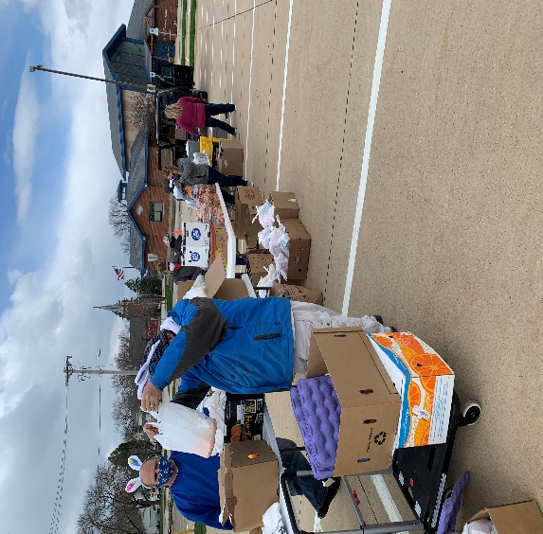
Collaboration Examples
Donated billboard from City of Marion, IA
Rural produce pantry in partnership with food bank
COVID food distribution with local hotel support

Slide 25
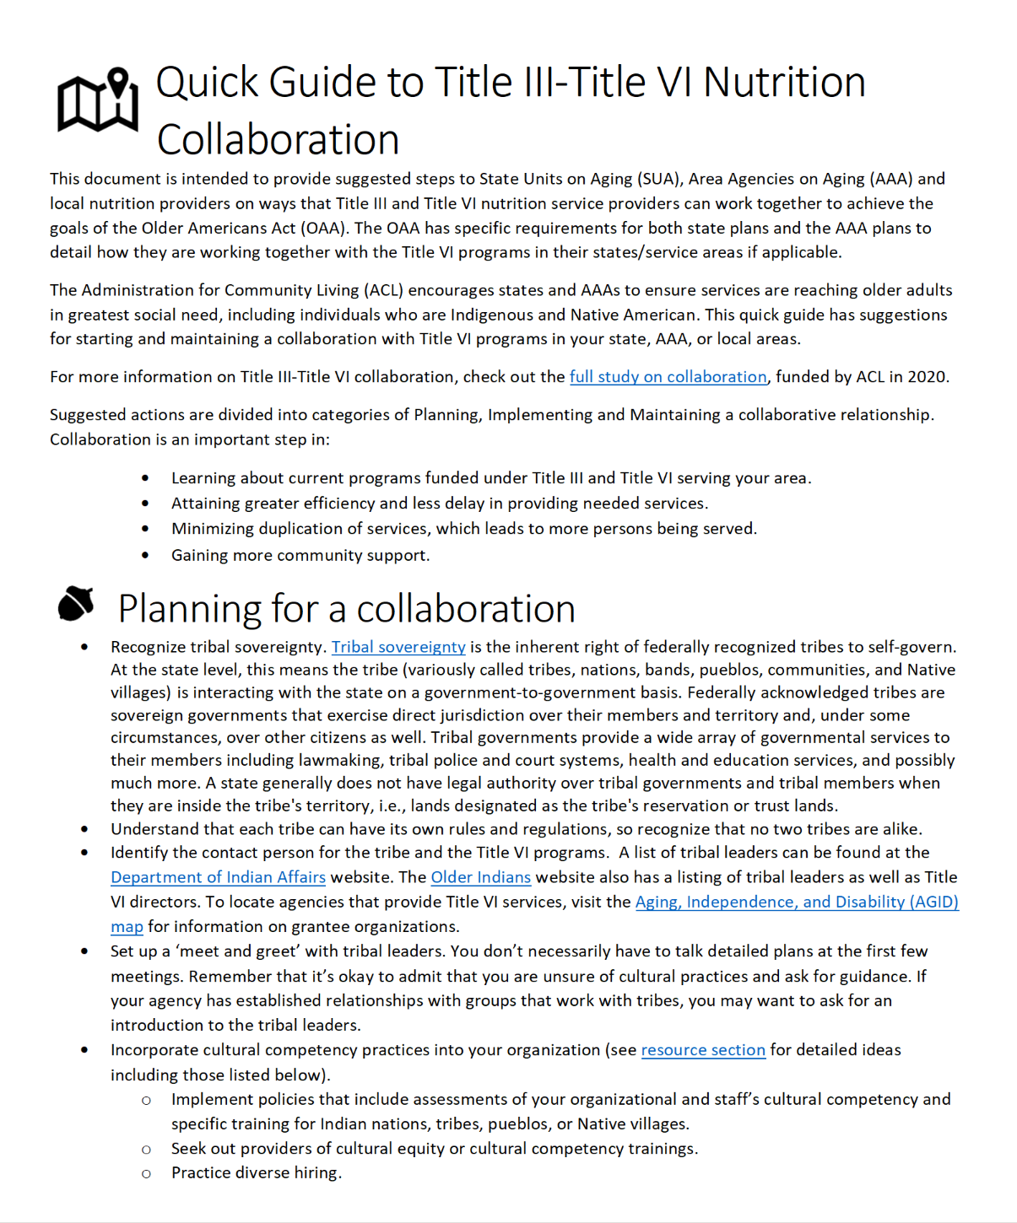
Tribal Communities
Quick Guide to Title III-Title VI Nutrition Collaboration:
  Planning for collaboration
  Implementing collaboration
  Maintaining collaboration
Resource link at end of the slide deck

Slide 26
Volunteers needed!
Assist with serving and delivering meals
Transporting services
Grocery delivery
Create shelf stable meal kits
Help with food drives
Counselling services

Slide 27

Fundraising Activities
“Adopt a senior”
Fundraising meals
Charity runs and car shows
Auctions
Golf tournaments
Book and craft sale events
Holiday cards

Slide 28
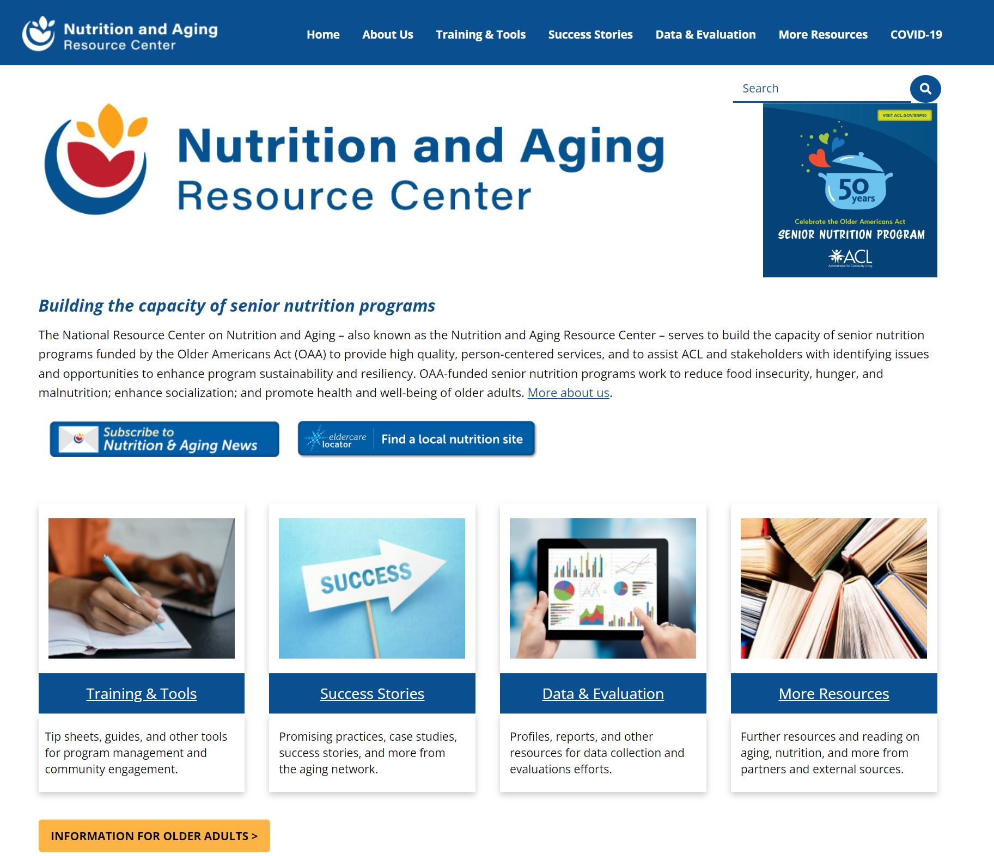
Nutrition and Aging Resource Center
ACL.gov/senior-nutrition resources include:
Food insecurity information
Consumer information
Tip sheet for providers
Guides
Webinars
Innovation programs and more!

Slide 29
Partnering is essential.
Next steps:
Find the champion
Be a consistent voice on coalitions
Develop partnerships for your community events
Be willing to help other organizations
Use social media to communicate with your community

Slide 30
Upcoming Educational Topics
State Unit on Aging food insecurity best practices
Identifying and screening for food insecurity
Referring participants who are food insecure

Slide 31
Questions?
Kathryn Tucker, MS RD LD FAND: Kathryn.tucker@acl.hhs.gov
Tim Getty: Tim.Getty@kirkwood.edu

Slide 32
Resources
Nutrition and Aging Resource Center (ACL)
  Quick Guide to Title III-Title VI Nutrition Collaboration
  Business Acumen Basics for Senior Nutrition Programs
  Meal Services Elements for Sustainability
  Options for Contracting Meals
  Partnerships with Foodbanks and Other USDA Programs
  Volunteer Engagement and Recruitment Resources
Definitions of Food Security and Stats (USDA)
  Screening and Survey Tools
  Commodity Supplemental Food Program State/Local Agency Information
Food and Food System Resources During COVID-19 (CDC)
Food Research & Action Center
Feeding America
Defeat Malnutrition Today
  National Blueprint: Achieving Quality Malnutrition Care for Older Adults
  Quality Malnutrition Care
Malnutrition for Professionals (NCOA)
Malnutrition Solution Center (ASPEN)
Nutrition Focused Physical Exam (AND)

