Slide 1
Food Insecurity Education Series
Webinar 2
State Units on Aging Promising Practices Combatting Food Insecurity
Kathryn Tucker, MS, RDN, LD, ACL Contractor
Carmen Clutter, MS, RDN, LD, Ohio Department of Aging
Autumn Trombetta, MS, RDN, Ohio Department of Aging
Ophelia Steppe, MS, RD, LD, New Mexico Aging & Long-Term Services
August 2022

Slide 2
Objectives
Describe components of food security continuum and how initiative can make a difference.
Give examples of best practice efforts across the OAA program.
Identify possible obstacles to efforts and ways to overcome them.
Learn how the network can increase partnerships to combat food insecurity.
Identify ways states can use data and outcomes to make an impact.

Slide 3
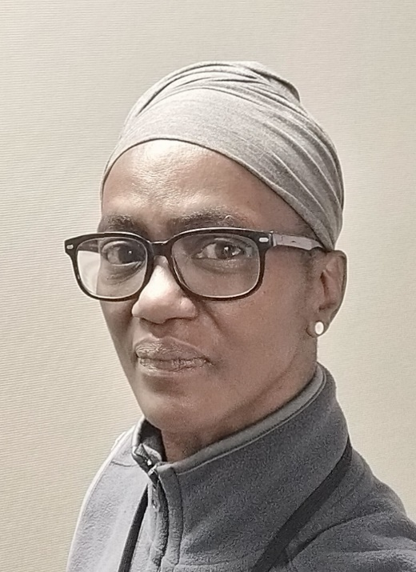
Speakers
Kathryn Tucker
ACL Consultant
Carmen Clutter
Assistant Chief
Ohio SUA
Autumn Trombetta
Population Health & Nutrition Manager
Ohio SUA
Ophelia Steppe
SUA Nutritionist
New Mexico SUA

Slide 4
What is food insecurity?
USDA defines food security as “access by all people at all times to enough food for an active life.”
Food insecurity occurs when nutritionally adequate and safe foods may not be available.

Slide 5
Level of Food Security
Low food security
Poor nutrition quality and limited variety. Little or no indication of reduced food intake.
Very low food security
Reports of skipping meals or not eating. Has reduced food availability.

Slide 6
Food Security Continuum
Stage 1
Short Term Relief Strategies
Food banks, soup kitchens, farm aid
Food policy, social justice, coalitions, and councils
Stage 3
Food System Strategies
Stage 2
Capacity Building Strategies
Community gardens, community kitchens, buying clubs
FOOD SECURITY
Adapted from: Laura Kalina, Building Food Security in Canada, From Hunger to Sustainable Food Systems: A Community Guide.
Notes:
Food Security Continuum Stages 1 to 3:
Stage 1: Short Term Relief Strategies: Food banks, soup kitchens, farm aid. Stage 2: Capacity Building Strategies: Community gardens, community kitchens, buying clubs. Stage 3: Food System Strategies: Food policy, social justice, coalitions, and councils Food Security.

Slide 7
Growing Need in States
Older adult population is growing
Food insecurity and looming hunger cliff
Increased financial concerns for older adults
Decreased physical abilities in food insecure older adults
Relationships between chronic disease and malnutrition
Increased risk of hospital readmissions

Slide 8
Focus on Food Insecurity
Decreasing Food Insecurity
Food assistance program utilization
Increases food resources
Improves overall health
Improves physical function
Reduces hospital readmissions
Improves overall quality of life

Slide 9
SUA PROMISING PRACTICES

Slide 10
Georgia Food Insecurity Initiatives
State Plan to Address Senior Hunger
Senior Hunger Nutrition Coordinator
12 senior hunger coalitions
Provide mini-grants for initiatives
Food security screening on all clients
Host Aging and Disability Resource Connection conference
Contact Allison.Bernal@dhs.ga.gov with any questions
Notes:
Email: Allison.Bernal@dhs.ga.gov

Slide 11
California Food Insecurity Initiatives
HCBS Senior Nutrition Infrastructure Grant Program
Older Adults Recovery and Resilience funding (OARR)
Food assistance analysis
Partnerships
Other state agencies
California Association of Food Banks
Local government agencies
Agencies specializing in senior resources
Highlighting success stories
Contact linda.wonderly@aging.ca.gov with any questions
Notes:
Email: linda.wonderly@aging.ca.gov

Slide 12
Ohio Department for Aging
Carmen Clutter
Assistant Chief
Ohio SUA
Autumn Trombetta
Population Health & Nutrition Manager
Ohio SUA
Notes:
CARMEN
Good afternoon to all!
We are so happy to be joining ACL and New Mexico Aging & Long-Term Services Department on today’s webinar.
Thank you to Kathryn Tucker for extending the invite to the Ohio Department of Aging.
My name is Carmen Clutter and I am the assistant chief of the Elder Connections Division at the Ohio Department of Aging.
I am joined today by my colleague and fellow-dietitian, Autumn Trombetta, who serves as our division’s Population Health and Nutrition Manager.
Within our division, we focus on non-Medicaid funded programs and supports for older adults and caregivers, including those supported through the Older Americans Act, such as Title III-C senior nutrition programs.
While brief, we hope to share with you Ohio’s approach to promising practices to promote food security with our aging adults.
Next slide please

Slide 13
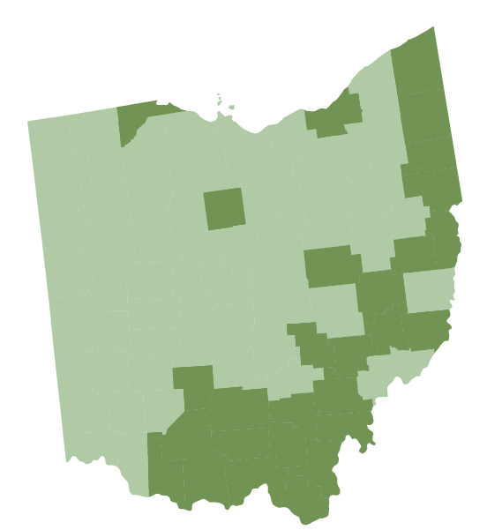
Senior Hunger in Ohio
12.5% of older Ohioans face the threat of food insecurity (2018-2019)
National average: 12.6%
Increased risk:
Rural
Appalachian
Source: Feeding America, Map the Meal Gap
Notes:
CARMEN
To set the stage, I wanted to first share some data related to hungry older Ohioans.
Food insecurity—the lack of consistent access to enough food for an active, healthy life—is trending in the right direction for older Ohioans.
In 2019, 12.5% of Ohioans, ages 60 and older, faced the threat of hunger in the past 12 months.
By definition, they are considered marginally food insecure.
This is a decrease from 13.1% in 2016.
While our senior food insecurity rates are “average” nationally, there is work that needs to be done, specifically when you consider nutrition health of older adults.
Pictured here is the overall food insecurity rate for Ohio – this image is NOT specific to older Ohioans.
However, as a State we see a larger disparity in Ohioans experiencing food insecurity that live in rural Ohio counties or our Appalachian regions.
Next slide please
Map of Ohio Summary:
The map of Ohio is shown with two shades of green representing the overall food insecurity rate. In most of the western and central parts and parts of the central and eastern areas of the state the rate of food insecurity is 4 to 14%. In several north central areas, and many of the eastern and southern areas the food insecurity rate is 15 to 19%. Ohio sees a larger disparity in Ohioans experiencing food insecurity that live in rural Ohio counties and Appalachian regions.

Slide 14
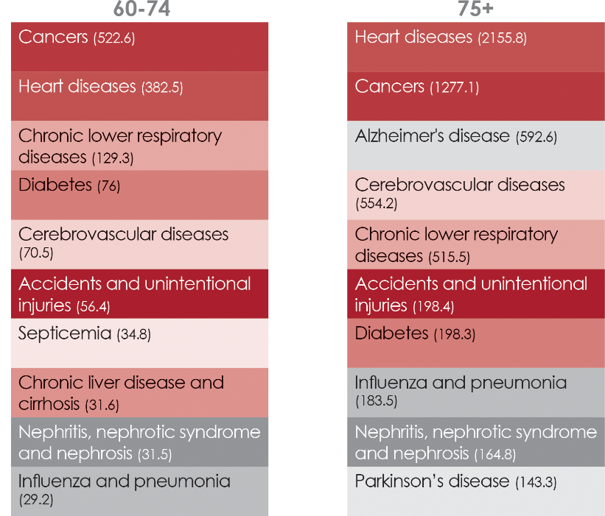
Top 10 Leading Causes of Death for Ohioans (death rate per 100,000 population), across the life course, 2018
Note: Colors were assigned to help readers track the placement of causes on the top ten list and to easily identify when new causes appear on the top ten list at different stages of the life course. Color codes do not indicate prevalence or disease categories.
Source: HPIO analysis of data from the Ohio Department of Health Public Health Data Warehouse. Accessed Jan. 10, 2020
Notes:
CARMEN
Data findings from our 2020 Summary Assessment of Older Ohioans suggests a need to address the heart health of older Ohioans – a condition largely influence by adequate and sound nutritional intake.
Ohio performs worse than the U.S. overall and is trending in the wrong direction on hypertension. Nearly two-thirds of Medicare FFS beneficiaries (60%) in Ohio were diagnosed with hypertension in 2017.
Heart disease was the number two cause of death for Ohioans ages 60-74 and the number one cause of death for Ohioans ages 75 and older.
While Ohio performs similarly to the U.S. overall on several indicators of chronic disease, we see notable disparity for both obesity and diabetes prevalence among older Ohioans:
In 2017, older Ohioans, ages 65 and older with incomes below $50,000, were more likely to be identified as having obesity than Ohioans with higher incomes.
Additionally, Ohio Medicare FFS beneficiaries who were black (36%), Hispanic (36%) or Asian/Pacific Islander (30%) were more likely to be diagnosed with diabetes in 2017 than white Ohioans (27%).
As you can see we have plenty of work to do to address food insecurity with all older Ohioans, with a focus on our priority populations that experience heightened insecurity or whom otherwise are inequitably plague by other poor health outcomes.
Next slide please
Top 10 Leading Causes of Death for Ohioans Summary:
Arrows point out that Heart Disease and Diabetes are among the leading causes of death for Ohioans. Ages 60-74: Cancers (522.6), Heart diseases (382.5), Chronic lower respiratory diseases (129.3), Diabetes (76), Cerebrovascular diseases (70.5),
Accidents and unintentional, injuries (56.4), Septicemia (34.8), Chronic liver disease and cirrhosis (31.6), Nephritis, nephrotic syndrome and nephrosis (31.5), Influenza and pneumonia
(29.2) Ages 75+ Heart diseases (2155.8), Cancers (1277.1), Alzheimer's disease (592.6), Cerebrovascular diseases, (554.2), Chronic lower respiratory, diseases (515.5), Accidents and unintentional injuries (198.4), Diabetes (198.3) Influenza and pneumonia (183.5) Nephritis, nephrotic syndrome and nephrosis (164.8), Parkinson's disease (143.3).

Slide 15
Malnutrition Commission Report
Malnutrition is a leading cause of morbidity and mortality
Malnutrition Prevention Commission established in 2018 to study:
Education and awareness
Health care costs, data, and evaluation
Prevention models
Final report with findings and recommendations
Notes:
CARMEN
I am sure that many of you on this call today know how devastating malnutrition can be, especially for older adults.
In fact, malnutrition is a leading cause of morbidity and mortality among older adults and all older adults are at increased risk for developing malnutrition.
We know that older adults experiencing food insecurity suffer from higher rates of chronic disease, including diabetes, heart disease and depression.
But they also endure a lower quality of life, with limitations on activities of daily living comparable to food-secure seniors who are 14 years older.
On the other hand, good nutrition has been shown to help support a healthy and active lifestyle, reduce frailty and disability, improve health outcomes, and reduce health disparities and health care costs.
Which is why addressing, preventing, and treating malnutrition is SO important for healthy aging.
One point for us all to consider is the problem we want/need to solve food – food security vs. nutrition security.
Food security is the availability and access to food; whereas nutrition security demands the intake of a wide range of foods to provide essential nutrients – this is the intersection of where food insecurity and malnutrition meet.
In late 2016, Ohio’s 131st General Assembly passed Bill 580, which established Ohio’s Malnutrition Commission.
The Commission was tasked with developing recommendations to reduce the incidence of malnutrition among older Ohioans based on collected information and studies of malnutrition in older adults.
The Commission studied malnutrition as it relates to education and awareness; healthcare costs, data, and evaluation; and prevention models.
The Commission produced a final report of findings and recommendations in 2018, which have greatly guided our focus even into present time.
Link Final Report: https://aging.ohio.gov/wps/wcm/connect/gov/3bdac1a7-904a-4341-88e9-6e1730a84d13/Malnutrition-Prevention-Commission-Report-FINAL.pdf?MOD=AJPERES&CONVERT_TO=url&CACHEID=ROOTWORKSPACE.Z18_M1HGGIK0N0JO00QO9DDDDM3000-3bdac1a7-904a-4341-88e9-6e1730a84d13-ncAM.9R
NEXT SLIDE

Slide 16
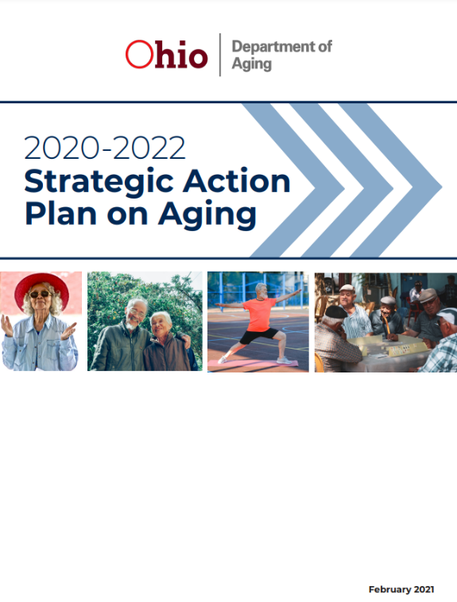
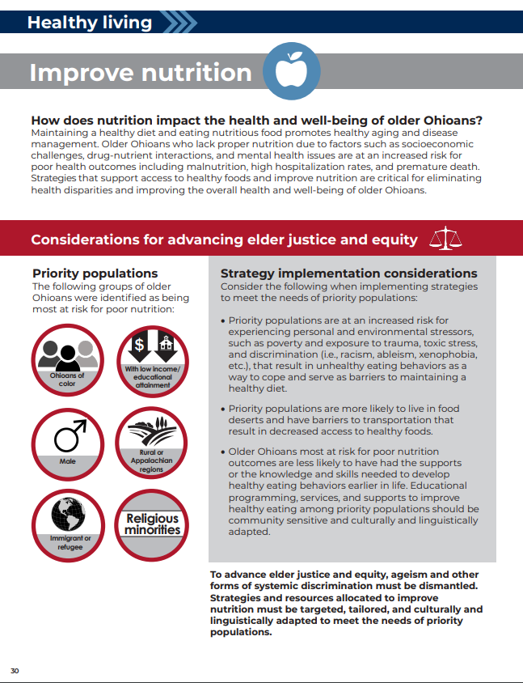
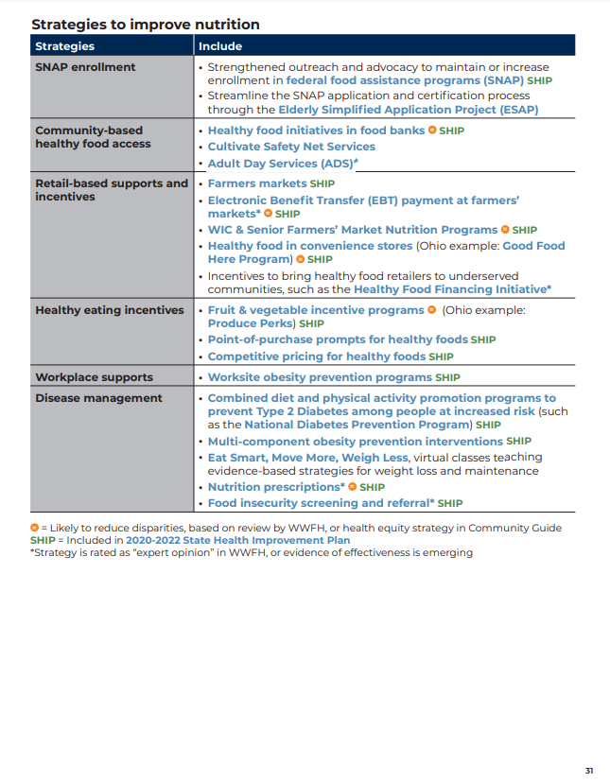
Ohio’s 2020-2022 Strategic Action Plan on Aging (SAPA)
Learn more about
Ohio’s SAPA
Notes:
CARMEN
Ohio’s Strategic Action Plan on Aging (known as our “SAPA”) is a prioritized plan to advance elder justice and equity and achieve optimal health and well-being for older Ohioans, which includes a focus on social determinants of health, such as nutrition and food access.
Having a document like the SAPA is important for many reasons, but one of the key reasons is that aging is a universal experience that should be valued and celebrated.
Older Ohioans make substantial contributions to society, including working, volunteering, caregiving for young children or other family members and serving as community leaders and mentors.
Often, these contributions go unrecognized and are uncompensated.
We know older Ohioans also face obstacles to health and well-being and are not always afforded the opportunity to age with respect, dignity and autonomy.
Ohio’s aging landscape is changing.
By 2030, older Ohioans (ages 60 and older) will account for more than a quarter of Ohio’s population (26.3%), up from 19.8% in 2010.
Supporting healthy aging and valuing all older Ohioans in the face of this changing landscape is critical.
The SAPA also includes a strategy and resource section for each of our prioritized topic areas.
On our screen you see a snapshot of our strategy section on improving nutrition for older Ohioans.
This section provides a menu of evidence-informed strategies, and a list of national and state-based resources that provide additional guidance and information on ways to impact and more nutrition for older adults.
For example, OAA nutrition service programs are examples of strategies to address risk reduction for dementia. Nutrition strategies are also supportive of social connectedness, too – think of the congregate meal program.
With the publication of our next State Plan on Aging, to be effective this fall, October 1, 2022, our SAPA framework and detailed strategies will guide Ohio’s focus for the next four years.
Next, I’ll pass the presentation over to my college, Autumn, to share a few examples of Ohio’s promising practices to promote food security.
Autumn…

Slide 17
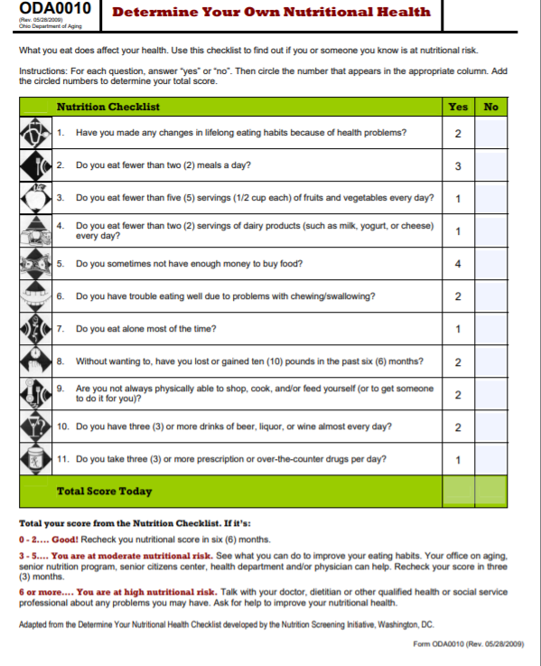
Nutritional Health Screening
Determine Your Own Nutritional Health checklist
Screen consumers annually
Referral
HCBS services
Notes:
AUTUMN
Thank you Carmen and good afternoon to all.
With regards to our Older Americans Act-funded senior nutrition programs, we do require AAAs and/or their contracted service providers to conduct nutritional health screening of all consumers at lease once a year.
Ohio rule requires that consumers must be screened for nutritional health as part of any nutrition project, like congregate meal services and home delivered meals. ​
Ohio implements The Determine Your Own Nutrition Health checklist, as seen on your screen.
Our administrative code further encourages this screening to be done in-person, if possible, as we know it a prime way to assess the home environment of an older adult.
Consumers who screen at high nutritional risk (which is a score of 6 or above) are then referred to providers of home and community-based services, like our congregate meal and/or home-delivered meal providers, or even contracted dietitians for nutritional counseling​.
While this checklist identifies those at nutritional risk, it does ask a couple questions related to food and nutrition access, such as:
Do you eat fewer than 2 meals a day? and
Do you sometimes not have enough money to buy food?
Link Determine Your Own Nutritional Health : https://aging.ohio.gov/wps/wcm/connect/gov/f54183f7-bf27-4163-b67c-2eecad9f3dba/ODA0010.pdf?MOD=AJPERES&CVID=n5QqLxr
Next slide please

Slide 18
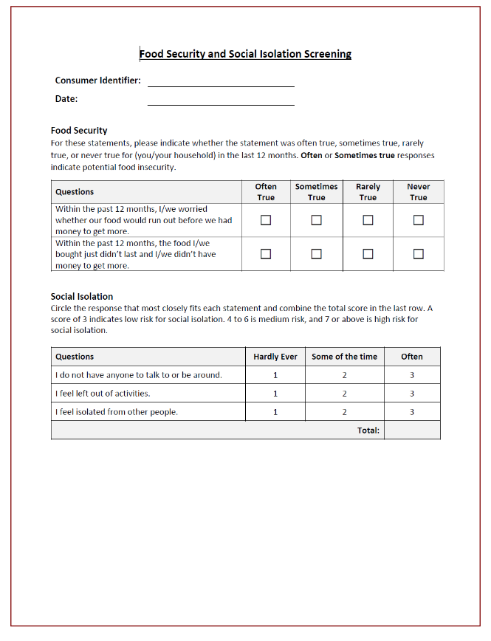
Health Screening – Pilot Project
Health Screening Tools
Determine Your Own Nutrition Health
Household Food Insecurity (USDA)
Loneliness Scale (UCLA)
Notes:
AUTUMN
In Ohio State Fiscal Year 22 & 23 (7/1/2021 – 6/30/2023), in addition to the required Determine Your Own Nutrition Health nutrition health screening tool, Ohio is piloting a Food Security and Social Isolation Screening tool to be used with one local grantees in Lorain County, Ohio who provide home-delivered meals and congregate meals within the county.
This project will identify consumers at risk for social isolation and food insecurity and consumers will be referred to local food resources and access points.
The food security screen uses the 2-item subset from the USDA’s 18-Item Household Food Security Survey, which includes the following two questions:
Within the past 12 months, have you worried whether your food would run out before you had money to get more? and,
With the past 12 months, did the food you bought not last and you didn’t have money to get more?
In addition, consumers are being assessed for social isolation using UCLA’s three-item loneliness scale and if a consumer is scored at medium to high risk, they will automatically be referred to community-based initiatives and resources.
Our goal is to assess the feasibility of adding additional screening questions and to understand the helpfulness and effectiveness of connect those at-risk consumers with community resources to meet their needs.
This pilot will conclude in June of 2023, and we look forward to evaluating the results, and hopeful success for potential statewide implementation.
Next slide please

Slide 19
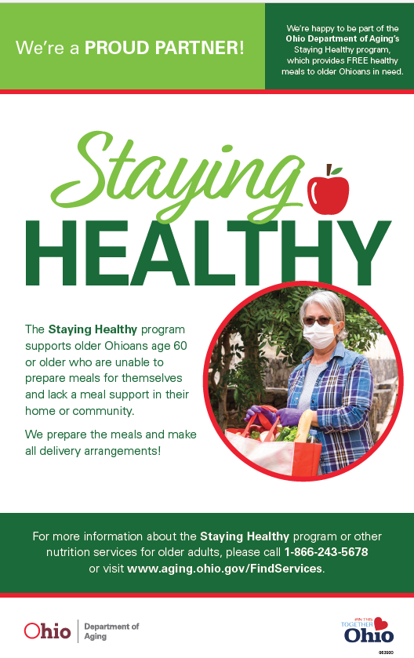
Promising Practices During Pandemic-Times
Increase of 20,000 home-delivered meals
New/Innovative Practices
Grab-and-go meals
Grocery shopping & delivery
Emergency shelf-stable food boxes
Adult Day & Senior Center Provider Relief Funds
Ohio SFMNP Produce Box
Ohio’s Staying Healthy Initiative
Notes:
AUTUMN
As I’m sure many States can say – during the COVID-19 pandemic, Ohio and our aging service providers had to quickly respond and adapt services to assure continued food access to our consumers.
We saw a sharp increase in consumers receiving home-delivered meals, from about 40,000 consumers in Fiscal Year 2019 to over 60,000 in Fiscal Year 2020.
New and innovative practices emerged – including grab-and-go meals options, expanded services of grocery shopping assistance and delivery, as well as aging network providers ensuring consumers had access to emergency shelf-stable food boxes in the event their meal services were interrupted or unexpectedly impacted.
Additionally, state-supported provider relief funds were extended to adult day care facilities and senior centers to support re-opening of their nutrition services. Many of these providers use funds to upgrade kitchen amenities or purchase additional vehicles to support home-delivered meal capacity.
Through amendments to our Senior Farmers’ Market Nutrition program, we expanded program operations to permit the use of bulk purchasing and the assembly and distribution of mixed-variety produce boxes. Program partners remained agile to meet the food needs of older adults, while adjusting operations through produce drops and home-delivered produce.
And finally, we were proud to launch Ohio’s Staying Healthy initiative with CARES Act funding. This initiative focused on Ohio’s small-business restaurants and providers of home-delivered meals. It was a win-win opportunity – support local restaurants heavily impacted during the pandemic, while meeting the rising need for home-delivered meals.
Many, if not all, of these mentioned services and programs are ongoing.
Next Slide Please

Slide 20
State Strategic Partnerships
Ohio Nutrition Incentive Network (OHNIN)
Ohio State Nutrition Action Committee (SNAC)
Ohio Department of Job & Family Services (ODJFS)
Supplemental Nutrition Assistance Program (SNAP)
Ohio Department of Rehabilitation & Corrections
AAAs and Aging Network Partners
Notes:
AUTUMN
We know that strategic solutions are best implemented through collaborations, and we are fortunate to work with many partners throughout the State.
The Ohio Nutrition Incentive Network is a partnership of retailers, producers, state agencies, and local partners collaborating to strengthen Ohio’s produce incentive programs to improve food access and reduce malnutrition.
The Network is facilitated by Ohio’s nutrition incentive program and nonprofit, Produce Perks Midwest.
Produce Perks doubles the purchasing power for low-income shoppers – providing dollar for dollar match on SNAP purchases on healthy foods.
Last year alone, the program served over 28,000 SNAP recipients.
Another strong state-wide group we work closely with is the Ohio State Nutrition Action Committee.
This Committee is managed through Ohio State University’s Extension Office that implements the SNAP-Ed program and corresponding marketing campaign, Celebrate Your Plate.
They have a robust suite of resources including placemat visuals, videos, and recipes.
Ohio Department of Aging’s involvement has led to the inclusion of older adults featured in testimonials and videos.
We have also been sure to highlight easy, healthy recipes appropriate for older adults eating alone or recipes for two.
Another close partner is Ohio Department of Job and Family Services.
They are working on the Elderly and Disabled Simplified Application Project which will allow extension of the certification period to 36 months (vs current 24) for SNAP eligibility.
A multi-year partnership with the Ohio Department of Rehabilitation and Corrections has explored opportunities to invest and support aging well while incarcerated.
One of the initiatives focused on supporting the selection of healthier options.
Partners worked together to identify the “Go-Slow-Woah” foods available and then provide education and promotional materials to support picking the healthiest option.
And finally, we cannot fail to mention are ongoing, strong continued partnerships with our Area Agencies on Aging, we have 12 in Ohio, and the wide network of our dedicated aging service providers. Collaborations with these partnership are key to ensuring access to social, nutrition, and economic supports throughout the state.
Next slide please

Slide 21
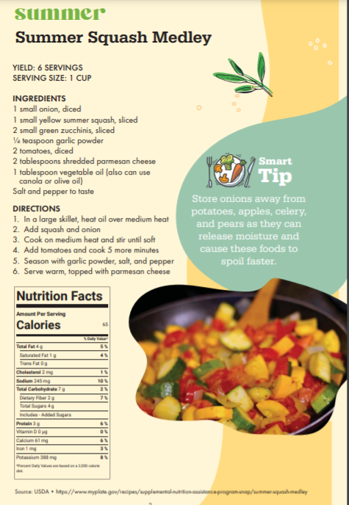
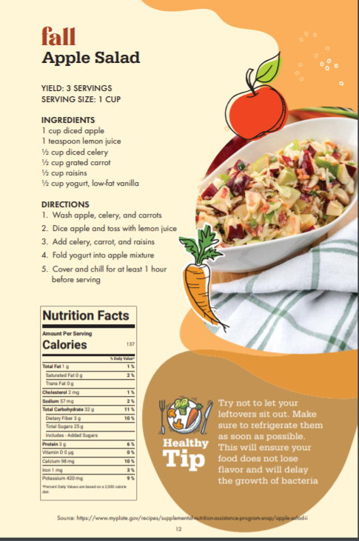
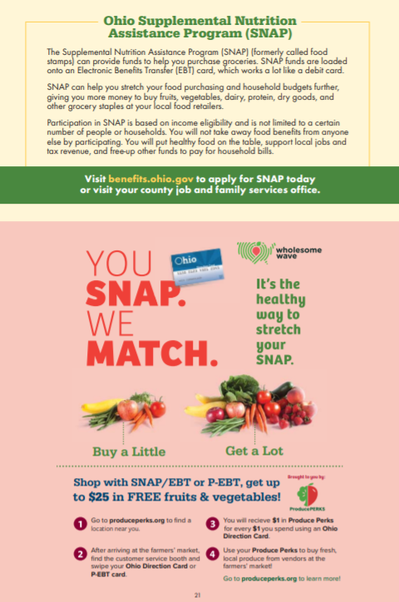
Resources to Promote Nutritional Health
Eating Well: Farmers’ Market Recipe Book
Notes:
AUTUMN
Finally, we’ll conclude Ohio’s presentation by sharing a couple resources that have proved both beneficial and popular in addressing food insecurity and promoting sound nutritional health of older Ohioans.
In Program Year 2021, we published Ohio’s Eating Well: Farmers’ Market Recipe Book for our Senior Farmers’ Market Nutrition Program.
This publication has been used well beyond the Senior Farmers Market Nutrition Program, including most recently at the Ohio State Fair and also by Ohio’s WIC Farmers Market Program.
This recipe book features 18 produce-based recipes and health tips, but also includes information on nutrition assistance programs for food insecure Ohioans.
We have a variety of languages spoken throughout the state and through our partnership with Ohio Department of Health, who facilitates the WIC Farmers Market Program, we translated the Recipe Book into the top 7 non-English languages.
These can all be found on our website: aging.ohio.gov
Next Slide Please.

Slide 22
Resources to Promote Nutritional Health Continued
Senior Nutrition Fact Sheets
Notes:
AUTUMN
Another recent resource our team developed, was our compilation of 12 Nutrition Facts sheets.
Each sheet is focused on consumer-friendly tips and education on sound nutritional health.
We focused on nutrition related topics most relevant to older adults, including choosing health fats, meeting calcium and vitamin D needs, and how to read a nutrition food label.
These resources were shared widely with our aging network and have been incorporated into nutrition education requirements of our Older Americans Act-funded nutrition services.
They are also all available on our website.
Thank you for your time and attention today.
Next Slide

Slide 23
New Mexico State Unit on Aging
Ophelia Steppe
SUA Nutritionist
New Mexico SUA

Slide 24
New Mexico
The New Mexico Food, Farm, and Hunger Initiative Designed to Alleviate Hunger
The Food, Farm, and Hunger Act was passed during the New Mexico legislative session of 2022.
The initiative will support the commitment to foster a food system that addresses hunger while improving economic resiliency in high-need counties throughout New Mexico.
Improve the food supply chain and support small farms and ranches, all while increasing access to healthy food for more people.

Slide 25
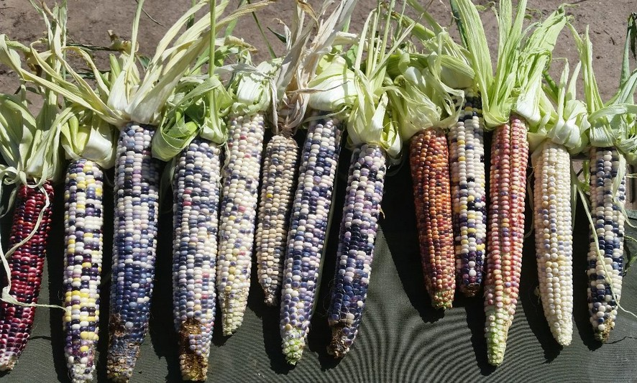
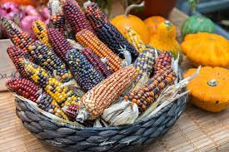
Initiatives to Combat Hunger and Improve the Food Supply Chain
NM Grown Program
Senior Food Boxes

Slide 26
New Mexico Grown
Los Jardines Institute
The New Mexico Grown Program aspires to incorporate fresh New Mexico produce into ALL State Nutrition Programs that support local purchasing for schools, senior centers, and early childhood education sites.
FY22 $147,000 was used to fund 36 senior centers with NM Grown local produce.
In FY23, $530,000 will be allocated to 50 senior centers, and the NM Grown Program will be expanded to include meat and allowable food items.

Slide 27
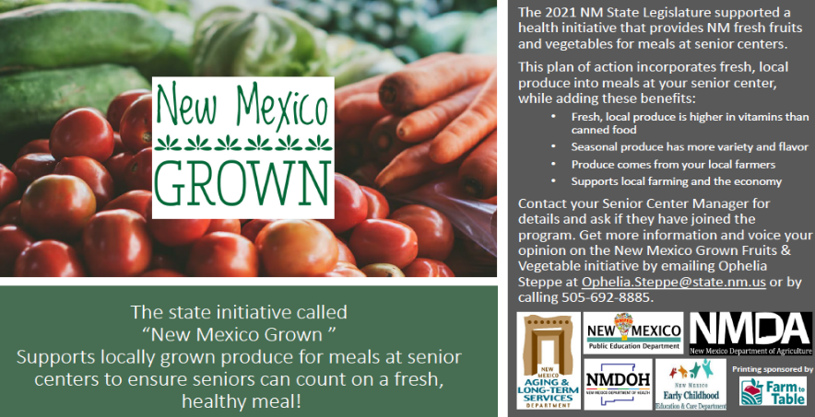
Promoting the New Mexico Grown Program
RAC Cards
NM Grown Stickers
NM Grown Poster

Slide 28
New Mexico Collaboration
NM Aging & Long-Term Services Department
NM Departments
New Mexico Public Education, Early Childhood & Early Care Department of Health & Human Services, and the Department of Agriculture.
ALTSD has collaborated with other state agencies and stakeholders to coordinate and address food initiatives and programs.
Interagency Taskforce
NM Grown
Since the Fall of 2020, there have been monthly collaboration meetings with the "Interagency Taskforce" to align, implement, and address food initiatives. Monthly round-tables are held with providers.
The Food Farm and Hunger Initiative has empowered numerous state departments and agencies to expand on the New Mexico Grown Program and fund rural in-house food pantries at senior centers.

Slide 29
Farmers & Food Hubs

Slide 30
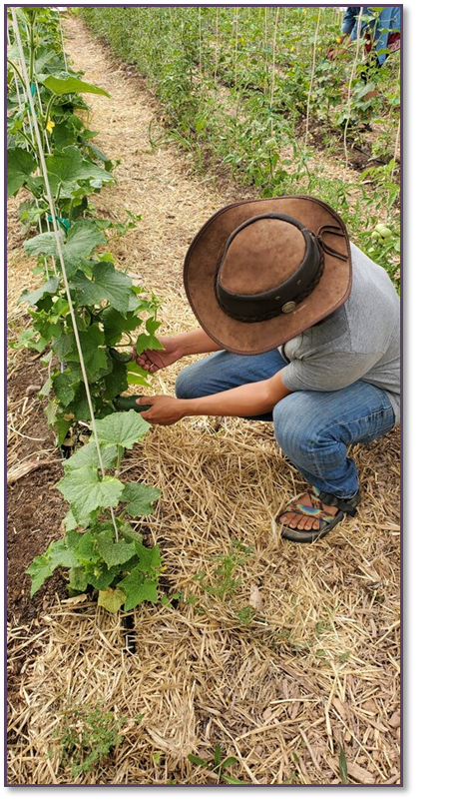
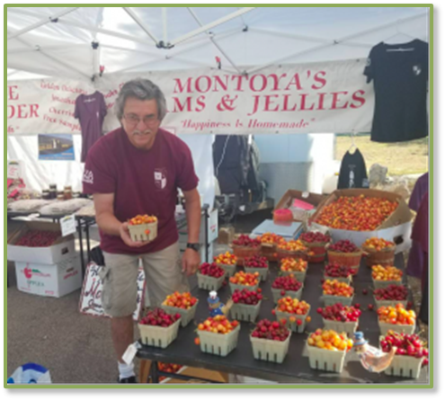
Farm to Table
Chispas Farm
Montoya Orchard
Center of Southwest Culture
Cerro Vista Farm

Slide 31
NM Grown Program
New Mexicans will be able to consume locally grown produce, meat from local ranchers, and other minimally processed food items through the New Mexico Grown Program.
Invest in New Mexico producers by expanding market opportunities and providing financial support.
Overall, the NM Grown Program will provide meals for the senior nutrition program, schools, and early childhood centers that contain locally grown, healthy, fresh produce, meat, and minimally processed food, benefiting low-income communities and local farmers while also providing health and economic benefits.

Slide 32
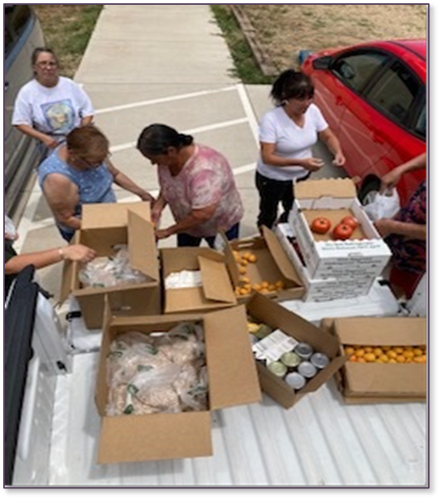
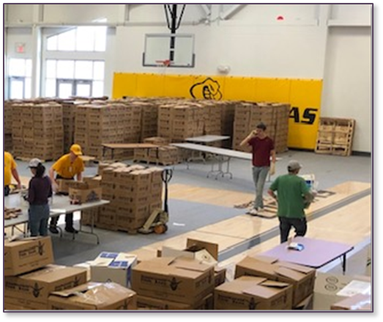
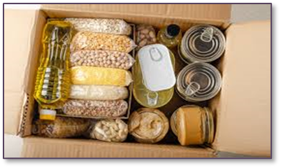
Senior Food Box Program
FY23: The project will distribute non-perishable food boxes to senior centers in five food desert communities to homebound older adults or provide distribution at congregate sites.
FY20 Emergency
Food Box Project
40,490 boxes
833,026 pounds of food
Each month, an average of 2,000 pounds of food, equivalent to 1,667 meals, will be delivered to the five rural sites.

Slide 33
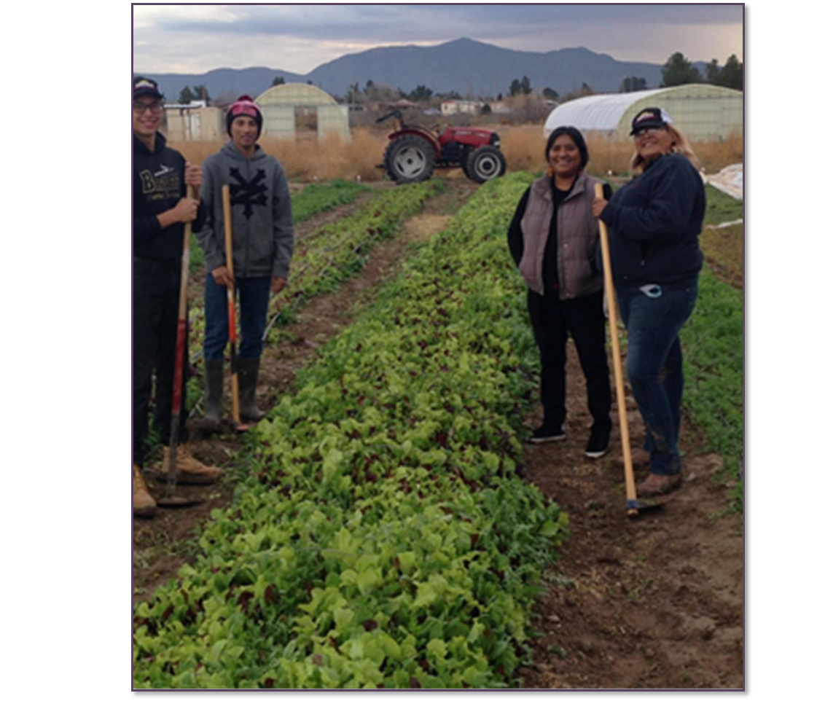
Anthony Youth Farm

Slide 34
Potential Obstacles
Service providers overwhelmed by the volume of need
Staffing issues
Reopening congregate sites
Obtaining Food, meals and nutrition providers
Supplemental funds ending

Slide 35
Resource Center Links
Senior Nutrition Programs and Sustainability: Guide to Prioritizing Clients
Tips for Recruiting and Working with Volunteers
Options for Contracting Meals
Innovative Models
Tips and Guides

Slide 36
Summary
Improve policies around food insecurity
Find your champion
Bridge gaps in services
Maximize participation in federal nutrition programs
Improve your partnerships
Collect data and educate key audiences

Slide 37
Food Insecurity Webinar Series & Educational Topics
July 2022:
Combating Food Insecurity with Collaboration
September 2022:
Identifying and Screening for Food Insecurity
October 2022:
Referring Participants who are Food Insecure
August 2022:
State Units Food Insecurity Promising Practices
NRCNA website at acl.gov/senior-nutrition
Notes:
Website: acl.gov/senior-nutrition

Slide 38
Questions?
Kathryn Tucker, MS RD LD FAND: Kathryn.tucker@acl.hhs.gov
Carmen Clutter, MS RD LD CClutter@age.ohio.gov
Autumn Trombetta, MS, RDN ATrombetta@age.ohio.gov
Ophelia Steppe, MS RD LD Ophelia.Steppe@state.nm.us
Notes:
Emails:
Kathryn Tucker, MS RD LD FAND: Kathryn.tucker@acl.hhs.gov
Carmen Clutter, MS RD LD CClutter@age.ohio.gov
Autumn Trombetta, MS, RDN ATrombetta@age.ohio.gov
Ophelia Steppe, MS RD LD Ophelia.Steppe@state.nm.us

Slide 39
Resources
Policies to Reduce Food Insecurity: An Ethical Imperative
How Food Insecurity Affects Older Adults | National Poll on Healthy Aging
Meals on Wheels America: Hunger in Older Adults
Food insecurity During the COVID-19 Pandemic: Evidence from a Survey of Low-income Americans
Feeding America: The State of Senior Hunger in 2020
The Food Security Continuum: A Novel Tool for Understanding Food Insecurity as a Range of Experiences

