Slide 1
Food Insecurity Education Series
Webinar 3
Identifying and Screening for Food Insecurity
Kathryn Tucker, MS, RD, LD, Administration for Community Living
Temitope A. Walker, PhD, Georgia Division of Aging Services
September 15, 2022

Slide 2
Objectives
Define and characterize food insecurity
Identify the importance of assessing food insecurity
Explore the different food insecurity screens
Learn about the frequency of measuring food insecurity
Discover assessment training resources

Slide 3


Speakers
Kathryn Tucker
ACL Consultant
Temitope A. Walker, PhD
Senior Hunger &
Nutrition Coordinator
Georgia Division of Aging Services

Slide 4
What is food insecurity?
Food insecurity is defined as “the limited or uncertain availability of nutritionally adequate and safe foods or limited or uncertain ability to acquire acceptable foods in socially acceptable ways.”

Slide 5
Levels of Food Insecurity
Low food security
Poor nutrition quality and limited variety. Little or no indication of reduced food intake.
Very low food security
Reports of skipping meals or not eating. Has reduced food availability.

Slide 6
Factors Influencing Food Insecurity
Food Insecurity
Limited Income
Disparities
Food Deserts
Lack of Transportation
Lack of Employment
Social Isolation
Renting

Slide 7
The Impact of Food Insecurity
78% more likely to experience depression
40% more likely to experience chest pain
55% more likely to develop asthma
10% more likely to experience high blood pressure
21% more likely to experience limitations in activity

Slide 8
Importance of Food Insecurity Screening
Program and Policy Development
Program Implementation
Program Evaluation
Intervention Development
Supports Public Assistance Referral
Helps in Addressing Food Insecurity

Slide 9



Food Insecurity Screening in Georgia
Screen
Identify factors
Address factors

Slide 10
Measuring Food Insecurity
“Food insecurity is measured as a household-level concept that refers to uncertain, insufficient, or unacceptable availability, access, or utilization of food.”

Slide 11
Validated Food Security Survey Modules
18-Item U.S. Household Food Security Survey Module (USDA)
10-Item U.S. Adult Food Security Survey Module (USDA)
6-item Short Form of the Household Food Security Survey Module (USDA)
Hunger Vital Sign™ two-question screening tool (Children’s HealthWatch)

Slide 12
18-Item U.S. Household
Food Security Survey Module (USDA)
Administered annually to around 45,000 households in the Census Bureau’s Current Population Survey (CPS-FSS)
First item addresses worries about food running out
Other items address possible reductions in food intake due to finances
Sample questions:
  “Did you ever cut the size of any of the children’s meals because there wasn’t enough money for food?”
  “Did any of the children ever not eat for a whole day because there wasn’t enough money for food?”

Slide 13
10-Item U.S. Adult Food Security
Survey Module (USDA)

Slide 14
Ten-Item Questionnaire
Advantages
Less respondent burden
Limitations
No information about food security of children
No children’s food security questions
Improves comparison of households with and without children

Slide 15
USDA Six-Item Short Form Questions
The food that (I/we) bought didn’t last and we don’t have money to get more.
(I/We) couldn’t afford to eat a balanced meal.
In the last 12 months, did you cut the size of your meals or skip meals because there wasn’t enough money for food?
(If Yes) How often did this happen?
In the last 12 months, did you ever eat less than you felt you should because there wasn’t enough money for food?
In the last 12 months, were you ever hungry but didn’t eat because there wasn’t enough money for food?

Slide 16
Six-Item Short Form
Advantages
Less respondent burden
Limitations
Identifies food insecure and very low food security
High specificity and sensitivity
Minimal bias
Does not measure the most severe levels of food insecurity

Slide 17
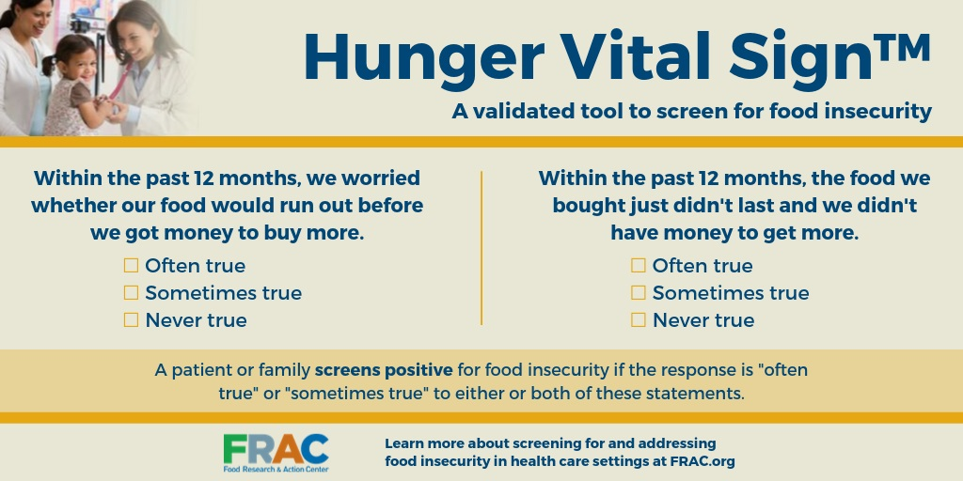
Hunger Vital Sign

Slide 18
Hunger Vital Sign™ Screen:
Two-Question Food Validated Insecurity Tool
97% probability of screening positive in food insecure homes
83% probability of screening negative in food secure homes
97% sensitivity among adults and young children
74% specificity range among adults
Easy to use in clinical and community settings
Administered verbally or in writing
Available in many languages

Slide 19
Two-Item Questionnaire
Advantages
Less respondent burden
Limitations
High specificity and sensitivity
Validated for children and adults
Does not measure the most severe levels of food insecurity

Slide 20
What We Do in Georgia
Validated six-item food insecurity measure since 2011
Statewide statistics of clients comparable to federal statistics
Identified critical unmet need for nutrition services
Shows significant contribution of receiving nutrition services to achieve food security
Highlights difficulty in meeting basic food and health care needs of food insecure older Georgians

Slide 21
Modified six-item U.S. Household Food Security Survey Module
6-Item food insecurity survey questions | Responses
During the last 30 days, how often was this statement true: The food that we bought just didn't last, and we didn't have money to get more | Often Sometimes Never
During the last 30 days, how often was this statement true: We couldn't afford to eat balanced meals. | Often Sometimes Never
In the past 30 days, did you or other adults in your household ever cut the size of your meals because there wasn't enough money for food? | Yes | No
In the past 30 days, did you or other adults in your household ever skip meals because there wasn't enough money for food? | Yes | No
In the last 30 days, did you ever eat less than you felt you should because there wasn't enough money to buy food? | Yes | No
In the last 30 days, were you ever hungry but didn't eat because you couldn't afford enough food? | Yes | No

Slide 22
Quantifying Food Insecurity Using the Six-Item Survey Module
  Sum of affirmative responses (“Often”/”Sometimes” and “Yes”)
  Food insecurity summary score (score of 0-6) is calculated
  Individuals classified into one of four levels or two levels:
  Food security (score 0)
  Marginal food security (score 1)
  Low food security (score 2-4)
  Very low food security (score 5-6)
  Food secure (score of 0-1)
  Food insecure (score of 2-6)

Slide 23
Levels of Severity of Food Insecurity
Least severe: Was this statement often, sometimes, or never true for you in the last 12 months? "We worried whether our food would run out before we got money to buy more."
Somewhat more severe: Was this statement often, sometimes, or never true for you in the last 12 months? "We couldn't afford to eat balanced meals."
Midrange severity: In the last 12 months, did you ever cut the size of your meals or skip meals because there wasn't enough money for food?
Most severe: In the last 12 months, did you ever not eat for a whole day because there wasn't enough money for food?

Slide 24
When to Assess Food Insecurity
Initial intake
In conjunction with other relevant assessments
When identified by concerned staff or volunteer
During reassessments
When services change
Timepoints based on state and agency requirements

Slide 25
Potential Assessment Training Resources
Review state and agency policy first; training may be available there.
USDA Food Security Survey Modules are standardized and provide a straightforward process in how they should be administered.
The short form of the U.S. Household Food Security Survey Module used in Georgia.
See this session’s takeaway sheet for additional resources from organizations such as Feeding America and the Food Research & Action Center (FRAC).

Slide 26
Takeaways
Find a screen that works best for your agency
Recognize that these screens should not be used alone
Determine the frequency of assessment
Identify participants at risk and screen them
Leverage the value of assessing food insecurity
Provide staff training on food insecurity and assessing it

Slide 27
Food Insecurity Webinar Series
& Educational Topics
July 2022: Combating Food Insecurity with Collaboration
September 2022: Identifying and Screening for Food Insecurity
October 2022:
Referring Participants Who are Food Insecure
August 2022:
State Unit Food Insecurity Promising Practices
Recordings available NRCNA website at acl.gov/senior-nutrition

Slide 28
For Dietitians
To receive CPEU credit, go to the CDR website.
Log the program:
  Step 2: Activity Log under Activity Type 170 - Lecture/Seminar or
  Activity Type 171 - Teleseminar/Webinar
Claim 1 CPEU for every 1 contact hour spent during the activity.
Save all documentation of the webinar and attendance for records.

Slide 29
Questions?
Kathryn Tucker, MS, RD, LD, FAND: Kathryn.tucker@acl.hhs.gov
Temitope Walker, Ph.D.: Temitope.walker@dhs.ga.gov

Slide 30
References
Food Insecurity (Healthy People 2030)
Food Insecurity and Health Outcomes (Gundersen, C. & Zilak, J.)
Food Insecurity and Hunger in the United States: An Assessment of the Measure (Panel to Review the U.S. Department of Agriculture’s Measurement of Food Insecurity and Hunger) Press.
Food Security in the U.S. (USDA)
Food Security of Older Adults Requesting Older Americans Act Nutrition Program in Georgia can be Validly Measured Using a Short Form of the U.S. Household Food Security Survey Module (Lee, J., Johnson, M., Brown, A., & Nord, M.)
Nutritional and Health Consequences are Associated with Food Insecurity among U.S. Elderly Persons (Lee, J. & Frongillo, E.)
The Hunger Vital Sign™ (Children’s HealthWatch)

