Slide 1
Grab-&-Go Slides
Sample layouts and content ideas for senior nutrition programs

Slide 2
About This Slide Deck
The slides in this file are not meant to comprise the content of an entire presentation. Instead, a variety of slide styles are presented as ideas. Layouts have been created using Microsoft’s Designer tool.
All images used in this deck are pulled from Microsoft’s creative content (stock images and illustrations available to Office users).
A good-faith effort has been made to include evidence-based information. However, the accuracy and completeness of any slide content used are entirely the user’s responsibility.
There is no attribution required to use any contents of this slide deck.

Slide 3
Did you know?
Nearly 25% of adults 65+ are considered socially isolated.
Social isolation is linked to high blood pressure, heart disease, depression, and cognitive decline.
Lack of social connection can increase the risk of premature death as much as smoking 15 cigarettes a day.

Slide 4
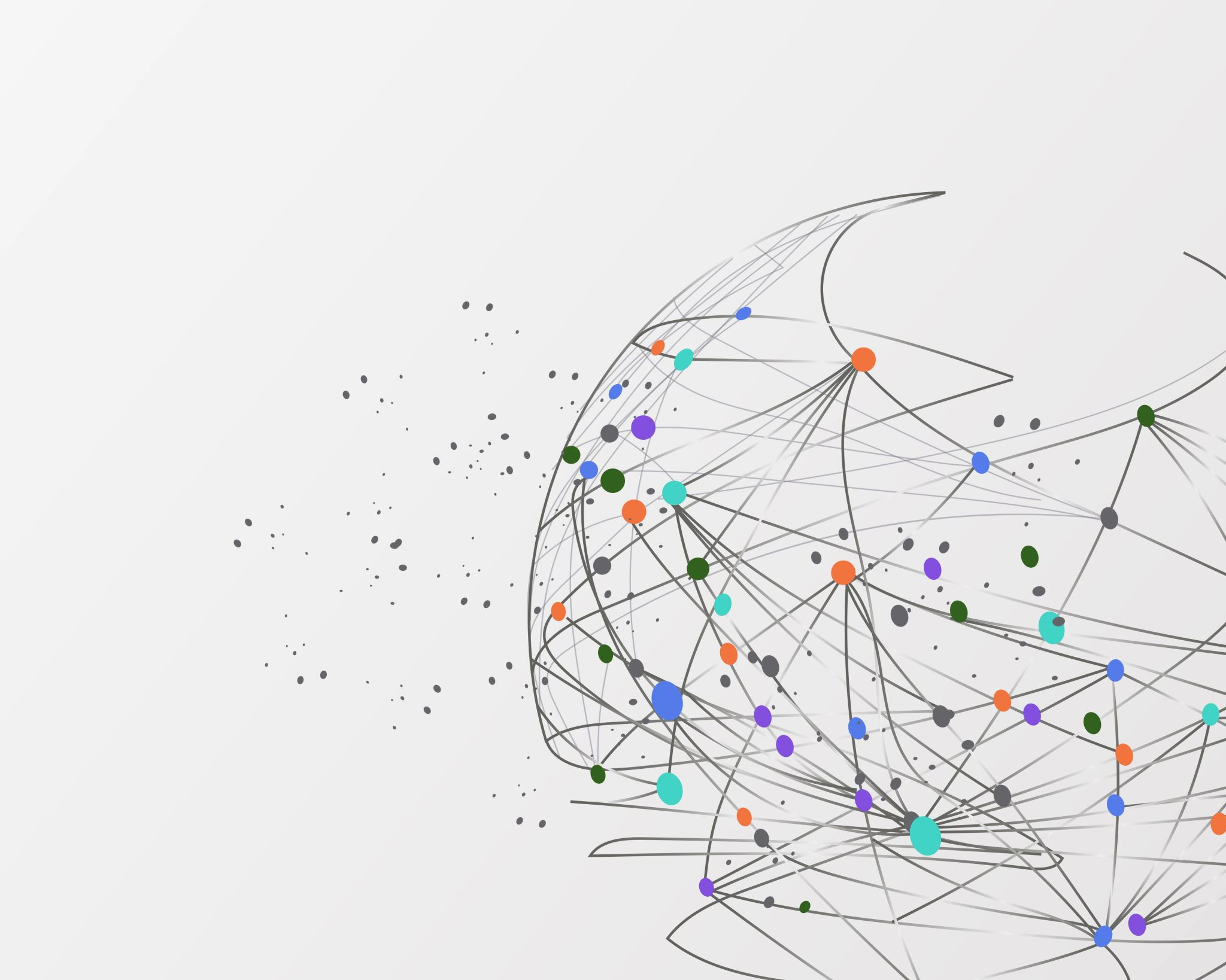
Staying connected is essential to healthy aging.

Slide 5

Congregate Meal Programs
Serve adults 60+ (and in some cases, caregivers, spouses, and younger people with disabilities)
Provide healthy meals in senior centers, places of worship, and other community settings
Offer social engagement, access to community resources, and volunteer opportunities

Slide 6
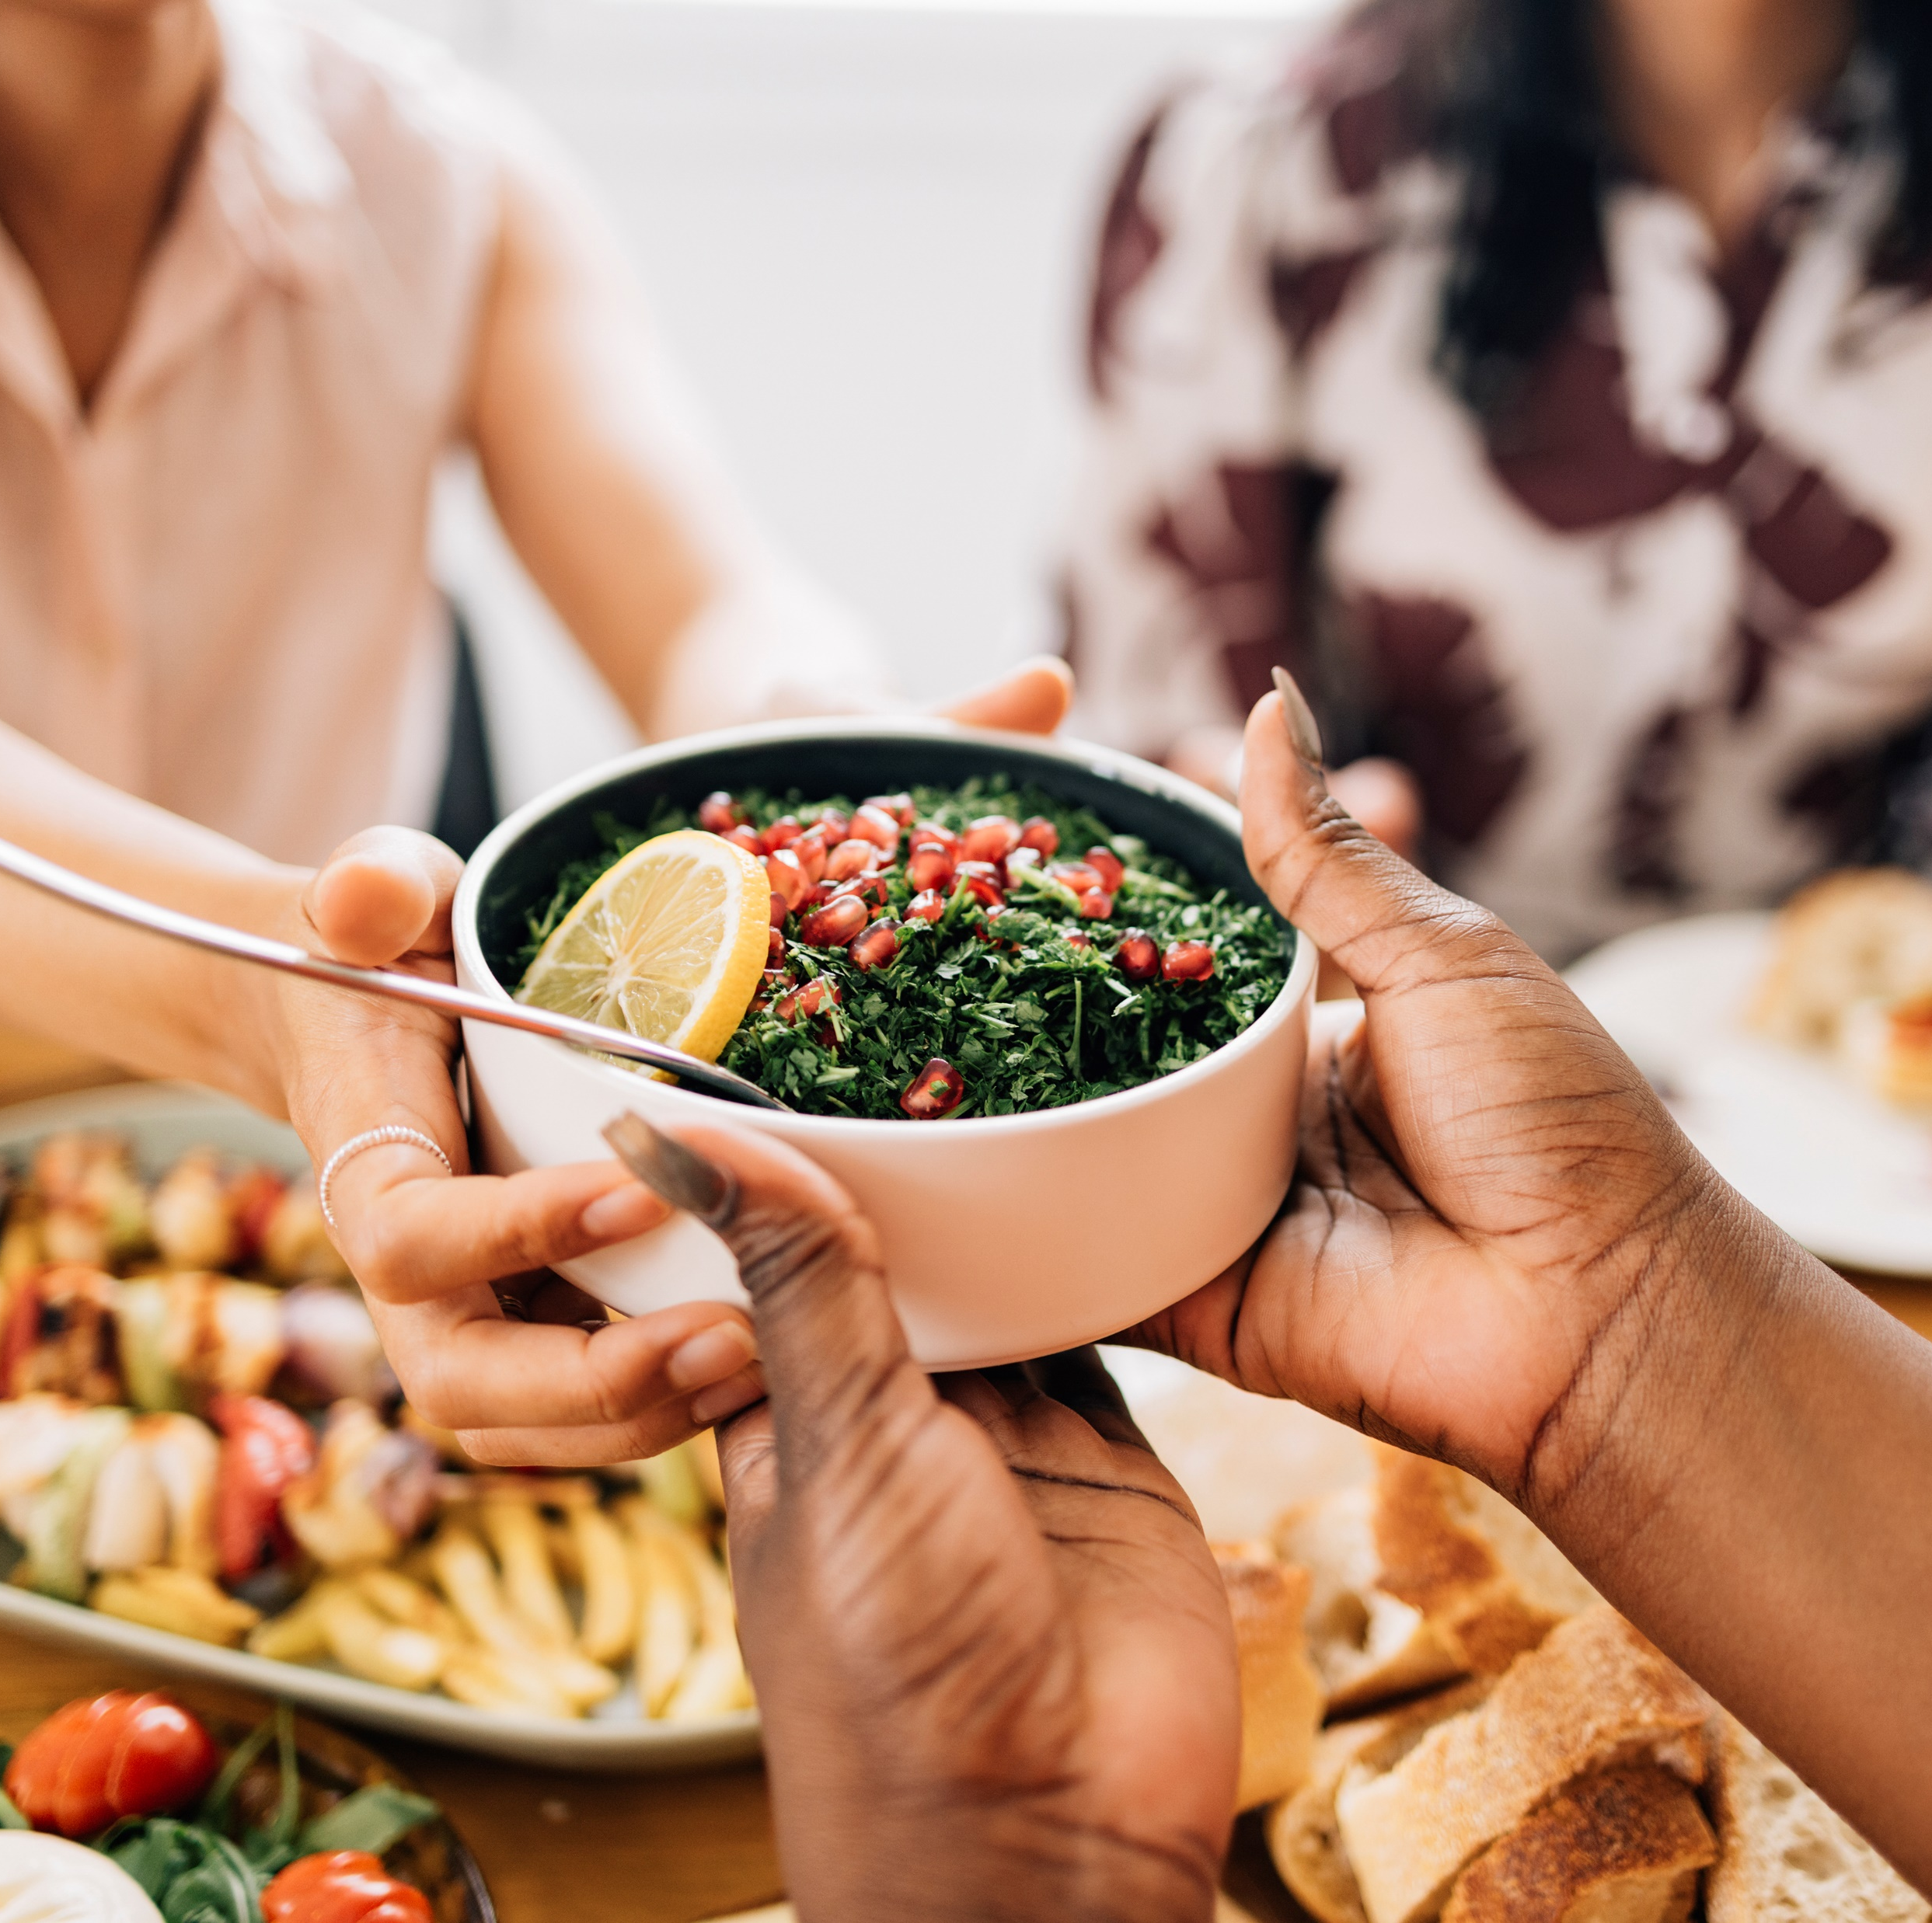
Better Nutrition Through Socialization
Reduced hunger is more common as we age. Some older adults skip meals or eat in an unbalanced manner when eating alone.
When we eat with others, we’re more likely to:
  Eat healthier overall or within certain food groups like vegetables.
  Consume more calories to provide needed energy.
  Take in more nutrients like iron and calcium.

Slide 7
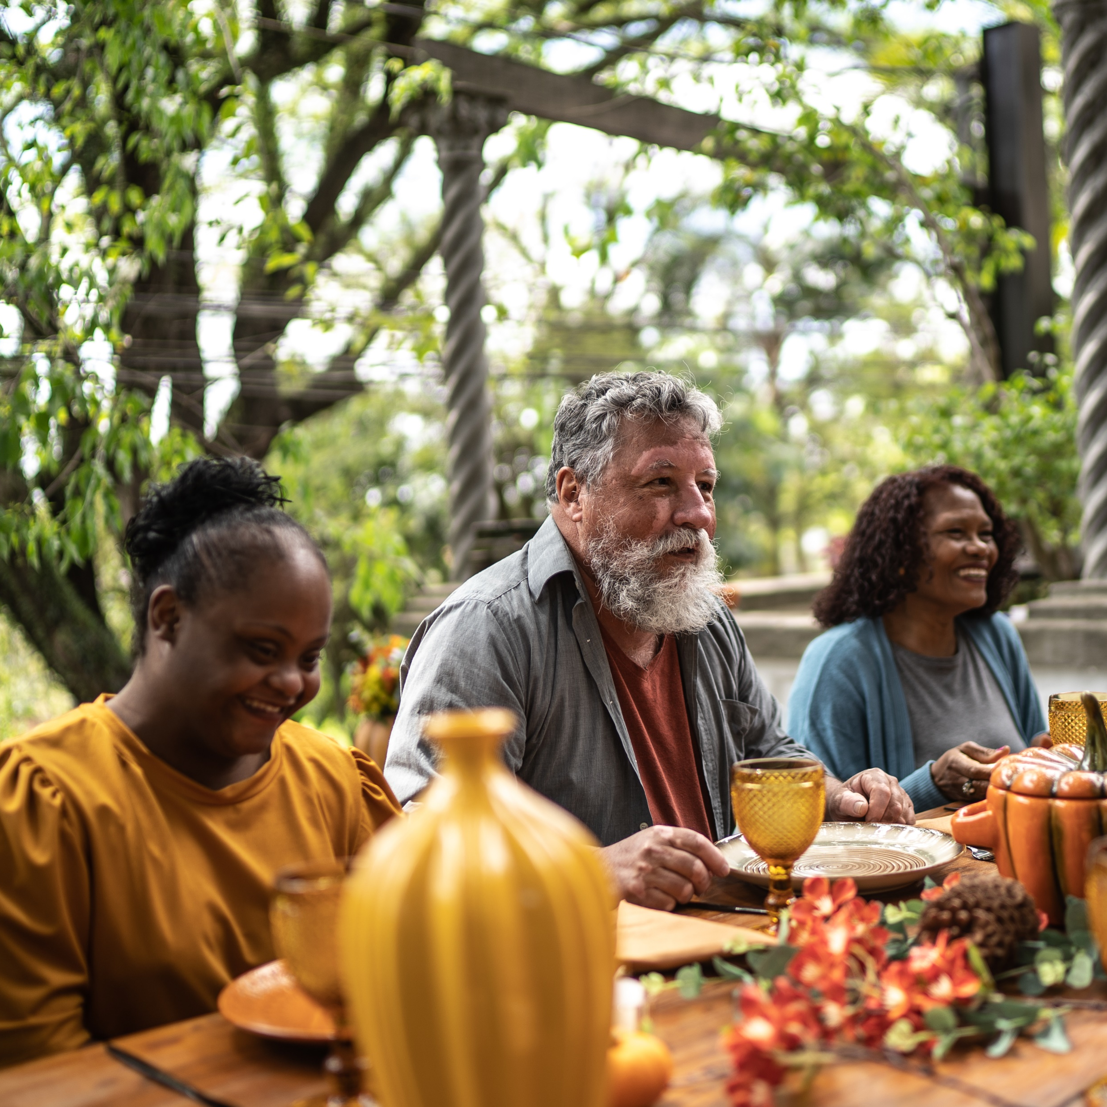
Socialization
Studies show that people who dine with others regularly eat healthier and report a better quality of life.

Slide 8
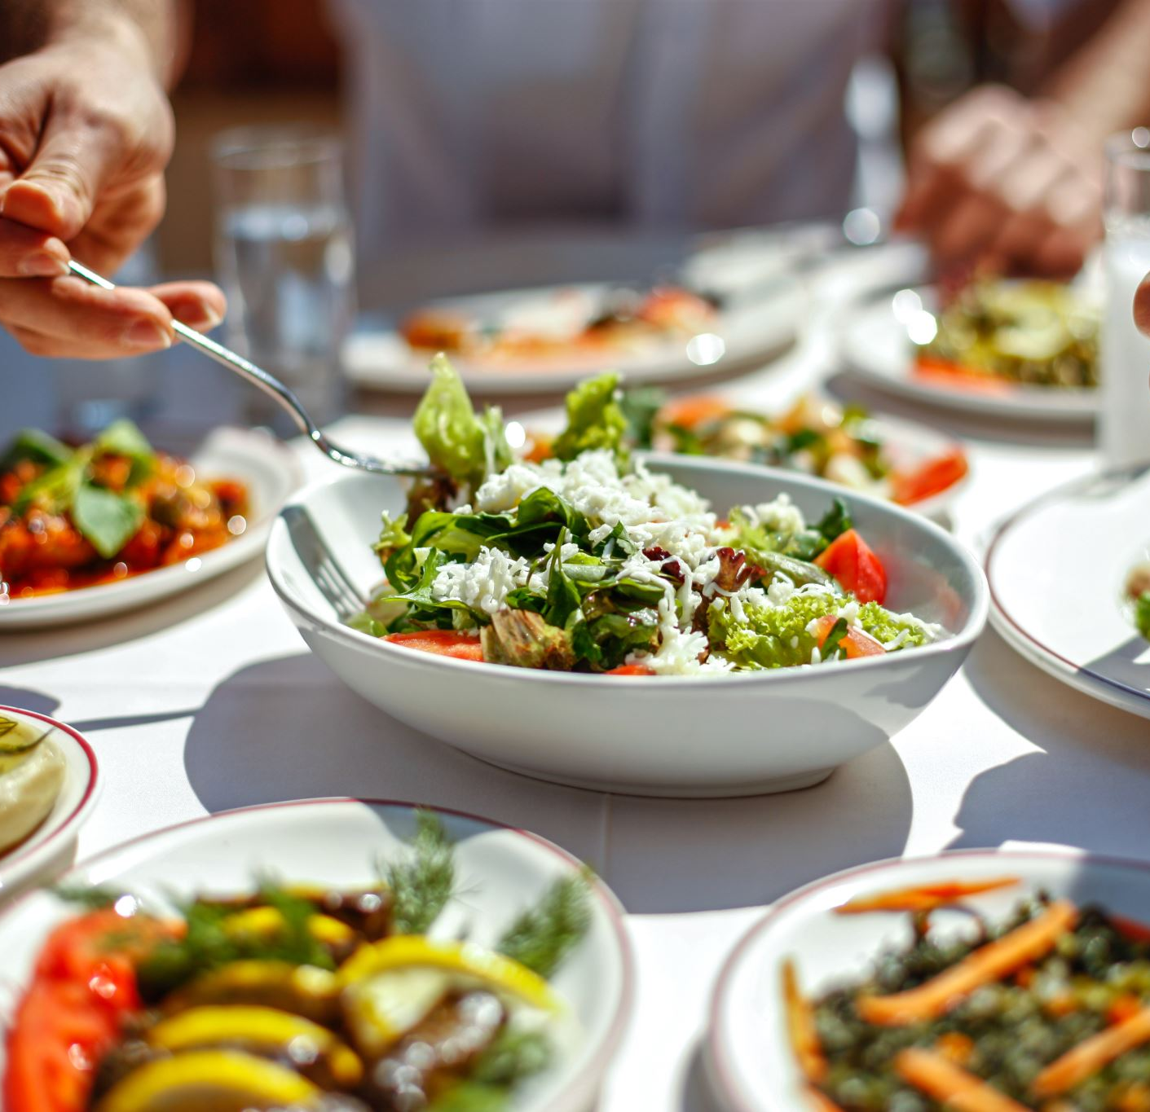
The Benefits of Eating With Others
In addition to improving nutrient intake and encouraging balanced meals, coming together over meals has the potential to:
Strengthen relationships
Foster cultural connections
Create a sense of belonging
Provide structure and routine
Encourage better self-care
Combat anxiety and depression
Lessen risk of chronic conditions
Increase overall well-being

Slide 9

Senior Nutrition Program Benefits: Older Adults
Learn about good nutrition and healthy habits
Save time and money with less shopping and cooking
Get healthy food with less effort
Avoid missed meals
Get out and socialize over a meal
Connect to other services and events

Slide 10





How Senior Nutrition Programs Benefit Communities
Decrease food insecurity
Fight malnutrition
Promote community involvement
Increase citizen productivity
Decrease health care costs

Slide 11
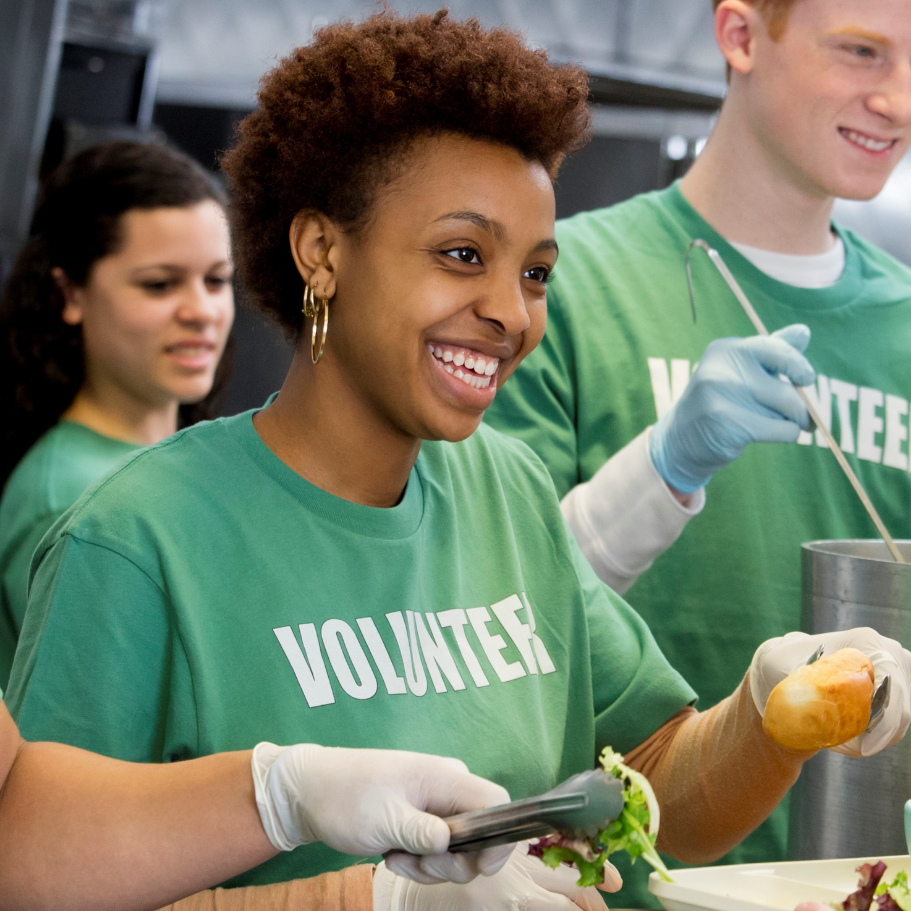
Give your time to a local senior nutrition program.
Help fight hunger and malnutrition.
Make a difference in the lives of older adults.
Grow and sharpen your skills.
Combat social isolation — for yourself and others.
Support your own health by staying active.
Have fun while doing something meaningful.

