Slide 1

Innovations in Nutrition Grant* Initiatives
MDoA-MASNP conference call
May 16, 2019
10am
Call in information:
260-639-8679‬
PIN: ‪989 167 542#‬
*Administration for Community Living Grant # 90INNU0002

Slide 2
Presentation Content
What is Malnutrition? Why is it an Important Issue for Older Adults?
Meal Packages
Community Malnutrition Care Pathways
Stepping Up Your Nutrition
HDM Priority Tool Validation Study

Slide 3
What is malnutrition?
Malnutrition is the inadequate intake of nutrients, particularly protein, over time and may contribute to chronic illness and acute disease or illness and infection.
Two or More of the Following*
Insufficient food intake
↓Body fat
↓Muscle
Weight loss
Reduced handgrip
Fluid
Often associated with general physical wasting
Linked to chronic disease
Individuals with malnutrition may be underweight, normal weight, overweight or even obese
*Source: White JV, et al. J Parenter Enter Nutr. 2012;36(3):275-283.

Slide 4
Why Older Adult Malnutrition?
1 in 2 older adults at risk
300% increase in healthcare costs for those with poor nutritional status
4 to 6 days longer in the hospital
$51.3 billion in costs for disease-associated malnutrition in older adults annually
60% of older adults in hospitals may be malnourished

Slide 5
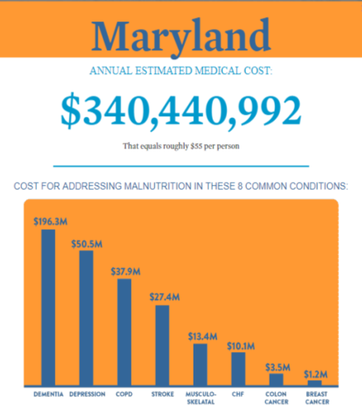
Hidden Co-Morbidity
10%
Impaired Immunity (infections)
20%
Decreased Healing
30%
Pressure Ulcers
40%
At Risk of Death (pneumonia)
LEAN BODY MASS
Goates S, Du K, Braunschweig CA, Arensberg MB (2016) Economic Burden of Disease-Associated Malnutrition at the State Level. PLoS ONE 11(9): e0161833. https://doi.org/10.1371/journal.pone.0161833. Interactive page accessed at: http://avalaunchmedia.com/inter/Abbott/malnutrition.html

Slide 6
Causes of Malnutrition in Older Adults
Limited income
Trouble swallowing/chewing
Poor dental health
Changing taste buds
Living alone
Medication side effects
Poor appetite
Restricted diets
Lack of mobility
Depression
Dementia
Gastrointestinal problems
Chronic conditions
Notes:
I’d like everyone to think about the person they are providing care for, or yourselves or others who are older adults. Choose one person and close your eyes. Imagine them waking up in the morning – are they by themselves? Preparing a meal on their own? How about activities throughout the day? Medications or doctor visits? Do they deal with one or more chronic conditions such as diabetes, arthritis, hypertension…..are those conditions well managed? Do they eat small amounts throughout the day, follow a special or restricted diet – say due to lactose intolerance or because a doctor told them to eliminate certain foods? Do they enjoy their meals and eat with others regularly? Do they drink fluids often? Are they mobile and get some physical activity throughout the day? Now picture this person getting ready for bed – more medications?
Ok, now as you think of that person, let’s open our eyes and see if that person might be at risk for malnutrition. Listen to each cause and stand up if that person has 2 or more factors that can lead to malnutrition. (Go through each item, then see how many people are standing at the end of the slide)
We’ll take these issues one-by-one to tease out practical solutions to each.
Before we do this, however, I’d like to ask for 2-3 general suggestions from the audience for how to prevent malnutrition.
(Examples may include: see a dietitian, see your doctor, read labels, get food stamps, etc)
Limited income: if one has to spend most of one’s income on shelter and other living necessities, there may not be much left to purchase nutritional foods. By accessing programs one is eligible for, that allows additional funds to be devoted to food.
SHIP for eligibility for insurance and Medicare decision making capability
MAP (or other social service organization) to assist with eligibility for Medicaid in-home supports as well as connecting you to other programs such as SNAP, heating assistance programs, home care services and more.
Trouble swallowing/chewing: pocketing food in one’s cheeks, coughing during eating or drinking, are signs of dysphagia which can lead to aspiration pneumonia a serious condition that can cause serious illness and death
Contact doctor to determine underlying cause
Likely referral to speech and language pathologist
Poor dental health: If one has to eat soft foods, the meals may not be appealing
Dentist or free oral care clinic – to deal with outstanding dental health issues, adjust dentures
Choose canned or frozen items
Dietitians or other trusted nutrition resources can be helpful to share interesting menus and recipes for softer foods
Changing taste buds: reduced smell and taste which is very common as we age
Use new flavorings and spices in foods to enhance flavor
Flavor or put lemons/limes in water to make more appealing
Cooking at home helps add smells that enhance smell and taste
Living alone: isolation can lead to a loss of interest in cooking or eating
Attend senior center/50+ center, adult day care and adult day health programs
Senior Nutrition Program – meals at community centers, churches and other religious centers
Social/physical activity and volunteering
Villages, friendly visitors or reassurance calls
Senior housing, assisted living, CCRCs etc.
Medication side effects:
Confer with pharmacist, doctor or other healthcare provider to check for potential interactions and advice on how to limit side effects.
Review instructions for foods to avoid, whether to drink or eat along with medications, etc
Be sure you need to be taking each medication
Remember that supplements, like vitamins/minerals/herbals, can interact with medications- be sure you share these items with your doctor/pharmacist
Poor appetite:
Contact doctor to determine underlying cause
May need to adjust medication → doctor, pharmacist, etc
Review instructions for foods to avoid, whether to drink or eat along with medications, etc
Restricted diets: research shows that if a person is following a special diet, allowing people to eat a wider variety of food improves their nutritional status. Sometimes we hold onto general nutrition guidance, or old advice given at a different time in our lives, which may not be relevant to our current health situation. An example is sodium restriction for a person who is losing weight rapidly due to cancer or it’s treatment. The priority is to maintain weight and strength, since without that, one might not survive and won’t be in the best position to remain as strong as possible. In this case, it is likely the best solution is to stop dietary restrictions, other than those used to add comfort (avoiding lactose due to lactose intolerance since symptoms would cause further problems).
Contact doctor or see a dietitian to identify whether diet restrictions can be reduced or eliminated.
Prioritize the issue causing malnutrition rather than holding fast to a restricted diet
Lack of mobility:
MAP (or other social service organization) to assist with eligibility for Medicaid in-home supports as well as connecting you to other programs such as home care and transportation services and more
Transportation assistance (Metro Access, etc)
Some senior center/50+ sites provide transportation
Depression:
Contact doctor to determine underlying cause
Dementia: People with dementia may have altered eating habits, begin avoiding important
Senior center, adult medical day care, or similar stimulating environment
Contact doctor to determine underlying cause
GI problems:
Contact doctor to determine underlying cause
May need to adjust medication → doctor, pharmacist, etc
Dietitian may be able to assist with foods to avoid or adjust, once condition causing problems is identified
Chronic Conditions:
Senior center/50+ center, and other locations such as YMCAs and your local hospital, provide the Diabetes Prevention Program, Living Well with Chronic Conditions/Diabetes, Cancer Thrive and survive and other similar classes which have a proven impact on helping people manage their chronic or ongoing conditions.

Slide 7
Meal Packages
Post-Discharge Meals Program
12 days, shelf stable, medically tailored
Hospitals select at-risk patients, measure outcomes
Partners: Maryland Food Bank, Bethesda NEWtrition (BNWS), MAC, University of Maryland Hospital St Joseph’s and Medical Center, Peninsula Regional Medical Center, Atlantic General Hospital.
Peer Network for Post Discharge Meals
Slack network
Quarterly calls/webinars (ending Sept 2019 – new home?)
50 national members. Interested? Contact laura.sena@Maryland.gov

Slide 8
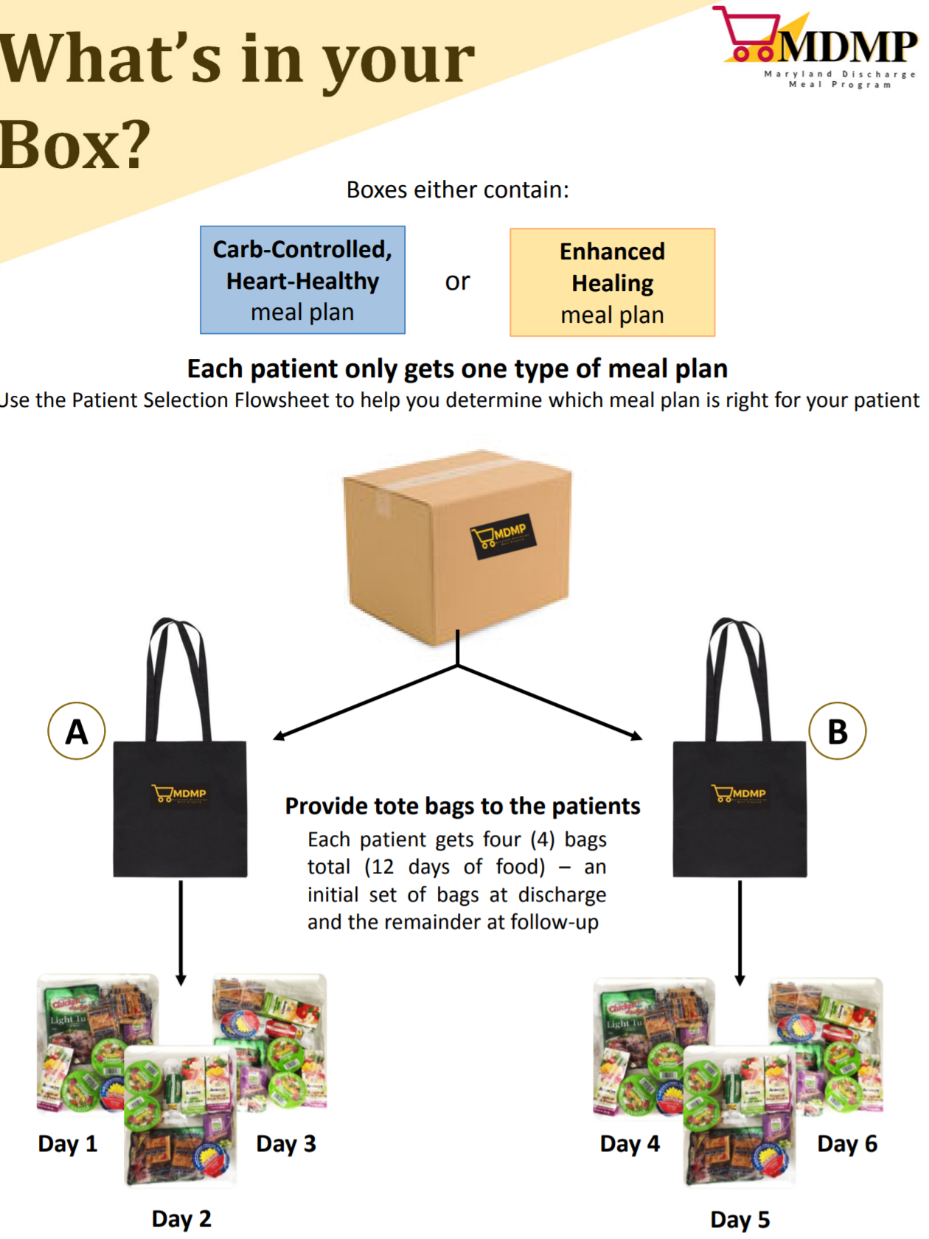
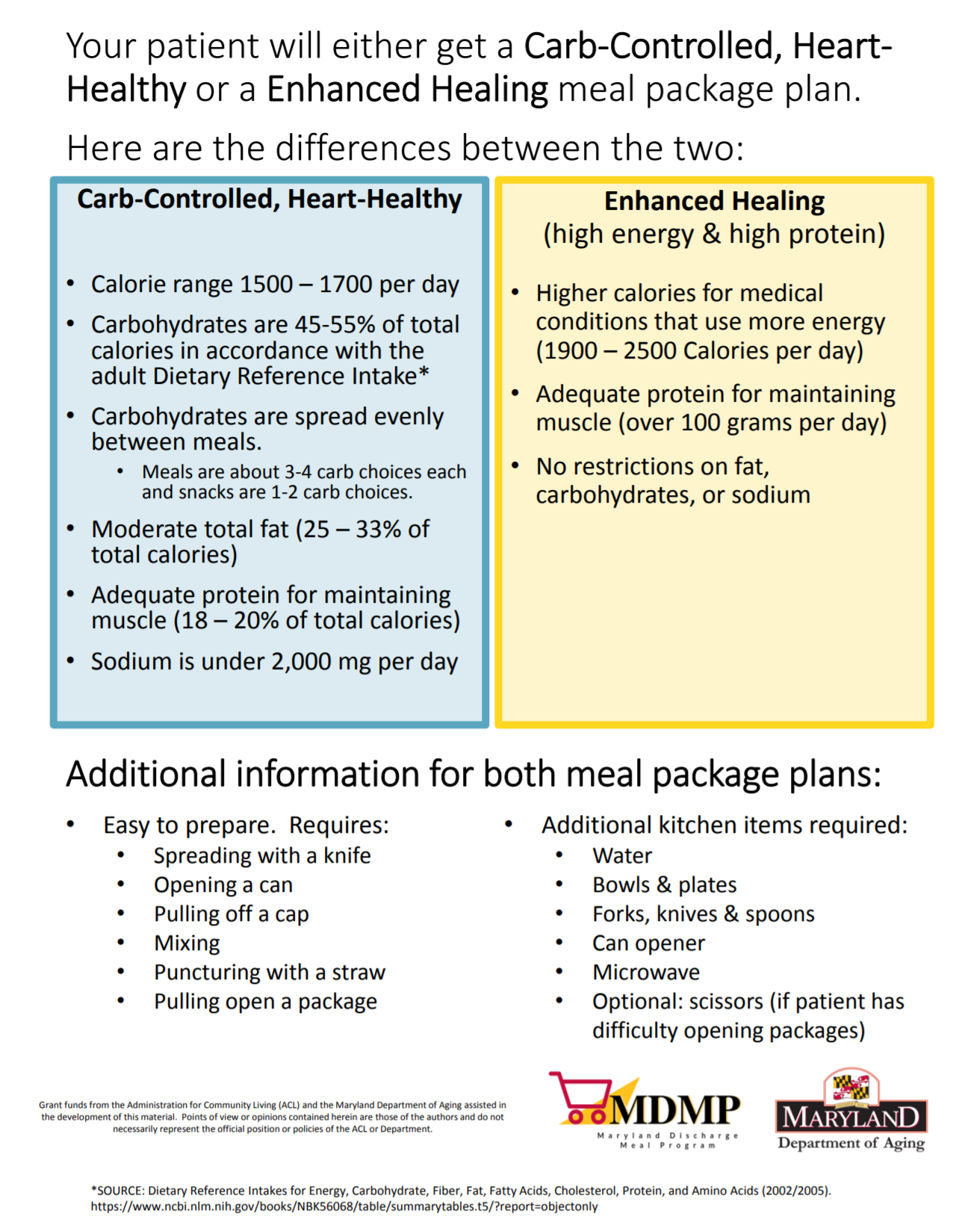
Post-Discharge, Medically-Tailored Meal Packages

Slide 9
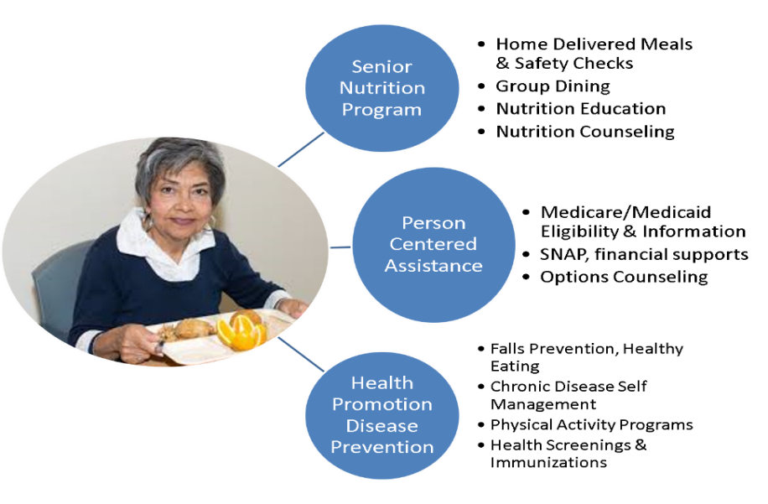
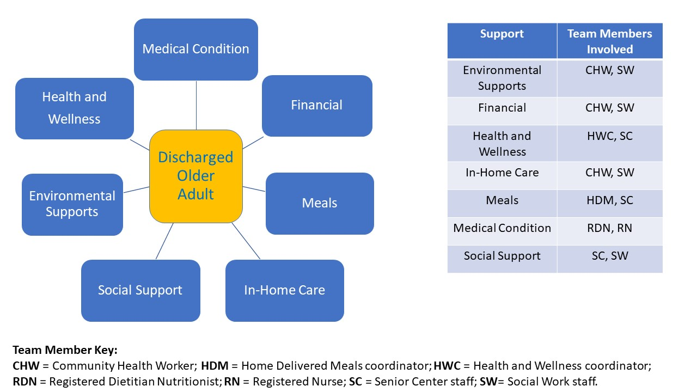
Community Malnutrition Care Pathways
Aging Network Solutions Addressing Socio-Behavioral Determinants of Health
Partners: AAA Pilot sites (Baltimore City, Carroll Co, MAC, Washington Co), BNWS consultants.
Product: Community Malnutrition Toolkit (Summer-Fall 2019)

Slide 10
HDM Priority Tool
Cognitive interviews completed by University of Maryland to ensure questions in the tool are understood by respondents
Validation study underway with 200 home delivered meal applicants to determine if higher priority level is associated with poorer diet quality, lower socioeconomic status, and use of coping strategies
Mobile phone app being created to allow for easy re-assessment and data recording
Graphic designer working on paper version to make tool more approachable and user-friendly
Sahyoun, N.S., Vaudin, A.M., and Simon J.R. (2019). Developing a tool to prioritize home-delivered meals to the neediest older adults. Manuscript submitted for publication.

Slide 11

STEPPING UP YOUR NUTRITION
2.5 Hour Workshop Paired with Evidence-Based Programs
Workshop Goal: Understand the importance of balanced nutrition for the prevention of falls and how to identify the key warning signs of poor nutrition.
Key Messages:
Nutrition status and muscle health are linked to falls risk
Exercise and protein are key factors to help maintain and build strong muscles
How to take action and collaborate with your health care provider to reduce falls risk
How to find local resources for food/nutrition services

Slide 12
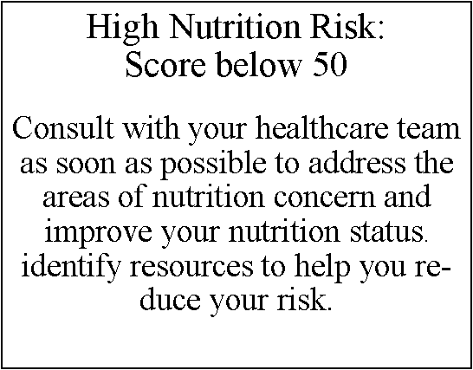
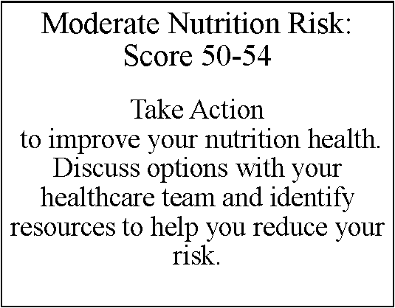
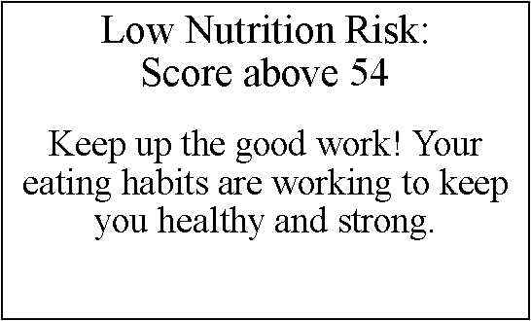
Measuring Malnutrition Risk Level

Slide 13
Stepping Up Your Nutrition Evaluation
  Documentation of Malnutrition and Food Insecurity Risk
      Referral to provider/services for at risk individuals
      Referral to Food Banks and other community resources for food insecurity
      Screening for social determinants/social isolation
      Referral to appropriate evidence-based programs
  Pre/Post Knowledge and Behavior change Assessment (week 1 and end of week 7)
  Grip Strength measurement (week 1 and end of week 7); potential follow-up at 3 months
  Malnutrition Risk, Grip Strength and Action Plan shared with provider

Slide 14
Jan 1 2018 – April 28 2019: 415 Participants
40 Workshops, 11 Counties
QUESTION | PERCENT
Live alone | 94%
Age 70 - 89 | 91%
Race, Ethnicity | AA 63% Caucasian 36%
Eat one or more meals with someone | Sometimes 48% Never 13%
Difficulty getting groceries | Sometimes 19% Often 4%
Food just didn’t last, no $ for more | Sometimes 14% Often 2%
Skip meals | Sometimes 46% Often 4%
Have someone to eat healthy meals with | Sometimes 48% Rarely 5%
Unintentional weight loss | 24%

Slide 15
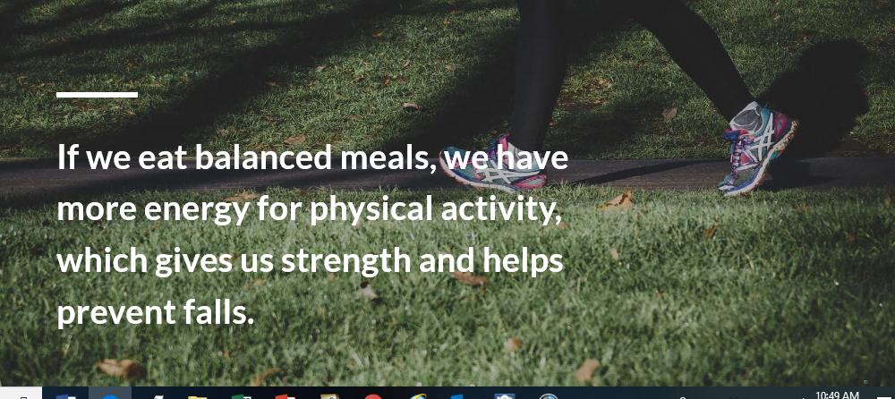



SUYN Early Success and Next Steps
The International Council on Active Aging® (ICAA) August 2017 ICAA Innovators Achievement Award
National Association of Area Agencies on Aging (n4a) 2018 Aging Innovations Award
Transition from in-person to online interactive training available soon

