Slide 1
Nutrition Education in congregate and home delivered meal program settings
What do we know?
12/11/18

Slide 2
Nutrition Education in Congregate and Home delivered meal program settings: what do we know?
Christina Riccardo, EdD, RD
Rowan University
Glassboro, NJ

Slide 3
Overview
Learning Objectives
Background
Purpose of Research
Methodology
Description of Survey Participants & Findings
Overview of Nutrition Education Materials
Implications for Practice

Slide 4
Learning objectives
Describe the current state of nutrition education delivered to congregate and home delivered meal program participants;
Discuss the differences in education provided by non-dietetics professionals and dietetics professionals;
Explain how to incorporate theory-based and behaviorally focused nutrition education into nutrition education sessions.

Slide 5
Background
Adequate nutrition is a key component of aging well.
Congregate and home-delivered meal programs are an ideal setting in which to provide nutrition education for older adults that can lead to increases in successful aging.
Additional impetus for conducting this research came from my personal experience as a nutrition educator.

Slide 6
Purpose of research
Purpose
To identify the type and frequency of education; lessons theory-based and behaviorally-focused; if credentials mattered; evaluation of nutrition education efforts.
Method
Cross-sectional, national study;
  Survey of nutrition educators.

Slide 7
Professional Credentials of Survey Participants
Dietetics Professionals (n = 189) | Non-Dietetic Professionals (n = 152)
Registered Dietitian | Health and Human Services degree
Licensed Dietitian | Certified Dietary Manager
Dietetic Intern | Registered Nurse
 | Licensed Practical Nurse
 | Social Worker
 | Licensed Social Worker
Thank you to those of you who participated in this research!
Notes:
We surveyed a total of 341 nutrition educators in congregate and home delivered meal sites
Explain the breakdown of dietetic vs. non-dietetic professionals

Slide 8

Survey Participant characteristics
Almost 70% in profession for 10+ years;
  Almost ½ worked with older adults for 10+ years.
59% dietetics professionals had master’s degree;
27% non-dietetic health professionals had a master’s degree;
Almost 60% of participants were over the age of 50;
89% of the participants were female.

Slide 9
NUTRITION EDUCATION SESSIONS CHARACTERISTICS
More than 80% worked in both home delivered and congregate meal settings;
More dietetic professionals were responsible for ≥ 10 sites than non-dietetic health professionals (56% vs. 35%);
Most common group size for nutrition education was 10-20 (28.8%);
Most common length for education session was between 15-20 minutes (50%).
Notes:
?

Slide 10
% EDUCATORS COVERING TOPICS IN PAST TWO YEARS
Notes:
Explain the topics covered

Slide 11
Poll Question: how often do you develop your own nutrition education materials/sessions vs. use off-the-shelf curricula?
-Usually
-sometimes
-rarely
-never
Notes:
Integrating educator expertise (skills obtained through practice and experience) with the best available external evidence from systematic research about nutrition education outcomes.

Slide 12

CRITERIA USED FOR CHOOSING MATERIALS
29% choose materials that focus on specific behavior change;
32.5% choose materials based on nutrition risk assessment;
82.5% choose materials that cover topic clients are interested in;
73.4% choose materials that are targeted.
This Photo by Unknown Author is licensed under CC BY-NC-ND
Notes:
Explain why focusing on behavior change is important
When broken down, 35% of dietetics professionals and 24% of non-dietetic health professionals focus on specific behavior changes
Nutr risk assessment- 31.7% dietetic prof and 34.1% non- dietetic prof
Interest- 92.5% dietetic and 74.4% non-dietetic
Targeted meaning specific topics for older adults- 81.7% dietetic and 65.9% non dietetic

Slide 13

Criteria used for choosing materials (cont.)
Delivery considerations:
  Interesting activities (41.3%)
  Easy to teach/implements (56%)
  Can teach in allotted time (34.9%)
  Provides all teaching materials needed (38.9%)
  Materials already familiar with (14.3%)
  Organization selected for me (8.3%)
  Simple messages (63.1%)
  Practical (63.5%
  Cost (29%)
This Photo by Unknown Author is licensed under CC BY
Notes:
Activities- 43.3% diet, 40.3% non-diet
Easy 65.8% diet,47.3% non-diet
Time – 43.4% diet, 26.4% non-diet
providesMaterials 36.7% diet 41.1% non-diet
Familiar 16.7% diet, 12.4% non-diet
Organization 3.3% diet 12.4 non-diet
Simple messages 72.5% diet 55% non-diet
Practical 72.5% diet 55% non-diet
Cost 28.3% diet 295% non diet

Slide 14
Methods of delivery

Slide 15
Materials used for Nutrition education
SNAP-ED/County extension materials
State Department on Aging Nutrition education materials
State University extension programs
Company materials
Eat Smart, Live Strong
MyPlate
DASH diet
Chef Charles/Fresh Conversations
Eat Better & Move More
Cooking Matters
Healthy Eating for Successful Living in Older Adults
Notes:
Participants in the survey rated each of these materials on a scale that ranged from do not use to use extensively
Materials used the least were Chef Charles/ Fresh conversations and Eat Better & Move more ;
The materials used the most were MyPlate materials which participants reported they use components of MyPlate for education
All other materials were rated as familiar with but do not use
Many of these items are theory-based and behaviorally focused as well as evidence based

Slide 16
Satisfaction with nutrition education materials
Question: Are you satisfied with the nutrition education materials you use?
On a 4 point scale:
  0 = not satisfied
  1 = neutral
  2 = somewhat satisfied
  3 = satisfied
  4 = very satisfied
Average Score = 2.2
Notes:
Score- so participants indicated they were somewhat satisfied with nutrition education materials available. This is similar for dietetics prof and non-dietetic prof with diet prof being slightly more satisfied (perhaps because they are more aware of the materials available)

Slide 17
Satisfaction with nutrition education materials (cont.)
Question: Would you like more resources to provide education?
  Scale 0-4
    0 = definitely not
    1 = probably not
    2 = might or might not
    3 = probably yes
    4 = definitely yes
Average Score = 2.84
Notes:
Overall, participants were between might or might not and probably yes to needing more resources to provide nutrition education
- This was higher for non-diet than diet prof – non-diet prof want more resources

Slide 18
Barriers to conducting nutrition education with older adults
 | Total (%) | Dietetics Professionals | Non-Dietetic Health Professionals
Lack of materials available | 23.0 | 19.1 | 27.1
No budget for nutrition education activities | 52.8 | 49.5 | 56.8
No promotion of nutrition education sessions | 21.4 | 26.6 | 16.9
Staff unaware of visits/unprepared | 7.4 | 9.2 | 5.7
Competitive events scheduled | 16.6 | 18.3 | 14.4
No incentives | 26.6 | 27.5 | 26.3
Clients/participants not interested | 47.6 | 44.0 | 51.7
Lack of time | 38.4 | 40.4 | 37.3
No access to cooking resources | 17.5 | 24.8 | 11.0
No computer/projector | 19.2 | 21.1 | 16.7
Difficulty getting/maintain participant attention | 48.0 | 44.0 | 52.5

Slide 19
Facilitators to conducting nutrition education with older adults
 | Total (%) | Dietetics Professionals | Non-Dietetic Health Professionals
More nutrition education materials available | 49.6 | 44.5 | 55.3
Larger budget for nutrition education | 57.5 | 52.7 | 63.2
Promotion of nutrition education sessions | 35.0 | 37.3 | 33.3
Congregate meal site staff/participants prepared for visit | 28.3 | 34.5 | 22.8
Decrease in competing events | 18.6 | 21.8 | 14.9
Increased participant interest | 51.3 | 43.6 | 58.8
More time for preparation and delivery of nutrition education | 32.4 | 32.1 | 33.3
Access to cooking resources (i.e., hot plates) | 20.8 | 30.0 | 12.3
Access to projector, computer | 21.2 | 24.5 | 17.5

Slide 20
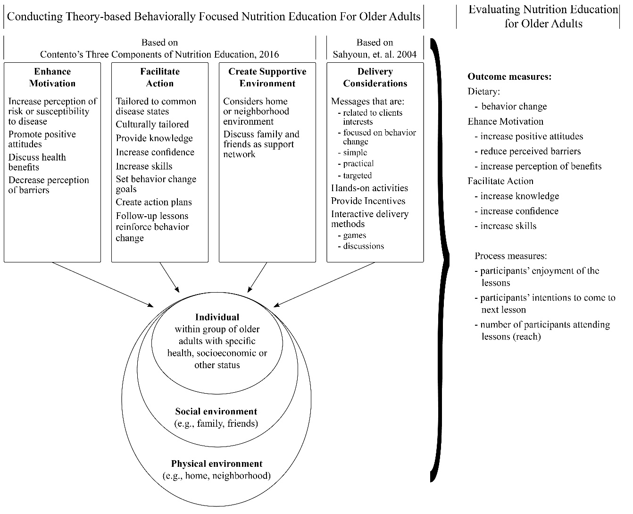
Revised Model for Nutrition Education for Older Adults
Notes:
Talk about what ways this has been revised .

Slide 21
Why choose theory-based, behaviorally focused education materials?
Required for behavior change to occur and be sustainable;
Involves lessons that target specific dietary behaviors;
  Example: Eat more vegetables at dinner
Includes goal setting
Helps participants identify barriers to achieving goals
  Strategies to overcoming barriers

Slide 22
Goal of nutrition education
The goal of nutrition education is to change behavior. Creating or selecting a nutrition education curriculum that can aid in this effort is key.
Health behavior change is critical but challenging to do. Public health practitioners have developed theories to understand how behavior change can occur.
A theory is a systematic approach to understanding events, behaviors and/or situations.
Theories are supported through understanding how behavior change occurs in real life – in day to day work settings or via research evidence.

Slide 23
Willingness to Use evidence-based materials
 | Total (mean) | Dietetics Professionals | Non-Dietetic Health Professionals
Would use evidence-based nutrition education program if available | 3.01 (0.91) | 3.01 (0.87) | 3.03 (0.94)
Have funding for reasonably priced evidence based materials | 1.80 (1.1) | 1.91 (1.0) | 1.69 (1.1)
No significant difference between those surveyed!
Notes:
Be sure to state that most evidence-based materials are FREE

Slide 24
Examples of Theory-based and behaviorally focused nutrition programs

Slide 25

Theory-based and behaviorally focused nutrition programs
Fresh Conversations
  Newsletter-based nutrition education;
  Includes a section intended to facilitate discussions;
  Funded by SNAP and can be accessed online;
  Video and free training guide are available.
Notes:
Will explain more

Slide 26
Theory-based and behaviorally focused nutrition programs (2)
Eat Better and Move More (EBMM)
  Developed by the National Policy and Resource Center on Nutrition and Aging at Florida International University
  12 weekly sessions
    Mini talks and activities for group nutrition and physical activity sessions
  Guidebook is available to educators
  Designed to be just 30 minutes for each session
Notes:
Will explain more

Slide 27

Theory-based and behaviorally focused nutrition programs (3)
Eat Smart Live Strong: Nutrition Education for Older Adults
  Developed to increase fruit and vegetable intake and physical activity.
  Free online resources
    Includes leader’s guide;
    Interactive education sessions;
    Ready-to-go participant handouts;
    Marketing flyers.
This Photo by Unknown Author is licensed under CC BY-NC-ND
Notes:
Will explain more

Slide 28

Theory-based and behaviorally focused nutrition programs (4)
Cooking Matters
  Empowers resource-limited families to eat better for less.
  6-week cooking classes.
  In-store educational curricula available.
Notes:
Will explain more

Slide 29
Q & A Question:
What resources would enable you to provide theory-based, behaviorally focused nutrition education?

Slide 30
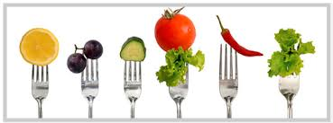
Implications: what do we know?
Create a repository of materials and programs:
  Track the nutrition education curricula you use;
  Stay informed on availability of new materials and programs.
This Photo by Unknown Author is licensed under CC BY-NC-ND
Notes:
Almost 50% of total survey participants indicated that one factor that could facilitate their nutrition education efforts is higher availability of education materials. A central repository of nutr ed materials is helpful since many of these programs and resources, even at the local county and state level, appear to be underutilized ; might also help save time
Title III D program has a document with a table that lists various health promotion and disease prevention evidence –based programs, along with information on websites, program descriptions and goals, target audiences, costs, training requirements and who should deliver the program. No such list or table exists for the title III-C nutr programs to help educators find and utilize high- quality education materials and programs

Slide 31
Dietetics vs Non-dietetics Credentialed educators: conducting TBBF Nutrition education
Rationale | Total (mean) | Dietetics Professionals (mean) | Non-Dietetic Health Professionals (mean) | T | p
Enhance Motivation | 2.80 (0.76) | 2.96 (0.68) | 2.67 (0.80) | -3.36 | 0.001
Facilitate Action | 2.33 (0.71) | 2.96 (0.68) | 2.18 (0.74) | -3.24 | 0.001
Create Supportive Environment | 1.90 (0.93) | 2.13 (0.91) | 1.72 (0.90) | -3.54 | <0.001
Delivery Considerations | 2.11 (0.95) | 2.29 (0.87) | 1.97 (0.97) | -2.75 | <0.001
Total | 2.29 (0.68) | 2.49 (0.62) | 2.11 (0.70) | -4.29
Notes:
When dietetics prof were compared to non-diet prof, diet prof scored sig higher on each individ component and higher on overall score, indicating they are conducting more TBBF nutrition education

Slide 32
Implications: what do we know? (cont.)
More training and resources at the local and national levels are needed for all educators, especially non-dietetic professionals focusing on:
  Theory-based, behaviorally focused nutrition education:
    What it is,
    Why it matters, and
    How to incorporate it into nutrition lessons
Program administrators are encouraged to develop training manuals and how-to guides to support provision of high-quality nutrition education.
Notes:
Is this an implications slide? if so, please make this more clear. To whom are the implications directed - program managers? practitioners? ACL? Please specify.
More training for all educators by qualified practitioners/higher level RDs on TBBF nutrition education
ACL could maybe develop a training manual to educate program managers and practitioners on what TBBF nutrition education is and how to incorporate it into lessons- along with resources.

Slide 33
Take home messages
Theory-based, behaviorally focused nutrition education is recommended;
Theory-based, behaviorally focused nutrition education is available;
Many evidence-based programs are available for free or low cost;
More awareness raising and training on availability of materials needed:
  Especially for non-dietetic professionals.

Slide 34
references
Fresh Conversations training: https://idph.iowa.gov/inn/fresh-conversations/coordinators/training-materials
Fresh conversations resources: https://idph.iowa.gov/inn/fresh-conversations/coordinators/resources
Eat Smart, Live Strong manual and resources: https://snaped.fns.usda.gov/nutrition-education/fns-curricula/eat-smart-live-strong
Cooking Matters website and resources: https://cookingmatters.org/
Eat Better and Move More resources: http://nutrition.fiu.edu/You_Can/index.asp

Slide 35
Thank you!
Christina riccard0, EDD, RD riccardo@rowan.edu

Slide 36
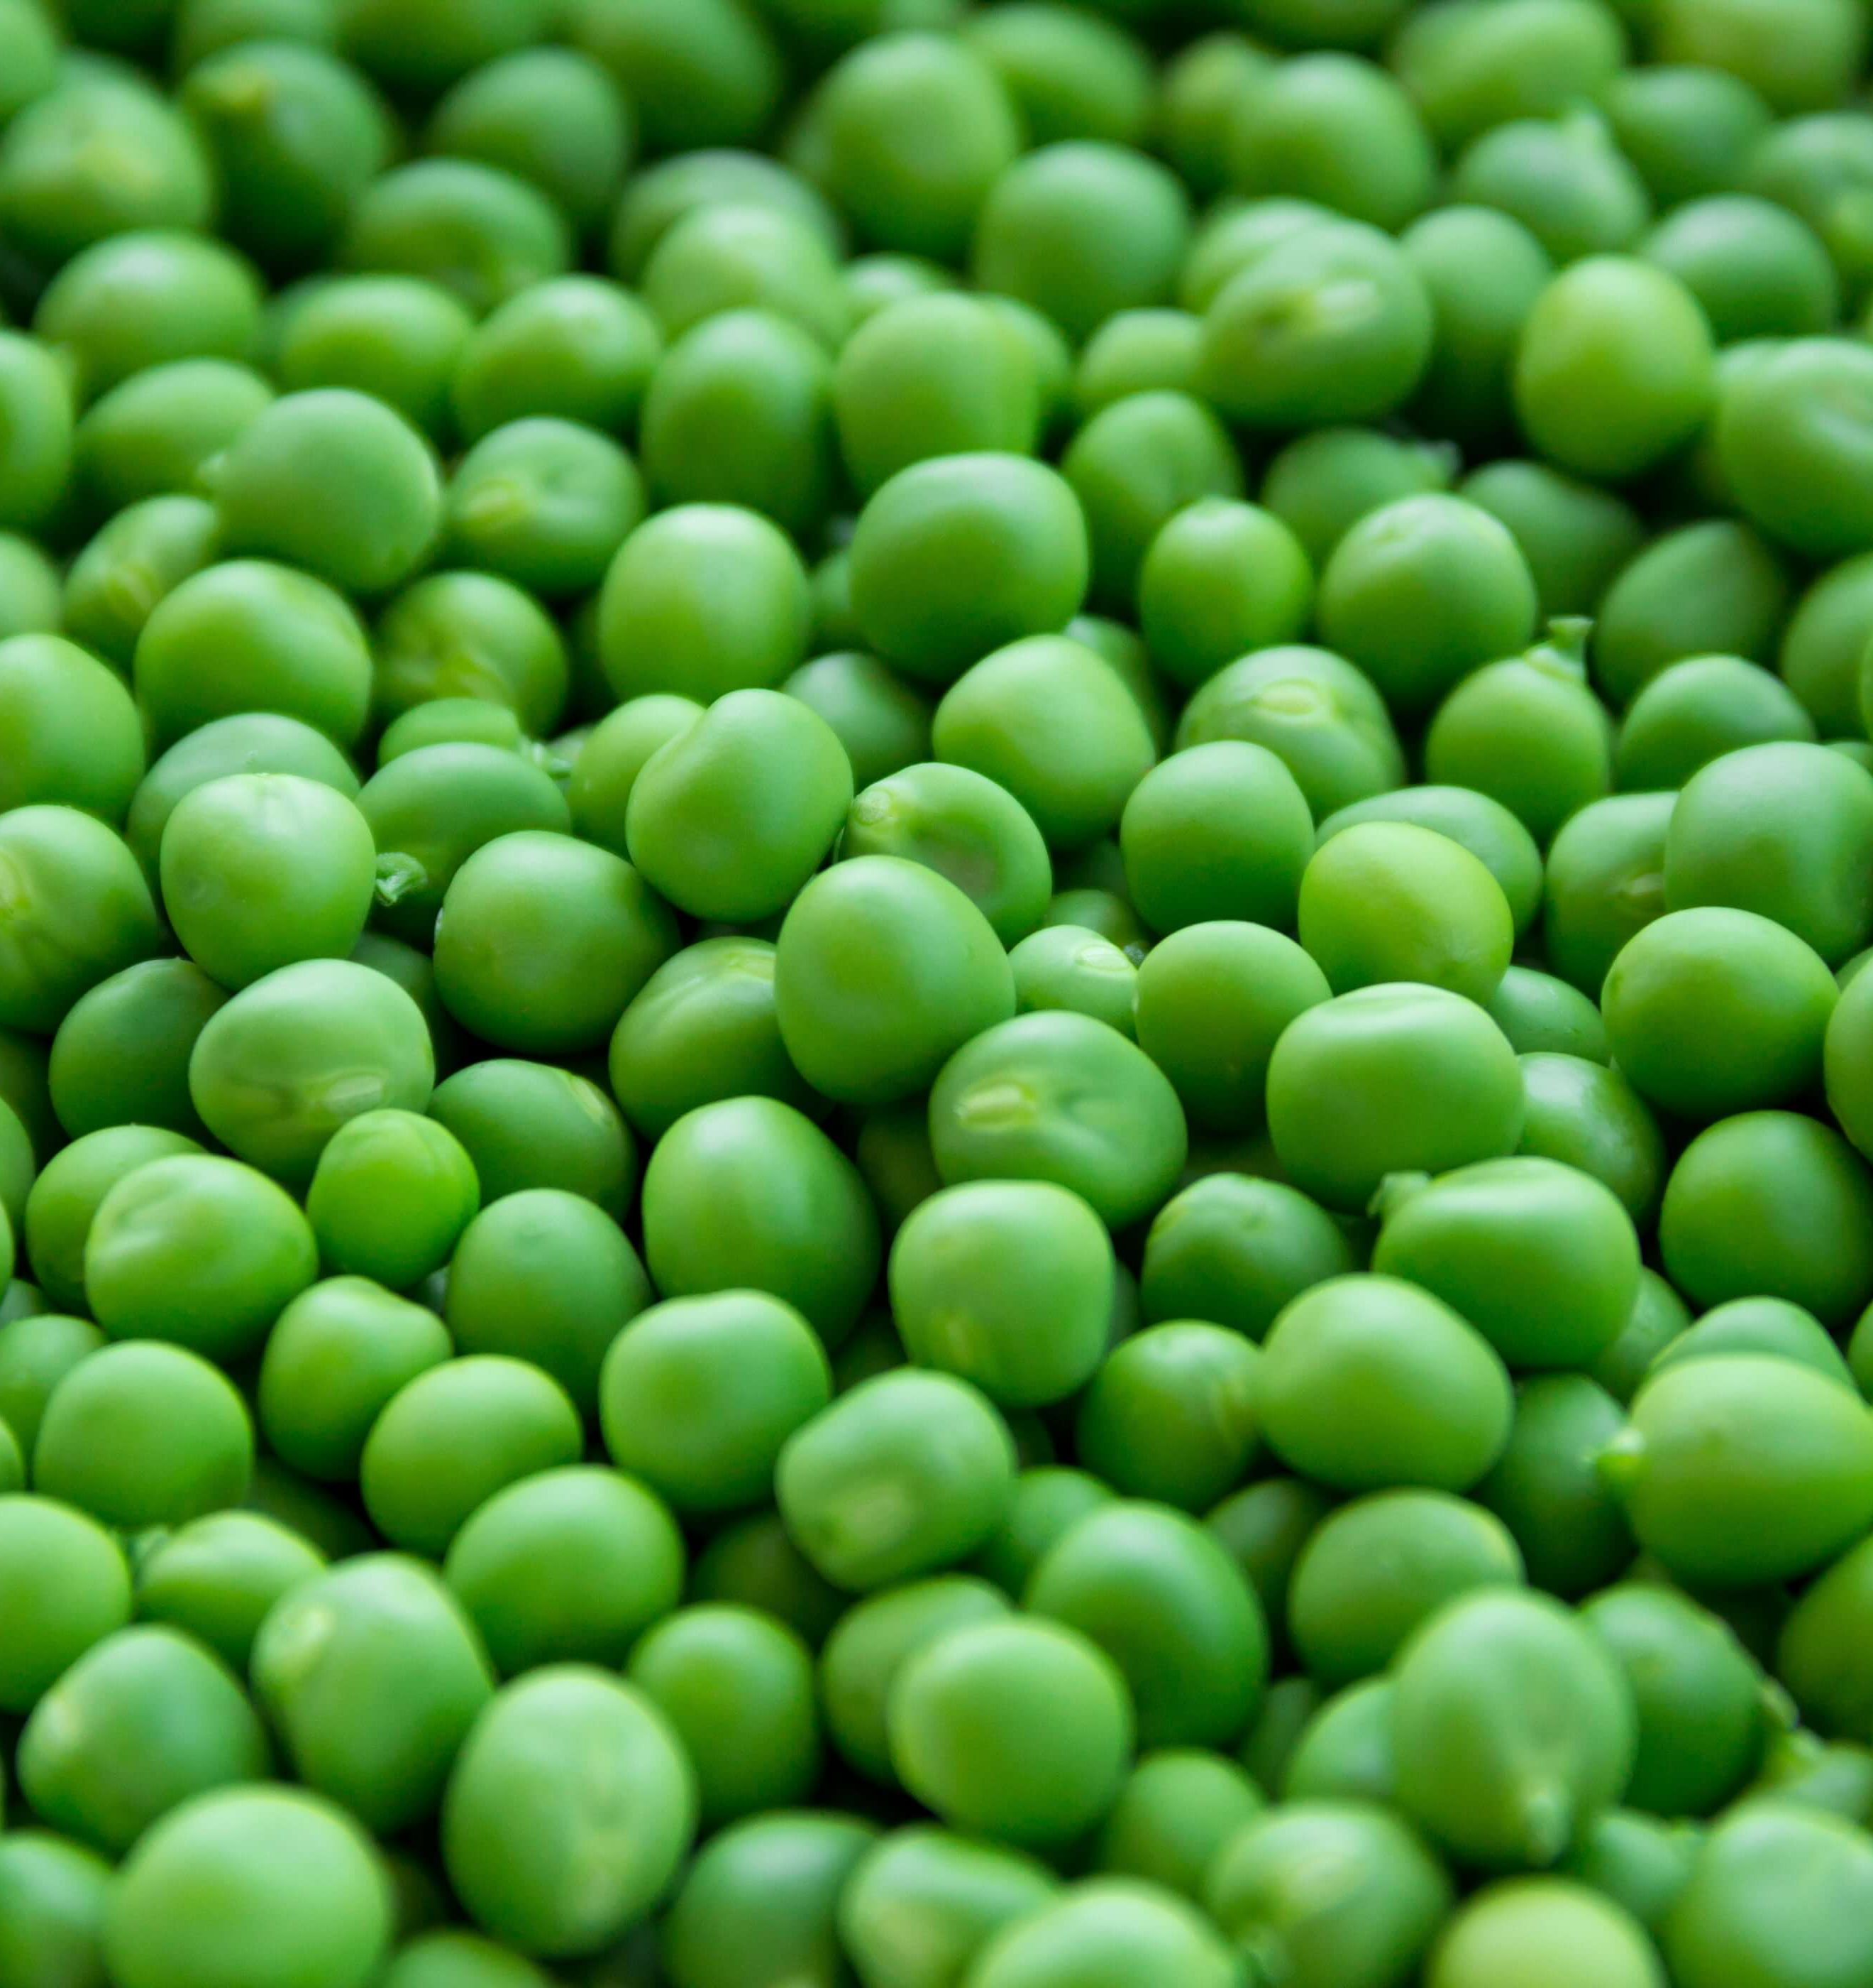
Upcoming webinar
New tools and resources

Slide 37
Nutrition education webinar: Part 2
Nutrition Education In Congregate And Home-Delivered Meal Program Settings
  Where Do We Go?
Date: December 13, 2018
Time: 3:30pm ET
To Register: Visit the National Resource Center On Nutrition And Aging’s Website
Join Us!

Slide 38
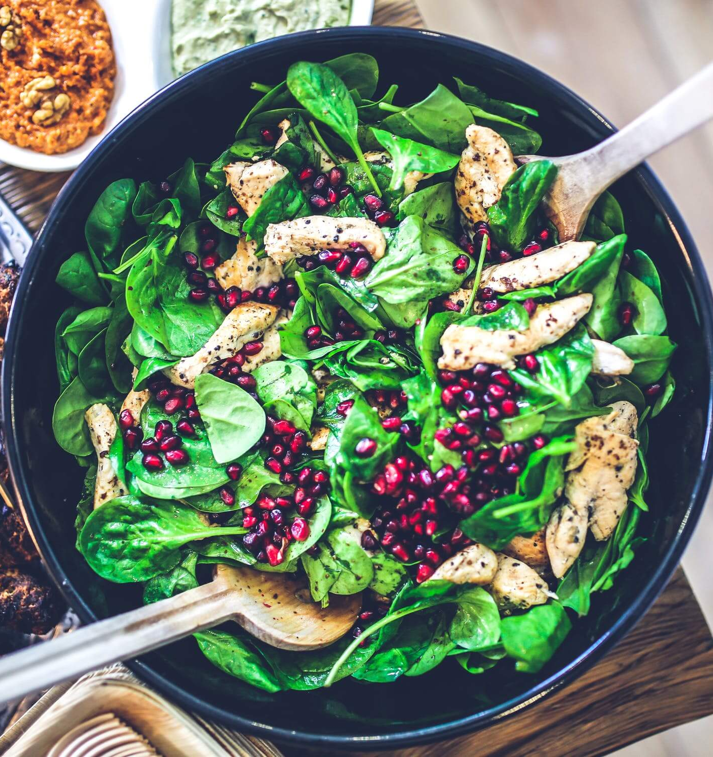
Thank you!

