Slide 1
National Resource Center on Nutrition & Aging
Nutrition Education
What’s New for Reporting and Connecting with Clients
Judy Simon, MS, RD, LDN, National Nutritionist Administration for Community Living
Carmen Clutter, MS, RDN, LD, Population Health and Nutrition Manager
Ohio Department of Aging
Fall 2021

Slide 2
Agenda in Brief
Nutrition education and why it’s important as people age
SPR/OAAPS changes to definitions and descriptions
Nutrition education and health literacy
Q&A segment
Challenges and solutions around education delivery
Recommended resources
Preparing for change
ACL Innovation in Nutrition grantees’ best practices
Resource links provided throughout the session

Slide 3
Federal Reporting in FY 2022
New SPR implementation: October 2021
Title III SPR data elements ≠ policy
SUAs develop policies, regulations, and procedures
State policies will vary
Older Americans Act Performance System (OAAPS)
State Performance Report (SPR)

Slide 4
Defining Nutrition Education
Current Definition
A targeted program to promote better health by providing accurate and culturally sensitive nutrition, physical fitness, or health (as it relates to nutrition) information that is consistent with the current Dietary Guidelines for Americans (DGA) and instruction to participants, caregivers, or participants and caregivers in a group or individual setting overseen by a dietitian or individual of comparable expertise.

Slide 5
Redefining Nutrition Education
New Definition (effective FY 2022)
An intervention targeting OAA participants and caregivers that uses information dissemination, instruction, or training with the intent to support food, nutrition, and physical activity choices and behaviors (related to nutritional status) in order to maintain or improve health and address nutrition-related conditions.
Content is consistent with the DGA; accurate, culturally sensitive, regionally appropriate, and considers personal preferences; and overseen by a registered dietitian or individual of comparable expertise as defined in the OAA.

Slide 6
Service Unit Definition
Redefining a Unit
Related Resources
Current definition specifies 1 session per participant
New definition: may be delivered in-person or via video, audio, online, or the distribution of hardcopy materials
Nudging in education
Economics of Education Review
Why nudges work and how to use them to keep students on track EAB
The Use of Nudges and Other Behavioural Approaches in Education ERIC

Slide 7
Service Unit Examples
1 presentation = 1 session
Even if offered more than 1 time, by more than 1 presenter, and/or in multiple formats
1 social media message = 1 session
Includes text messages
1 newsletter = 1 session
Even if containing more than 1 article
1 set of hardcopy materials = 1 session
Each set covering a different topic/message = separate session
The same message communicated more than 1 way (e.g., menu notes + social media) = 1 session

Slide 8
Examples of State Flexibility
Social Media
Not counted
Only certain types
Hardcopy
Not counted
Only certain types
Presentations
Not Permitted
Requiring a minimum length or frequency
Qualifications required for person delivering nutrition education
Interventions inconsistent with nutrition education definition
Session types not listed in the SPR/OAAPS session definition

Slide 9
New Element: Audience Size
Defined by SPR/OAAPS in Appendix A: Data Element Definitions:
An individual who receives a service funded in whole or in part with OAA funds (see Consumer).
For non-registered services (nutrition education and information and assistance) for which an “estimated audience size” is to be reported, an unduplicated count of participants may not be feasible and therefore audience size is acceptable. This figure is anticipated to be a duplicated count.
FAQ: Title III New SPR & OAAPS
AGID Technical Documentation & Training Resources

Slide 10
Social Media Audiences
Estimated Audience Size Resources
How to Find out Who Is Watching Your YouTube Videos Livewire
How to track post views on Facebook Lee Media Group
About your activity dashboard Twitter Help Center

Slide 11
Audience Size Examples
Gut Health Workshop
Social Media Campaign
Delivered across state
5 different providers
50 attendees at each
Session count: 1
Estimated audience: 250
Messages on importance of eating fruits/vegetables
1,000 followers
Session count: 1
Estimated audience: 1,000
Remember, state-specific guidance applies.
Consider ability to collect information about offering the same program across the state.

Slide 12
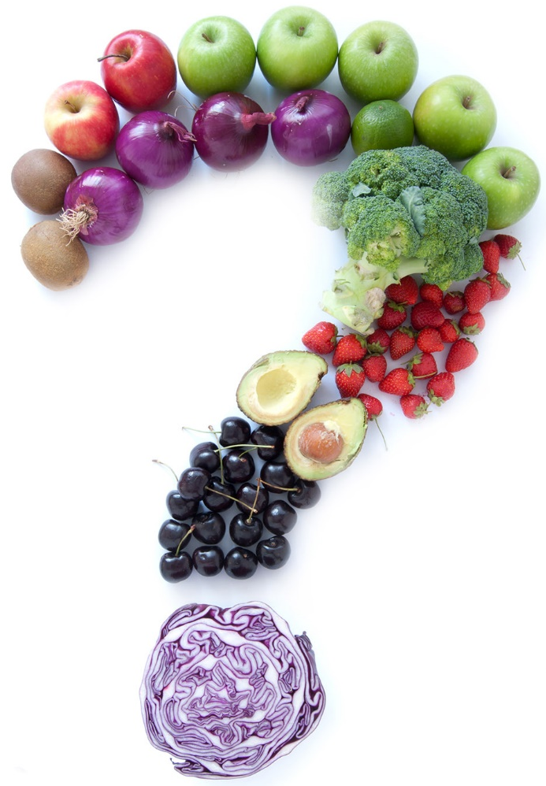
What is Nutrition Education?
Notes:
Thank you, Judy for that warm hand off.
Next, I will focus on exploring the topic of nutrition education by reviewing the importance of health literacy and plain language guidelines when developing appropriate content.
In Ohio, we define nutrition education as "a service that promotes better health by providing consumers or caregivers with accurate and culturally-sensitive information and instruction on nutrition, physical activity, food safety, or disease prevention. We also require education material delivered to our consumers to be tailored to their needs, interests, and abilities (which include their current level of literacy)

Slide 13
Nutrition Education
Relevant and interesting
Support learning needs
Involve participants
Focus on behaviors and be achievable
Include contact with professionals
Presented in short sessions
Evaluation component
This Photo by Unknown Author is licensed under CC BY
Notes:
Nutrition education is any combination of educational strategies, accompanied by environmental supports, designed to facilitate voluntary adoption of food choices and other food- and nutrition-related behaviors conducive to health and well-being. Nutrition education is delivered through multiple venues and involves activities at the individual, community, and policy levels
To support these goals, nutrition education for senior nutrition program participants must:
Meet OAA nutrition program goals
Be relevant and of interest to the audience
Support adult learning needs and Build off previous knowledge of the participants
Actively involve individuals in determining personal goals and Include hands-on activities
Focus on behavior modification and Be achievable or able to be implemented
Include contact with health or nutrition professionals
Be presented in short sessions
Have an evaluation component that allows for both process and outcome measures to be tracked

Slide 14
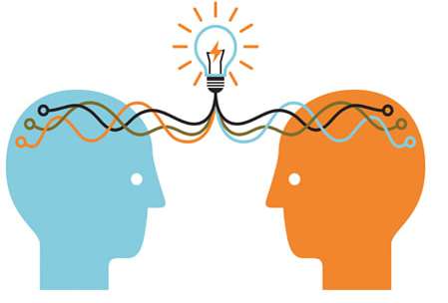
Health Literacy
Level individuals can obtain, process, and understand basic health information.
Low health literacy more prevalent among:
Older Adults
Minorities
Low-Income
Medically underserved
This Photo by Unknown Author is licensed under CC BY-SA-NC
Notes:
Health literacy is the degree to which individuals have the capacity to obtain, process, and understand basic health information needed to make appropriate health decisions.
Results of the 2003 National Assessment of Adult Literacy showed that only 12 percent of American adults have proficient health literacy skills.
With that, nearly half of American adults lack adequate literacy skills
Low health literacy is more prevalent among:
Older adults
Health literacy challenges may impact older adults more than other age groups.¹² On average, adults age 65 and older have lower health literacy than adults under the age of 65.²⁷ Low health literacy among older adults is associated with increased reports of poor physical functioning, pain, limitations of daily activities, poor mental health status^{34, 35}
Minority populations
Those who have low socioeconomic status
Medically underserved people
.

Slide 15
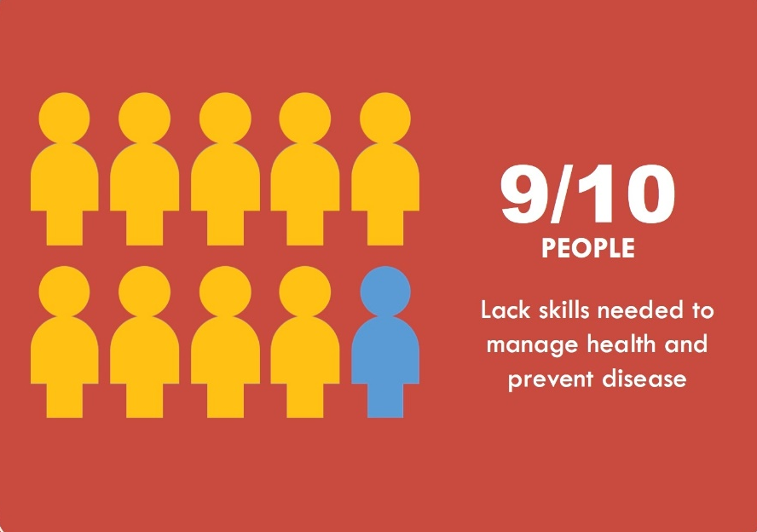
Health Literacy (cont.)
Reasons for low-health literacy:
Complex words
Low-education skills
Cultural barriers
Limited-English
National Action Plan to Improve Health Literacy
Notes:
Health literacy is a common thread through all of our programs. A large portion of the people we serve are poor and medically underserved.
They need help understanding and navigating a complex health care system. They require culturally competent providers who speak their language so they can make informed health care choices.
A number of patients may be confused with certain medical language, have difficulty understanding English, struggle with filling out forms, or have limited access to health providers in their community.
With the proper training, health care professionals can identify patients' specific health literacy levels and make simple communication adjustments.
Reasons for an individual’s low-health literacy can also be related to:
Health care professionals using words consumers don’t understand
Low education skills
Cultural barriers
Limited English proficiency. Individuals who do not speak English as their primary language. They have a limited ability to read, speak, write, or understand English and may be limited English proficient, or "LEP."
These individuals may be entitled language assistance with respect to a particular type or service, benefit, or encounter.
Results from the National Assessment of Adult Literacy demonstrated that Hispanic adults have the lowest average health literacy scores of all racial/ethnic groups, followed by black and then American Indian/Alaska Native adults.²⁷ People with low health literacy and limited English proficiency are twice as likely as individuals without these barriers to report poor health status.³¹
Evidence supports 2 major solutions to improve consumer comprehension – plain language and teach-back. We will touch on both today.
.

Slide 16
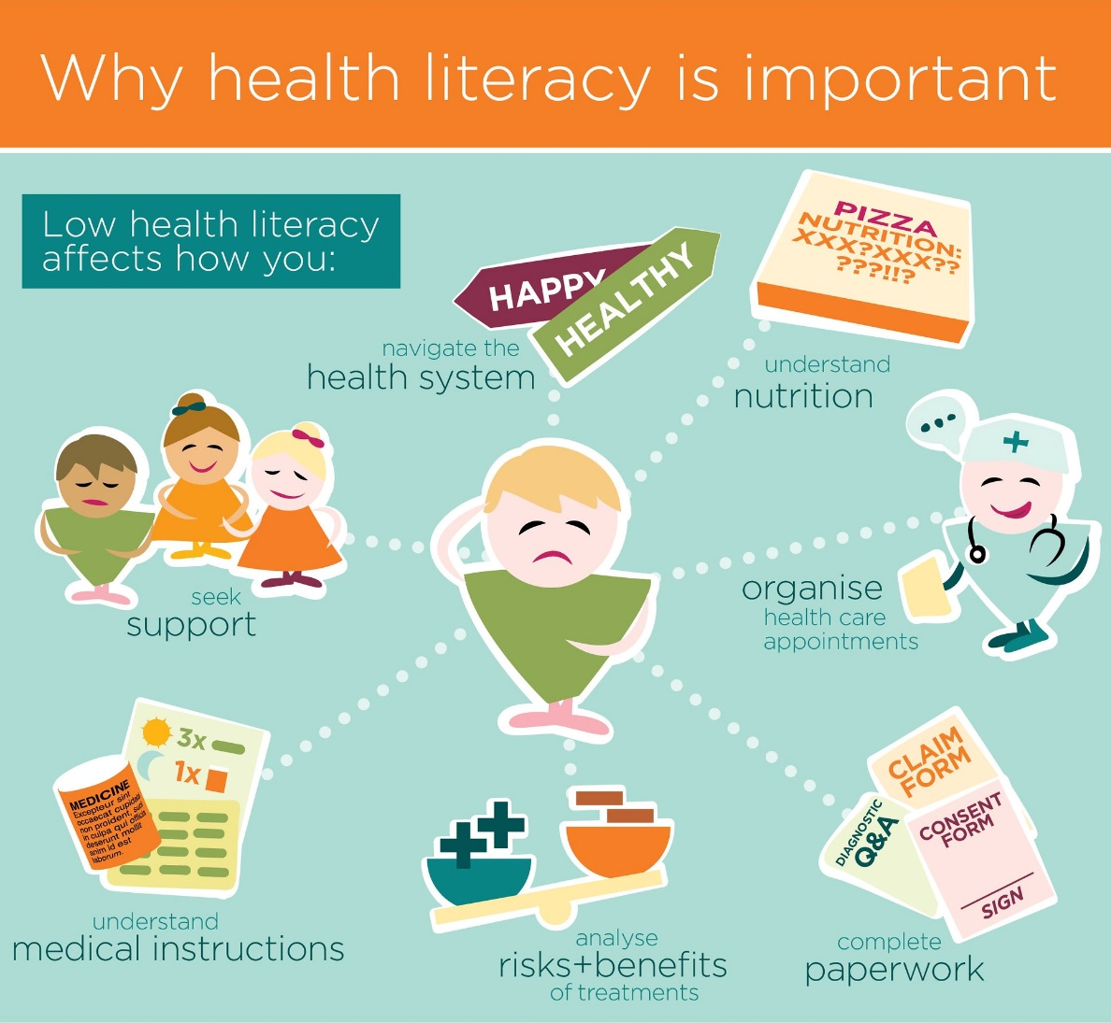
Why health literacy is important
World Literacy Foundation
Notes:
Consumers with low health literacy may have difficulty filling out enrollment/application forms, seek out preventative health care (including health promotion programs), understand the connection between unhealthy behaviors and their overall health and wellness, and then finally, may experience great challenge understanding information provided to them and how to apply it to their own wellness.
The good news is, there is plenty we, as health professionals and service providers can do. Today, I’m hopeful that the information I share with you with resound well and help you provided the best nutrition education to all consumers, regardless of their health literacy status

Slide 17
What’s the Audience’s Need?
Who is my audience?
What do they already know?
What do they need to know?
What questions will they have?
What are the outcomes?
This Photo by Unknown Author is licensed under CC BY
Notes:
Carmen Talking Points:
The best way to grab someone’s attention, it to figure out who they are and what they want to know, right? Exactly! The same is true with nutrition education that delivers a benefit to the consumer.
When preparing nutrition education content, one of the best places to start if first determining who your audience is.
Understand their key demographics, including their age, education, skills
Do not assume or guess who they are or what their needs are.
Identifying your audience will do more than ensure you write clearly. It will also help you focus on their need.
Reflect the age, cultural, ethnic and racial diversity of patients
For Limited English Proficiency (LEP) patients, provide information in their primary language
Use language and examples that your audience knows and feel comfortable with.
If needed, identify cultural considerations to take into account, or even food preferences.
If possible, identify the reading level of your consumers. If you do not know this, aim for a 6th grade and 8th grade reading level.
First start out by thinking about their current situation.
Then, think about how to guide them from their current knowledge to what you need them to know.
For example, if a congregate meal site really struggles with consumers complaints of lack of salt shakers on tables, first acknowledge that. YOU may know that this meal site tries to avoid the lure of table salt, but do your consumers really understand why? If we took the opportunity to educate on putting a halt to the salt, would the lack of salt shakers be an issue?
To help you do this in your current practice, consider the following questions:
Who is my audience?
What does my audience already know about the given subject?
What does my audience need to know?
What questions will they have?
And then finally, don’t forget to acknowledge the outcomes – what are the desired outcomes for your consumers AND your agency? Is it to meet nutrition education standards? Is it solely to educate more people on the benefit of eating a reduce sodium diet? This will be truly individualized.

Slide 18
What’s the Audience’s Need? (cont.)
Listen to consumer questions
Talk to understand
Analyze findings and data
This Photo by Unknown Author is licensed under CC BY-SA-NC
Notes:
In order to develop content unique for your users, you need to further define what they need
Listen to consumer questions – what do consumers ask when completing annual verifications/nutrition screenings? What do they want to know about a provider’s menu? What are your common consumer comments/questions?
Talk to consumers, consider asking them what’s of value. What do they want to learn? What would support them in maintaining their health and wellbeing?
Consider surveying consumers. This could be done directly at a congregate meal site, or a dropped off survey with a home-delivered meal. Seek opportunity to directly ask the consumer.
You’ll uncover the need, and be able to stand on professional expertise to properly educate on the need.
Considering analyzing current data to sway decisions of education topics.
Does your nutrition screening tools indicate a risk of malnutrition or a risk of food insecurity? Can you develop content to address those topics areas?
Similarly, are you serving a population that experience high rates of chronic disease?

Slide 19
Plain Language
Style of writing that is clear and to the point, thereby improving communication and understanding.
Goals:
Find what they need
Understand what they find
Use what they find to meet their needs
Plain Language Association International
Notes:
Carmen Talking Points:
The plain writing act of 2010 was signed on October 13, 2010. This law requires federal agencies to use clear communication that the general public can understand and use.
While you may not be held accountable to this law and federal requirements, the guidelines do provide valuable recommendations that you may find beneficial to enhance your current nutrition education practice.
Plain language is a style of writing that is clear and to the point. It helps to improve communication and understanding. And , it takes less time to read and understand.
The Plain Language Association defines communication that is plain language when its wording, structure, and design are so clear that the intended audience (our meal consumers, for example) can easily find what they need, understand what they find, and use that information appropriately.
Writing in plain language is not unprofessional. It’s not “dumbing down” the message or “talking down” to the audience. When you write clearly and get to the point without using unnecessary words or technical jargon, you get your message across more quickly and increase the chance the information will be understood and used.
The overall goal of your consume-facing education, should touch 3 core components:
find what they need,
understand what they find; and
use what they find to meet their needs

Slide 20
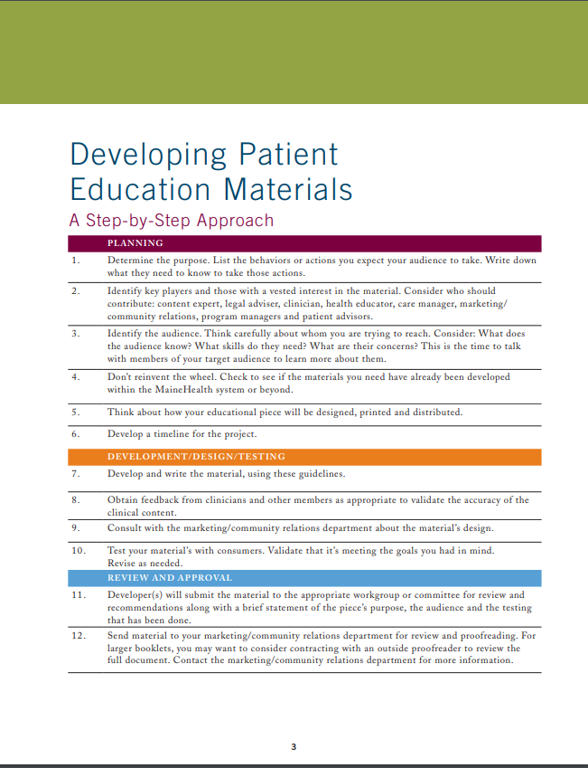
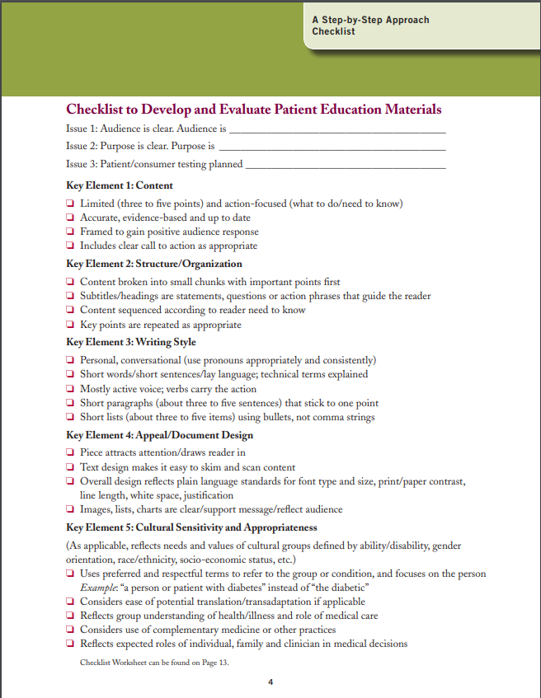
MaineHealth
Guidelines for Effective Print Communication
Notes:
Next, I want to actually explore guidelines and recommendations for use when developing consumer-facing educational content.
While there are many great resources out there, I am partial to this resource developed by MaineHealth.
This resource IS targeted for patient education in the clinical space, however, many of tips and recommendations are absolutely applicable and valuable when preparing nutrition education for our older adult consumers.
Please also know that these concepts can also apply to in-person and virtual instruction as well as any visuals (flyers, posters, table tents, placemats) you use in your spaces to educate consumers about nutrition.

Slide 21
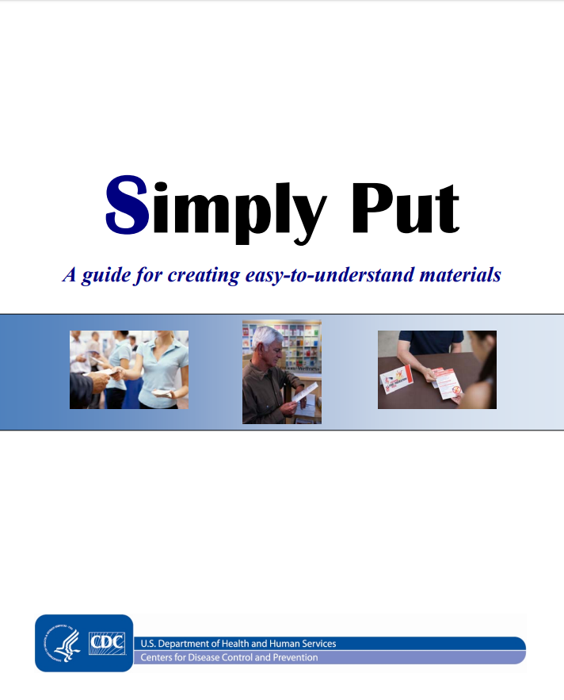
Simply Put
A guide for creating easy-to-understand materials
Notes:
Another reason worthwhile to share is the CDC’s Simply Put – a guide for creating easy-to-understand materials.
This resource also speaks to many similar components that MaineHealth includes, but also provides great resources for checking your current content and even reviewing for readability.
It also includes really practical examples of “do this, not this” and offers easy-to-follow recommendations to improve current materials.
I would encourage you to review this guide for easy, helpful tips to improve your current materials and offerings.

Slide 22
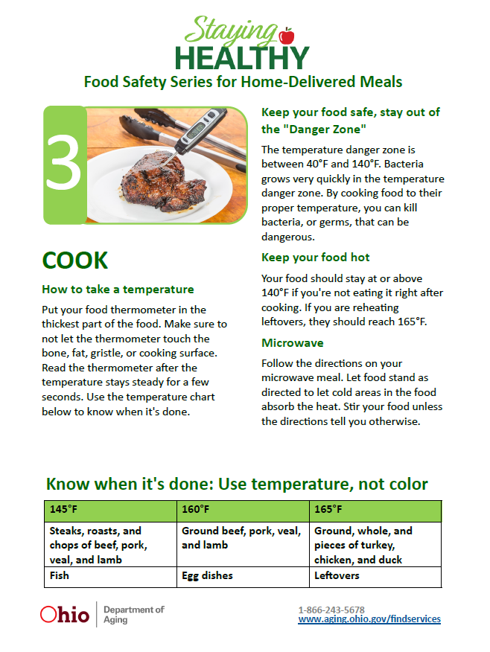
Content
Evidence-Based
Limited (3 to 5 points)
Action focused
Call to Act
Notes:
When beginning to develop consumer education materials (whether handouts, brochures, posters, etc.), start first with your content.
By now you have identified the needs of your audience and what they NEED to know – this is your content focus.
Obviously, it like goes without saying that you need to first guarantee your content is up-to-date and likely evidence based.
For example, have your reviewed the updated Dietary Guidelines for Americans to ensure content you were using in years past aligns with the updated, 2020 – 2025 DGAs?
To ensure the best possibility of consumer understanding, you want to limit your content to ideally three to five major points. limited (three to five points) and action-focused (what to do/need to know)
Framed to gain positive audience response
Includes clear call to action as appropriate
Included here is an example of nutrition education we developed for use with home-delivered meals. This specific example is from a four part series focused on food safety. For this particular nutrition education handout, we focused on one main principle (Cooking to proper temperature) and limited it to really 4 basic points – how to take a temperature, keeping food out of the danger zone, keeping food hot, and microwave use. The call to action is emphasized here – instructing consumers to use temperature, NOT color to assess the “doneness’ of a food.

Slide 23
Structure & Organization
Use headers and subtitles to guide
Break up into small chunks
Use short sentences
One-topic paragraphs
Sequence content
Repeat key points
Define technical terms
This Photo by Unknown Author is licensed under CC BY-SA
Notes:
Content broken into small chunks with important points first ❏ Subtitles/headings are statements, questions or action phrases that guide the reader ❏ Content sequenced according to reader need to know ❏ Key points are repeated as appropriate
Rely on short sentences. These are easier for consumers to understand
Even when educating about a complex topic, diabetes, for example, shorter sentences work best because they can break up information into smaller chunks – better digestible for readers.
Organize information so that the most important points stand out and repeat this information
Should your education piece include paragraphs, ensure each paragraph only covers one topic area.
Paragraphs can be daunting to readers, particularly those with a low-literacy level or struggle with reading comprehension.
Long paragraphs discourage your audience from even trying to understand your material.
If you must use paragraphs, write short paragraphs and limit each paragraph to only one topic area.

Slide 24
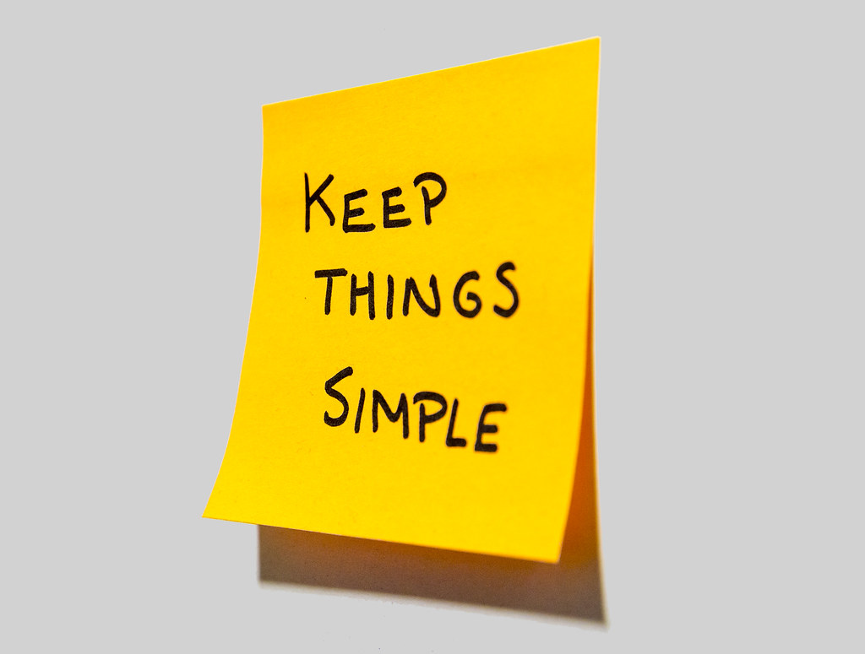
Writing Style
Use familiar words
Avoid jargon
Use personal pronouns
“You”
“Your”
Address a single person
Maintain active voice
This Photo by Unknown Author is licensed under CC BY
Notes:
No matter your education method – visuals, hand-outs, in-person/virtual instruction, your focus should be on keeping the content as simple as possible.
Vocabulary is an important part of communicating clearly.
The words and descriptions you choose make an impact on how well your audience will understand the content.
In making word choices, pick the familiar or frequently used word over the unusual or obscure.
Use the simplest word that conveys your meaning.
Remember, the goal with consumer education is to get your reader to understand and apply it..
Focus on making your content rich, while your words are clear and comprehensive.
PlainLanguage.gov has some great resources for just list, including a list of complex words and suggested substitutes
Jargon: avoid jargon unless your reader is familiar with it, and if they are not, explain technical terms.
Remember, even though your education may eventually “speak” to many consumers, you want your education to truly speak to the one person that is reading it.
Ensure your writing reflects this by using clear, singular sentence structure
Use personal pronouns and write in a conversational style.
Rather than he/she, use “you” or “your” as appropriate pronouns
Write in active voice, rather than passive voice.
Active voice makes it clear who is suppose to do what. In an active sentence, the person is the subject. This illustrates a clear point. “You should eat 3 servings of vegetables each day”. “You” is our subject.
I also believe that when writing in active voice, it speaks directly to the consumer. The education seems more relevant and they are able to reflect more on it.
Finally, think about the wording. While some techniques will vary from language to language, key areas to consider include:

Slide 25
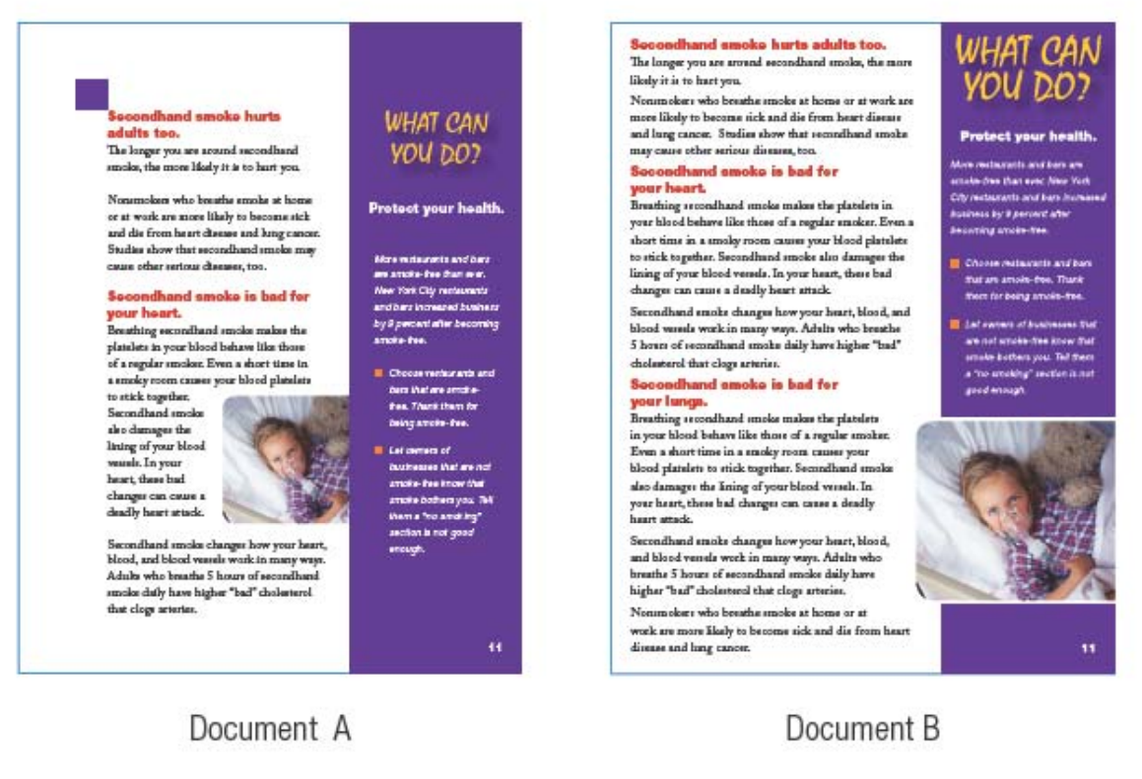
Design
Layout
White space
Headers & subtitles
Typography
Font
Type Size
Spacing
Information Graphics
Notes:
Increasingly, the visual appearance of a communication is just as important as the structure and language.
You want your material to engage your audience and draw them in.
It’s the whole concept that we eat with our eyes first – if our meal looks more visually appealing, we are more likely to eat it! Right? The same goes with consumer-facing content. The more visually appealing, the increased likelihood of the consumer reviewing it.
When developing your consumer-facing content, consider the design and overall appeal of the piece (whether that be a poster, flyer, or educational handout)
Consider:
Layout
Text design makes it easy to skim and scan content
Make sure that the layout and margins include plenty of white space as that helps to separate different parts of the text. This helps to guide the eye and not make the page appear so busy
We already discussed the structure and organization of the piece, but keep in mind your headers and subtitles will help your readers navigate the material. Make sure it’s meaningful and navigating appropriately.
I pulled this example from the CDC’s Simply Put guide. While this is a bit difficult to actually read, the concept here is all about white-space. Both documents (Document A on the left and Document B on the right) present similar content. However, document A is easier to read because there is more white space.
This is very much a less is more approach.
Too much content can be overwhelming. If you have lots of content, consider breaking it up into multiple materials.
Typography
Select a font and type size that will be easy to read.
Make sure there is plenty of contrast between the text and the background, and the spacing between lines and paragraphs is at least the same as the size of the type
Information graphics
Also consider visual devices such as tables, diagrams, photos, charts, and bulleted lists to present information in an accessible and engaging form.
Keep in mind, these visuals should be use to enhance your message. The whole concept of repeating key points – try not to teach NEW content through tables or charts, but rather, use them as another way of presenting materials.

Slide 26
Cultural Considerations
Use preferred and respectful terms
Focus on the person
Depict culture through images
Translate when needed
This Photo by Unknown Author is licensed under CC BY
Notes:
Culture affects how people understand and respond to health messages.
The best way to ensure that your materials are culturally appropriate is to engage members of the target audience early on in the communication planning phase – this is the phase we already discussed – learning who your audience is. Talk to them, but most importantly, listen!
Your audience will help you identify messages and images that are likely to work best within their culture.
Your educational materials should uniquely reflect the needs and values of the groups that you serve, including their culture
This may be defined by their ability/disability, gender orientation, race/ethnicity, socio-economic status, etc.
Considerations to keep in mind:
Uses preferred and respectful terms to refer to the group or condition, and focuses on the person Example: “a person or patient with diabetes” instead of “the diabetic”
Be careful about language as some words may have different meaning to older adults than to you or your professional peers.
For example, the word “dementia” may connote “insanity” is some cultures. If you use the word “dementia” ensure you define it for your audience.
Reflects group understanding of health/illness
Considers use of complementary medicine, dietary practices (vegan, vegetarian, etc.)
Reflects expected roles of individual and family.
If you are going to use pictures or illustrations, choose pictures that show your actual audience. For example, if you serve a high Hispanic population, choose images in which their culture is represented.
Considers ease of potential translation/transadaptation if applicable
You may even consider getting advice from community organizations that are familiar with the culture to understand more about the unique needs and how best to communicate.

Slide 27
Evaluate & Improve
Checklist & internal review
User Testing
Surveying/Post-Test
Readability
This Photo by Unknown Author is licensed under CC BY-SA-NC
Notes:
Finally, to assess a the applicability and success of developed material, you need to evaluate it.
One goal of evaluation is to determine whether or not nutrition education has been successfully delivered to people.
A second goal of evaluation is to learn if people who have participated in nutrition education have benefited in a way that may lead them to practicing healthier eating behaviors in the future.
It is important to keep in mind that although the same education intervention may be delivered to many people, individual experiences and outcomes will vary, sometimes significantly.
Also, the frequency of nutrition education, one versus multiple exposures, may influence individual experiences, too.
In Ohio, we require the service provider to implement a methodology for evaluating the effectiveness of its nutrition education. We want to ensure the education being delivered is meets their needs
Find what they need
Understand what they find
Use what they find to meet their needs
At a very simple level, this may involve editing the communication against a standard or checklist, or having another person review it.
Wherever possible, carry out some user testing with your audience. This might be through surveys, interviews, or testing with people who are representative of your readers.
There are multiple checklists available on the internet that you can use to evaluate developed content. Both resources I shared with you today, MaineHealth’s guidelines and CDC’s Simply Put include checklists to evaluate consumer-facing materials, as well as formulas to determining and calculating readability level.
You could also review your existing material alongside this presentation today. Is your content simple? Do you use jargon? Does it speak to the cultures that you serve?
User testing may not always be necessary or cost effective, such as with an internal email. But it becomes more important for a document that has a wider audience, like a user manual.
Additionally, you may test the documents readability. There are several ways to determine reading level. You can test by hand or use software. Several word processing software programs, including Microsoft Word, include reading level assessment capabilities. The BEST way to judge is actually to pre-test it with your audience.
Through your evaluation, you may find opportunities to enhance or modify what you have developed, or simply find new opportunity to change things up! If Mr. Jones has been attended a congregate meal site twice/week for the past 2 years, he should have the opportunity to receive and take away updated education.

Slide 28
Teach-Back Method
Ask consumers to:
Explain what they learned
Demonstrate what they learned
Ask questions
“How…”
“What…”
Notes:
Earlier, I mentioned that evidence also supports the teach-back method as being a powerful solution to improve consumer comprehension
In the event you have an opportunity, to encourage and implement teach-back methods, strive for this!
This may not be feasible in all setting, such as home-delivered meal drop-offs, but within a congregate nutrition setting, it can be a great opportunity to enhance learning, foster relationships and socialization, and an evaluation tool to determine if the education your delivering is meeting the mark.
Ask patients to explain your instructions (teach back method) or demonstrate the procedure
Ask questions that begin with “how” and “what,” rather than closed-ended yes/no questions

Slide 29
Resources
CDC.gov/HealthLiteracy
Simply Put
PlainLanguage.gov
Federal Plan Language Guidelines
MaineHealth Guidelines for Effective Communication
SeniorNutrition.ACL.gov
ACL.gov/SeniorNutrition/CommunityKit
Nutrition.gov/Topics/Nutrition-Age/Older-Adults
HungerandHealth.FeedingAmerica.org
Notes:
Finally, there are valuable resources easily accessible on the internet for your use.
Some of these resources I referred to during my discussion today, but I would encourage you to explore further.
Next, I will pass it back over to Judy.
Judy…

Slide 30
Question & Answers

Slide 31
Biggest challenges in providing nutrition education?
Notes:
What have you seen as the biggest challenges for nutrition providers in identifying or providing nutrition education?
Within the past year, the biggest challenge has absolutely been the ability to continue providing effective nutrition education despite the pandemic. In Ohio, and I would be in many places nationwide, our congregate meal sites, including senior centers, have been closed. This also included other community locations, such as libraries, that hosted congregate education events or even nutritional evidence-based programs. AAAs and nutrition service providers have had to pivot and find other avenues to meet nutrition education needs of consumers – for many, this included exploring virtual options (virtual congregate meals) and the ability to deliver nutrition education over the phone or through web-based meeting platforms. Many partners took social media outlets – promoting sound nutrition through Facebook, Instagram, or blog posts.
I think the another struggle will continue to reside with identifying the need of our homebound consumers – some may say these are our most at-risk. These home-delivered meal consumers may benefit the most for sound nutrition education, but the tricky part is adapting to meet their unique needs. This is the audience that is challenging to determine what their nutrition needs are beyond just providing a meal.
And finally, while I have only been with the aging network for 2 years, I have notice that we and our partners seem to fall into the way – this is how we have always done things. I’ve notice a hurdle and sometimes, a struggle to truly acknowledge and appreciate the benefit of nutrition education. We need to think of it not as simply checking the box as an OAA requirement, but really as a strategy to prevent poor health outcomes and an opportunity to further enhance the health and wellness of an older adult. This means ensuring the nutrition education we offer is tasteful, attractive and up-to-date. Participants are not receiving the SAME education each time. Keep it fresh – keep it inviting.

Slide 32
How do I develop nutrition education that is tailored to my consumers?
Notes:
What are the resources you use to develop nutrition education and how do you find or decide on topics?
This is a great question and really goes back to learning about your audience.
If you have the opportunity to talk with your consumers, and really learn about their needs and what information they need to stay well, that’s the perfect recipe!
Going back to those points I discussed about identifying your audience will ensure you develop nutrition education tailored to your consumers.
One of the best approaches you may consider implementing is actual post-testing. Develop the resource (whatever it may be – handout, poster, table tent, etc.) provide it to a sample of consumers and evaluate their response – did the nutrition education resound with them? Did it meet the need?

Slide 33
How will you assist AAAs and your network of nutrition service providers?
Notes:
With the OAAPs coming October 1st and the Nutrition Education definition change, what are your plans to assist your AAAs and nutrition projects?
As a State Unit on Aging, we are seeking opportunities to better support our AAAs, nutrition service providers, and aging partners to enhance nutrition education. We are looking to develop statewide resources these partners can use in the field – ensuring resources meet the health literacy needs as well as our goal for enhancing overall nutritional knowledge for older adults.
Additionally, many of our partners already have great resources and nutrition education tools that resound well with consumers. We believe this to be a grand opportunity to share resources statewide. No need to reinvent the wheel – focusing on collaborations and resource sharing will benefit all.
Nutrition education and counseling, is and should continue to be an a very important component of caring for the older adult. It is both prevention and maintenance.

Slide 34
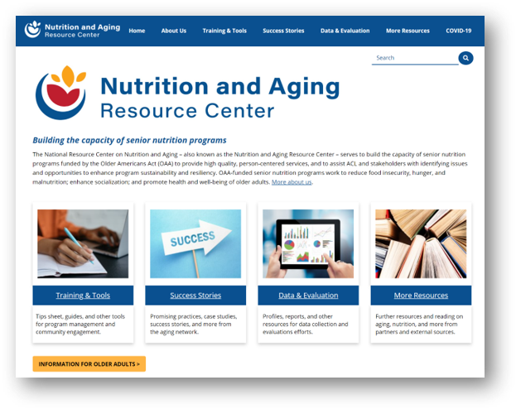
ACL Nutrition Resource Center
COVID-19 Resources
Service Provider Resources
Innovative Program Ideas
Consumer Information
Program Information, Data, and Evaluation Materials
acl.gov/senior-nutrition

Slide 35
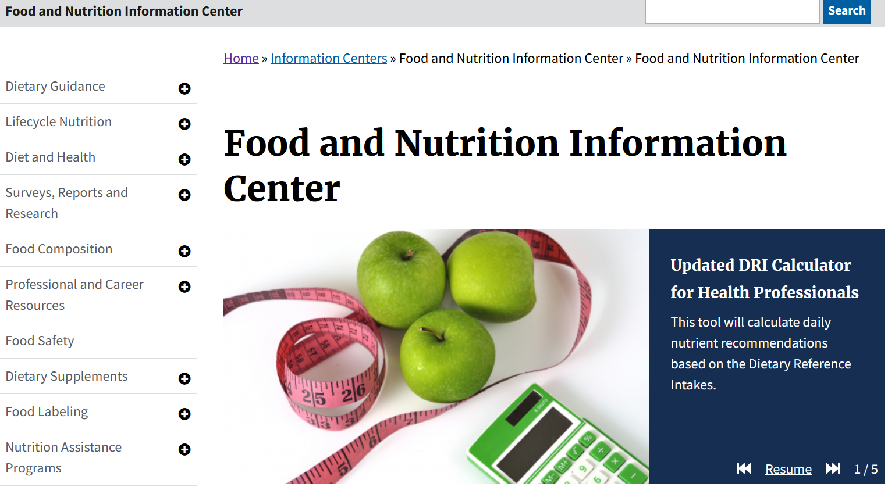
Food and Nutrition Information Center (FNIC)
National Agricultural Library
United States Department of Agriculture
Food and nutrition resources for:
Educators
Health professionals
Researchers
Policy makers
Public and students
www.nal.usda.gov/fnic

Slide 36
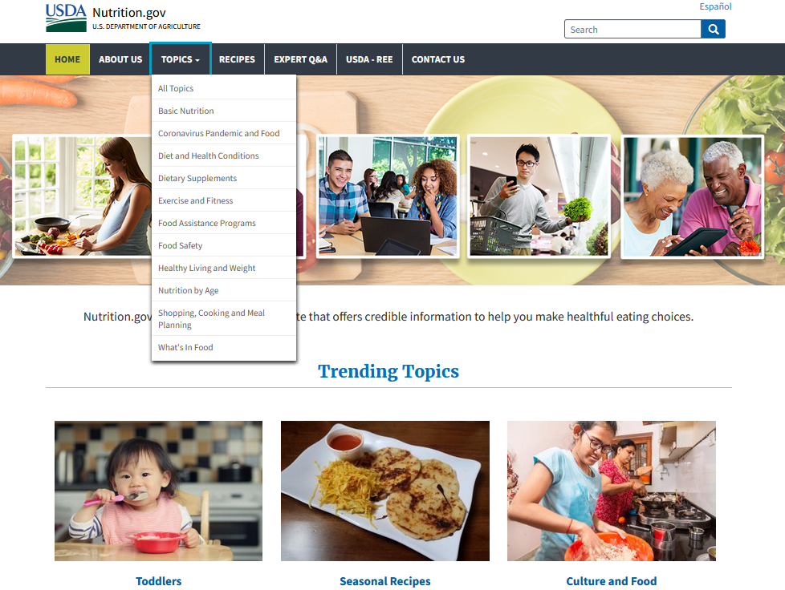
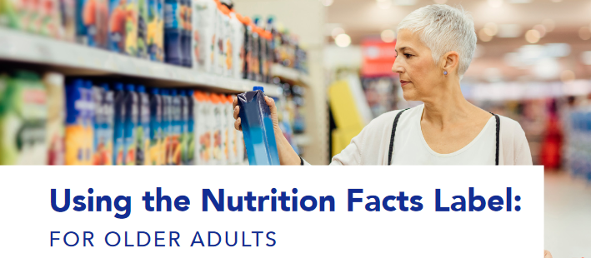
Nutrition.gov
National Agricultural Library
United States Department of Agriculture
Resources for the public on:
Food
Nutrition
Physical activity
Food safety

Slide 37
Innovations in Nutrition Grantee
New York’s Public Health Solutions
Launched 6-week curriculum
Partnered with Registered Dietitian, Columbia University
Targets older adults in East Harlem
English and Spanish
Content includes:
Intro to food environment/culture, health outcomes, food justice
MyPlate, DASH diet, skills-building for seniors
Virtual during pandemic
Tablets and Internet service provided if needed

Slide 38
Additional Resources
Additional Innovations in Nutrition Grantee Highlights
NRCNA’s Virtual Nutrition Education for Older Adults
NCRNA’s Caregiver Nutrition Education Toolkit
SPR/OAAPS Appendix A Definitions and FAQ document

Slide 39
Thank You
judy.simon@acl.hhs.gov
cclutter@age.ohio.gov

