Slide 1
ACL/NIDILRR’s
Small Business Innovation Research (SBIR) Program
September 2021
Notes:
Page numbers are intentionally omitted from this title slide. An alternate title slide design is shown as Slide 1 in this template deck. Use only one or the other.

Slide 2
Brief History
  The Rehabilitation Research program was created in 1954, through an Amendment to the Vocational Rehabilitation Act.
  NIDRR was originally called the National Institute of Handicapped Research when it was formally created by the 1978 amendments to the Rehabilitation Act. At that time, we were situated in the Department of Health, Education, and Welfare.
  In 1980, the NIHR moved from HEW to U.S. Dept. of ED under the Office of Special Education and Rehabilitative Services (OSERS).
  In 1986, our name was changed to the National Institute on Disability and Rehabilitation Research (NIDRR), by that year’s Amendments to the Rehabilitation Act.
  In the summer of 2014, the Rehabilitation Act was reauthorized as part of the Workforce Innovation and Opportunity Act (WIOA). This reauthorization changed our name to the National Institute on Disability, Independent Living, and Rehabilitation Research (NIDILRR). It also changed our administrative home from the Department of Education, to the Department of Health and Human Services.
  ACL & NIDILRR are not part of the NIH.

Slide 3
NIDILRR’s Unique SBIR Program
NIDILRR’s SBIR program is unique in that its sole purpose is to fund small business grants to perform research and development designed to improve the lives of people with disabilities.
NIDILRR’s SBIR budget is approximately $3.2 million per year.
NIDILRR holds one Phase I competition each year at the beginning of the year, and one Phase II competition sometime in the spring.

Slide 4
Phases
Phase I
  Develop prototypes, models, proofs-of-concept
  Up to $100,000 for six months
  10 awards per year
  40 to 50 applications
Phase II
  Further research and development to bring Phase I concepts to commercialization
  Successful Phase I grantees invited to apply
  $575,000 over two years ($200,000−$300,000 per year)
  Awards for two years
  4 to 5 awards per year
  14-17 applications (Phase I grantees throughout federal government are eligible to apply)
  8 +/- active awards

Slide 5
More Information
No mobile apps (we fund an App Factory separately)
No: Fast Track, Direct to Phase II, Phase IIB, or TABA
If no indirect cost rate agreement exists, indirect costs are limited to 10%
Indirect costs and fees come out of grant funds
Prior Phase I awards
Prior Phase II awards (commercial success rate over 50%)
Examples: low vision (navigation, readers, tactile devices), mobile apps (scheduling, employment, monitoring), prosthetics and fitting, portable dialysis, switches for severe mobility impairments, learning software for hearing, hearing aid software (signing, etc.), wheelchair navigation & propulsion, telerehabilitation, etc.

Slide 6
Phase I Chances of Success:
2017: 66 applications, ten funded 10/66 = 15 percent
2018: 46 applications, ten funded 10/46 = 22 percent
2019: 41 applications, ten funded 10/41 = 24 percent
2020: 17 applications, ten funded 10/17 = 59 percent*
2021: 32 applications, ten funded 10/32 = 31 percent
Five-year average 50/202 = 25 percent
* Restriction on mobile applications introduced

Slide 7
Phase II Chances of Success:
2017: 14 applications, four funded 4/14 = 29 percent
2018: 14 applications, four funded 4/14 = 29 percent
2019: 15 applications, four funded 4/15 = 27 percent
2020: 15 applications, four funded 4/15 = 27 percent
2021: 14 applications, four funded 4/15 = 29 percent
Five-year average 20/72 = 28 percent
Phase II commercialization success rate > 50 percent

Slide 8
Applying for a NIDILRR Grant
Grant Opportunities:
  https://www.grants.gov/ (link to Grants.gov)
  Subscribe to this Grants.gov search: https://www.grants.gov/web/grants/search-grants.html?keywords=nidilrr
Working with a NIDILRR Grant:
  Maintaining and amending at Grant Solutions: https://home.grantsolutions.gov/home/
  NIDILRR Reporting: https://nidilrr.rti.org/
TA Resources:
  Life Sciences: https://sbir.nih.gov/resources/lifescience-state-contacts
  Local assistance: https://www.sbir.gov/local-assistance
  Federal And State Technology (FAST) Partnership Program: https://www.sbir.gov/about-fast
Other Links:
  NIDILRR’s SBIR Program: https://acl.gov/programs/research-and-development/small-business-innovation-research-program

Slide 9
Other links Continued:
ACL’s Home Page: https://acl.gov/
About NIDILRR (includes other NIDILRR funding mechanisms): https://acl.gov/about-acl/about-national-institute-disability-independent-living-and-rehabilitation-research
NARIC: https://naric.com/ (subscribe to this newsletter)
NIDILRR’s Project Database: https://naric.com/?q=en/ProgramDatabase (past awards)
Donate Your Brain to Science – Peer reviewer training module: https://naricforms.naric.com/?q=Peer%20Review%20Orientation
This will give you some valuable insight into preparing an application for NIDILRR. Our review process is very different from the NIH.
This link shows all of NIDILRR’s current announcements: https://www.grants.gov/web/grants/search-grants.html?keywords=nidilrr
This link shows all of ACL’s current announcements: https://www.acl.gov/grants/open-opportunities

Slide 10
Tips for Success
Meet the needs of people with disabilities (just to be eligible)
Identify your population, the problem they experience, and present your solution
This is field initiated (see first bullet), but send me an email to vet ideas
Follow criteria format
Get most recent Funding Opportunity Announcement to get started *
Write to person on the street (avoid jargon, explain concepts)
Know the current state of the art (What’s out there? Why is yours better?)
Cite knowledge, don't just speak from personal knowledge or experience
* https://www.grants.gov/web/grants/search-grants.html?keywords=nidilrr (subscribe to this search)

Slide 11
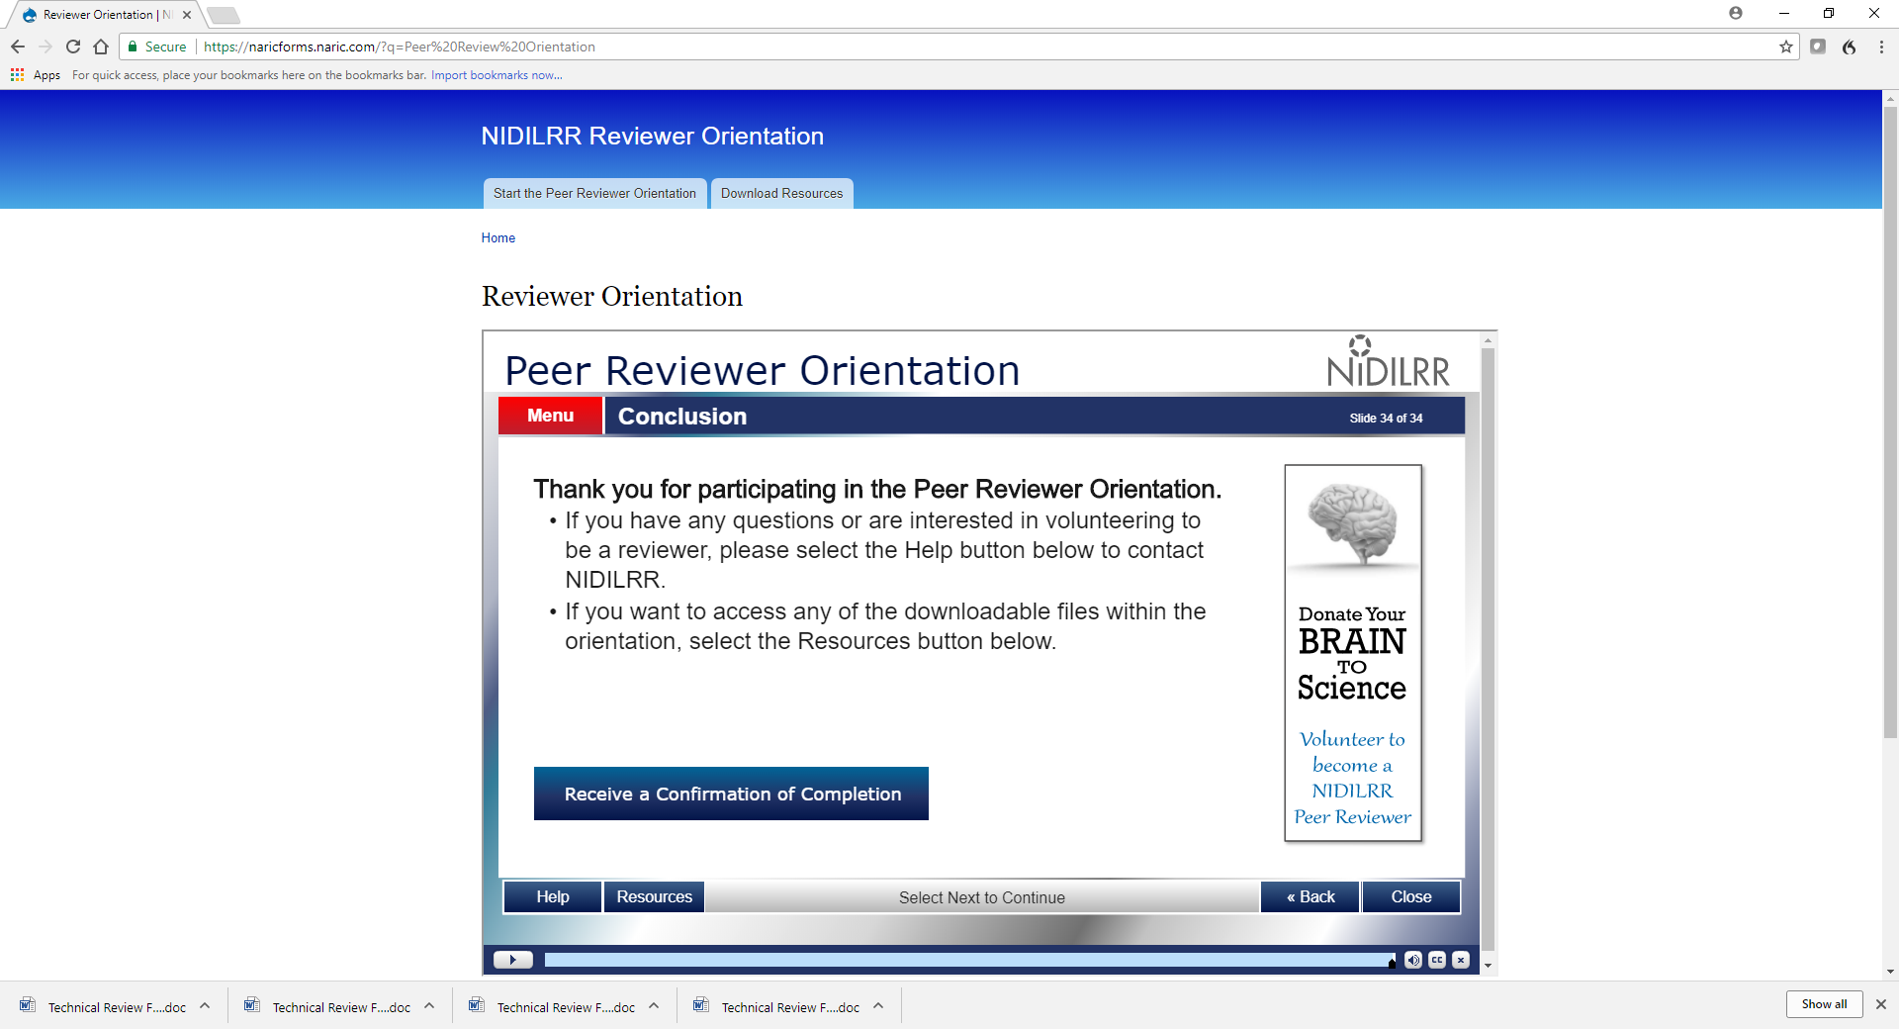
Donate Your Brain to Science
  Peer reviewer training module: https://naricforms.naric.com/?q=Peer%20Review%20Orientation
  This will give you valuable insight into preparing an application for NIDILRR. Our review process is different from the NIH.

Slide 12

Questions?

Slide 13
Contact Info:
Brian Bard
SBIR Program Coordinator
National Institute on Disability, Independent Living, and Rehabilitation Research
Administration for Community Living
U.S. Department of Health and Human Services
Washington, DC 20201
202-795-7298
brian.bard@acl.hhs.gov

