Slide 1
Promoting Autonomy for
Older Adults and Adults with Disabilities through
Decisional and Other Supports
Allison Cohen Hall, PhD, Institute for Community Inclusion
Jim Berchtold, Esq., Justice in Aging
November 14, 2023

Slide 2
Housekeeping
All on mute. Use Questions function for substantive questions and for technical concerns.
Problems getting on the webinar? Send an e-mail to NCLER@acl.hhs.gov.
Written materials and a recording will be available at NCLER.acl.gov. See also the chat box for this web address.

Slide 3
About NCLER
The National Center on Law and Elder Rights (NCLER) provides the legal services and aging and disability communities with the tools and resources they need to serve older adults with the greatest economic and social needs. A centralized, one-stop shop for legal assistance, NCLER provides Legal Training, Case Consultations, and Technical Assistance on Legal Systems Development. Justice in Aging administers the NCLER through a contract with the Administration for Community Living’s Administration on Aging.

Slide 4
About Institute for Community Inclusion
The Institute for Community Inclusion at UMass Boston supports the rights of children and adults with disabilities to participate in all aspects of society. As practitioners, researchers, and teachers, we form partnerships with individuals, families, and service agencies. Together we advocate for personal choice, self-determination, and social and economic justice.
We are dedicated to advancing the full inclusion of people with disabilities in all aspects of life. Our work encompasses research, program evaluation, training, consultation, education, policy analysis, and service delivery across four main areas of emphasis: Employment, Education, Community Life, and Health Care.

Slide 5
About Justice in Aging
Justice in Aging is a national organization that uses the power of law to fight senior poverty by securing access to affordable health care, economic security, and the courts for older adults with limited resources.
Since 1972 we’ve focused our efforts primarily on populations that have traditionally lacked legal protection such as women, people of color, LGBT individuals, and people with limited English proficiency.

Slide 6
Welcome
Vicki Gottlich, Deputy Administrator for Policy and Evaluation at the Administration for Community Living

Slide 7
What We’ll Cover
Introduction to Decisional Supports
Supported Decision-Making
The Wonderful World of Supports
  Informal, social, lifestyle
  Financial
  Health care
Supports in Action

Slide 8
Part 1:
Introduction to
Decisional Supports

Slide 9
The “Why?”
The ability to make decisions about one’s life is a fundamental human right and one of the hallmarks of adulthood/personhood.
  Autonomy: the quality or state of being self-governing, self-directing, free, and independent.
At times, we all need support making and implementing decisions, both big and small.
  Think about the various support mechanisms you utilize in your own life every day.
Some people need more support than others – and that’s okay – in fact…

Slide 10
The Goal
Celebrate supports!
Celebrate supporters!
Normalize utilizing supports!
Destigmatize needing those supports!
  Understand the spectrum of support mechanisms available to you and those you support to preserve autonomy and independence.

Slide 11
Some Basics
“Decisional supports” encompasses all means of support, from formal practices to informal interactions.
  Informal supports
  Social supports
  Financial supports
  Healthcare supports
Methods are person-centered and person-directed.
  Decision-making is driven by the person and their values, priorities, and wishes, as well as their circumstances, preferences, abilities, resources, and life experience.
Tools in your toolbox, arrows in your quiver, pick your metaphor.
  Remember: It’s not just a menu, it’s a process.

Slide 12
Part 2:
Supported Decision-Making

Slide 13
Self-Determination
Getting support with making decisions is really about promoting self-determination

Slide 14
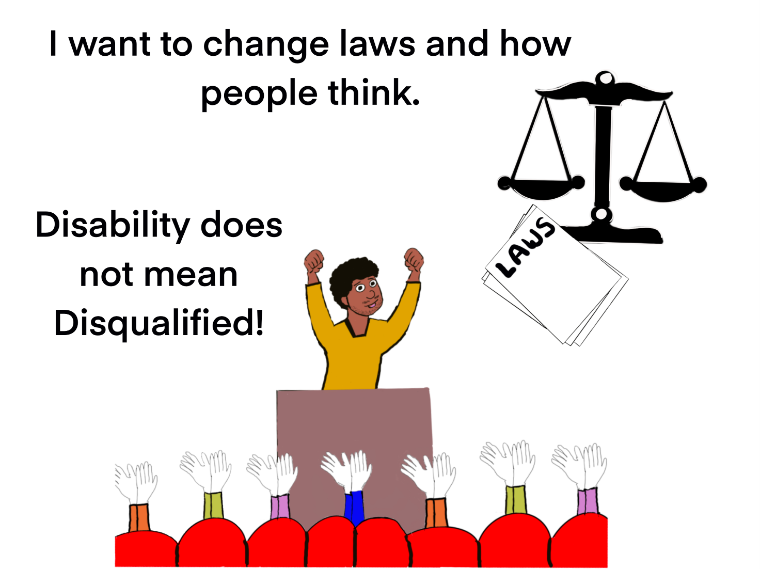
Disability Does Not Mean Disqualified

Slide 15
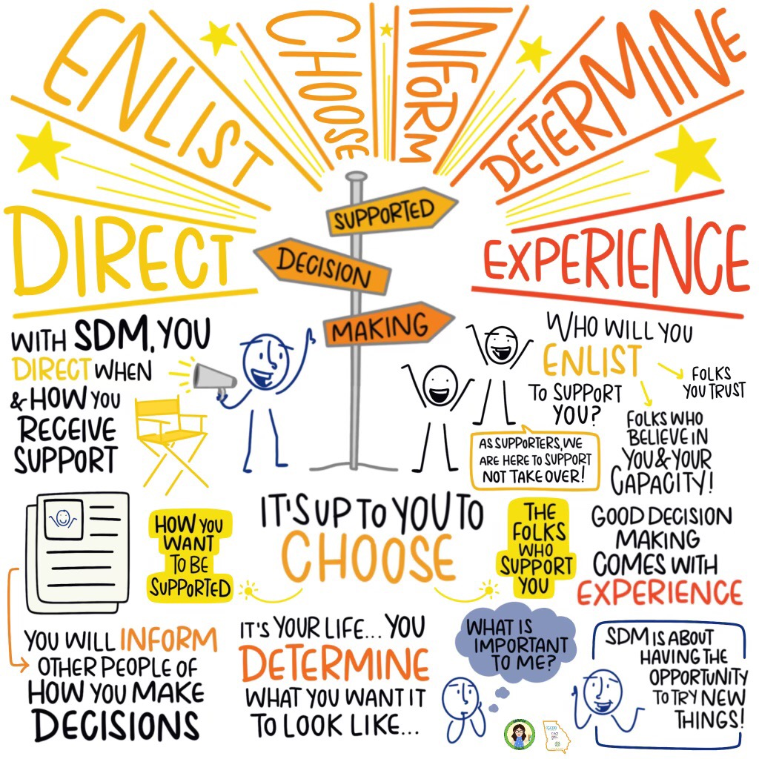
Supported Decision-Making
Source: I Decide Georgia

Slide 16
What is Supported Decision-Making?
People with disabilities retaining their rights
Supporters provide guidance and assistance
The person with the disability gets the support of trusted people to make THEIR OWN DECISIONS about the direction of their lives
Can be formal or informal, and can be practiced in any state, regardless of legislation

Slide 17

Who are Supporters?
Supporters are people who help with making decisions. They could be:
  Family
  Personal and family friends
  Teachers and counselors
  Religious or faith leaders
  Employment specialists and/or employers
  Financial and legal advisors
  Medical professionals (medical, dental, psychological/ psychiatric)
  Really, any trusted individual

Slide 18

What is a Supported Decision-Making Agreement?
Includes a description of responsibilities
Explanation of the rights of the person being supported
Protects the privacy of a person with a disability by defining what info a supporter can receive or see
Clarifies expectations!
A document that helps to inform others that a formal relationship exists (e.g. service coordinators, doctors, lawyers)
Can be changed or terminated by the person with a disability at any time

Slide 19

Center on Youth Voice, Youth Choice
The Center on Youth Voice, Youth Choice is a resource center for youth with disabilities.
https://youth-voice.org
Notes:
Mike
We have a project, the Center on Youth Voice, Youth Choice, that we will talk about next. We will share information about the project and then we will hear from a CYVYC youth ambassador

Slide 20
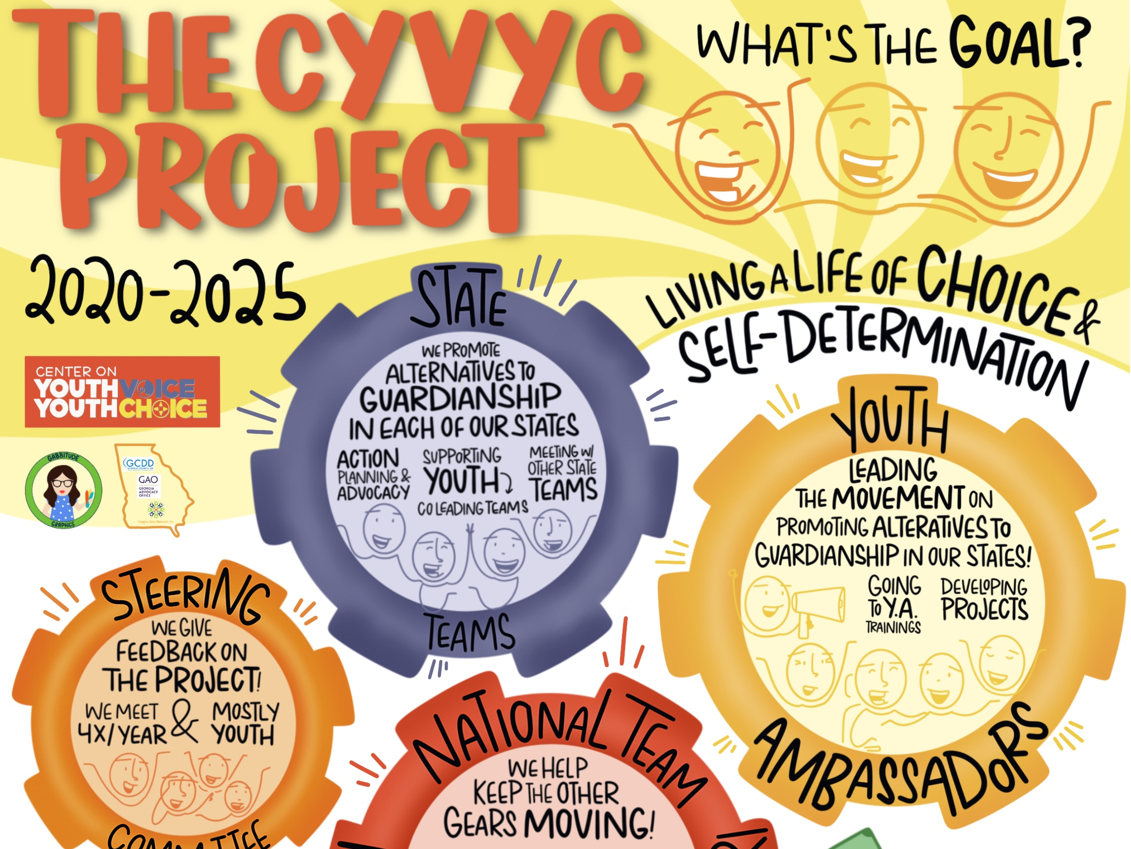
The CYVYC Project

Slide 21
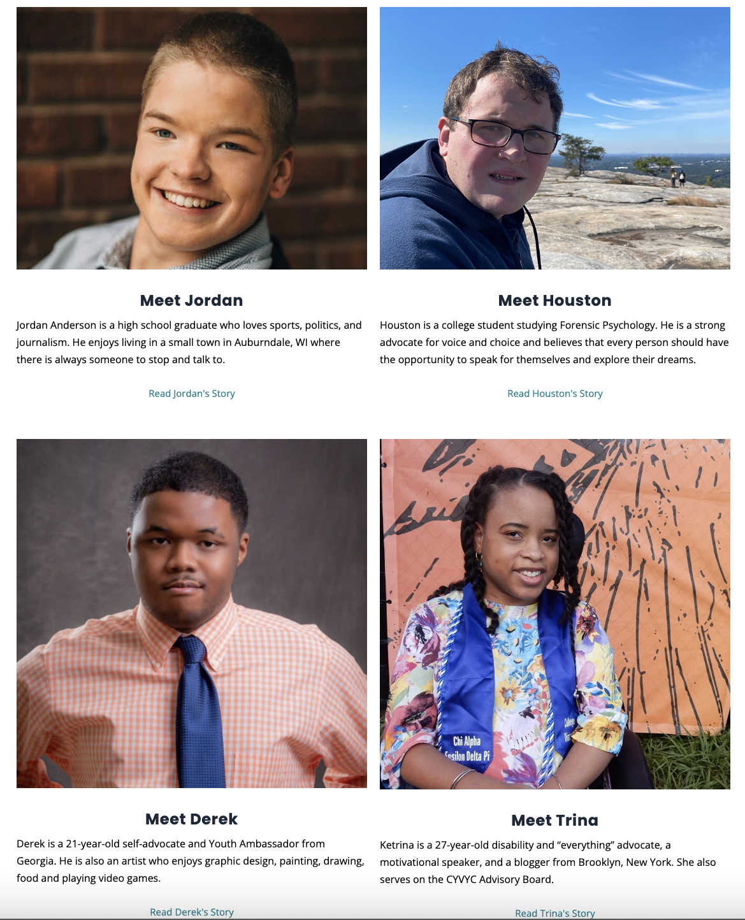
Youth
Stories

Slide 22
Part 3:
The Wonderful World of Supports

Slide 23
The Broad Spectrum of Supports
Wide variety of supports
  Informal, social, lifestyle
  Financial supports
  Health care supports
Supports fall on a spectrum of formality:
  From very informal
    Advice from a friend, an occasional ride, etc.
  To very formal
    Power of attorney, a trust, etc.

Slide 24
Informal, Social, Lifestyle Supports
Family, friends, neighbors, community, and religious organizations
Congregate and home-delivered meals
Housekeeping services
Day programs
Transportation services
Delivery services and online shopping
Remember that SDM can (and should) be incorporated into other support mechanisms

Slide 25
Financial Supports
Trusted person designations
Accounts with read-only access, shared statements/notices
Debit/credit cards with agreed limits
Direct deposit/automatic banking
Joint bank accounts and authorized signers
  Presumption of ownership, maybe inheritance rights, judgment liability
Money management and bill pay services
  Possibly free or low cost, maybe monthly or hourly

Slide 26
Financial Supports (cont.)
Representative payees
  Administrative thru agency (Social Security, SSI, SSD, VA)
  Could be voluntary or involuntary (“unable to manage benefits” because of mental or physical disability)
  You can designate a rep payee in advance
Financial power of attorney
  Immediately effective or springing
  Authority limited to grant in documents, can be tailored
  Very powerful and very useful
  Requirements vary by state
  Note: Financial institution might require specific form
Trusts
  Asset management and probate avoidance

Slide 27
Health Care Supports
Telehealth and remote medical monitoring
GPS tracking
Remote video monitoring
Electronic medication management devices
Care managers and coordinators
  Professionals who identify needs, create care plans, implement services
  Patient coordinators/navigators—organize health care and treatment, facilitate communication/info sharing
Living will directive with agent/supporter designation
  Varies by state

Slide 28
Health Care Supports (cont.)
Health care surrogate, proxy, agent
  Short form/oral
  Document and state law control scope of authority
  If no surrogate designated, state law might designate default surrogate
Power of attorney for health care
  Requirements vary by state
  Immediately effective or springing
  Authority limited to grant in documents, can be tailored

Slide 29
Selecting and Implementing Supports
It’s not just a menu, it’s a process.
  Identify the specific issue and familiarize yourself with all of the circumstances.
  Get to know
    Background, history, life experience
    Goals and values
    Abilities and limitations
  Target supports to specific issues
    Start with most informal supports first
    Use creative combinations, trial and error
  Always a person-directed and person-centered process!
  Remember that everything evolves and changes.

Slide 30
Part 4:
Decisional Supports in Action

Slide 31

Who am I?
I'm a 23 year-old with autism, furthering disability rights and justice through providing direct services to youth with disabilities.
I work as a Youth Independent Living Specialist for Able South Carolina.
In my free time, I enjoy chess and strategy video games and spending time with friends and my significant other.
I am also an advocate for Supported Decision Making, and independent living.
Holden Roberts

Slide 32
My Training as a Youth
Ambassador with the Center on Youth Voice, Youth Choice
Over the course of several months, we learned about different ways people can get help with making decisions. We also learned about the negative effects of having people make decisions for you without your input. I also helped to lead the South Carolina State Team that promotes supported decision-making.

Slide 33
Our CYVYC Youth
Ambassador Projects
Every youth ambassador works on their own project. My project involves making a resource for young adults and teens in South Carolina. This resource provides specific information about decisional supports in our state. Many youth are not aware of what decisional supports can help them.
Another resource in development is geared towards parents of younger children with disabilities. It helps parents prepare early for supported decision-making, so that they can have high expectations for their children and help them practice decision-making skills.

Slide 34
Benefits of the CYVYC Youth Ambassador Training
Applying it to my own life, and knowing that it’s okay to ask for help sometimes.
Encouraging the principles of it to friends and family.
Teaching about decisional supports at the Equip Summer Series and the Youth Leadership Forum.
Being a resource for our peers who seek our services at Able South Carolina.
During our training, we learned a lot about the fight for disability justice nationwide and how important it is to promote autonomy for everyone.
We made meaningful partnerships and built greater community across states for people with disabilities.

Slide 35
Questions for Holden
What kinds of conversations did you have with your family about making your own decisions, and getting help with making decisions?
What are some examples of how you’ve used supported decision-making?
How have you chosen your supporters?
What would you tell someone who is just learning about supported decision-making? What advice would you give them?

Slide 36
Example
Mary is an older adult who lives alone in her own home. She is married but separated from her husband. Mary has a daughter who lives in another state and a son who lives nearby. Mary receives Social Security and a support check from her husband every month.
Mary’s daughter has become concerned after learning that some of Mary’s bills have gone unpaid, she has missed a number of doctor appointments, and her neighbors are complaining that her house is falling into disrepair/hoarding.

Slide 37
Conclusion
Hilary Dalin, Office of Elder Justice and Adult Protective Services at the Administration for Community Living

Slide 38
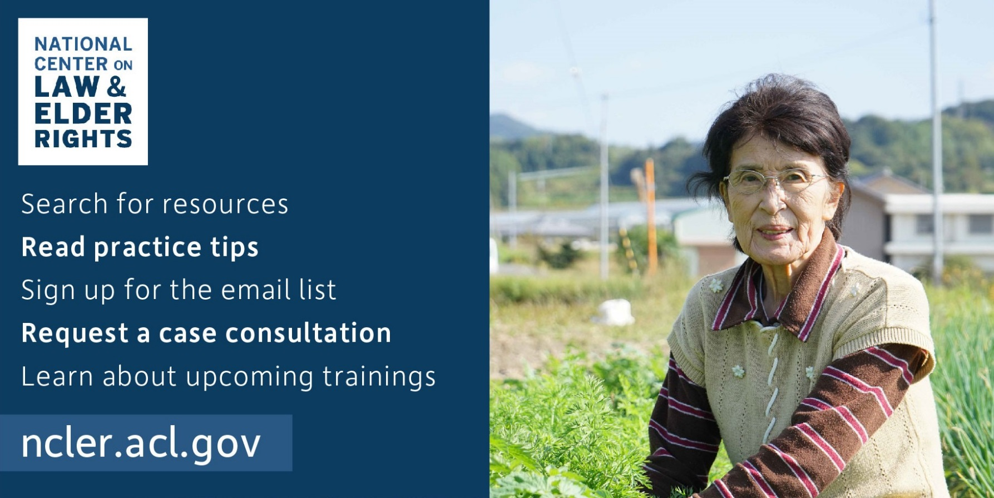
Visit Our Website: ncler.acl.gov

Slide 39
Case Consultations
Case consultation assistance is available for attorneys and professionals seeking more information to help older adults. Contact NCLER at ConsultNCLER@acl.hhs.gov.

