Slide 1

Trifecta:
Food Insecurity and Malnutrition
Celebrate Our Senior Nutrition Program
March 2021

Slide 2
Questions
Please direct all questions and inquiries regarding today’s presentation, including Certificates of Attendance to, Nicole.Becerra@acl.hhs.gov
Questions may be submitted up to one week post webinar
Questions will be compiled for each speaker. Please write the presenter’s name for who the question(s) are intended for in the subject line.

Slide 3
Agenda
Welcome
Judy Simon, MS, RD, LDN - National Nutritionist, ACL
Network Speakers
  Pam VanKampen, RDN, CD, Older Americans Act Consultant-Nutrition Specialist-Senior Center Representative, Greater WI Agency on Aging Resources (GWAAR)
  Paul Hepfer - CEO, Project Open Hand
Closing Comments

Slide 4
Learning Objectives
Distinguish between nutrition and food insecurity
Identify the root causes of malnutrition and present innovative approaches to combatting malnutrition
Discuss the importance of partnerships and lessons learned

Slide 5
Judy Simon, MS, RD, LDN
National Nutritionist
Office of Nutrition and Health Promotion Programs
judy.simon@acl.hhs.gov

Slide 6
Intent of the Older Americans Act
Reduce Hunger, Food Insecurity and Malnutrition
Promote Socialization
Promote the Health and Well-Being
Notes:
DID YOU KNOW?
Sec 106. Malnutrition. Clarifies that screening for malnutrition is included as part of nutrition screening within broader routine health screenings in the definittion of disease prevention and health promotion services. Adds reducing malnutrition to the purpose of nutrition services programs under the Older Americans Act.

Slide 7

Malnutrition vs. Food Insecurity
Malnutrition - two or more of the following:
Weight Loss
Insufficient Food Intake
Reduced Body fat
Reduced Muscle
Reduced Handgrip
Fluid
Food Insecurity -Without reliable access to enough affordable, culturally appropriate and nutritious food
Notes:
Malnutrition is different than food insecurity or hunger.
Malnutrition –is a clinical condition that requires a dietitian or a physician to diagnose. This slide shows the 6 components for diagnosing malnutrition – 2 are needed for someone to be identified as having malnutrition.
Food Insecurity – When someone is without reliable access to enough affordable, culturally appropriate and nutritious food.
Thankfully, YOU can screen for both of these malnutrition and food insecurity in our community programs. In fact, ANYONE can do that screening; the key is to ensure they know the appropriate supports and referrals to address risk for malnutrition or food insecurity.

Slide 8
Role of the Aging Network
OAA mission
We know our participants
Un-addressed malnutrition causes great risk
Our strength is SDOH
Healthcare partner
  Transitions of care
  Prevention
Notes:
The aging network’s mission to “Maximize the independence, well-being, and health of older adults” aligns with the importance of addressing malnutrition.
● Aging network staff often know their clients well, develop person-centered approaches, and are best-suited to identify malnutrition risk.
● Malnutrition or “poor nutrition” is more common than we realize and causes significant risk for illness, falls and poor quality of life. It often goes undetected, but there are signs that can be identified in the community, which can prevent these deleterious outcomes.
● The aging network is able to impact malnutrition through providing services that address social determinants of health, which contribute to malnutrition risk.
● Hospitals are unable to manage the complex needs of malnourished patients, but community-based organizations (CBOs) have years of experience providing services that support nutritional well-being.
● CBOs are important partners for healthcare, to smooth malnourished patients’ transitions of care and prevent malnutrition in community-residing older adults.
Why do we say a community-based organization, with possibly no clinical staff – meaning dietitian, nurse or physician – can address malnutrition? And WHY is it our role?
First, malnutrition, like other conditions such as diabetes or high blood pressure, is affected by the social determinants of health. For example, if someone is not eating well because they are depressed, no amount of food will improve their nutrition – the depression must be addressed.
This is well recognized by our partners in healthcare, and it is actually part of what our organizations address everyday. For example, our ADRCs provide

Slide 9
Community Malnutrition Care Pathway
IMPLEMENT VALIDATED SCREENING TOOLS
Intake clients that are self-referred from the community or referred by healthcare or outside organizations.
Screen clients with validated malnutrition and social determinant of health tools.
Tool: List of malnutrition and SDOH screening tools
ADDRESS ROOT CAUSE(S)
Refer client to new and/or existing programs and services that can address the root cause(s) of malnutrition and implement interdisciplinary cross-referrals. Document screen results and service/program referrals.
Tool: Sample Referral Table
MONITOR CLIENT PROGREE AND QUALITY OF SERVICES
Document client goals, referrals, action steps, and progress notes.
Follow up with clients at established intervals to re-screen for continued unmet needs and assure the quality of services provided.
Report positive screens, ICD-10 codes, client status and outcomes to healthcare partners.
Tool: Sample Community Care Plan
Source: Addressing Malnutrition in Community Living Older Adults: A Toolkit for Area Agencies on Aging. ACL 2017-2019 Innovations in Nutrition Programs & Services grant, Maryland Department of Aging, access at: https://acl.gov/SeniorNutrition
Notes:
Judy will create TPs for this slide

Slide 10
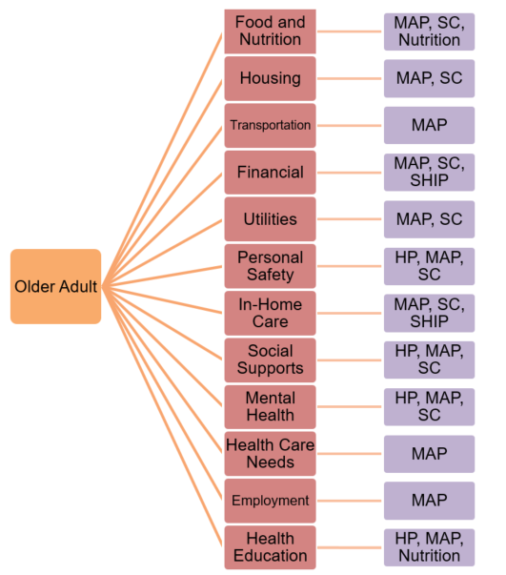
“Whole Team” Approach
Source: Addressing Malnutrition in Community Living Older Adults: A Toolkit for Area Agencies on Aging. ACL 2017-2019 Innovations in Nutrition Programs & Services grant, Maryland Department of Aging, access at: https://acl.gov/SeniorNutrition
Notes:
Judy will create TPs for this slide.
Older Adult branches of to: Food & Nutrition and MAP, SC Nutrition; Housing and MAP, SC; Transportation and MAP; Financial and MAP, SAC, SHIP; Utilities and MAP, SC; Personal Safety and HP, MAP, SC; In-home Care and MAP, SC, SHIP; Social Supports and HP, MAP, SC; Mental Health and HP, MAP, SC; Health Care Needs and MAP; Employment and MAP; Health Education and HP, MAP, Nutrition.

Slide 11
Medical Billing
Table 3: Social Determinants of Health ICD-10 Codes.
SDOH | Sample ICD-10 Codes
Living Situation (Housing, Utilities) | Z590 - Problems related to housing and economic circumstances Z600 - Problems related to social environment Z602 - Problems related to living alone
Food | Z590 - Problems related to housing and economic circumstances Z594 - Lack of adequate food and safe drinking water
Safety | Z600 - Problems related to social environment
Financial Strain | Z590 - Problems related to housing and economic circumstances
Employment | Z560 - Problems related to employment and unemployment
Family and Community Support | Z630 - Other problems related to primary support group, including family circumstances Z600 - Problems related to social environment
Education | Z550 - Problems related to education and literacy
Mental Health | Z650 - Problems related to other psychosocial circumstances
Source: Addressing Malnutrition in Community Living Older Adults: A Toolkit for Area Agencies on Aging. ACL 2017-2019 Innovations in Nutrition Programs & Services grant, Maryland Department of Aging, access at: https://acl.gov/SeniorNutrition
Notes:
Judy will create these talking points

Slide 12
Pam VanKampen, RDN, CD
Older Americans Act Consultant-Nutrition Specialist-
Senior Center Representative
Greater WI Agency on Aging Resources (GWAAR)
pam.vankampen@gwaar.org
608.228.8095
Special thank you to WI Nutrition Programs, UW Health, UW Stout Dietetic Interns & Students

Slide 13
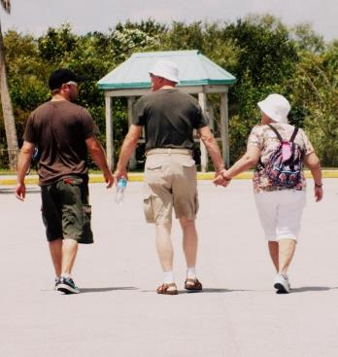
“Older Adult Malnutrition is a Critical Health & Public Safety Issue”
Defeatmalnutrition.today

Slide 14
Brief Overview - Malnutrition
Defined as a nutrition imbalance including under-nutrition and over-nutrition.
Malnutrition is a leading cause of morbidity and mortality among older adults. Due to an array of causes and contributors.
Older adults, across all population groups, are at an increased risk for developing malnutrition. -Moveira et al, 2016
Notes:
Malnourished individuals can come in all sizes
715,000 U.S. adults aged 65+ are underweight
1 in 3 U.S. adults aged 65+ are overweight
You can be underweight or overweight and still be malnourished.
(reference SUYN course)

Slide 15
No one wants to become or be identified as malnourished
But the statistics are shocking…

Slide 16
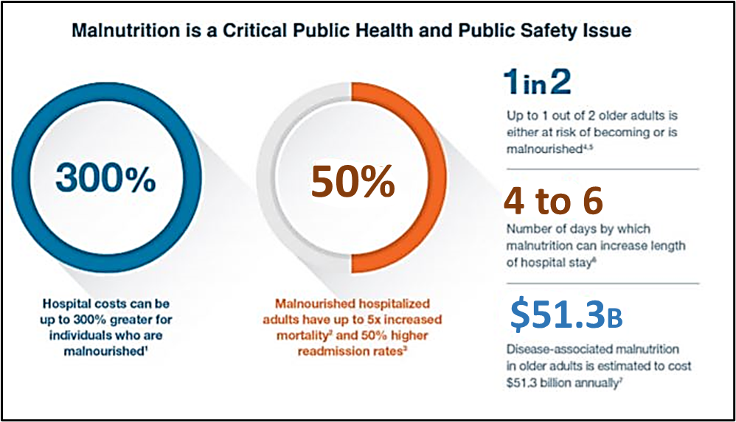
The Role of Malnutrition
http://defeatmalnutrition.today/sites/default/files/documents/Malnutrition%20Legislative%20Toolkit%20Infographic.pdf
Notes:
Malnutrition is a critical public health and public safety issue. Hospital costs can be up to three hundred percent greater for individuals who are malnourished. Malnourished hospitalized adult have up to five times increased mortality and fifty percent higher readmission rates. Up to 1 out of 2 older adults is either at risk of becoming or is malnourished. Four to Six- number of days by which malnutrition can increase length of hospital stay. Disease-associated malnutrition n older adults is estimated to cost $52.3 billion annually.
Source: http://defeatmalnutrition.today/sites/default/files/documents/Malnutrition%20Legislative%20Toolkit%20Infographic.pdf

Slide 17
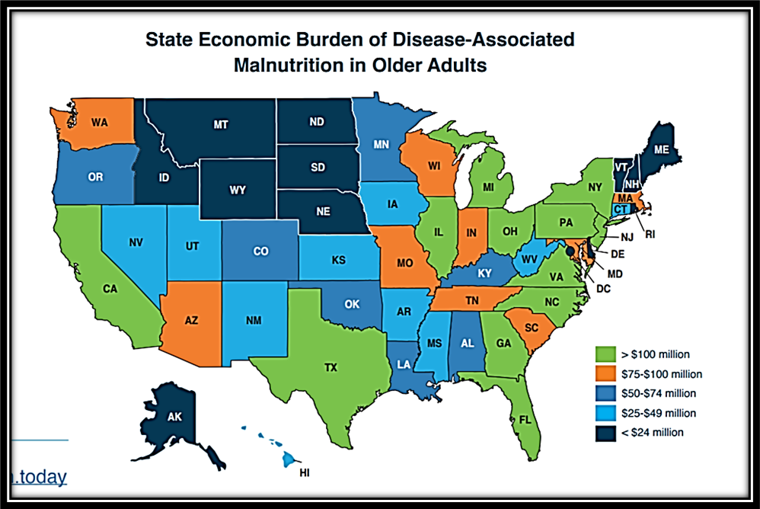
United States Overview
https://www.defeatmalnutrition.today/sites/default/files/documents/Malnutrition%20Legislative%20Toolkit%20Infographic.pdf
Notes:
State Economic Burden of Disease-Associated Malnutrition in Older Adults infographic shows a map of the United States with corresponding data for each state. To access the full infographic visit: https://www.defeatmalnutrition.today/sites/default/files/documents/Malnutrition%20Legislative%20Toolkit%20Infographic.pdf

Slide 18
What’s your “Why”?
Has malnutrition affected you, your family, or your clients?
Defeat Malnutrition Today is currently collecting malnutrition stories.
WI Stories and Testimonials form
Notes:
Read stories from ASPEN https://www.nutritioncare.org/Guidelines_and_Clinical_Resources/Malnutrition_and_Mom/

Slide 19
What Does Malnutrition Look Like in Older Adults?
Notes:
Malnutrition is a nutrition imbalance that affects both overweight and underweight individuals. You can be overweight and malnourished due to eating foods that contain few nutrients but are high in calories. (e.g. a box glazed donuts). Just because someone is eating, doesn’t mean they are nourishing their body. Therefore, it is vital we reframe the conversation to help people understand that their bodies are not “laundry chutes”. Everything we put into our bodies affects our health, for better or worse. Again, the tree, if properly nourished, will grow, remain strong and provide protection for years to come.

Slide 20
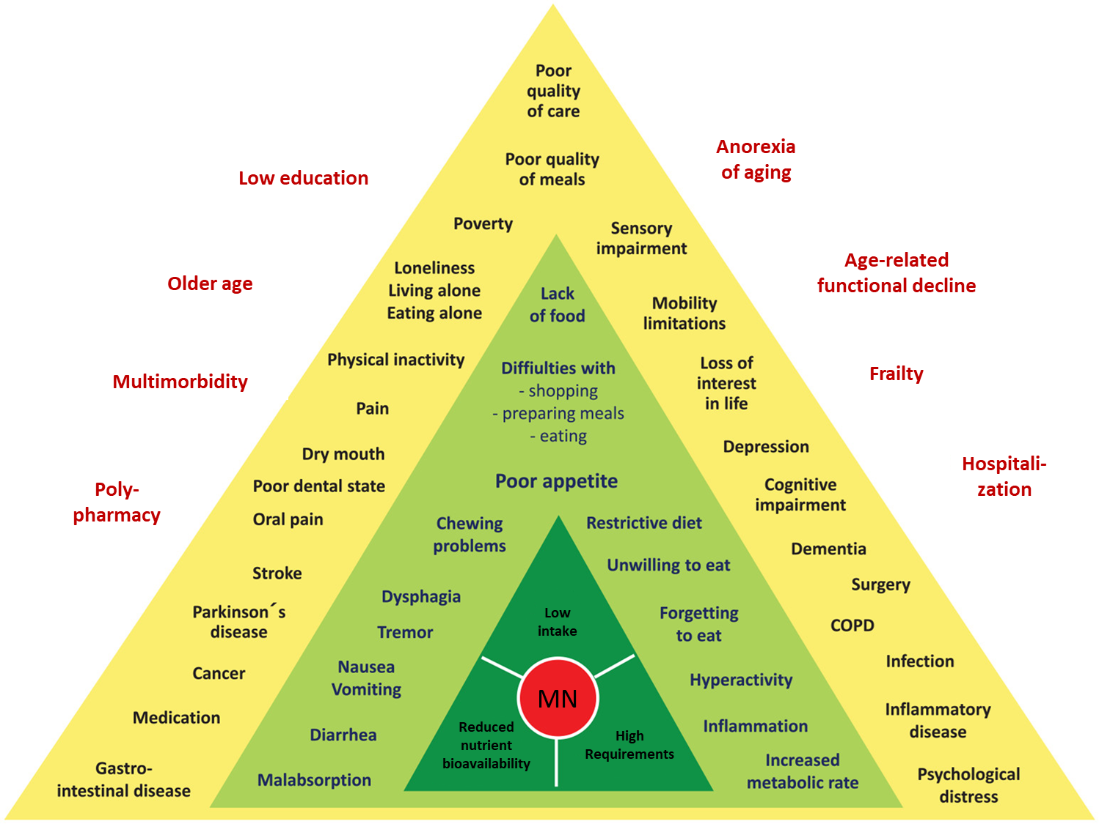
Potential Determinants of Malnutrition
Article Copyright © 2019 Authors, Source DOI: 10.1177/2333721419858438. See content reuse
guidelines at: sagepub.com/journals-permissions
Notes:
The topic of malnutrition is like trying to drink an ocean. This article and graphic do help capture the complex nature.
All factors—independent of the level—are regarded as (potential) “determinants” of MN meaning that they may contribute to the development of MN in a causative manner. The levels illustrate different modes of action: Level 1 (dark green): Central etiologic mechanisms; Level 2 (light green): Factors in this level directly lead to one of the three mechanisms in Level 1 (e.g., swallowing problems may directly cause low intake); Level 3 (yellow): Factors in this level may indirectly lead to one (or more) of the three central mechanisms through one (or more) of the direct factors in the light green triangle (e.g., stroke may cause low intake via dysphagia or difficulties with eating); surrounding factors in red are age-related changes and general aspects which also contribute to the development of MN, but act even more indirectly or subtle. DoMAP = Determinants of Malnutrition in Aged Persons; MN = malnutrition.

Slide 21
MALNOURISHED
There are many root causes that can have a cumulative effect.
We must dig deeper and think differently to uncover them; they are easily Overlooked and can contribute to anyone becoming …
Notes:
Malnutrition has many warning signs:
Muscle weakness
Fatigue
Increased illness or infection
Feeling irritable or depressed
Unplanned weight loss
Decreased appetite

Slide 22
Nutrition Foundation at Risk?
Medications/Polypharmacy. Memory issues/dementia
Access to food, meal prep/transportation. Appetite (small)
Loss of lean body mass/muscle weakness. Limited income. Lives alone
Nutrient poor intake/absorption
Oral health concerns (chewing, swallowing, teeth, dentures)
Unintentional weight loss
Restricted diet
Illness with infection/inflammation
Sensory changes (taste, vision, smell). Sensitivity to foods (GI issues). Smoking
Hospitalization, health conditions (acute and chronic)
Exhausted. Eating disorder. Emotional health/grief
Depression, dehydration, drug/alcohol dependence
See what others don’t see…
Root Causes of Malnutrition are often overlooked.
Notes:
Most don’t identify ahead of time the gradual deterioration in health status that eventually leads to expensive hospitalization and worsening outcomes.

Slide 23
An Unexpected Journey…
Chronic Condition
Medication side effects
Decreased Appetite/ Intake
Unintentional Weight Loss
Access: Unable to shop for, cook, eat, decreased energy
Nutrient Intake Declines
Nutrient Poor Convenience Food Choices
Loss of Lean Muscle/Decreased Strength
Decrease Immunity, Increase Inflammation
Health Episode (Acute) Pneumonia or Fall
Viscous Cycle Starts Again
Downward Spiral toward Malnutrition

Slide 24
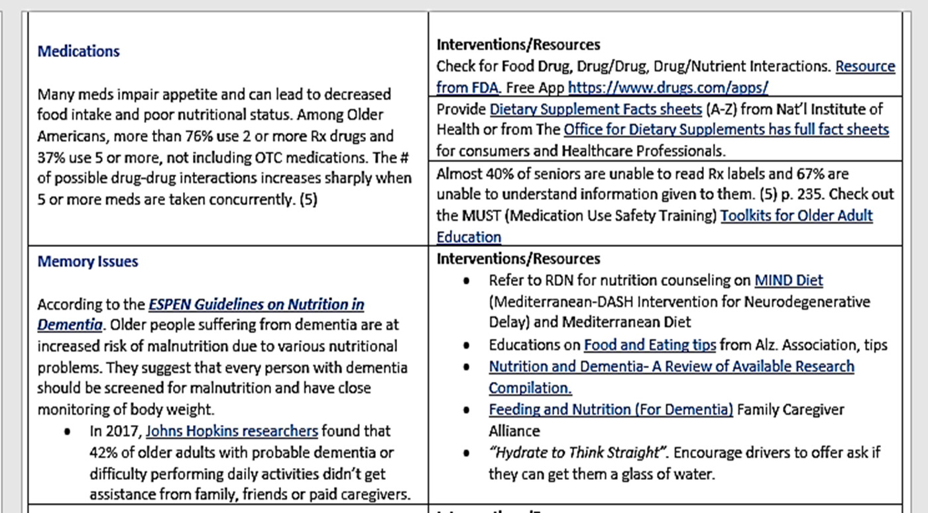
Root Causes Summary Document

Slide 25
Enhanced DETERMINE
(Draft GWAAR)
Purpose: To assist HDM Assessors to identify root causes that can contribute to malnutrition and connect them with additional programs and services to diminish their risk by developing a person-centered Nutrition Plan of Care.
DETERMINE Question | If yes, ask follow-up questions | Referral/Intervention Options (Person-centered Plan)
I eat few fruits, vegetables or milk products. Yes or No? | Cannot chew fresh F/V No access to fresh F/V Cannot peel or cut fresh F/V Does not know how to prepare F/V Lactose intolerant Ask what F/V they typically eat and list below. | Refer to ADRC or Independent Living Center for Adaptive Equipment Evaluation. Refer to EBS to assist with FoodShare Application. Offer transportation for shopping. Refer to Dentist for Chewing Evaluation. Offer Lactaid or calcium and Vit. D fortified juice if available. Offer Senior Farmers Market Vouchers if available. Provide receipt booklet/handouts. Refer to Dietitian for nutrition education and counseling

Slide 26
Steps You Can Take to Combat Malnutrition- Reframe It!
What does “NOURISH” mean to you?
We NOURISH the Whole Person!
Nutritious Meals, Heart, Companionship, Caring, Encouragement, Compassion, Education, Happiness, Strength, Engaging, Health, Energy, Purpose, Volunteer Opportunities, Access, Equity, ….
“The Trifecta!”
  Nutritious Meals
  Socialization
  Health & Wellness
Notes:
We address not just physical hunger but also emotional hunger.
Nourish: Nutrients, Love, Nurture, caring, compassion

Slide 27

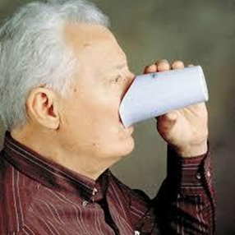

Adaptive Equipment (Access)

Slide 28
Use A Validated Screening Tool!
Find a Review of Several at NCOA’s site
Notes:
NCOA’s link: https://www.ncoa.org/assesssments-tools/malnutrition-screening-assessment-tools/

Slide 29
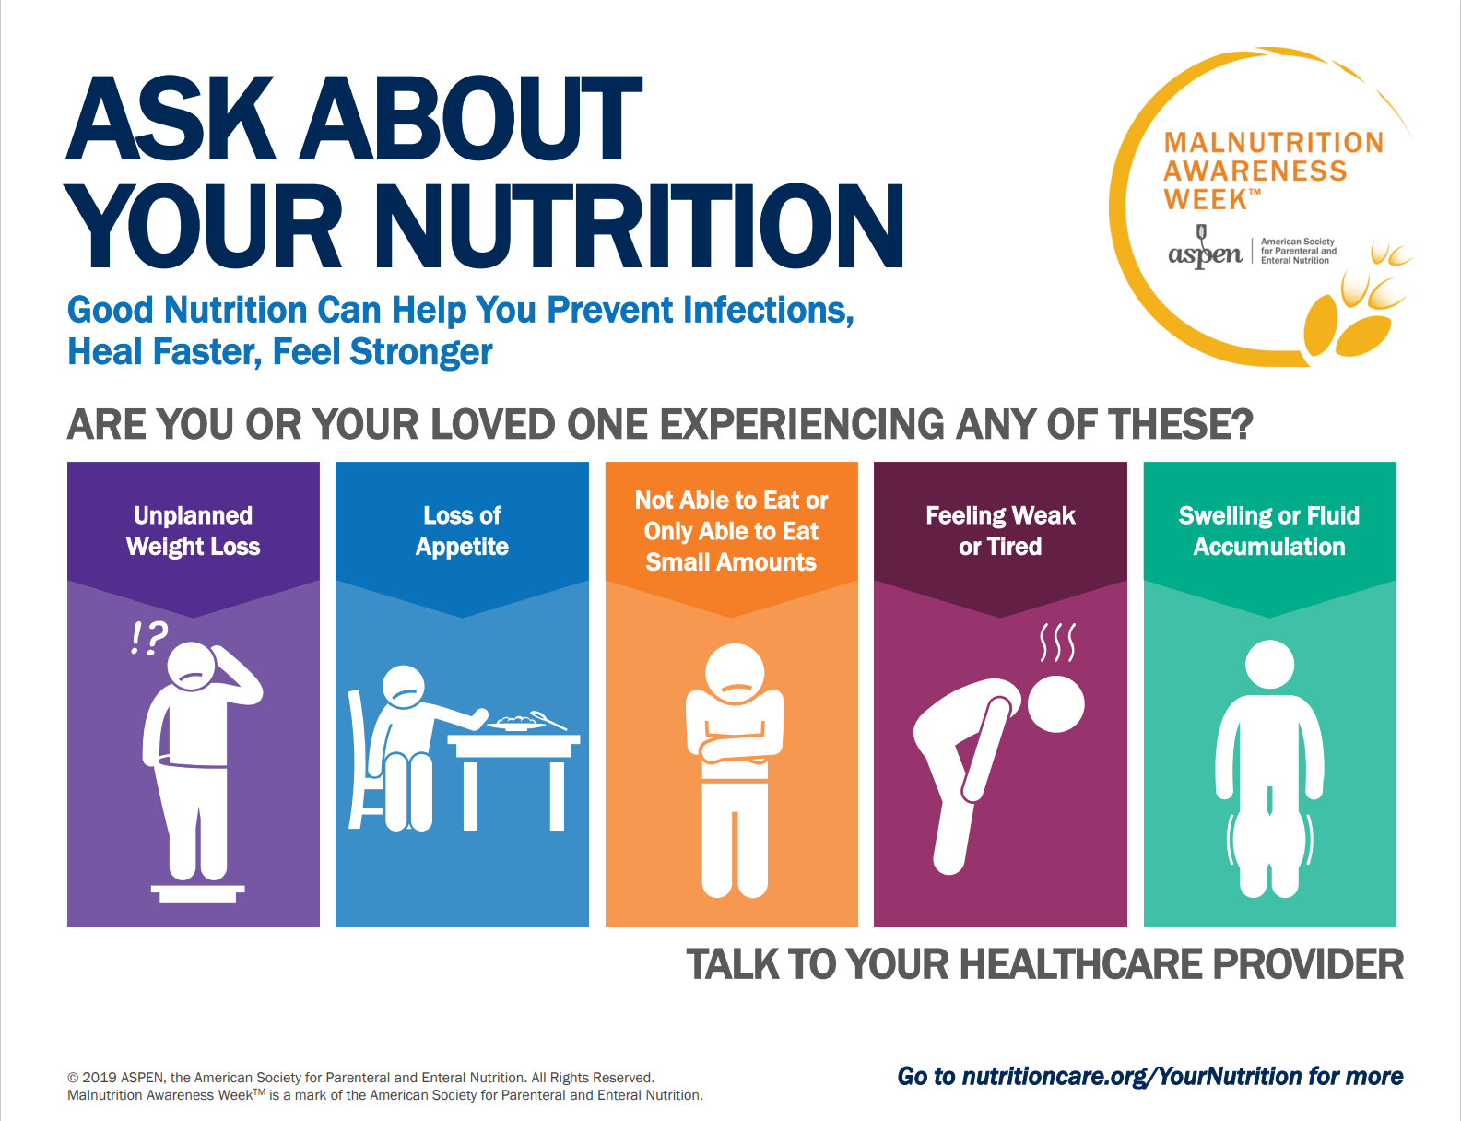
Malnutrition Awareness Week
(Oct. 4-8, 2021)
Notes:
Participate in MAW!

Slide 30


Stepping Up Your Nutrition
Stepping Up Your Nutrition (SUYN) is a 2.5-hour interactive community-based workshop that focuses on:
How nutrition affects falls risk
The importance of muscles for strength
Key nutrients for older adults, particularly protein and fluid
How to determine personal nutrition risk and handgrip strength scores
How to create an action plan to improve nutritional health https://www.steppingupyournutrition.com/

Slide 31
Nutrition Risk Jeopardy
Facts | Access | Medical | Physical | Mental
$100 | $100 | $100 | $100 | $100
$200 | $200 | $200 | $200 | $200
$300 | $300 | $300 | $300 | $300
$400 | $400 | $400 | $400 | $400
$500 | $500 | $500 | $500 | $500
Final Jeopardy

Slide 32
Eat Well, Age Well
Eat Well, Care Well
Nutrition Education Materials created by Greater WI Agency on Aging Resources (GWAAR) in collaboration with UW Stout Dietetic Students and Interns
https://gwaar.org/nutrition-education-and-activities
Notes:
I would want to be able to click on the links to show them the materials available at the site.
We have developed two educational initiatives for older adults and their caregivers called, “Eat Well. Age Well” and “Eat Well, Care Well.”
The intent is to provide education in small bites that incorporate Weekly Challenges, so they can take actions that will hopefully become lifestyle changes.
Food if Power, Food is Medicine, Food is to be enjoyed and celebrated and part of social interaction.
Food choices affect your physical and mental health, can help you prevent or control chronic conditions. There are many reasons older adults and their caregivers struggle with eating nutritious meals, thus placing them at risk of becoming malnourished

Slide 33
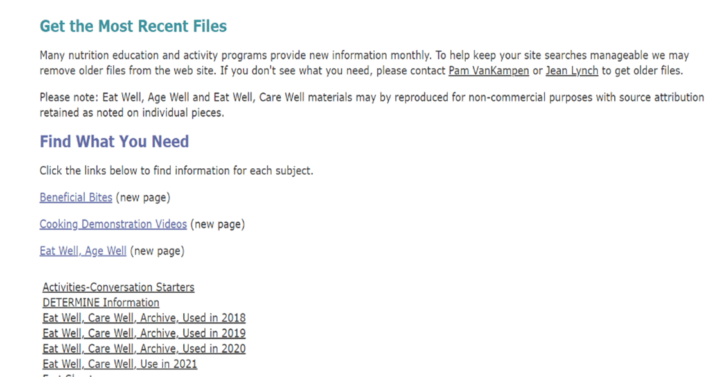
GWAAR Website Nutrition Ed Page
If you need an editable version for any of the Eat Well Materials, please email pam.vankampen@gwaar.org

Slide 34
Interactive & Engaging Nutrition Education Initiative!
Engage and create excitement. FUN!
Show it can be simple and affordable.
Teach them to fish.
Monthly handouts.
Weekly materials (placemats and table tents).
Weekly challenges.
Allow them to share their stories and experiences.
Extend your reach (marketing).
Reach caregivers and younger generation to educate and normalize healthy eating for optimal aging.
Use social media.

Slide 35
2021 Eat Well Topics
Eat Well, Age Well:
Here is the 2021 Calendar of Monthly Topics:
January- Eye Health
February- Heart Health
March- Brain Health
April- Nutrient Dense, Low Sodium
May- Understanding Added Sugar
June- Bone Health
July- Potassium
Aug- Gut Health
Sept- Magnesium
Oct- Nutrition and Arthritis
Nov- Fad Diets
Dec- Healthy Holiday Meals
Eat Well, Care Well
2021 Monthly Handout & Recipe:
January- Eye Health
February- Food Safety
March- How to Read the New Food Label
April- Oral Health Care Tips
May- 10 Min. Lunch Ideas
June- Low Sodium Cooking
July- Healthy Dinners in 30 Minutes
August- Hydration
Sept- Malnutrition Awareness Month
Oct- Healthy Fall Baking
Nov- Healthy Holiday Recipes and Tips
Dec- Healthy Holiday Recipes and Tips
Notes:
Even when the Senior Dining Sites aren’t open, you can still use the materials in print form as handouts, use them to promote weekly challenges, post them in your newsletters and/or on social media posts. If you need the Word version please let me know. Please share with your contract dietitians so they can utilize the materials in presentations, cooking demonstrations, etc.

Slide 36
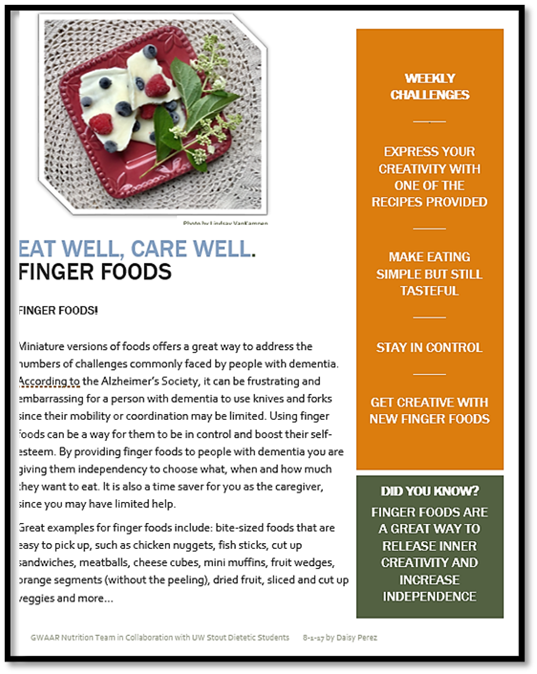
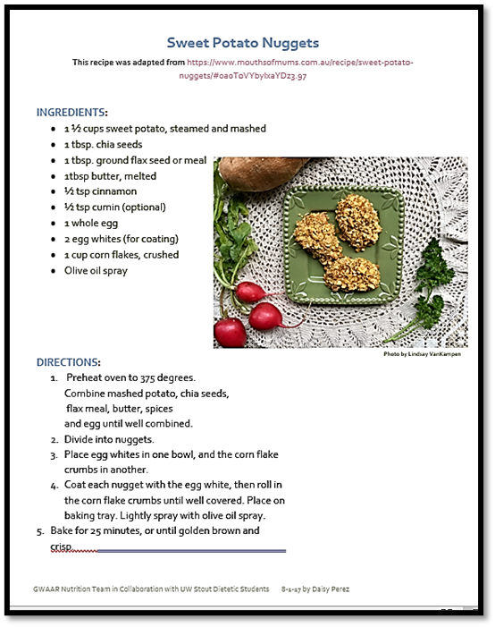
Eat Well, Care Well

Slide 37
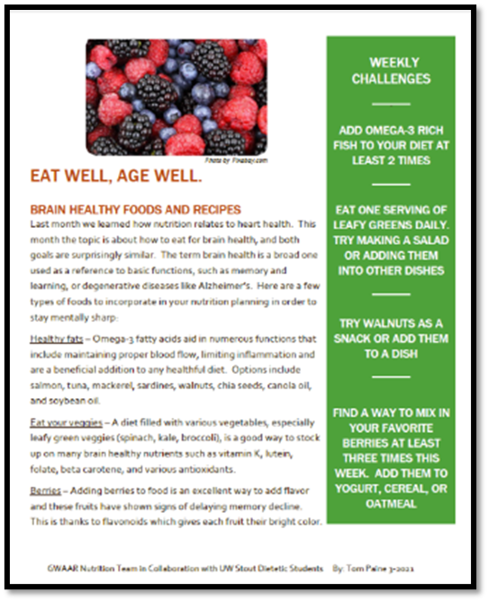
Eat Well, Age Well
Monthly Handout

Slide 38
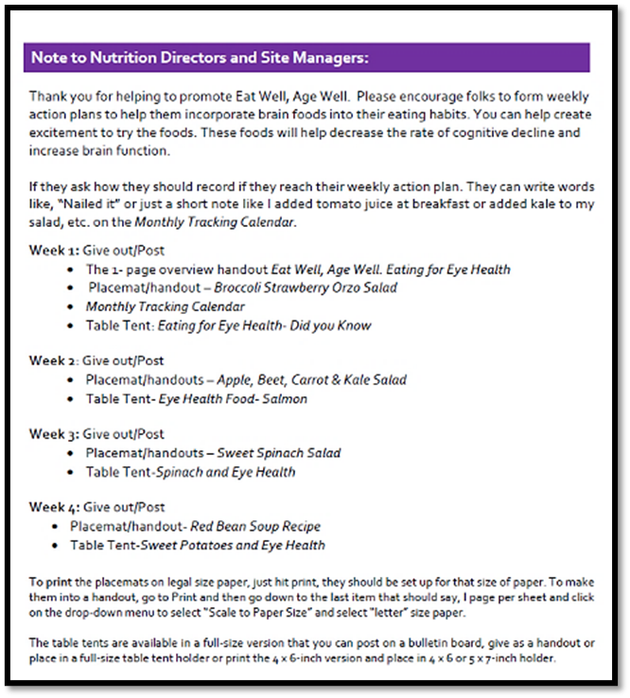
Monthly Instructions for Site Managers

Slide 39
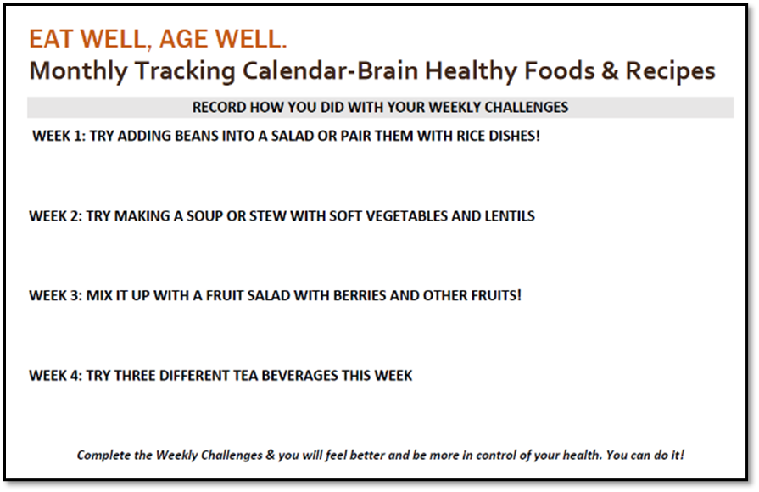
Eat Well, Age Well Monthly Tracking Calendar

Slide 40
Weekly Table Tent
Brain-healthy Foods Tents
https://gwaar.org/api/cms/previewFile/id/2006419

Slide 41
Weekly Placemat
Eat Well, Age Well – Brain Healthy Foods
https://gwaar.org/api/cms/previewFile/id/2006418

Slide 42
Eat Well, Age Well Materials
Visit Eat Well, Age Well (gwaar.org)

Slide 43
Eat Well, Age Well Recipe
Eat Well, Age Well Squash Recipe Mat
https://gwaar.org/api/cms/previewFile/id/2004749

Slide 44
Cooking Classes, Cooking Demos
Cooking Demonstration Videos (gwaar.org)
Notes:
We have 9 of the Eat Well Recipes video taped with a recipe handout. Special thanks to Rachel, Callie and Ilkay, UW Stout Dietetic Interns

Slide 45
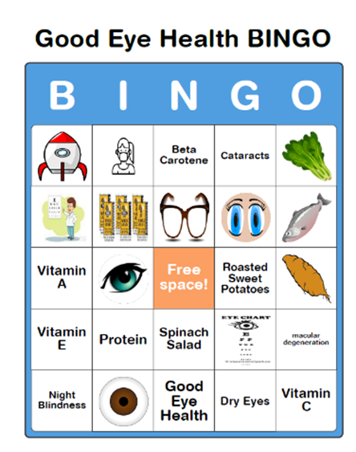
Just Added Monthly Bingo Cards!
Special thank you to Heidi Russell, Director of Aging, Shawano County Human Services and Naomi Moua, UW- Health Dietetic Intern for the idea and creation of the cards!

Slide 46
Engaging Nutrition Education Program
(Created by Barron County ENP)
Highlights 1 food per month
Interactive Activity
Newsletter Column
MOWs Insert
Recipe Cards
Some ppts
7+ years worth of materials
Materials posted on GWAAR Website. https://gwaar.org/nutrition-education-and-activities

Slide 47
Malnutrition Has Many Faces & Many Stories…
See the whole person; the root causes/unspoken needs/barriers.
Reframe the conversation. Think NOURISH!
Malnutrition is not just about food. We must screen, assess, educate, and intervene.
Notes:
If 1 in 2 older adults living in the community is malnourished, we should know the answer to this question. We look into faces every day that could be suffering from this devastating and PREVENTABLE condition. We need to ask ourselves, are we too focused on the problem of malnutrition? If we focus on the problem, it can prevent us from seeing the solution. As a scene from the movie Patch Adams suggests, never focus on the problem, look at me (older adult and their caregiver); look beyond what seems like the obvious solution, i.e. giving them food. See what no one else sees, see the whole person and the root causes/ unspoken needs/barriers that are present in their real-life situation. We can stop, or at least mitigate, the downward spiral (poor appetite, weight loss, malnutrition, depression, cognitive dysfunction, social withdrawal, isolation, giving up and death) and the COSTLY (~$51.3 BILLION annually), negative outcomes that stem from poor nutrition. Let’s reframe the conversation and shift the focus toward an upward climb to a meaningful, healthy life built on the foundation of optimal nutrition. Community based organization are perfectly poised to do this by: addressing barriers and risk factors, screening, assessing, offering solutions (program, services, referrals), that are person-centered, and evidence based. The strong relationships we have with older adults & their families provide encouragement & hope. It also allows us to notice changes in condition that can be addressed before they spiral down. Malnutrition is not just about food; we must see what others are not seeing, open the eyes of others, and act collectively so that older adults and their caregivers are living their best lives.

Slide 48
Resources
GWAAR Nutrition Education Materials https://gwaar.org/nutrition-education-and-activities
Drugs.com https://www.drugs.com/
#BeaNutritionNeighbor https://www.facebook.com/hashtag/beanutritionneighbor
Defeatmalnutrition.today https://www.defeatmalnutrition.today/
State Legislative Toolkit from Defeatmalnutrition.today https://www.defeatmalnutrition.today/sites/default/files/documents/2017%20Malnutrition%20Legislative%20Toolkit.bleed.pdf
National Blueprint: Achieving Quality Malnutrition
Care for Older Adults (the Blueprint). https://www.defeatmalnutrition.today/blueprint
Development of a Model on Determinants of Malnutrition in Aged Persons: A MaNuEL Project https://journals.sagepub.com/doi/10.1177/2333721419858438
Malnutrition Awareness Week 2021 http://www.nutritioncare.org/maw/#:~:text=SAVE%20THE%20DATE%3A%20ASPEN%20Malnutrition,detection%20and%20treatment%20of%20malnutrition
ASPEN Malnutrition Center http://www.nutritioncare.org/guidelines_and_clinical_resources/Malnutrition_Solution_Center/ and http://www.nutritioncare.org/Malnutrition/ www.nutritioncare.org to access ASPEN online tutorials, courses, training programs, self-assessment programs, publications, and more.
National Council on Aging Senior Hunger & Nutrition Resources https://www.ncoa.org/healthy-aging/hunger-and-nutrition/
Stepping Up Your Nutrition, https://www.steppingupyournutrition.com/
More Protein Tearpad and Protein Food Kit and Tearpad from Nasco created by Terese Scollard, RDN, LD https://www.enasco.com/search/?text=more+protein
https://oregon.providence.org/our-services/p/providence-nutrition-services/?utm_source=providence-org Providence Health & Services Nutrition Services has several excellent materials -nutrition&utm_medium=redirect&utm_content=providence-org-nutrition

Slide 49
Let’s not just imagine a country without malnutrition, let’s think bigger, work collaboratively to ensure all seniors are NOURISHED and have a Planned Journey Toward Health!

Slide 50


Paul Hepfer
CEO
Project Open Hand
https://openhand.org and https://calfimc.org

Slide 51

Outline
Intro to Food Is Medicine
CalFIMC and POH: Who We Are
What We Do: Medically Tailored Meals
  (MTM) Programs and Benefits
How: The Importance of Partnerships
Lessons Learned

Slide 52
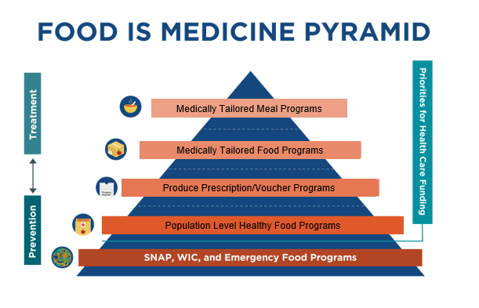
Food is medicine

Slide 53
Definition of Medically
Tailored Meals
Medically tailored meals (MTM) are meals approved by a Registered Dietitian Nutritionist (RDN) that reflect appropriate dietary therapy based on evidence-based practice guidelines.
Diet/meals are recommended by a RDN based on a nutritional assessment and a referral by a health care provider to address a medical diagnosis, symptoms, allergies, medication management and side effects to ensure the best possible nutrition-related health outcomes.

Slide 54
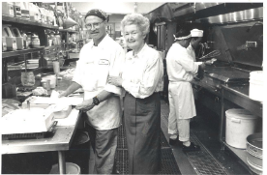
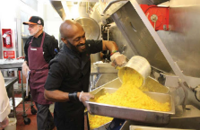
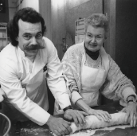
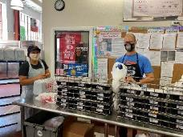
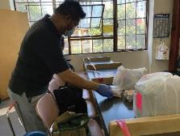
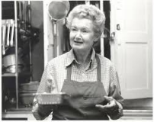
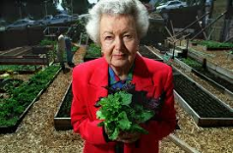
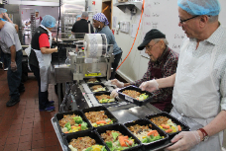
Project Open Hand

Slide 55
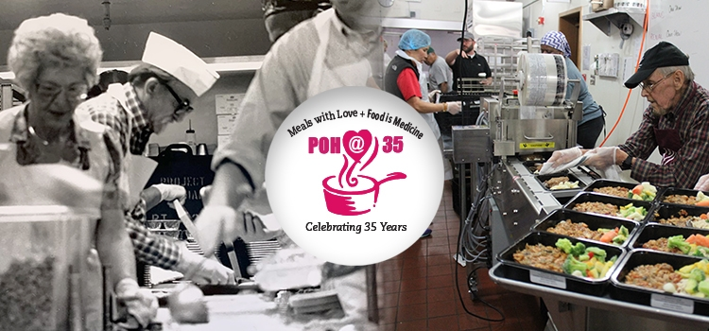
Celebrating 35 Years

Slide 56

Who We Are: CA Food Is Medicine Coalition and Project Open Hand
  Providers of Medically Tailored Meal Services (MTM) in California
  Coalition of six non-profit community based agencies, covering counties that represent 48% of the state population
  Over 150 years of collective experience providing nutrition security programs
  Focus on low-income patients with chronic and acute illnesses

Slide 57
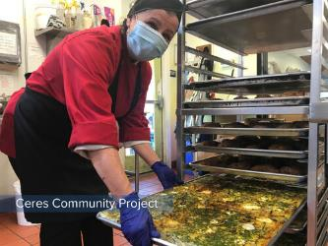
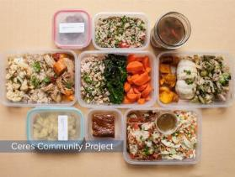
Who We Are:
Emphasize Nutrition Security
Nutrition security = a situation that exists when people, at all times, have access to sufficient, safe, and nutritious food that meets their dietary needs and food preferences for an active and healthy life (USDA, 2017).
Food security usually focuses on availability of calories.
Nutrition security requires the intake of a wide range of foods which provides the essential nutrients that individuals need to maintain or improve their health status, including meeting specific needs …(NLM, 2020).

Slide 58

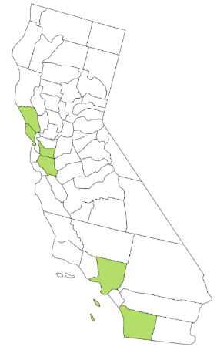






Who & Where We Are

Slide 59
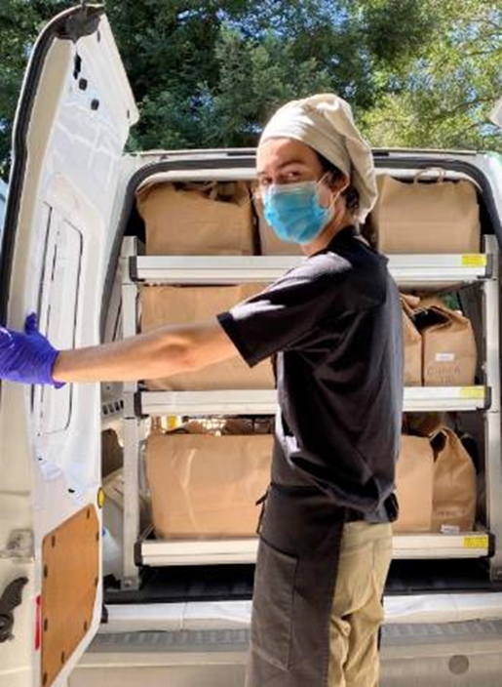
What We Do
State Supported MTM Pilot Program
  4-year pilot funded by $6 million from CA legislature; Overseen by CA Department of Health Care Services
  1,000+ Medi-Cal patients
  Complete nutrition (3 meals per day) for 12 weeks plus Medical Nutrition Therapy
  Eligibility: CHF diagnosis, Medi-Cal patients
Collaborate with Health plans for MTM Programs
  Anthem, Blue Shield Promise, Kaiser Permanente
  L.A. Care, San Francisco Health Plan

Slide 60
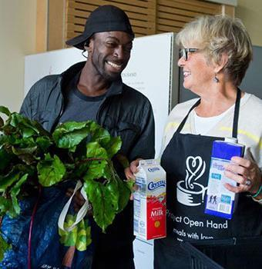
What We Do
Who We Serve
Collectively 75,000 meals per week, and up to 3.3 million meals annually
Over 16,000 clients annually
Emphasis on Health Equity:
  52% are People of Color
  51% are over 60 years old
  52% are under the poverty line

Slide 61
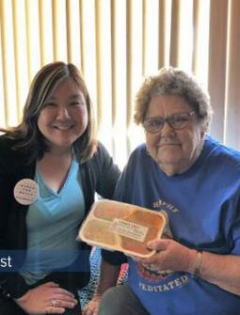
Impacts of MTM Service
Evidence shows great benefits of MTM,
including up to:
  32% Decline in Net Health Care Costs
    See calfimc.org/research for details
  63% Reduction in Hospitalizations
  50% Improvement in Medication Adherence
  Increase in Patient Satisfaction

Slide 62
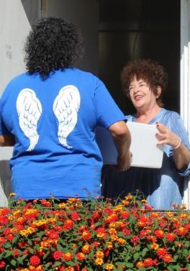
How?
Importance of Partnerships
We are members of National Food is Medicine Coalition – sharing information & practices
Formed California FIM Coalition to implement the state pilot program (with DHCS) in 2017
  Coordinate data gathering and tracking
  Share best practices – regular meetings
  Collaborate on evaluation, problem-solving, strategy, fundraising, expansion, etc.

Slide 63

Partnerships
Collaborate with State Government Agencies
  CA Department of Health Care Services
  CA Department of Aging – Master Plan
  Legislators as Champions
Collaborate with County & Local Agencies
  Departments of Aging & Disability
  City & County Health Departments
Federal Government
  Administration for Community Living
  FEMA
  New Federal Bill for MTM (McGovern)

Slide 64

Partnerships (cont.)
Collaboration with Health Plans
  Support of pilots/programs – contracts with our member agencies for nutrition services
  Advising (on our Medical Advisory council)
  Some support and partnership in our advocacy efforts
  Provide medical information and referrals for MTM programs

Slide 65

Additional Partnerships
Hospitals and clinics (medical & nutrition experts, healthcare providers)
Other non-profit organizations, on policy efforts & social services
Food banks
Food suppliers/companies
Numerous Volunteers
Philanthropy/foundations

Slide 66
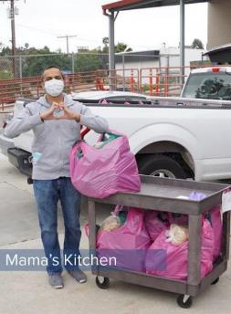
Lessons
Perseverance and Partnerships Pay off
Visibility, Credibility, and Involvement in Collaborative Policy Efforts
Dedication to Nutrition Security for All
Growing Recognition of the Importance of Nutrition Security →New Challenges and New Opportunities In response to COVID

Slide 67
Reminders
Please direct all questions and inquiries regarding today’s presentation, including Certificates of Attendance to, Nicole.Becerra@acl.hhs.gov
Questions may be submitted up to one week after the webinar
Questions will be compiled for each speaker. Please write the presenter’s name for who the question(s) are intended for in the subject line.

Slide 68
Trifecta:
Food Insecurity and Malnutrition
Thank you for attending!
Celebrate Our Senior Nutrition Program
March 2021

