Slide 1

Trifecta: Health and Well-Being
Celebrate Our Senior Nutrition Program
March 2021

Slide 2
Agenda
Welcome
Opening Comments
Speakers
  Carmen Clutter, MS, RDN, LD, Population Health and Nutrition Manager, Ohio Department on Aging
  Alexandra Bauman, RD, LDN, Nutrition, Health & Wellness Director, Iowa Department on Aging
Question and Answer
Closing Comments
  Keri Lipperini, Director of the Office of Nutrition and Health Promotion Programs at the Administration for Community Living, will offer closing comments

Slide 3
Learning Objectives
Define health and well-being including new challenges presented during the pandemic
Health and well-being programs and the value of partnerships
Reaching and marketing to the older American

Slide 4
Reminders
Questions should be held until the end and placed in the Q&A box
No questions in the chat box
Submit additional questions up to one week after the webinar
Write the presenter’s name in the subject line
Questions will be compiled for each speaker
Certificates of Attendance – send requests to Nicole.Becerra@acl.hhs.gov

Slide 5

Carmen Clutter, MS, RDN, LD
Population Health & Nutrition Manager
Ohio Department of Aging
cclutter@age.ohio.gov

Slide 6
A Vision of Healthier Ohioans

Slide 7
What We’ll Talk About-Part 1
Health & Well-Being
  Summary Assessment of Older Ohioans
Nutrition Strategies
  Essential Service Prioritization;
  Staying Healthy – Ohio’s Small Business Restaurant Initiative;
  Grocery Ordering & Delivery Services; and
  Senior Farmers’ Market Nutrition Program

Slide 8
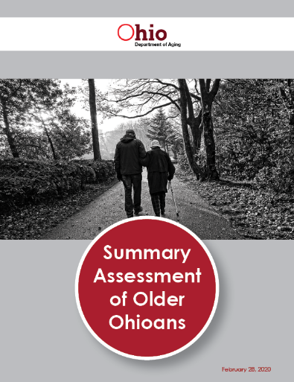
What is the Summary Assessment of Older Ohioans?
A comprehensive picture of the health and well-being of older Ohioans to inform development of the Strategic Action Plan on Aging
Summary Assessment of Older Ohioans. Ohio Department of Aging. June 1, 2020

Slide 9


Summary Assessment
What are the biggest health and wellbeing strengths and challenges for older Ohioans?
Which factors that impact the health and wellbeing of older Ohioans are most important to address?

Slide 10
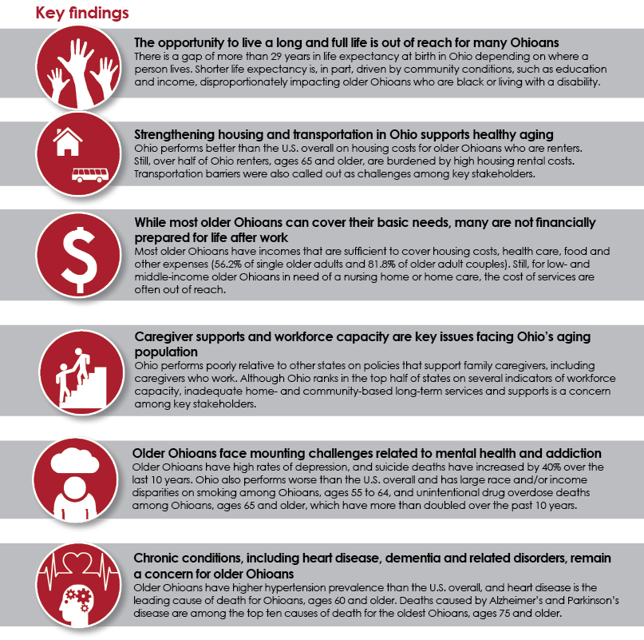
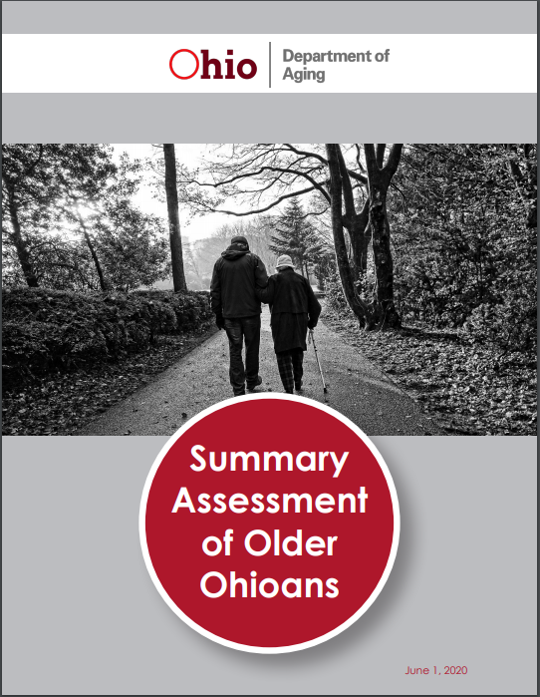
Summary Assessment Continued
Summary Assessment of Older Ohioans. Ohio Department of Aging. June 1, 2020
Notes:
Summary Assessment of Older Ohioans Key Findings- additional details can be found at: https://aging.ohio.gov/wps/wcm/connect/gov/4e3041b1-f49a-4164-9ed0-c6d7b39e5f7b/SAPA-Summary-Assessment-of-Older-Ohioans-Executive-Summary.pdf?MOD=AJPERES&CVID=ncWcvoc

Slide 11
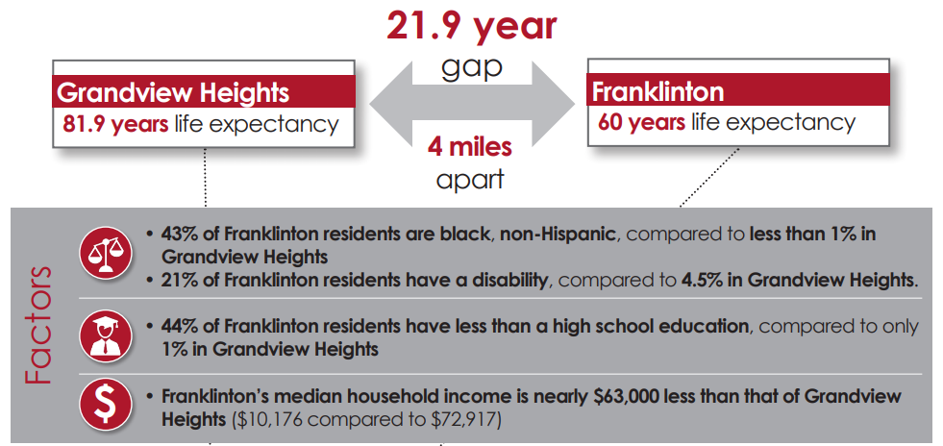
Gap in Life Expectancy
Notes:
Factors:
43% of Franklinton residents are black, non-Hispanic, compares to less than 1% in Grandview Heights
21% of Franklinton residents have less than a high school education, compared to only 1% in Grandview Heights
Franklinton's median household income is nearly $63,000 less than that of Grandview Heights ($10,176 compared to $72,917)
Summary Assessment of Older Ohioans Key Findings- additional details can be found at: https://aging.ohio.gov/wps/wcm/connect/gov/4e3041b1-f49a-4164-9ed0-c6d7b39e5f7b/SAPA-Summary-Assessment-of-Older-Ohioans-Executive-Summary.pdf?MOD=AJPERES&CVID=ncWcvoc

Slide 12
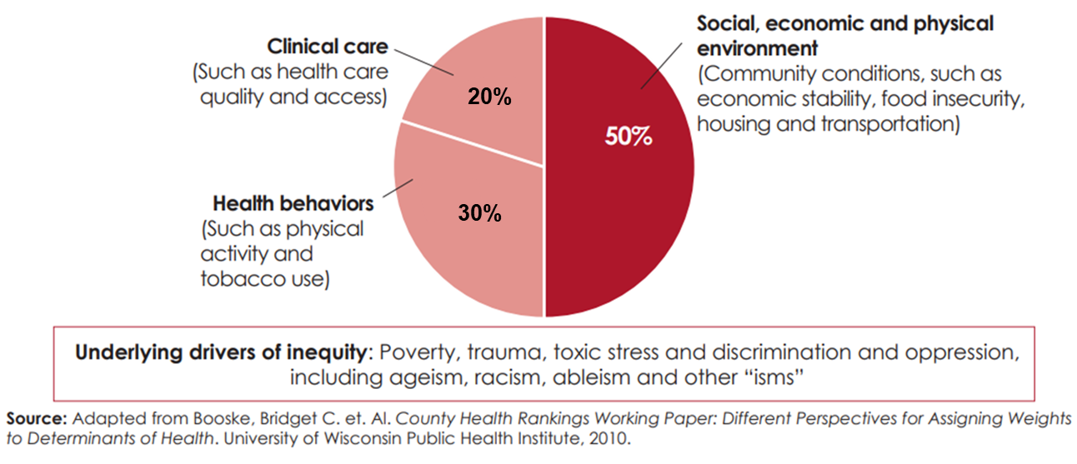
Drivers of Health and Wellness
Notes:
Clinical care (such as a health care quality and access) – 20%
Health behaviors (such as physical activity and tobacco use) – 30%
Social, economic and physical environment (Community conditions, such as economic stability, food insecurity, housing and transportation).
Underlying driver of inequity: Poverty, trauma, toxic stress and discrimination and oppression, including ageism, racism, and other “isms”.
Source: Adapted from Booske, Bridget C. et. AL. County Health Rankings Working Paper: Different Perspectives for Assigning weights to Determinants of Health. University of Wisconsin Public Health Institute, 2010.

Slide 13
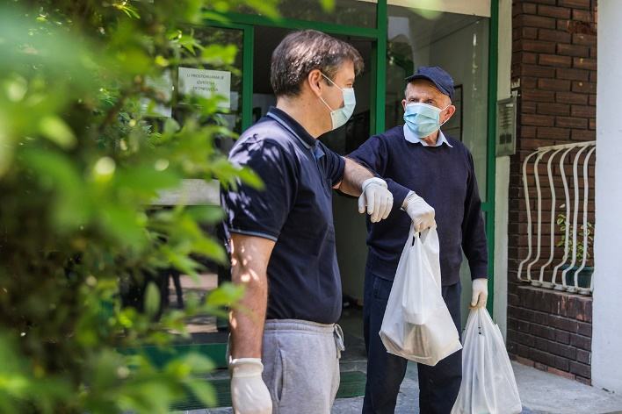

Nutrition Strategies
Supporting older Ohioan’s during the Pandemic
via Getty Images
via Getty Images

Slide 14
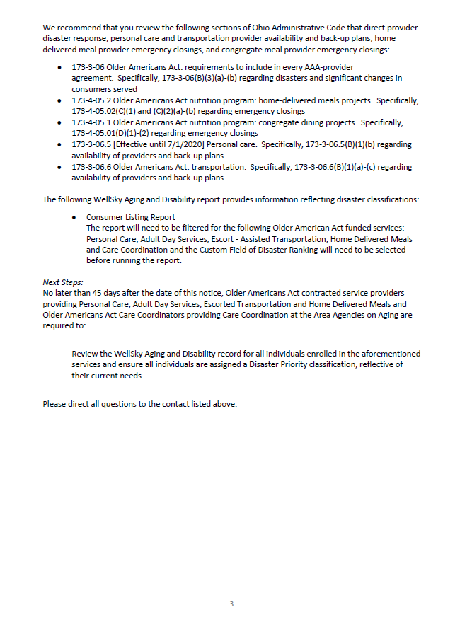
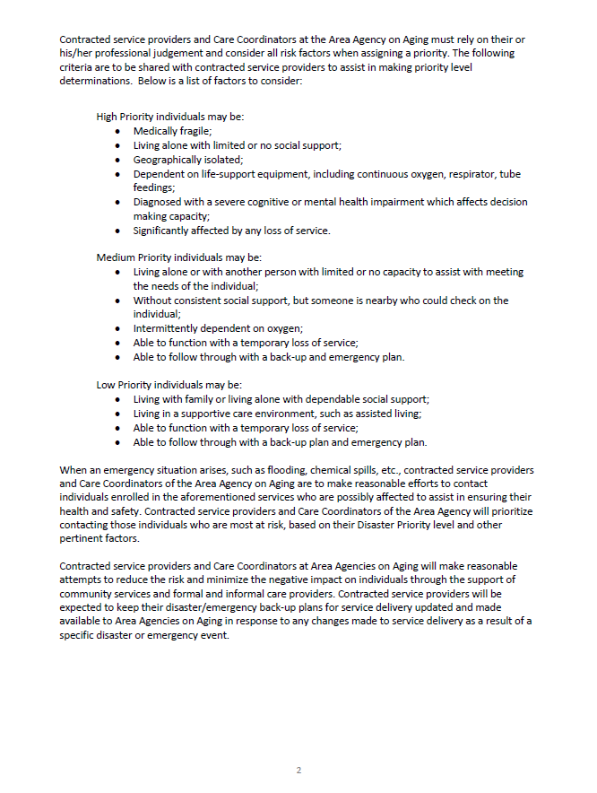
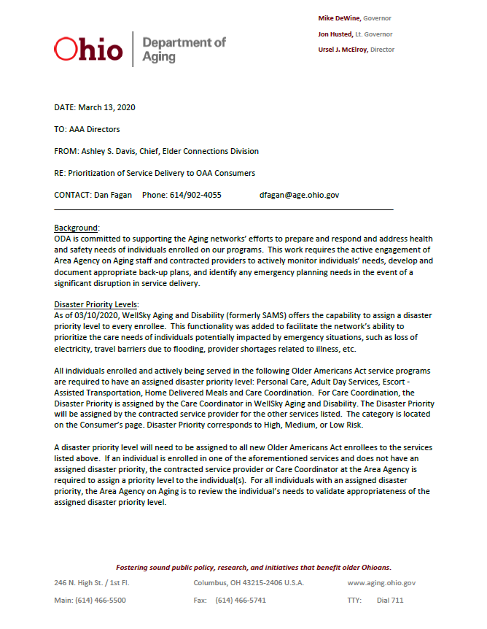

Prioritizing Essential Services
Essential Services
  Personal Care
  Adult Day Services
  Assisted Transportation
  Home-Delivered Meals
  Care Coordination
Disaster Priority Ranking
  High Risk
  Medium Risk
  Low Risk

Slide 15
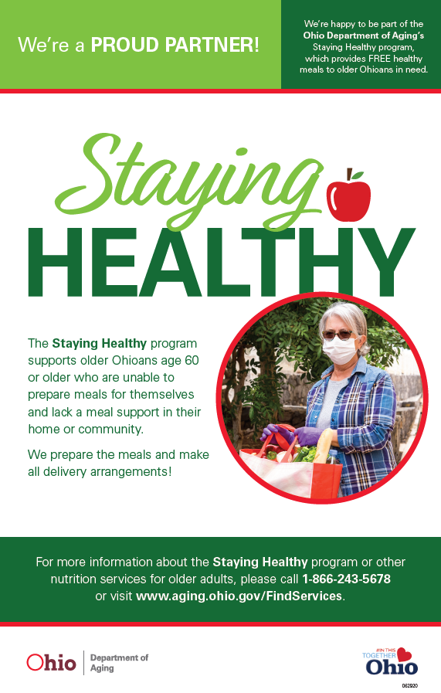
Ohio’s Small-Business
Restaurant Initiative
Spur local investment
Increase small-business restaurant
Meet the increased demand of home-delivered meals

Slide 16
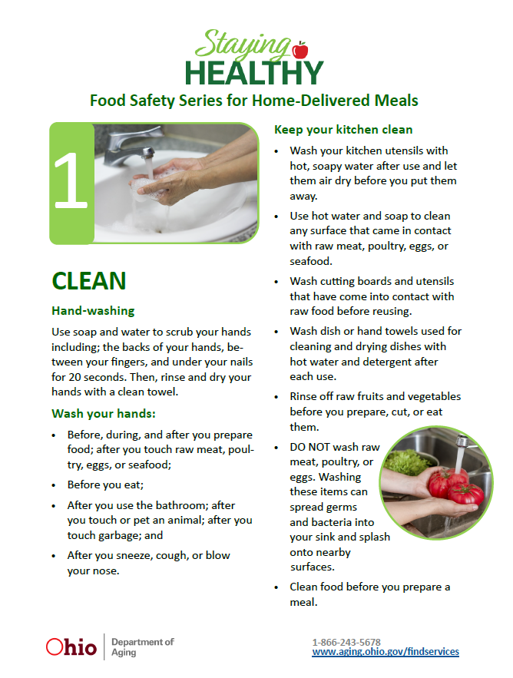
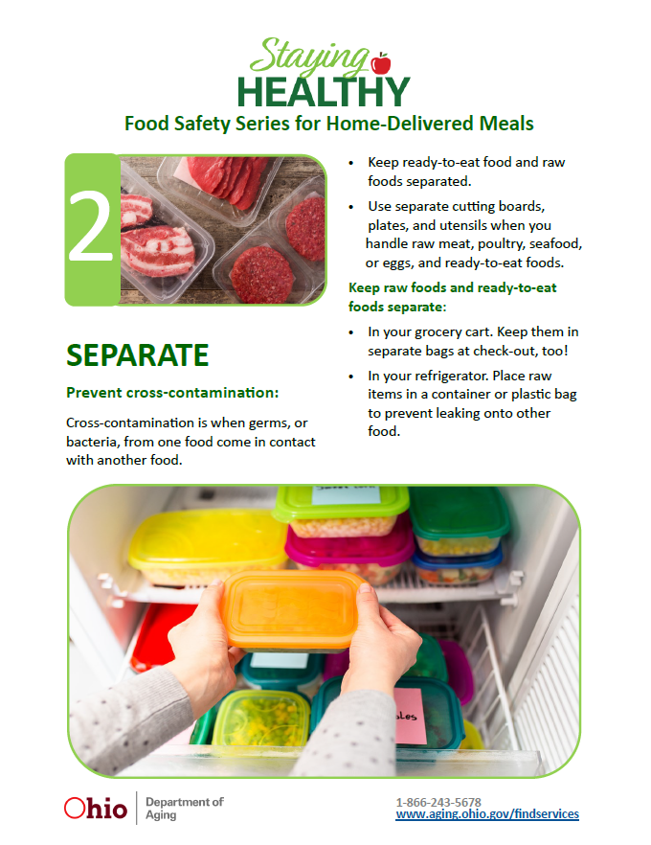
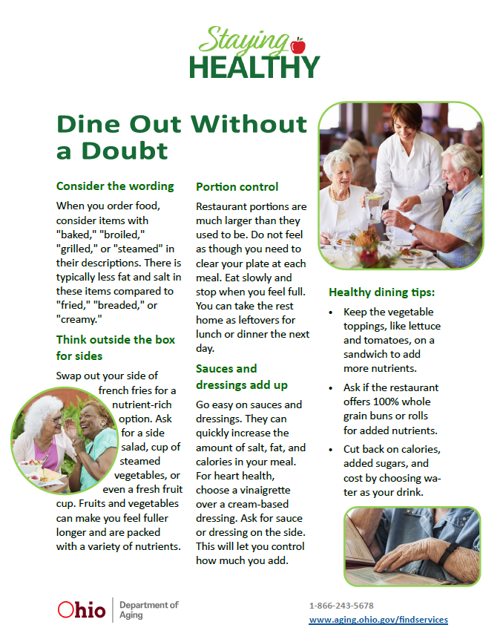

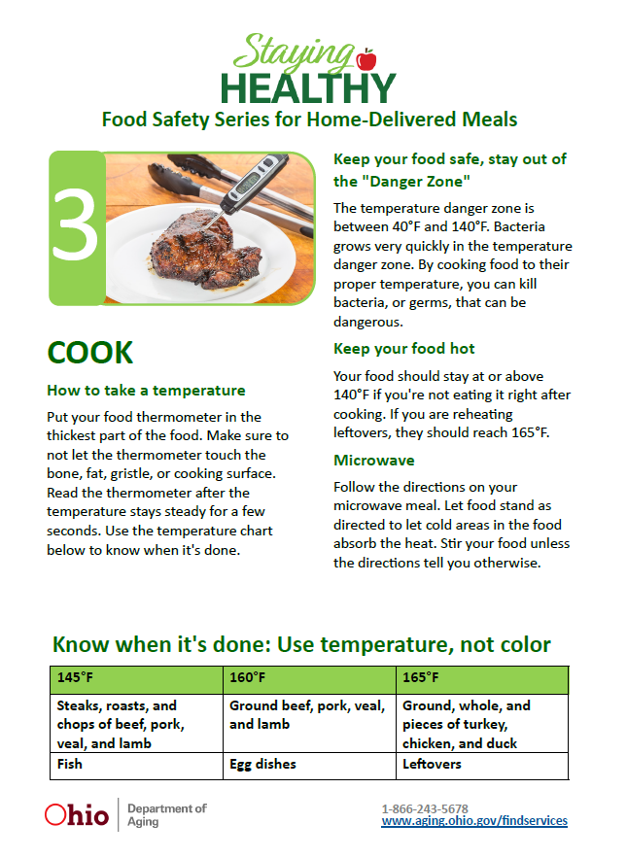
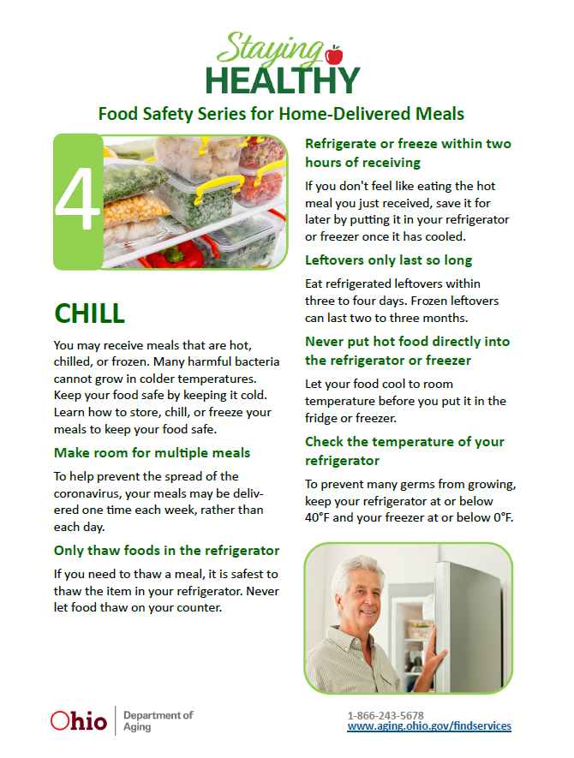
Ohio’s Small-Business
Restaurant Initiative Continued

Slide 17
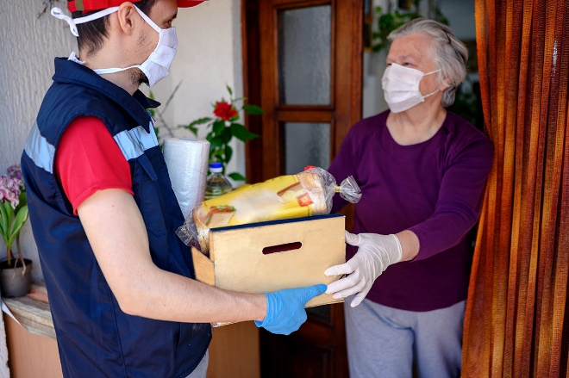
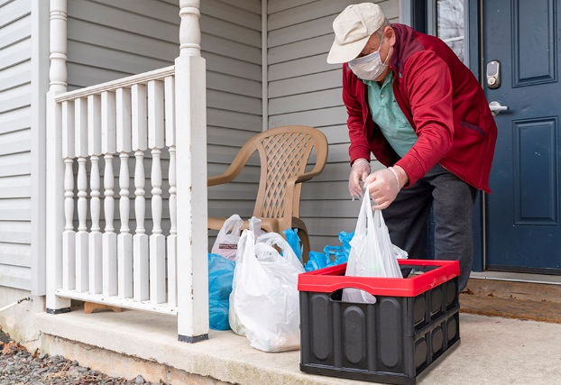
Grocery Ordering & Delivery Services
Title III-B funds
Expand services with contracted providers
No re-bidding
via Getty Images
via Getty Images

Slide 18
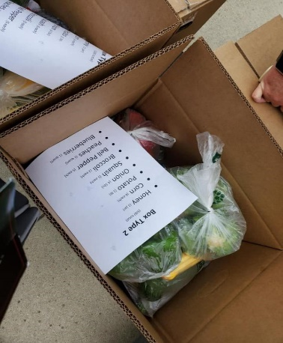
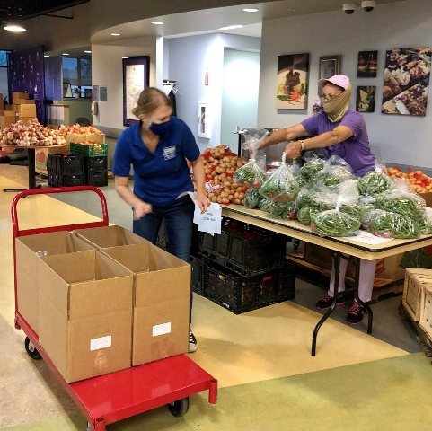
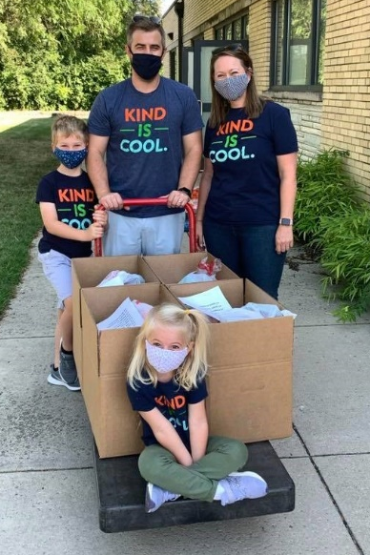
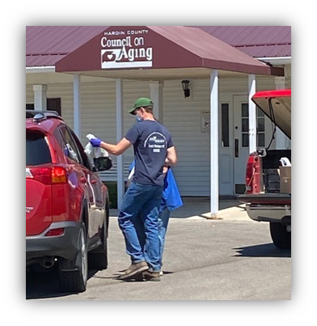
Ohio SFMNP Innovations
Bulk-Purchasing with Ohio Farmers
Drive-Thru Pick Up
Home-Delivered Produce

Slide 19
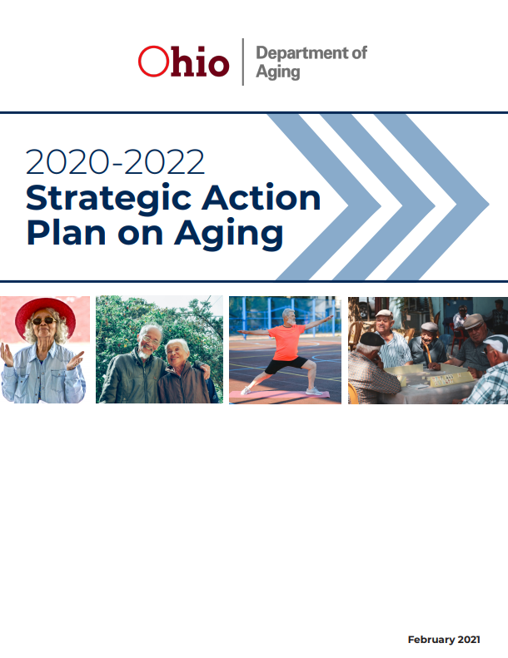
What is the SAPA?
Prioritized action plan to advance elder justice and equity and achieve optimal health and well-being for older Ohioans.

Slide 20
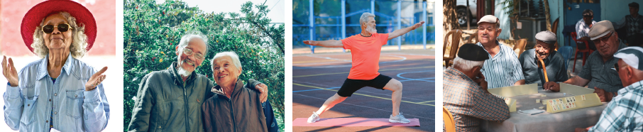

SAPA Goals & Vision
Goal
Vision
All Ohioans live longer, healthier lives with dignity and autonomy. Disparities and inequities are eliminated.
Ohio is the best place to age in the nation
Increase life expectancy
Reduced premature death
Improved health status
Reduced elder abuse neglect

Slide 21
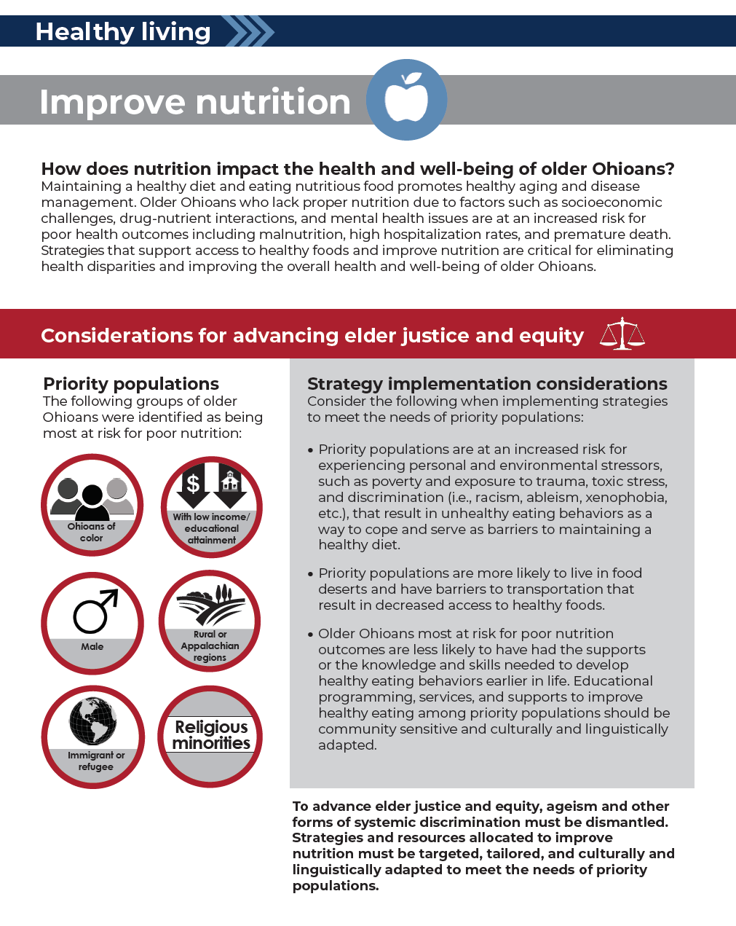
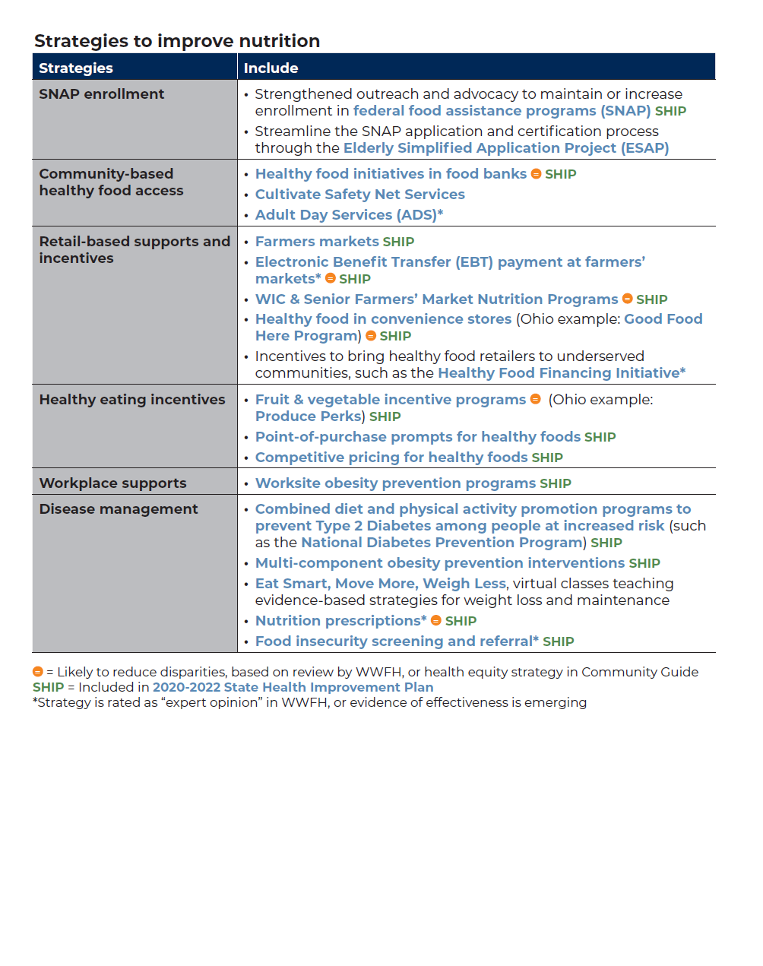
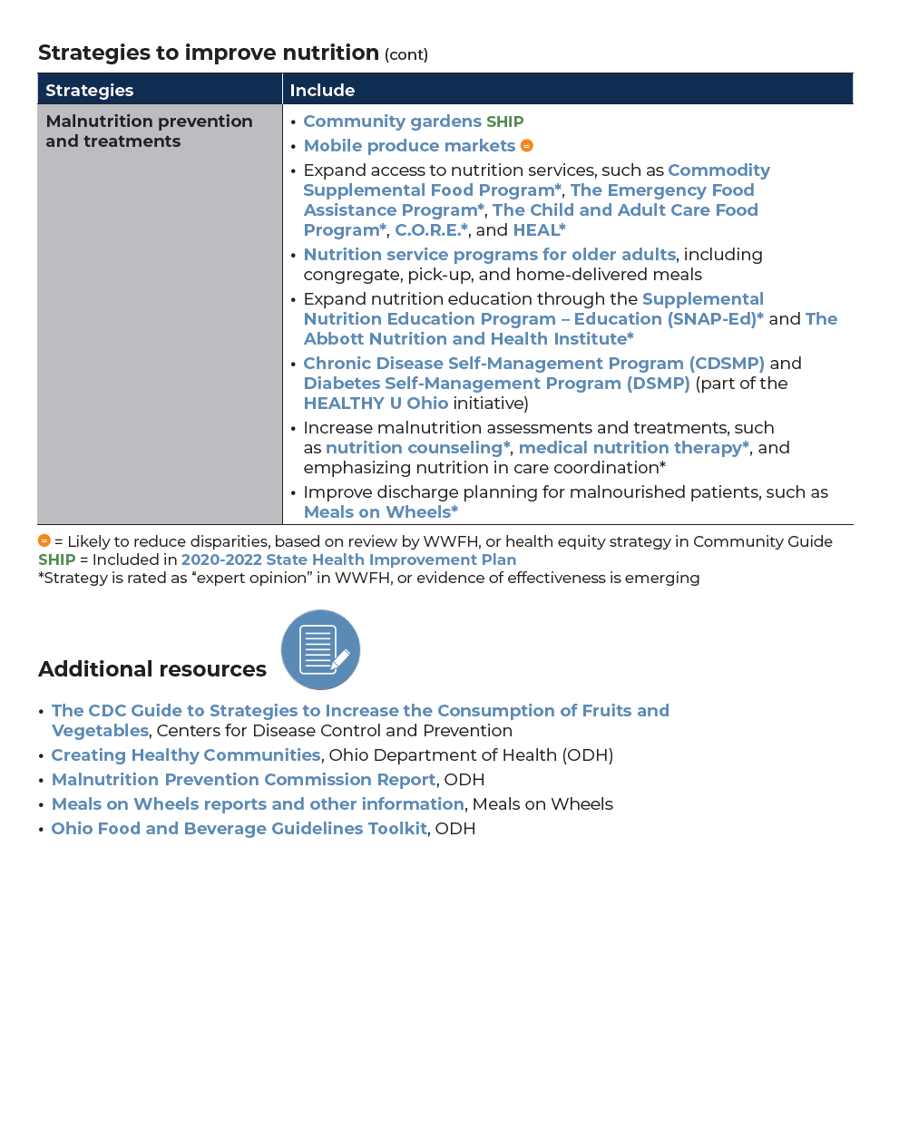
SAPA Nutrition Strategies

Slide 22
Measuring Nutrition Strategies
Healthy living
The following objectives will be used to monitor progress toward improving health behaviors for older Ohioans: improve nutrition, including malnutrition, and improve physical activity.
Improve nutrition
Indicator #1 (source) | Baseline (2019) | Short-term target (2023) | Intermediate target (2027) | Long-term target (2029)
Unintentional weight loss. Percent of Ohioans age 65 and older who recently lost weight without trying (Behavioral Risk Factor Surveillance System) [BRFSS] | 12.7% | 11.6% | 10.6% | 9.5%
Priority populations based on data
This indicator does not allow for disaggregation of data to identify priority populations. Ohio can work toward improved data collection in this area with special attention toward collecting data to identify priority populations.

Slide 23

More Information
Carmen Clutter, MS, RDN, LD
Population Health and Nutrition Manager
Elder Connections Division
246 N. High St. / 1st Floor
Columbus, OH 43215-2406
cclutter@age.ohio.gov

Slide 24

Alexandra Bauman, RD, LDN
Nutrition, Health & Wellness Director
Iowa Department on Aging
alexandra.bauman@iowa.gov
Notes:
Hello everyone! I’m so excited to speak with you all today.
My name is Alexandra Bauman. I’m the Nutrition, Health and Wellness Director at the Iowa Department on Aging, which is our state unit on aging.
I’m also a Registered Dietitian.

Slide 25
Health & Well-Being and the Older Americans Act
Notes:
Today, we will be focusing on Nutrition, health, & well being for the OAA in celebration of National Nutrition Month. Also a focus on what the state of Iowa has done with some innovations in nutrition services.

Slide 26
What We’ll Talk About-Part 2
Health and Well-Being Programs
Value of Partnerships
Reaching and Marketing to the Older American

Slide 27

Objectives
1
Identify six (6) barriers to innovations in OAA nutrition services
Prioritize Partnerships in project planning
Learn about specific projects Iowa used to address gaps in service during and beyond the COVID-19 pandemic
2
3

Slide 28


Iowa Congregate Nutrition Consumer Participation
60% Decline in Participation in 9 Years
Notes:
Iowa started a deeper dive into innovating nutrition services in 2017, in particular congregate nutrition as a result of the decline in participation. As most of you know, congregate meal participation is declining, and it’s a nationwide trend.
This graph shows Iowa’s statewide participation in congregate nutrition programs between 2010-2019.
That’s a 60% decline in participation in 9 years, so quite significant.
Data:
2010- 41,337
2016- 21,882
2017- 20,628
2018- 18,635
2019- 16,369

Slide 29


Congregate Meal Program
Condition of Iowa's Congregate Meal Program
August, 2018-December, 2018
Identified barriers
Nutrition & Health Promotion Trainings
April, 2019-April, 2020
Addressing barriers through building new knowledge
Congregate Nutrition Revitalization Action Plan
October, 2019-present
Addressing barriers and using new knowledge to develop action plan.
Addressing system issues
Implement Mini Grants
Source: Congregate Meal Program Dec 2018
Notes:
So what did Iowa as the SUA decide to do about it?
We created plan as you can see here in these 3 steps.
First, we wrote the condition of iowas congregate meal program report to identify barriers—link provided. We held congregate meal revitalization conversations in each of iowa’s 6 AAAs to gather grassroot information from participants, nutrition staff, and non-participants. We also reviewed national research and other state best practices.
Then, with these barriers and issues identified, we began our Nutrition & Health Promotion Trainings to address that. In Iowa, our state unit on aging hosts a semi-annual workgroup where the 6 AAA Nutrition Directors gather twice a year at the Iowa Department on Aging. We begun our Nutrition & Health Promotion trainings to address barriers through the building of new knowledge
Lastly, we created a congregate nutrition revitalization action plan to begin addressing these barriers through the implementation of mini grants for AAAs, applying for larger INNU grants, and creating best practice guides to encourage statewide rollout of innovations.
Source: Congregate Meal Program Dec 2018 - https://www.iowaaging.gov/sites/default/files/librarydocuments/Congregate_Meal_Program_Dec_2018.pdf

Slide 30

Purpose of the Older Americans Act Nutrition Programs
Reduce hunger, food insecurity, and malnutrition
Promote Socialization of older individuals
Promote health and well-being with access to nutrition & health promotion/disease prevention service to delay onset of chronic conditions
Notes:
I want to note that with all of our projects, we constantly look back at the purpose of the OAA Nutrition Programs. We are constantly re-evaluating and checking to make sure we are meeting the health and wellness goals of the OAA Nutrition program. Which is three fold….

Slide 31
Older Americans Act Nutrition Programs & Health and Wellness
80% of congregate nutrition participants say they eat healthier because of the meal program.
90% of home delivered nutrition participants report the program helped them live independently and remain in their home
Source: 2018 National Survey of OAA Participants
Notes:
Source: 2018 National Survey of OAA Participants - https://acl.gov/programs/health-wellness/nutrition-services

Slide 32
OAA Did You Know…
“The OAA Nutrition Program is not simply a “feeding program” or a “meal program.” It’s more than a meal! The OAA specifies three purposes of the nutrition program (above). Meals are part of the program certainly, and reducing hunger is part of it; but socialization, health, and nutrition education are also part of our program. Providing unhealthy food does not improve health. And providing unappetizing food that no one will eat also does not improve health or reduce hunger. Our programs need to provide healthy food that is appetizing.”
Source: Administration for Community Living (ACL). (May, 2015). The Older Americans Act Nutrition Program Did You Know…?
Notes:
If you haven’t reviewed this 2015 document of OAA did you know, I highly encourage you to do so. I always refer back to it, and this note in particular really influenced me.

Slide 33



Barriers Addressed
Marketing
Nutrition
Intake Form
Menu
Funding
Environment
Notes:
We found 6 major barriers to increasing participation at congregate nutrition sites.
Nutrition Requirements. We were hearing a lot of difficulties in meeting Iowa’s nutrition requirements. We took a look to make sure we weren’t making our requirements any more strict that the DGA’s and DRI’s. So we eliminated some unnecessary requirements, allowed two methods of nutrition compliance (MyPlate- style and electronic weekly average analysis). Purhcased a statewide nutrition analysis software to share menus and cut down on work.
Menu. we realized just because there’s a meal to eat, doesn’t mean people will eat it. We’re serving 2 different generations of older adults, so our meals also have to reflect that. We have about double the amount of baby boomers age 60-75 in our state vs. those age 75+. However, only 39% of our current participants were age 60-74, and we also know this age group had higher rates of food insecurity, so this is a big gap to fill. Choices was the big change here! Providing multiple meal options, providing the liver and onions and meatloafs and mashed potatoes along with the lighter sandwich, soup, salad options.
Environment. Again, just because there is a space where a meal is provided does not mean people will attend. We focused on transitioning to more attractive spaces. Moving from a church basement style to a café- style. One AAA called Heritage partnered with a beautiful new nature lodge to serve meals. Transitioning from Styrofoam meal trays to real plates, and dishes like a restaurant. Opening meal serving times rather than lining up and being called by table. Allowing leftovers to make it feel less institutional.
Funding. We know this is always a concern. With this, we really emphasized partnership building! building partnerships with local businesses and the county/city. Increase awareness in local government. Heritage AAA gained amazing support from their local mayor who gave free advertising, free public spaces, visited grand opening events, and publicity.
Intake form. This is our data requirements that all participants must fill out. It’s a paper form every new participant must fill out, and then again yearly. We heard complaints that people didn’t want to fill it out, so we tried to make it more person-friendly and less bureaucratic
Marketing. A lot of participants didn’t know the AAA existed, so I know a lot of times people are updating websites, utilizing facebook and traditional methods like newspaper, tv, radio, but we are really finding the most successful modes of marketing are again, increasing those partnerships. Word of mouth and working with local government, senior housing, libraries, food banks, parks & rec, grocery stores, and other non-profits that reach the same population.
When the pandemic hit a year ago, we were in the process of implementing all 6 of these. Even though it was geared towards congregate participation, the same tactics to increase attractiveness of the program applied to carry out and to-go meals. People want something that appears high quality.

Slide 34


Importance of Partnerships
Mayor and local government
Food Banks and Pantries
Non-Profits
AAA Community Partners
Grocery Stores
Public Space (parks, rec, library, schools)
Healthcare and Hospital Networks
Faith Based Organizations
Notes:
So when the pandemic a year ago, we had already begun working on nutrition innovation projects. We began with a simple exercise called an asset map. We used a piece of paper and listed all assets a AAA have currently, or want to have to make their innovative project work. What we found, as I’m sure many of you have found, that these partnerships were vital for the success of nutrition throughout the pandemic.
Some examples:
Some AAAs partnered with local restaurants to provide meals
Some AAAs contracted with frozen meal companies to deliver food to areas they couldn’t reach with their traditional nutrition services
IDA and some AAAs partnered with local food banks to provide senior food or produce boxes in addition to a home delivered meal
IDA partnered with a local non profit focused on homelessness that provided food truck meals with local food trucks in public parks targeted in low income areas
One AAA partnered with a local refugee to get food boxes to homebound participants.
Our lieutenant governor organized a Feeding Task Force with all state departments that organize feeding activities and the food banks in order to connect services and reconnect the food supply last year.
I’m sure many of you have thousands of stories just like this, but the moral of the story is—partnerships need to be put at the priority.

Slide 35
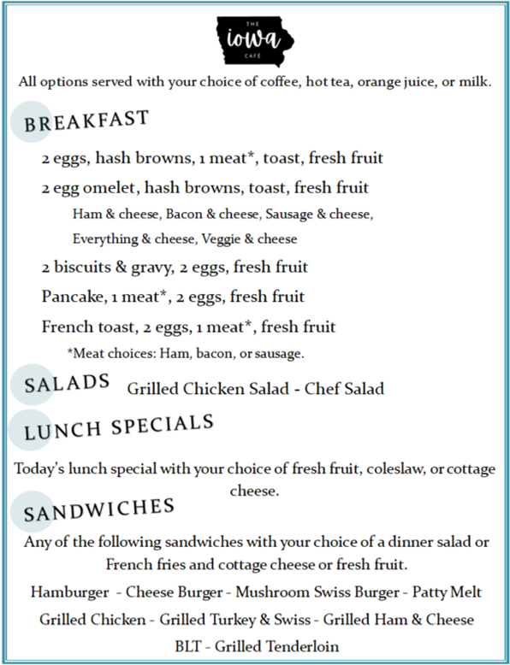

The Iowa Café

Slide 36

Iowa Café Participant from Garner, Iowa
“I don’t know what we did to deserve this. We are so happy we get to enjoy these delicious meals.”
Notes:
We had 40 participants signed up in rural Iowa the first two weeks of launch in a small, rural town. This was one participant who specifically wanted to stop by the AAA office to make a contribution.

Slide 37


What’s Next?
Alexandra Bauman, RD LDN
Nutrition, Health & Wellness Director
alexandra.bauman@iowa.gov
Notes:
So, what’s next? We are working on expanding this and our Encore Café model statewide for innovation. Working with local and state partners to continue marketing this and strengthening partnerships and continue to address health and well-being for older adults through nutrition, socialization, and nutrition education and wellness programming.
And I really want to challenge everyone to think outside of the box when it comes to meeting the health and wellness needs of older Iowans. It’s hard to change processes that have been in place for decades. We are still trying to get there right along with you. When we started this journey, we asked eachother: if you had unlimited funding and there weren’t any barriers for your nutrition programs, what would you do? And then, we figured out what we would need to make those ideas reality. So I’m asking you today—and you can put this in the chat box or write it down, if you had unlimited funding and no barriers, what would you do to deliver the OAA nutrition program in a bigger, bolder way?

Slide 38

Questions

Slide 39
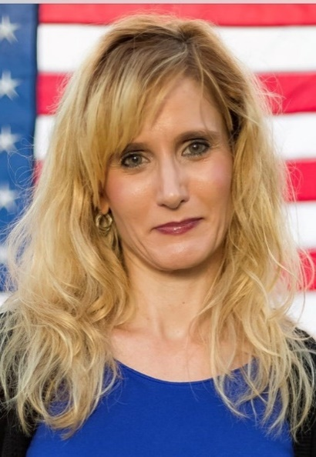
Closing Comments
Keri Lipperini, MPA
Director
Office of Nutrition and Health Promotion Programs
Administration for Community Living
Email – keri.lipperini@acl.hhs.gov

Slide 40
Trifecta: Health and Well-Being
Thank you for attending!
Celebrate Our Senior Nutrition Program
March 2021
The Administration for Community Living does not endorse any commercial product or service included in this presentation.

