Slide 1

Trifecta: Socialization
Celebrate Our Senior Nutrition Program
March 2021

Slide 2
Learning Objectives
Understand the socialization challenges faced by the aging network and the tribal nations
Highlight the importance of community, connections, and innovative ideas for combatting social isolation
Demonstrate how to use virtual programming to promote socialization

Slide 3
Agenda
Welcome
Celebrate the Senior Nutrition Program Update
Network Speakers
  Anna Feltz, Director, Old Bridge New Jersey Senior Center (New Jersey)
  Jasmine Aplin, JD - Office of American Indian, Alaskan Native, and Native Hawaiian Programs, ACL
Question and Answer
Closing

Slide 4
Reminders
Questions should be held until the end of the presentations and placed in the Q&A box. Please do not type questions in the chat box.
Additional questions may be submitted up to one week after the webinar.
Questions will be compiled for each speaker.
Please write the presenter’s name for who the question(s) are intended for in the subject line.
Please direct all inquiries and requests for Certificates of Attendance to Nicole.Becerra@acl.hhs.gov

Slide 5

Update

Slide 6
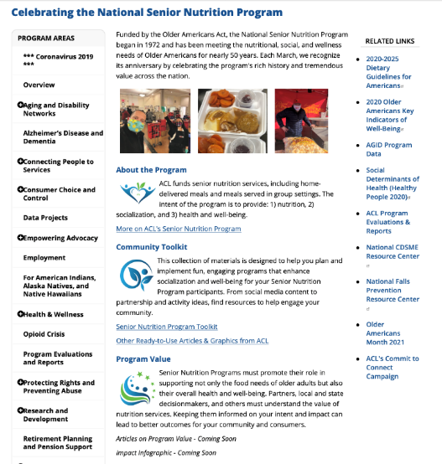
Celebrate the Senior Nutrition Program
Webinars
Community Toolkit
  Senior Nutrition Program Toolkit
    Activity Guides
    Tip Sheets and Guides
  Share Your Work
  Social Media Tools
Program Value
  Infographic and poster
  Tools to promote your program value
Notes:
Resource Links-
Webinars: https://acl.gov/SeniorNutrition
Community Toolkit: https://acl.gov/SeniorNutrition/CommunityKit
Share Your Work: https://acl.gov/sites/default/files/programs/Senior_Nutrition/ActivitySubmissionFormRelease.pdf
Program Value: http://www.acl.gov/seniornutrition

Slide 7
Activity Guides
Activities promote socialization
Incorporate COVID precautions
Guide includes steps of preparation needed, how to participate and supporting information
7 guides posted in the Community Tool-kit
https://acl.gov/SeniorNutrition/CommunityKit

Slide 8
Share Your Work
Materials located at https://acl.gov/SeniorNutrition/CommunityKit
Submit photos and activity descriptions of your innovative and best practices
Share how your program is making a difference
Complete the Activity Submission Form and email to the following address: healthpromotion@acl.hhs.gov
*We will share program information; however, we may not be able to share all submissions.
Notes:
Resource Links-
Activity Submission Form: https://acl.gov/sites/default/files/programs/Senior_Nutrition/ActivitySubmissionFormRelease.pdf

Slide 9


Social Media Tools
Use Senior Nutrition Program Celebration graphics to spread the word! Post to Facebook, Instagram, Twitter and LinkedIn
Eight different designs to add variety and interest
Use our official hashtag - #seniornutritionprogram

Slide 10
Key Resources
www.acl.gov/seniornutrition
  Final webinar: Trifecta Part 3 – Health and Well-Being Registration
https://acl.gov/SeniorNutrition/CommunityKit
  March Calendar
    Include connection activities to promote socialization
    Use infographics to promote your program to your community and stakeholders
  Social Media – Post on social media and include hashtag #seniornutrition and graphics to create interest
  Activity Submission Form - Share innovation and best practices with ACL
Notes:
Resource Links-
Activity Submission Form: https://acl.gov/sites/default/files/programs/Senior_Nutrition/ActivitySubmissionFormRelease.pdf

Slide 11
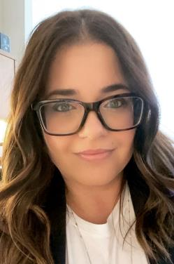
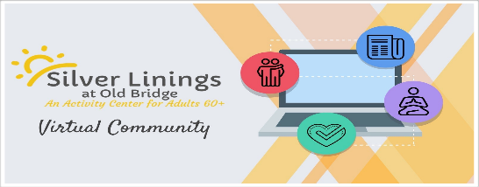
Anna Feltz
Manager, Silver Linings at Old Bridge
NISC Leadership Collaborative - NJ Representative

Slide 12
Preventing Social Isolation
During the COVID-19
12

Slide 13
What We’ll Talk About-Part 1
Preventing social isolation for congregate meal sites clients
Using virtual programming to promote socialization - program examples will be given
Ways to overcome barriers (i.e. staffing, lack of technology, budget/funding)

Slide 14
The Effects of COVID-19 on
Silver Linings at Old Bridge
Who are we? Activity center for adults over the age of 60 in Old Bridge, NJ
Building has been closed since March 13th, 2020
While center doors were closed, delivery of services remained, albeit in a limited capacity
Social services continued via phone
Transportation services remained in place for dialysis patients and critical medical appointments

Slide 15
The Effects of COVID-19 on
Silver Linings at Old Bridge (continued)
Assistance was provided to Meals on Wheels program for the delivery of meals to congregate meal clients who became homebound due to COVID-19
Initial hope of reopening on March 30th
However, NJ went into a lockdown and we have remained closed ever since

Slide 16
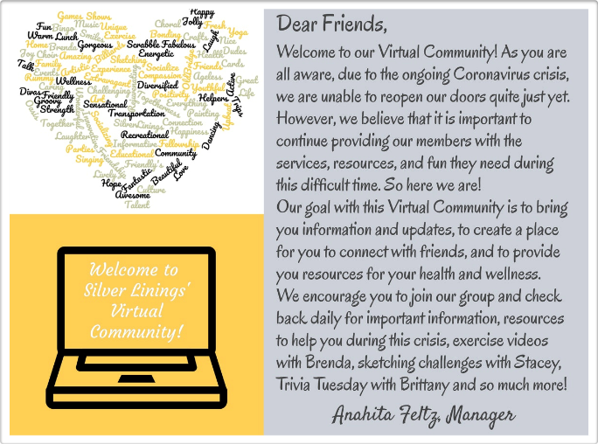
A Virtual Community Is Born
Once it became apparent that we would not be able to reopen on March 30th, we shifted our focus to virtual programming
What would be the best platform to deliver virtual programming to our members
For Silver Linings, Facebook proved to be the right social media platform

Slide 17

A Virtual Community Is Born (continued)
After receiving permission to start a Facebook group from Township administration, over the course of a weekend, we put together “Silver Linings Virtual Community”. So began our “Senior Center Without Walls”
And just like that, we were able to once again connect with our members

Slide 18
Content for Silver Linings
Virtual Community
Our Virtual Community includes the following types of content:
    Exercise videos (pre-recorded and/or via Facebook Live & Zoom)
    Sketch classes (pre-recorded sketching assignment and live comments and feedback from instructor)
    Paint classes (via Zoom with all supplies provided and delivered to their homes)
    Mindful Mondays - Mental Health posts and live presentations via Zoom
    Trivia Tuesdays
    Weekly Photo Challenge

Slide 19
Content for Silver Linings
Virtual Community (continued)
    Zoom Bingo
    “Summer School” Sessions - History “lessons” throughout the summer
    Arts & Crafts projects - plastic canvas, knitting, and crocheting. Members sign up for the projects and supplies/kits are then delivered to their homes.
    Themed Months/Weeks
    Technology Thursdays
    And more!
    All our Zoom presentations and programs are available via phone for our members without access to technology

Slide 20
Resources Used for Virtual Community
There are a variety of resources we have used to keep our Virtual Community going
3-4 posts per day keep the page active and members engaged
snappa.com is used for graphics designed for program announcements and calendar. We also used this website to design our group page photo
We are using Zoom for our virtual classes but you can also use Microsoft Teams

Slide 21
Resources Used for Virtual Community (continued)
Websites used for content:
    ACL.gov
    NCOA.org
    SeniorPlanet.org
    AARP.org
    idontmind.com
    history.com
    YouTube.com
    MyFreeBingoCards.com
Credit is given to sites when using articles/content

Slide 22
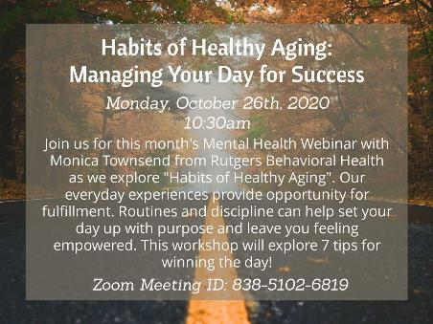


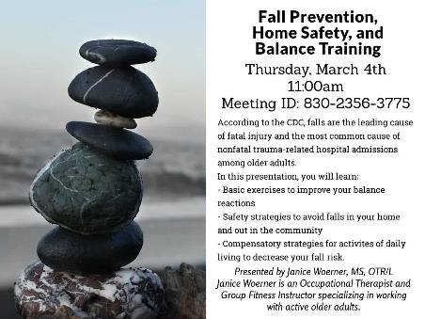


Highlights

Slide 23


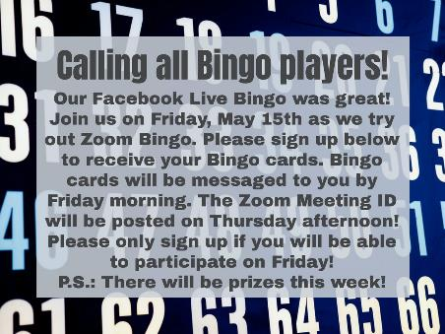


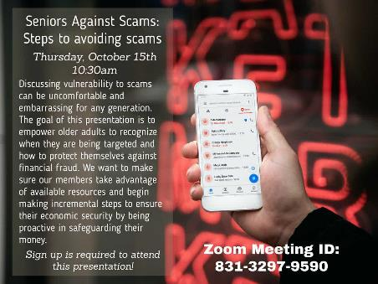
Highlights (continued)

Slide 24
Programming Ideas
Lunch & Learn: Host a “learning” luncheon via Zoom - the presentation can be on any topic: nutrition, scam preventions, health and wellness. You can also just host a lunch party where members can just catch up with each other. This program is good for members with or without technology
Grab & Go events: If you are doing grab & go meals, maybe do a raffle with a giveaway. You can also have a DJ come out and play music on special days (i.e. St. Patrick’s Day)

Slide 25
Programming Ideas (continued)
Establish a pen pal program (either via email or snail mail) amongst congregate meal clients
Partner with an organization in the community (i.e. schools/businesses) and have them donate items and money to make “Care Boxes”, filled with toiletries and various activities, such as puzzles, adult coloring books, Sudoku books, etc. to remind seniors that someone cares and they have not been forgotten

Slide 26
Overcoming Barriers
Staffing
  Partner with your site or senior center in delivering programming to homebound seniors
  Seek out volunteers to do wellness calls or to assist in grab and go events
Lack of technology
  Zoom does not cost any money for a participant to use. Participants can join via their computers, smart phones, and tablets
  Those without technology can join via phone (toll free)

Slide 27


Overcoming Barriers (continued)
Budget/funds:
  Seek out grant opportunities
  Seek out partnerships in the community (partnering with businesses, restaurants, etc.)
  Seek out donations from the community at large

Slide 28
“Social distancing refers to creating a physical space between one another and avoiding large gatherings. It does not mean to socially disconnect from one another. Instead we encourage you to strengthen your social ties while maintaining physical distancing.”
Daniel Aldrich, Professor at Northeastern University
March 2020 Washington Post article

Slide 29



More Information
Anahita Feltz, Manager
Silver Linings at Old Bridge
1 Old Bridge Plaza, Old Bridge, NJ 08857
732-721-5600, ext. 6625
afeltz@oldbridge.com
www.oldbridge.com/SilverLinings
www.facebook.com/groups/SilverLiningsatOldBridge

Slide 30
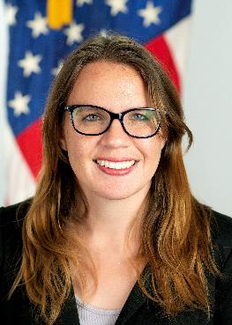
Jasmine Aplin, JD
Office of American Indian, Alaskan Native, and Native Hawaiian Programs
ACL
jasmine.aplin@acl.hhs.gov

Slide 31
Social Isolation in
Tribal Communities
31

Slide 32
What We’ll Talk About-Part 2
The unique challenges faced by Tribal communities
The importance of community
Innovative ways tribes are combating social isolation

Slide 33
Unique Challenges Facing Tribes
The rural nature of tribes: Many tribes are located in very rural or frontier areas. This can make it very difficult for tribal members to access a wide array of services
Grandparents raising grandchildren: Some tribal elders have additional responsibilities to their families. Some tribal members live in a multi-generational household and some grandparents are raising their grandchildren. This can create stress for the elder

Slide 34
Unique Challenges
Facing Tribes (continued)
Cultural Competency: Reaching elders without an understanding of their culture can be difficult. Someone reaching out may not speak my language, look like me, or understand what I have lost because of the pandemic

Slide 35
Importance of Community
Our directors carry many burdens…the burden of their health, their families health, the health of the elders, and the health of their community
We have found that it is EXTREMELY important for those carrying many burdens to know they are not alone

Slide 36
The Importance of
Community (continued)
Our office has a weekly “chat” every Thursday from 3-4 where our directors are invited to tell us how things are going in their community
We have also asked Dr. Alec Thundercloud, Director of SAMHSA’s Office of Tribal Affairs and Policy, to discuss mental health services that are available

Slide 37
Combatting Social Isolation
Many Title VI programs have created remarkable ways to combat isolation. Some ideas we have seen are…
  Red and green cards elders can post in their window to indicate whether they need to be checked on
  Car bingo. Some programs gather seniors in the parking lot and call out numbers so seniors can participate in a bingo game from their car

Slide 38
Combatting Social Isolation (continued)
We have found that adding cultural to any activity can enhance the activity!
  Having a cooking activity that shares recipes for traditional foods
  Activities surrounding native language
  We have suggested a phone game where elders are asked questions that are pulled out of a hat. The questions are specific to each community and allow the questions to be fun and unique

Slide 39

Questions

Slide 40
Trifecta: Socialization
Thank you for attending!
Celebrate Our Senior Nutrition Program
March 2021

