Slide 1

Trifecta:
Nutrition, Socialization, Health and Well-Being
Celebrate Our Senior Nutrition Program
March 2021

Slide 2
Agenda
Welcome
Nutrition Jeopardy
Network Speakers
  Jason Echols, Manager of Special Initiatives and Fraud Protection, AgeOptions, Illinois
  Joel Sekorski, Director, Services for the Elderly – Sullivan Senior Center, Connecticut
Special Guest-Edwin Walker

Slide 3
Learning Objectives
Understand the intention of the Older Americans Act
Discuss virtual programs and how to market successfully to older Americans
Explore how to expand initiatives to increase the outreach of seniors in need by thinking outside the box

Slide 4
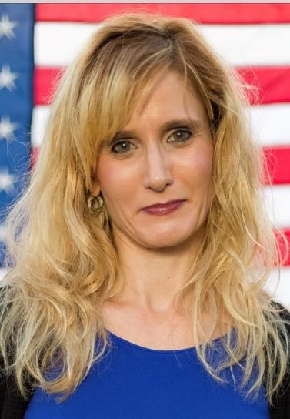
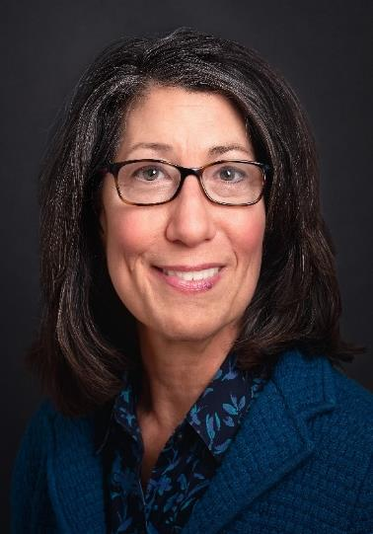
Nutrition Jeopardy Hosts
Keri Lipperini, MPA
Director, ONHPP
ACL
Judy Simon, MS, RD, LDN
National Nutritionist
ACL

Slide 5

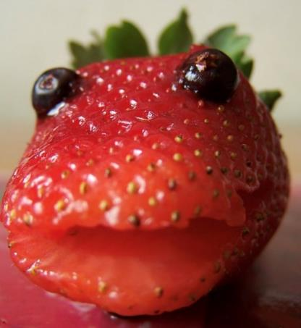
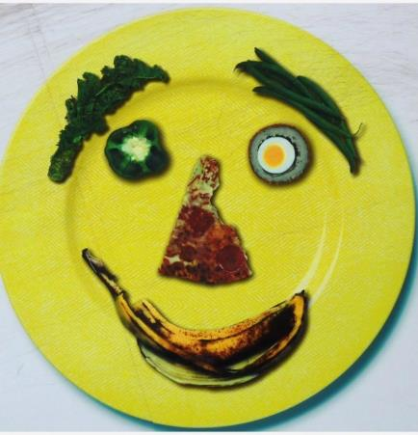
Jeopardy Contestants
Beatrice
Peaches
Ginger
"Healthy Food Face" by MTSOfan is licensed under CC BY-NC-SA 2.0
“Strawberry Face. (Sorry, i’m joking)" by Martino! is licensed under CC BY-ND 2.0
“Food Face" by Leo Reynolds is licensed under
CC BY-NC-SA 2.0

Slide 6

Let’s Play
This Photo by Unknown Author is licensed under CC BY-NC-ND

Slide 7
ACL Organization
The ACL office leading the Celebrate the Senior Nutrition Program events is:
  Office of Nutrition and Health Promotion Programs
  Office of Nutrition
  Office of Eating Well
  Office of Smart People

Slide 8
ACL Organization Answer*
The ACL office leading the Celebrate the Senior Nutrition Program events is:
  *Office of Nutrition and Health Promotion Programs
  Office of Nutrition
  Office of Eating Well
  Office of Smart People

Slide 9
2020 Reauthorization Changes:
Title III-C Nutrition Services
Which NEW issue was added to the 2020 reauthorization of the OAA that relates to the senior nutrition program? (select one)
    A. Hunger
    B. Food
    C. Malnutrition
    D. Meals

Slide 10
2020 Reauthorization Changes:
Title III-C Nutrition Services Answer*
Which NEW issue was added to the 2020 reauthorization of the OAA that relates to the senior nutrition program? (select one)
    A. Hunger
    B. Food
    C. *Malnutrition
    D. Meals

Slide 11
Purpose of OAA Title III-C
Nutrition Services Program
Which of the following is a purpose of the Older Americans Act nutrition program?
  Deliver meals to homebound older adults
  Educate people about eating blueberries
  Promote socialization of older individuals
  Offer dessert first…

Slide 12
Purpose of OAA Title III-C
Nutrition Services Program Answer*
Which of the following is a purpose of the Older Americans Act nutrition program?
  Deliver meals to homebound older adults
  Educate people about eating blueberries
  *Promote socialization of older individuals
  Offer dessert first, before the meal

Slide 13
Title III-C Eligibility and
Targeted Populations
Which statement is true about the Senior Nutrition Program?
  We must serve everyone who applies to participate
  Eligibility for meals is based on income
  Populations with poor nutrition should be targeted
  Nutrition programs should target older individuals who are in greatest social and economic need

Slide 14
Title III-C Eligibility and
Targeted Populations Answer*
Which statement is true about the Senior Nutrition Program?
  We must serve everyone who applies to participate
  Eligibility for meals is based on income
  Populations with poor nutrition should be targeted
  *Nutrition programs should target older individuals who are in greatest social and economic need

Slide 15
National Nutrition Standards
What national standards are the key nutrition requirements for the OAA nutrition program?
  Dietary Reference Intakes (DRIs) and Dietary Guidelines for Americans (DGAs)
  Aging National Nutrition Standards (ANNS)
  Eating Well For Older Adults (EWOA)
  Older Americans Nutrition Guidelines (OANG)

Slide 16
National Nutrition Standards Answer*
What national standards are the key nutrition requirements for the OAA nutrition program?
  *Dietary Reference Intakes (DRIs) and Dietary Guidelines for Americans (DGAs)
  Aging National Nutrition Standards (ANNS)
  Eating Well For Older Adults (EWOA)
  Older Americans Nutrition Guidelines (OANG)

Slide 17
Dietary Guides
When was the last time the Dietary Guidelines for Americans was released?
  2020
  2005
  1900
  Never

Slide 18
Dietary Guidelines Answer*
When was the last time the Dietary Guidelines for Americans was released?
  *2020
  2005
  1900
  Never

Slide 19
Meals
Based on the Dietary Guidelines for Americans, what is an important component of a meal served in the Senior Nutrition Program?
  Plenty of fiber, to help with constipation
  Raisins because they are a fruit
  Spicy food to help with decline in ability to taste
  Protein, to help address risk of sarcopenia

Slide 20
Meals Answer*
Based on the Dietary Guidelines for Americans, what is an important component of a meal served in the Senior Nutrition Program?
  Plenty of fiber, to help with constipation
  Raisins because they are a fruit
  Spicy food to help with decline in ability to taste
  *Protein, to help address risk of sarcopenia
Sarcopenia is age-related loss of muscle and strength. It results in functional declines and loss of independence.

Slide 21
Nutrition Education
According to the Older Americans Act, what professional is considered the source of reliable nutrition education?
  Certified Dietary Counselor
  Registered Dietitian
  Nutritionalist
  Keri Lipperini

Slide 22
Nutrition Education Answer*
According to the Older Americans Act, what professional is considered the source of reliable nutrition education?
  Certified Dietary Counselor
  *Registered Dietitian
  Nutritionalist
  Keri Lipperini

Slide 23
True or False? –
Same Nutrition Standards
  All states should have the same nutrition standards since they are all based on the Dietary Guidelines for Americans (DGAs) and the Dietary Reference Intakes (DRIs).

Slide 24
True or False? –
Same Nutrition Standards Answer*
  *FALSE. While required to meet the DGAs and DRIs, each State Unit on Aging develops its own unique policies, procedures and reporting mechanisms based on the needs of their populations and their state priorities.

Slide 25
True or False? –
Nutrition Analysis
  All states should require nutrition analysis of their menus because the OAA requires meals meet the Dietary Guidelines for Americans (DGAs) and the Dietary Reference Intakes (DRIs).

Slide 26
True or False?
Nutrition Analysis Answer*
  *FALSE. While required to meet the DGAs and DRIs, each State Unit on Aging develops its own unique policies, procedures and reporting mechanisms based on the needs of their populations and their state priorities.

Slide 27
Prioritizing Who We Serve
How can senior nutrition program prioritize which clients they can serve?
  First-come, first served
  Oldest clients first, then younger
  Lottery system
  Older Americans Act targeted populations and those with greatest social and economic need

Slide 28
Prioritizing Who We Serve Answer*
How can senior nutrition program prioritize which clients they can serve?
  First-come, first served
  Oldest clients first, then younger
  Lottery system
  *Older Americans Act targeted populations and those with greatest social and economic need

Slide 29


Jason B. Echols, MSW
Manager of Special Initiatives and Fraud Protection
Notes:
Page numbers are intentionally omitted from this title slide. An alternate title slide design is shown as Slide 1 in this template deck. Use only one or the other.

Slide 30
AgeOptions
AgeOptions is the Area Agency on Aging for suburban Cook County in Illinois
Our Vision: People thriving as they age
Our Mission: AgeOptions innovates, partners, and advocates to improve systems and services in order to strengthen communities so people thrive as they age

Slide 31
COVID turned everything Upside Down
“Upside down
Boy, you turn me
Inside out
And 'round and 'round”
-Diana Ross,
Upside Down” (1980)
Here’s how two of our programs survived…

Slide 32
Two AgeOptions Programs
Memory Cafes
Thrive with Pride Cafes
Social settings where people living with dementia or memory loss and their care partners can meet others & enjoy time together
  Started as a partnership between Caregiver Resource Centers and our meal sites
Local network of churches and other community-based organizations that partner with AgeOptions to host programming for LGBT+ older adults

Slide 33

Goal: Decrease Social Isolation
Memory Cafes
Thrive with Pride Cafes
Decrease social isolation that often accompanies dementia and caregiving
Decrease social isolation among LGBT+ older adults

Slide 34
What You Can Find at a Cafe?
Memory Cafes
Thrive with Pride Cafes
Cafes feature many different activities, including:
  Chair yoga
  Music therapy
  Sing-alongs
  Art therapy
  And more…
Check in and chat plus
Monthly guest speakers on topics including:
  Healthy Living
  Advanced Care Planning
  Legal Issues
  Fraud Prevention
  Benefit Programs
  And more…

Slide 35
Funding
Memory Cafes
Thrive with Pride Cafes
Funded in FY21 with CARES Act (Year 3)
State dollars before this year
  Year 1: Carryover dollars
  Year 2: Social isolation and ADRD dollars
Private foundation funding:
  Community Memorial Foundation
  The Chicago Community Trust

Slide 36

How it started…
Photo by Jon Birondo is licensed under Reshot
Everybody together in person and having fun!

Slide 37

How it’s going…
Photo: "Face Mask in peak Autumn" from Disabled and Here by Justin Katigbak
is licensed under CC BY 2.0
And then COVID happened.
Both programs had to adapt to a virtual setting

Slide 38
Living in a Virtual World
Memory Cafes
Thrive with Pride Cafes
AgeOptions provided extra funds to support tech
Contracted with Sounds Good Choir for their Good Memories Sing-a-Long program - they specialize in Zoom singing
Transitioned to a completely online format
One monthly plenary held live via Zoom and recorded for YouTube
Each site holds a follow up virtual meeting with guided discussions

Slide 39
How Will They Know?
“How will I know…”
-Whitney Houston (1985)
Promoting great programs (especially now)

Slide 40
Working With Our Aging Network
Include flyers in home delivered meals or with meal pick ups
Memory Cafes - Caregiver Resource Centers are connected with caregivers
  Congregate meal sites have continued to help promote our virtual cafes
Senior Centers include in their newsletters

Slide 41
Step Outside Your Network
Special Events
  SAGE Table - Intergenerational LGBT+ event
  Sounds Good Choir Good Memories Sing-A-Long
Non-traditional partnerships (& email lists)
  Faith communities (e.g., churches)
  Community organizations (including LGBT)
  Local legislators
Keep Networking! (Even in the Zoom chat)

Slide 42
Online Tools
Social Media
  Facebook Events
Website
  http://www.thrivingwithpride.org/
Forums or Google Group for helping cafe partners connect and collaborate

Slide 43
SUCCESS!
“Nothing’s gonna stop us now…”
-Starship (1987)
How do you define it?

Slide 44
Did Anyone Show Up?
Memory Cafes
Thrive with Pride Cafes
If a person with dementia is able to join a virtual program and stay engaged for 45 minutes, that’s success!
We know older LGBT+ folks are out there – Thrive with Pride is like a beacon to engage them with the Aging Network

Slide 45
Quantitative Measures
Memory Cafes
Thrive with Pride Cafes
UCLA Loneliness Scale pre and post surveys
End of Year surveys

Slide 46
Expanding Beyond Boundaries
Memory Cafes
Thrive with Pride Cafes
Agencies serving limited English speaking populations are adapting the basic model of the Memory Cafe but making it their own! Culturally responsive
Everyone is welcome!
We’re bring non-traditional partners and orgs into the Aging Network
  Churches
  LGBT orgs
“I feel more connected to my community.” – Comment from a participant

Slide 47
“People will forget what you said. People will forget what you did. But people will never forget how you made them feel.”
-Maya Angelou

Slide 48
Special Thanks To…
Beth Kozak & Amanda Wojan
  Beth & Amanda are managing the Memory Cafes
Kate Spelman
  Kate is managing Thrive with Pride www.thrivingwithpride.org

Slide 49
Contact Information:
Jason Echols, MSW
Manager
Special Initiatives and Fraud Protection
Illinois
jason.echols@ageoptions.org

Slide 50

Joel Sekorski
Director, Services for the Elderly
Sullivan Senior Center
Notes:
Page numbers are intentionally omitted from this title slide. An alternate title slide design is shown as Slide 1 in this template deck. Use only one or the other.

Slide 51
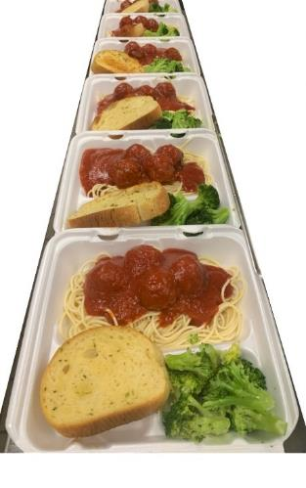
Congregate Meals Untapped Resource
Joel Sekorski Director, Services for the Elderly
Sullivan Senior Center
Litchfield Hills NW Elderly Nutrition Program,
City of Torrington, Connecticut
Food brings them in, awareness of programing content and services keep them coming back!
Notes:
Page numbers are intentionally omitted from this title slide. An alternate title slide design is shown as Slide 2 in this template deck. Use only one or the other.

Slide 52
Innovative Ideas
Using OAA Funds
Outreach, Programing, Partnerships
Think Outside the Box,
Reactions to the Pandemic Creativity
and Tools for Success
“Can’t Be Done?” “Not Funded?” “Not Enough Staff?”
There are no good excuses, only good results…
Notes:
Page numbers are intentionally omitted from this title slide. An alternate title slide design is shown as Slide 1 in this template deck. Use only one or the other.

Slide 53
Innovative Ideas With OAA Congregate Meals
Review upcoming Menus
Create an event centered around Holidays, special dates/events etc.
Partner with Caterers for special upgraded menus that meet the RDI requirements
Partner with Area Stakeholders for information and Giveaways that meet the Nutrition education requirements
Notes:
If you need to include any recurring logos on interior (non-title and non-closing) slides, add to the slide master so that assistive technology does not read it on every slide. Always add the first instance to the actual slide (not the slide master) so that assistive technology will read it once.

Slide 54
Review Menus
Request menu in advance from ENP or Caterer.
Select dates for your theme.
Utilize existing OAA Funds
The results will be…
INCREASED COUNTS
&
NEW MEMBERS

Slide 55
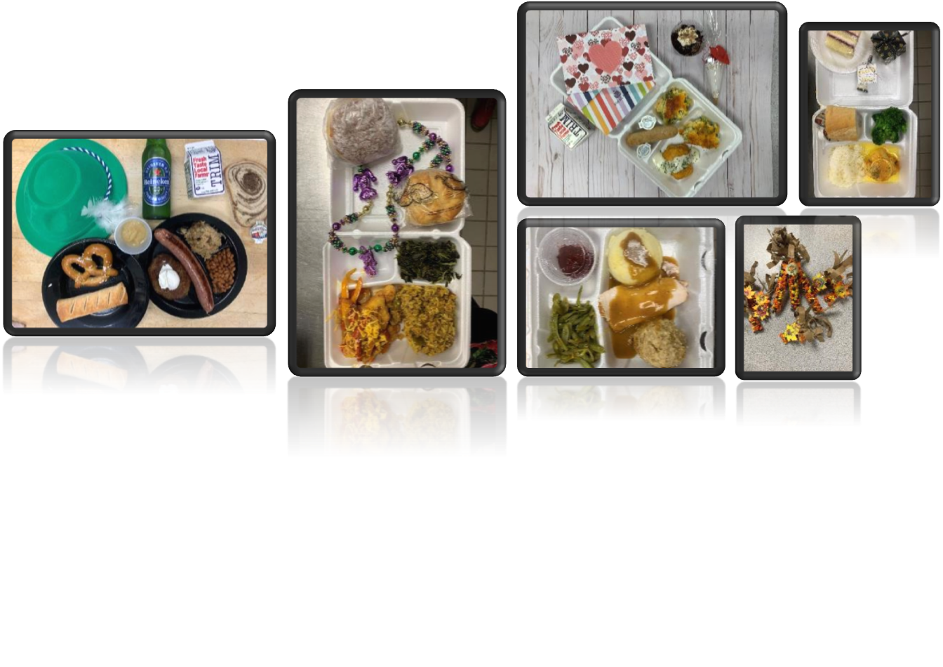
Creating a Special Event
Use Holidays

Slide 56

Thinking Outside the Box

Slide 57
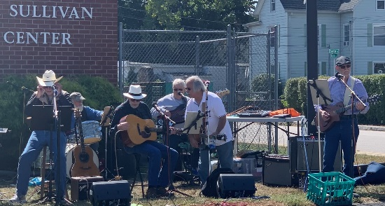
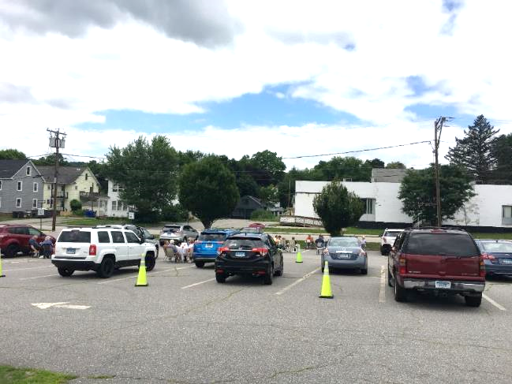
Live Entertainment & Car Hops

Slide 58
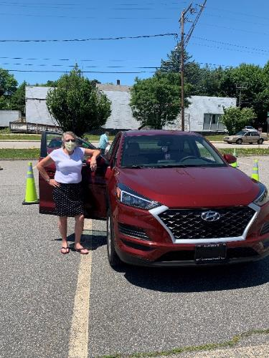
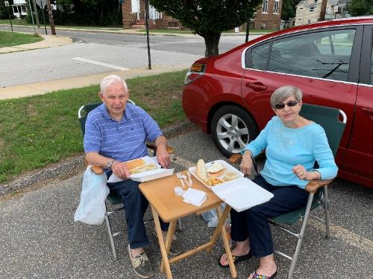
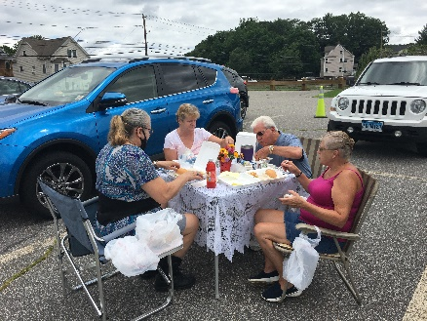
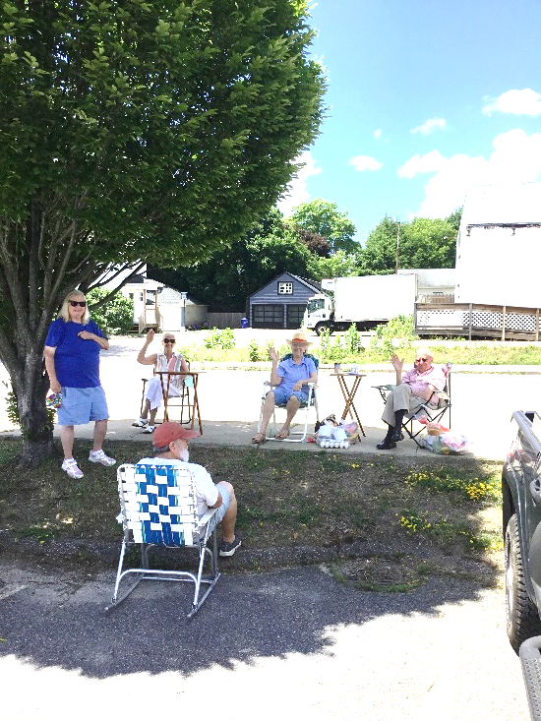
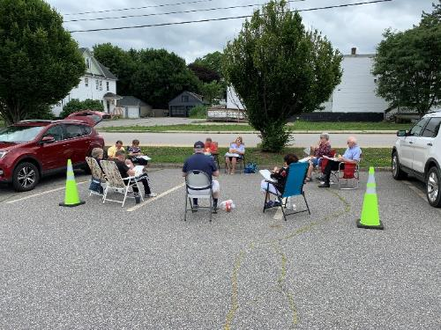
Parking Lot Socialization

Slide 59
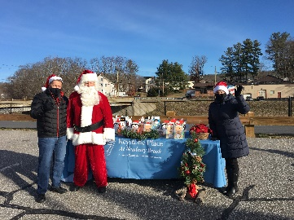
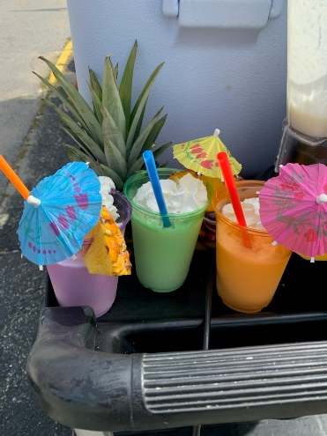
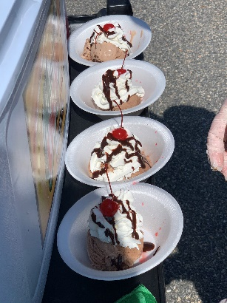
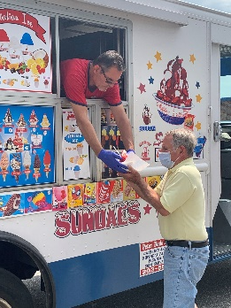
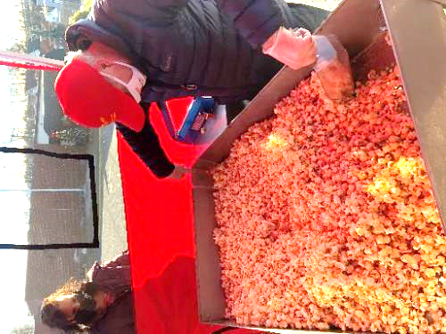
Fun Extras

Slide 60
Tools for Success
Partnerships
CSA Shares
Local Stakeholders needing to market themselves are looking to be included and want to be part of your events. Tell them what you need.
Use your facility for Food Sharing opportunities, this brings in new members.
Legislators are FREE labor! And have connections willing to support you.
Meet the First Responders.
Municipal Department Heads
Farm to Table Produce and Fruits
  Use to upgrade MOW & Congregate Meals
  Partner with Caterers to replace canned and frozen products.
Share with members
  Promote healthy eating at Home
  Provide recipes
Community Gardens
  Build or expand existing space encourage these areas to be gathering spots for social and educational purposes.

Slide 61
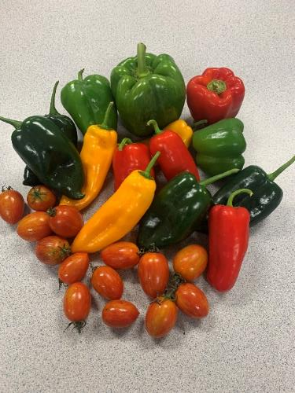
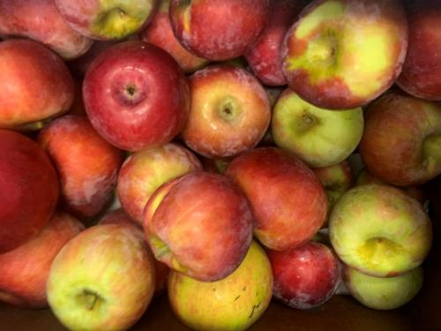
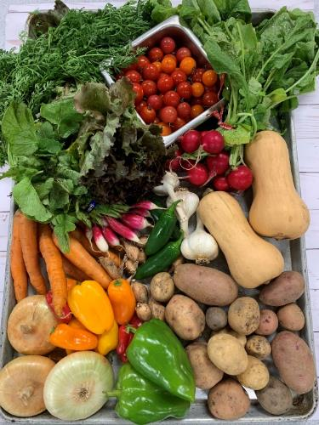
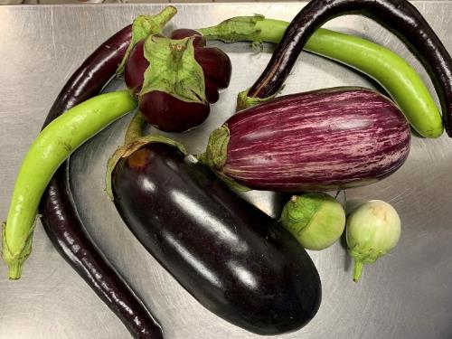
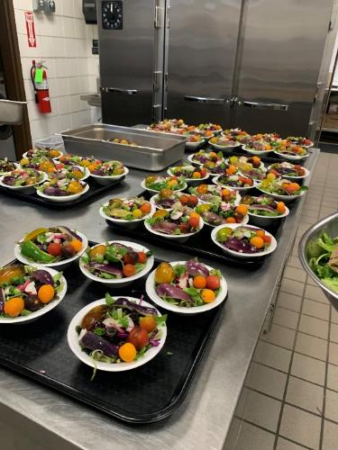
CSA Shares

Slide 62
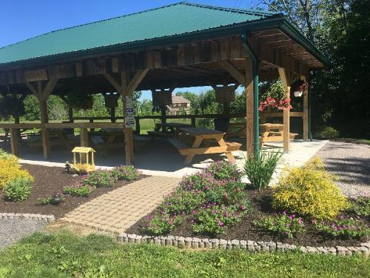
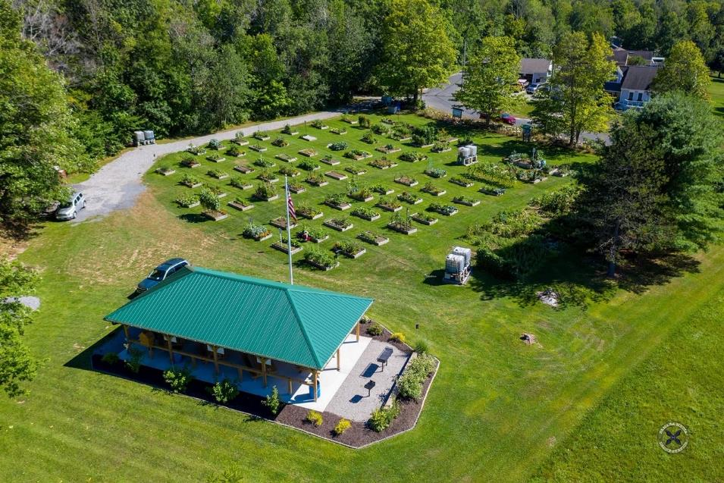
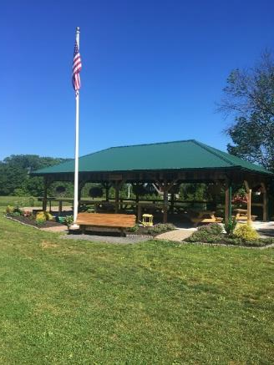
Community Gardens

Slide 63
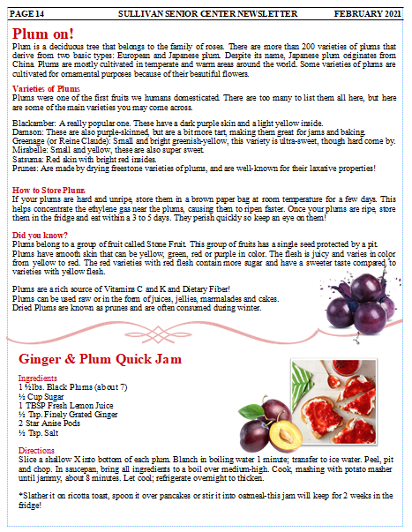
Monthly Newsletter Article
Nutrition Education
Newsletter Articles
Handouts to MOW and Curbside Clients
YouTube, Facebook, Instagram, etc. Use online links to taped educational videos shared or created.
  How to track it? Google Docs, email or call into office. Eligible for free giveaways when completed.
  Record live streamed conventional talks. This allows Q&A and the ability to be available forever.
  Using Wed Cams and Lap Tops multiple sites can be on one Nutrition Education Session with the RD, saving time and money.
Parking Lot or by appointment- Promote these links by running them on a loop a day or two monthly at the Senior Center for people without access to technology.

Slide 64


IT CAN’T BE DONE!
No Staff No Money…
COVID 19 has provided a unique opportunity to hit the reset button. We have all done amazing things during the last year that can propel us forward to better days!
-Use our new ideas even when we open back up
-Enhance our Nutrition Programs and Food options
-Keep our staffs engaged and involved when our volunteers return
-OAA should consider keeping take out meals available

Slide 65
Never Stop Innovating
Keep Your Staff Involved and
ALWAYS MAKE IT FUN!
Notes:
The ACL logo shown here is part of the master, as it is assumed that an initial instance of the logo will appear on the title slide with appropriate alt. text that does not need to be re-read here by assistive technology. If this is the only place where the ACL logo will appear, remove it from the slide master and insert it with alt. text.

Slide 66
Contact Information
Joel Sekorski
Director
Services for the Elderly
Sullivan Senior Center
Litchfield Hills NW Elderly Nutrition Program,
88 East Albert Street
Torrington, Connecticut
joel_sekorski@TorringtonCT.org

Slide 67
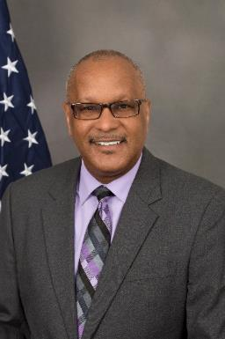
Closing Comments
Edwin Walker, JD
Deputy Assistant Secretary of Aging
Administration for Community Living
Email – edwin.walker@acl.hhs.gov

Slide 68
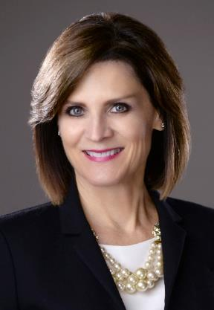
More Information &
Certificate of Participation
Kathy Wilson-Gold, MS, RDN, LD
Nutrition Consultant
Office of Nutrition and Health Promotion Programs
Email - kathy.wilson-gold@acl.hhs.gov

Slide 69
Trifecta:
Nutrition, Socialization, Health and Well-Being
Thank you for attending!
Celebrate Our Senior Nutrition Program
March 2021
The Administration for Community Living does not endorse any products/brands shared during this event.

